Slide 1
DevDream
Sokmontrey Sythat
Bello Olaseni
Jay Ajudiya
Yash Sawant

Slide 2
Social Engineering Attack
98%
220%
$10.3B
Lost in America
2022 alone
Of Cyber attacks are
Social Engineering attack
Increases in Phishing attack
during COVID-19 pandemic

Slide 3
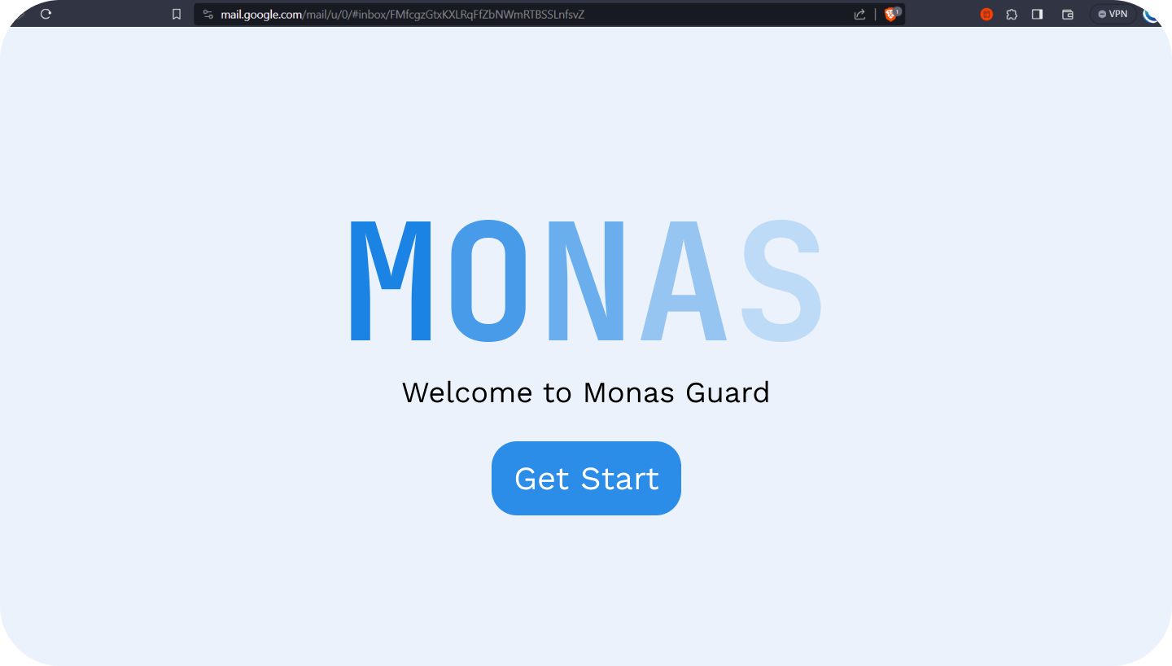
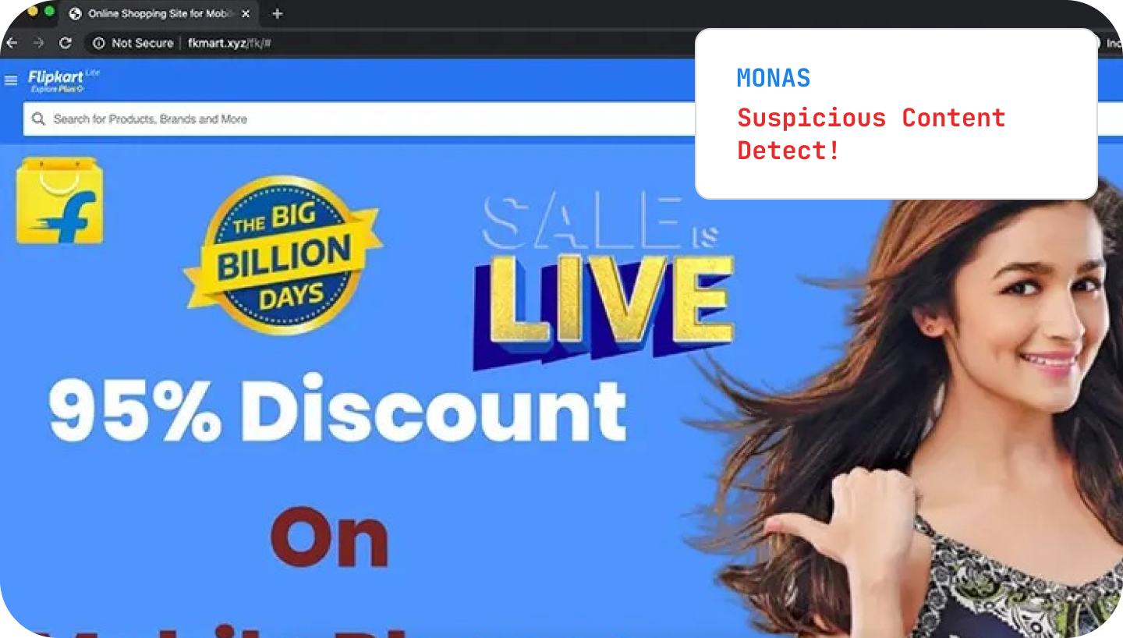
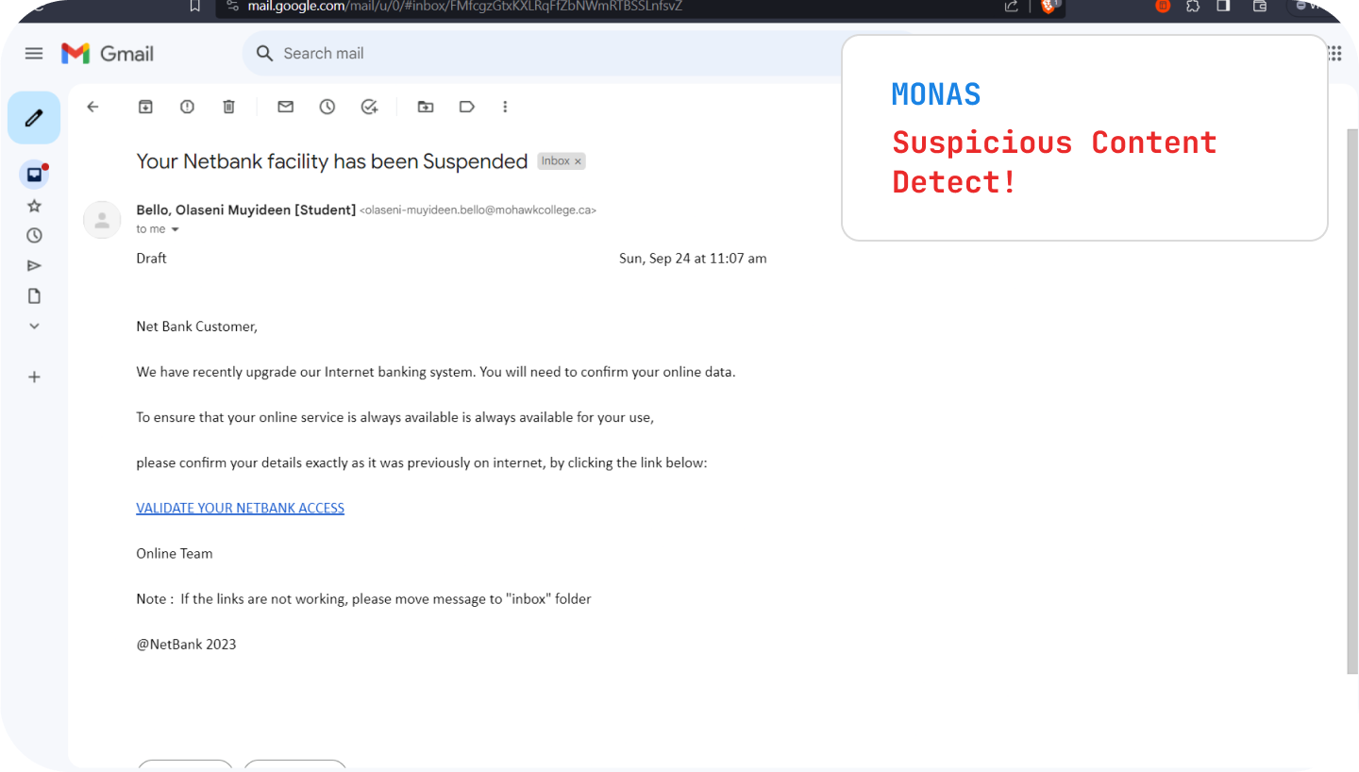
Monas Guard
Social Engineering Attack Detector

Slide 4

A Browser Plug-In
01
Available on any website
Extra protection

Slide 5
LLM
02
Context Awareness + Evolve overtime

Slide 6
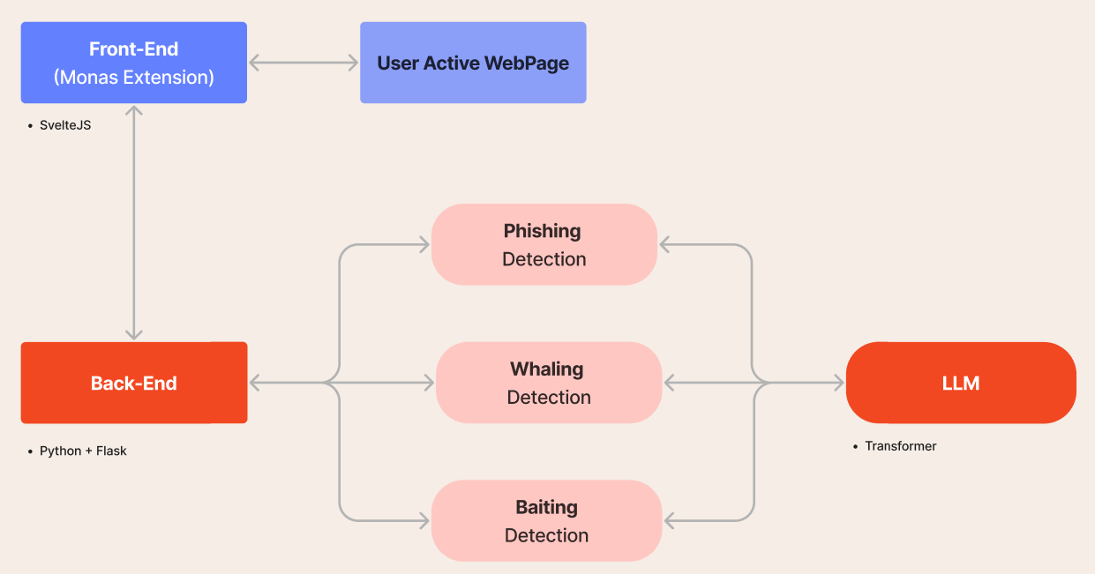

Slide 7
Social Engineering Attack
80%
70%
Improved accuracy
Reduced Chance of Phishing

Slide 8
Thank you

Slide 9
6 ways to Spot Suspicious Content
Grammar
Attatchments
1
2
Sites with Bad Grammar and Spelling Mistakes
Suspicious attatchments
Payment
Inconsistencies
6
3
Sites requesting payment credentials
Inconsistent content and domain names
Unrealistic
Links
5
4
Too Good to be true Emails
Usually contain suspicious links

