Slide 1
End-Sem Internship Review
Presenter: Yash Shewalkar (AI Intern at Siemens DISW)
Date: 14/05/2026

Slide 2

AdvantEdge AI – Siemens DISW GCO
Part of AdvantEdge AI program, an innovative AI initiative within Siemens Global Customer Operations (GCO). This program is dedicated to enhancing employee productivity, automating manual processes, and accelerating customer project timelines through the development and implementation of advanced AI tools.​
Team Composition:​
Advisors: The program is guided by experienced advisors.​
Architects: ​An experienced architect offers design insight and technical guidance, ensuring projects align with best practices and strategic goals.​
Co-ops: A dynamic team of five interns, including myself, actively contributes to various projects within the program.​
​My Role:​
As a co-op intern, I am deeply involved in several projects, collaborating closely with advisors and peers to develop innovative AI solutions. My contributions include research, development, and implementation of AI tools that align with the program's objectives.

Slide 3
Mentors
Dr. Ajinkya Bhave (Director and Head, CoE India at Siemens DISW)
Omkar Mundlik (Technical Solution Architect Advantedge AI at Siemens DISW)
Sanskruti Khedkar (Technical Solution Architect Advantedge AI at Siemens DISW)
Aript Saikia (Technical Solution Architect Advantedge AI at Siemens DISW)

Slide 4
Internship Work
Domain | Projects | Key Contributions | Status
RAG based AI Search service | Smart chunking strategy for complex structured JSON docs. | Indexing the data source using custom skillsets in Azure AI Search. | In Production
AI Agents for Simulation Workflow | Document aware agent which can provide concise response and validate the workflow models. | Building RAG documentation. Image + Text awareness Intent classification Query rewriting etc | In Development
Notes:
Scope
Automate the conversion of source data to target data.
Ensure schema matching and data integrity.
Enhance efficiency and reduce manual intervention.

Slide 5
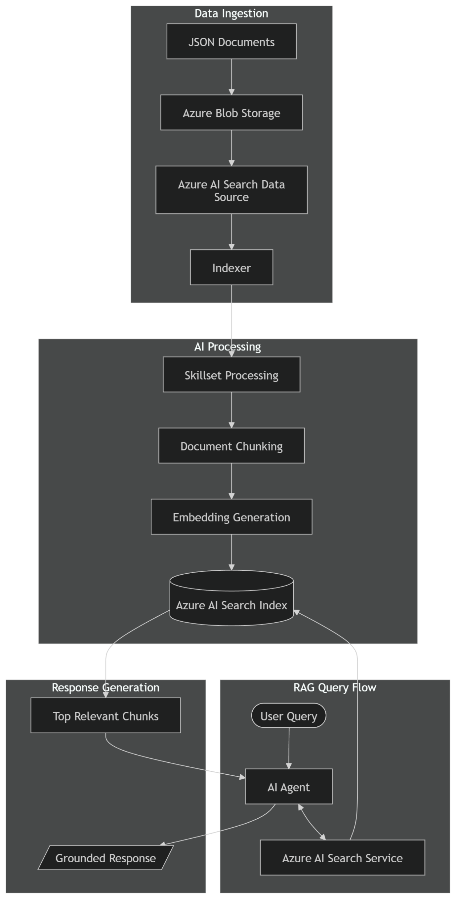
RAG Based Azure AI Search Service
Project Description
Development of an AI-powered search tool to find relevant JSON chunks using hybrid (keyword + semantic) search technique.
Addressed challenge:
Providing a Reliable Search service for RAG based tool calling agent which provides accurate results.
My role and Contributions:
Research and development of POC
Iterative Testing with QA engineer.
Architecture
Outcome
Time Saved: Search service was able to filter out chunks based on the subdomain user wants to search in.
Scope
Designed and implemented a RAG-compatible enterprise search layer using Azure AI Search.
Implemented semantic + keyword hybrid search for improved retrieval accuracy.
Developed custom skillset pipeline to process and chunk structured JSON documents.
Integrated the search service with an AI Agent for tool-based retrieval and response generation
Solution
Developed Azure AI Search Skillset which a two main submodels in the hierarchy.
Used the chunking separately on both and isolated the chunks in two categories.

Slide 6
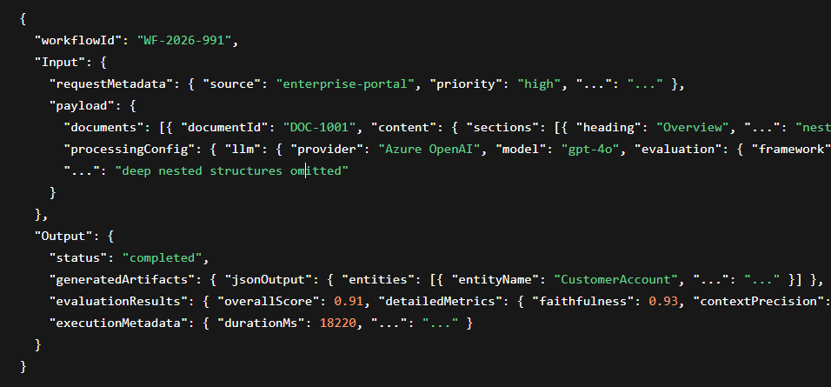
Sample JSON:

Slide 7
Document Aware Agent
AI Agents for Simulation Workflow
Benefits
Faster and easier access to precise, documented content.
Answers based on exact slides and sections relevant to the user’s question.
Provides relevant images gathered from the documentation in the answer.
Early Model Validation through automated, documentation-based cross-checking.
Instant Answers
Deeper Knowledge base
Get grounded answers to any question related to the workflow documentations in a concise format.
Assistant can understand both text and images in the document PPTs.
This ensures high relevancy in answers.
Features
Under
Development
Guidance
Model Validation
Ask any question and get step-by-step guidance for building any workflow.
Agent can assess your model using MCP server.
It can validate it with best practices from the documentation.
- UC735

Slide 8
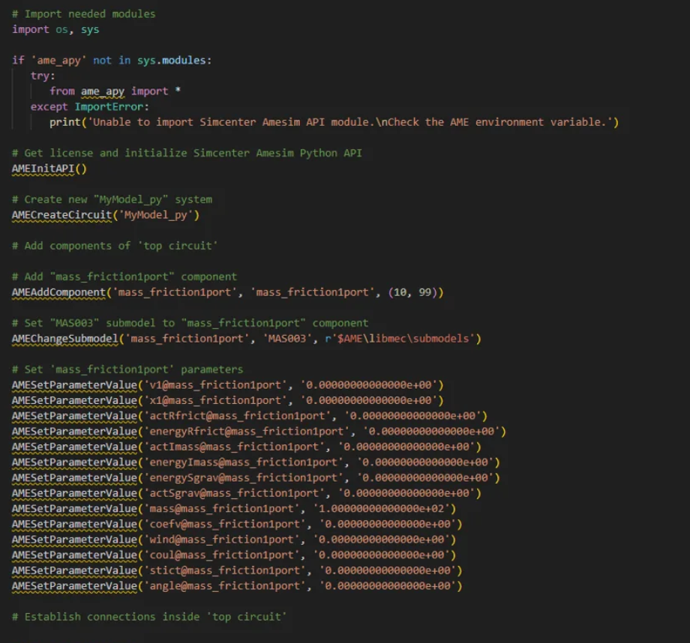
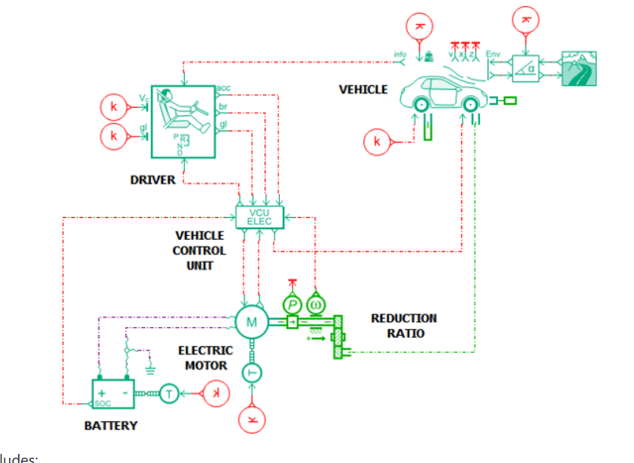
Sample Amesim Model:
Amesim Model.py / .ame
Amesim Model

Slide 9
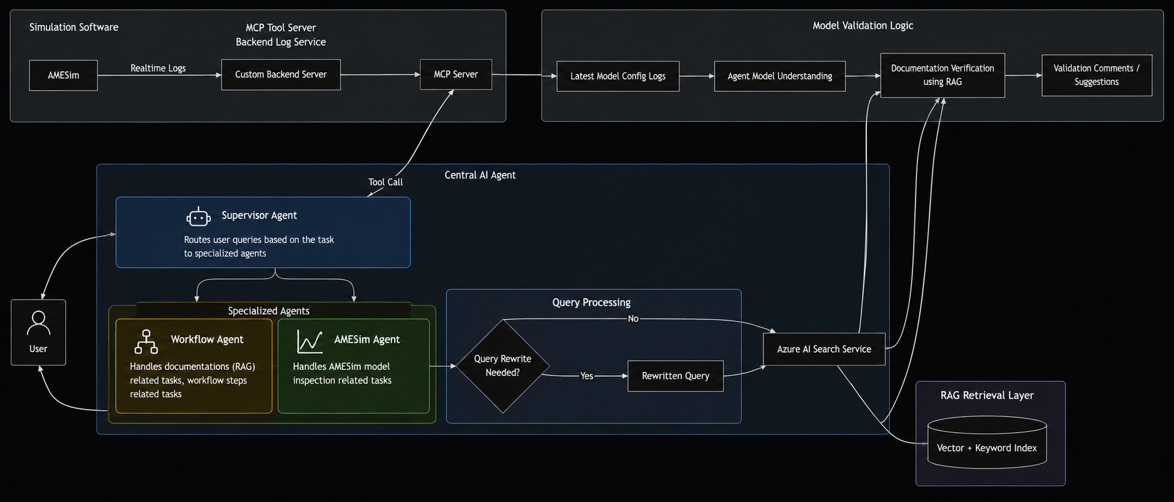
AI Agents for Simulation Workflow
My role and Contributions:
Research and development of POC
Production deployment on Azure.
Solution
Create Custom Skillset which can analyze image and create its description as text to build a RAG over it.
For Real-time access of Model Status in Amesim create a MCP server which will directly send logs of Amesim software through a backend server to which MCP can communicate.
Integrate the Azure AI Search service as a tool for Agent.
Create Workflow Agent to handle documentation related task and workflow steps related task.
Create Amesim Agent to handle Model Inspection related task.
Create a Supervisor Agent which can route the task to specific agent based on user query.
Architecture

Slide 10
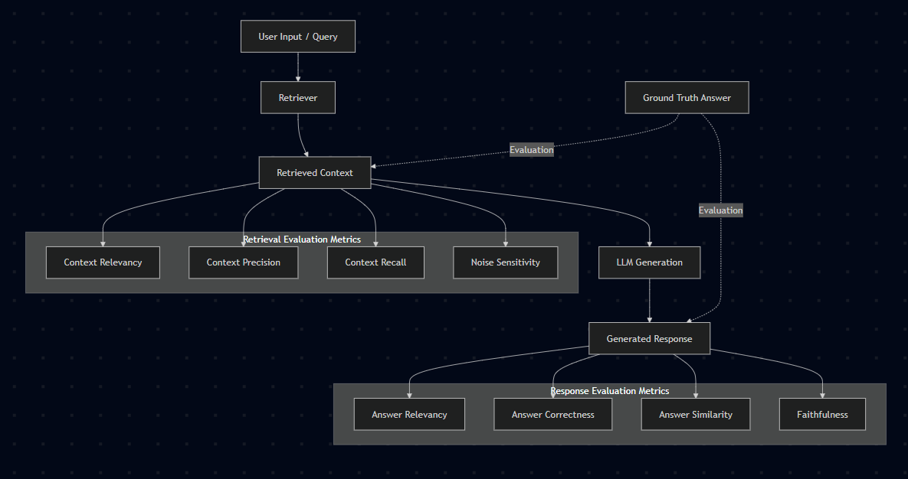
RAG Quality Evaluation: RAGAS Metrics

Slide 11
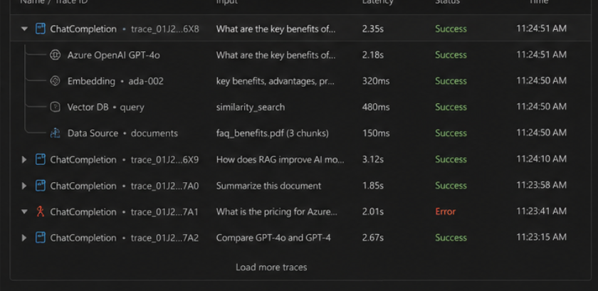
Tracing : Opentelementry in VS code and AI Toolkit

Slide 12
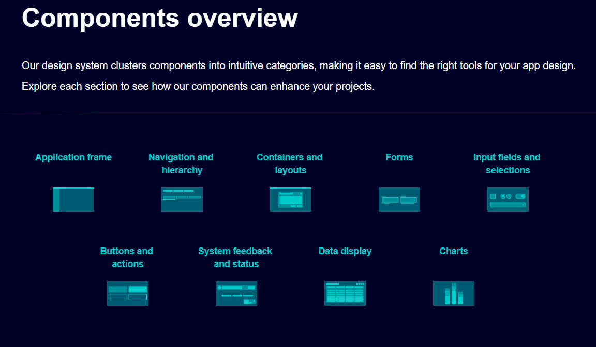
Chatbot UI in React using Siemens IX Component Library

Slide 13
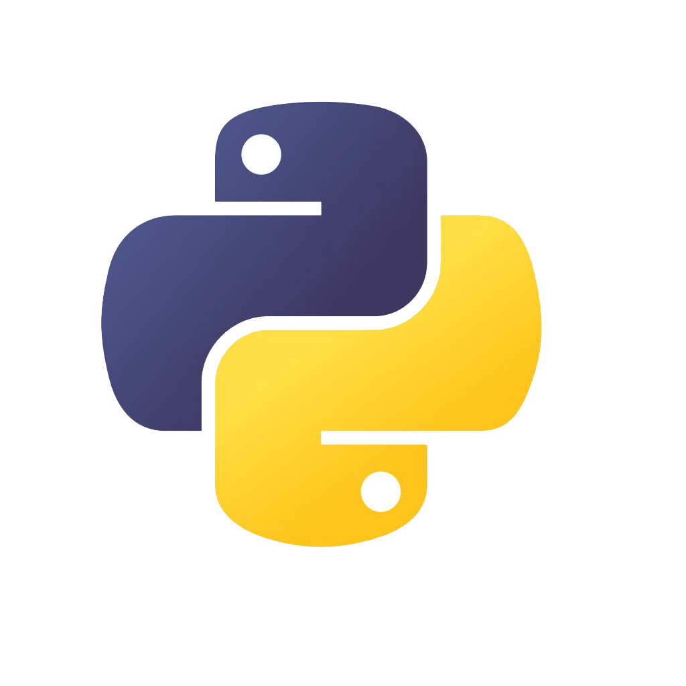

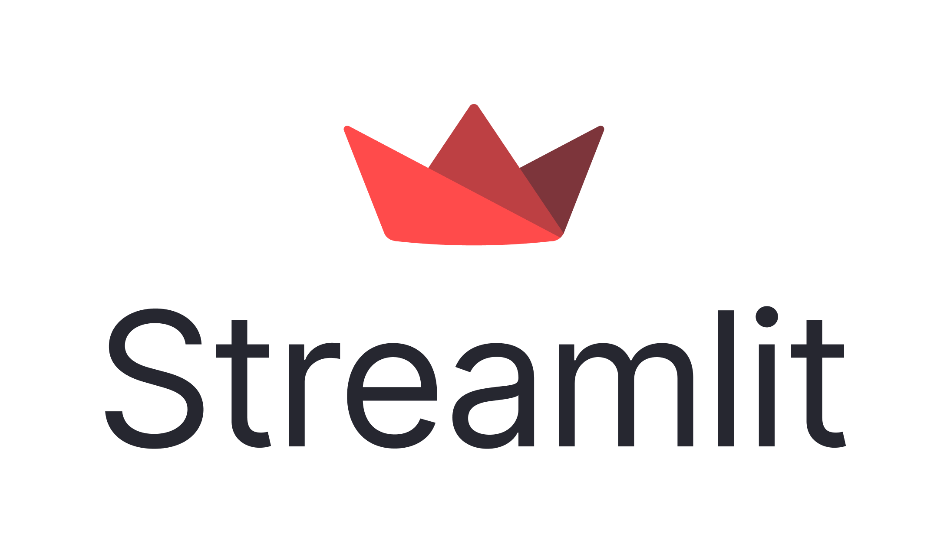






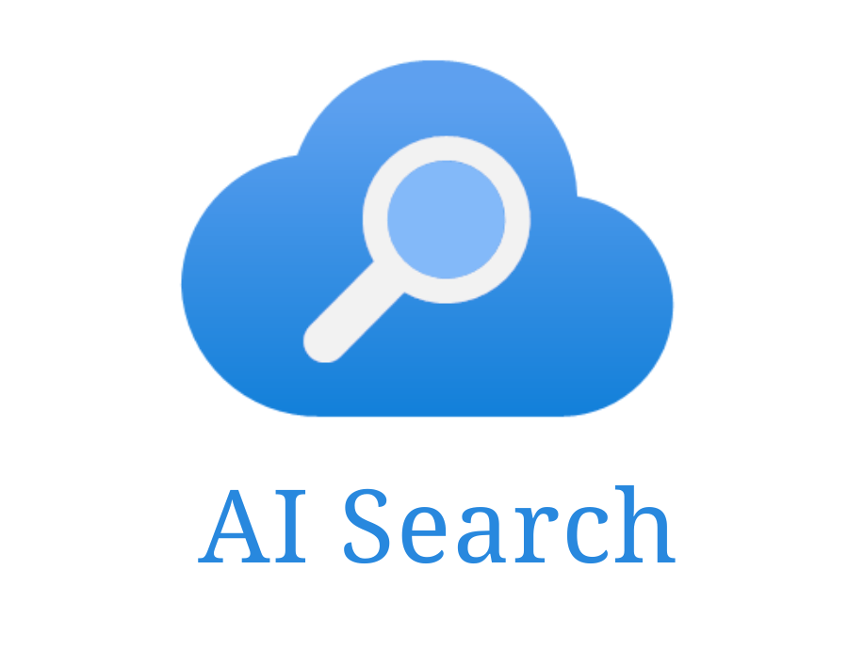

Tech Stack
Programming languages and Frameworks:
Deployment:
Databases:
Cloud service:
Azure Blob Storage

Slide 14
Thank You!

