Slide 1
Virtual Assistant
Team Number : 6
Mentor : Prof. Charu Sharma.
Team Members:
1.Yash Singhal(2022201004)
2.Atharva Vaidya(2022201046)
3.Patha Sai Sumith(2022202004)
4.Sarat Makineni(2022204022)

Slide 2
Introduction
Virtual Assistant is a virtual helper(kind of like a remote employee) that offers the following four functionalities.
Adding an event to the calendar.
Converts speech to text.
Wiki Search.
To-do list.
This virtual assistant is completely built using MERN stack.

Slide 3
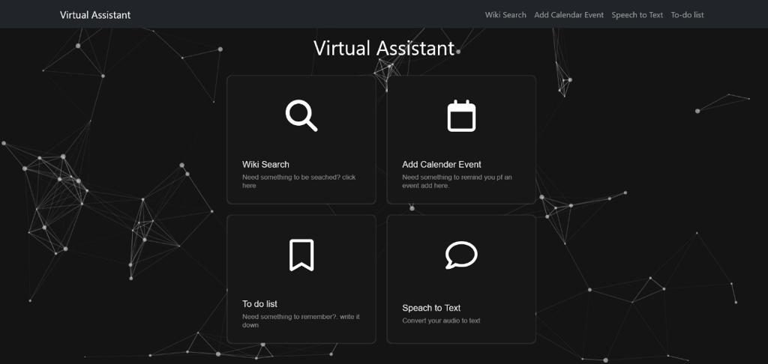

Slide 4
Adding an event to Calendar
It contains 4 fields
Summary of an event.
Description of an event.
Location.
Start date and end date of event.
A reminder is sent to the user 21 minutes before the starting of the event.

Slide 5
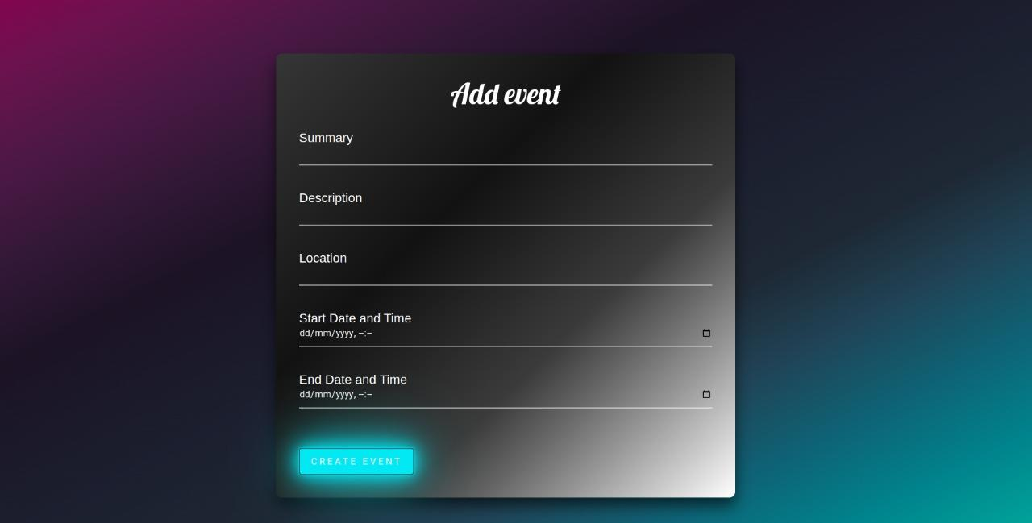

Slide 6
Converts Speech to Text
1.In speech to text conversion, user is able to convert speech that is recorded using a microphone to text.
2.It contains three buttons namely start , stop and reset.
3.Start button is used to start the conversion
4.By clicking stop button text conversion is stopped.
5.Reset clears the text that is converted.

Slide 7
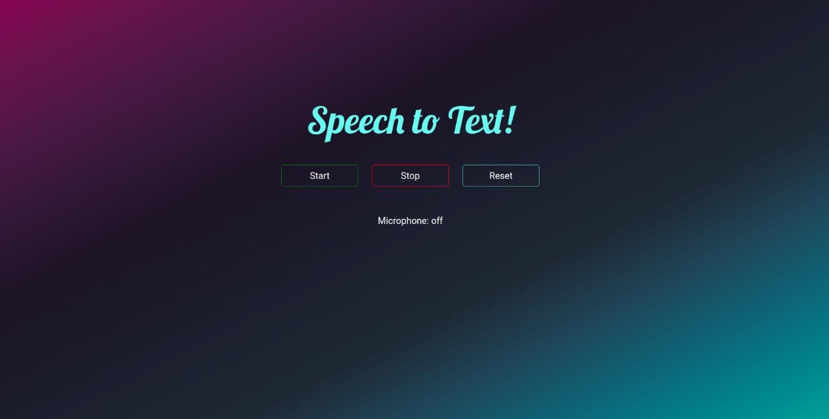

Slide 8
Wiki Search
Wiki search is a functionality where user is able to search about anything that is limited to Wikipedia and ten results are shown.

Slide 9
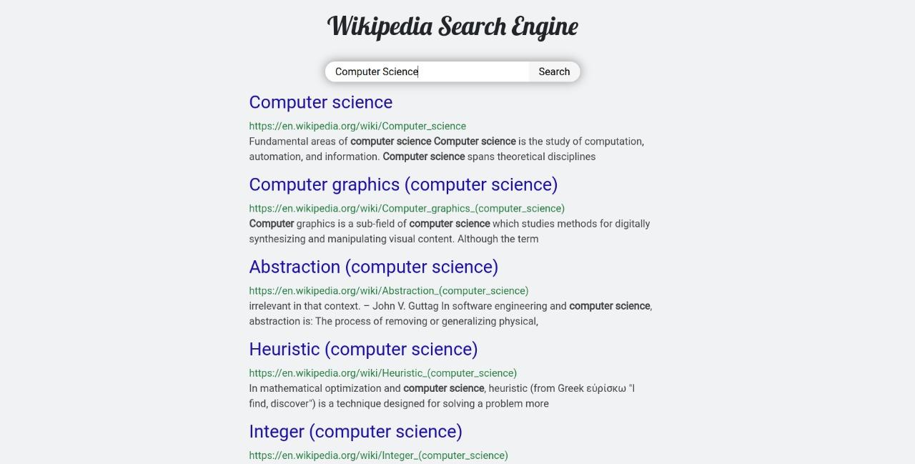

Slide 10
To-do List
1.To-do list helps user to add events to a list that is to be performed on that particular day.
2.User can add/delete day specific events.

Slide 11
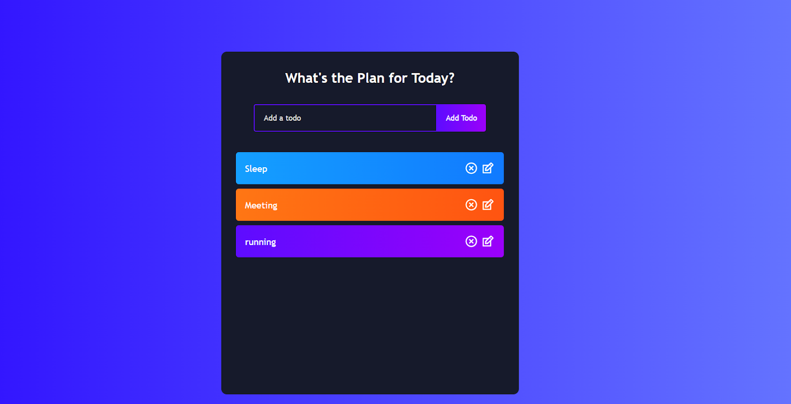

Slide 12
THANK YOU

