Slide 1

Project Presentation
on
Seth Anandram Jaipuria School
“School Management System”
Designed & Developed By
Softpro India Computer Technologies (P) Ltd.

Slide 2
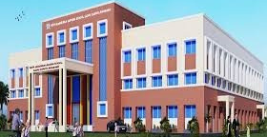
About
SETH A R JAIPURIYA,SCHOOL
Seth Anandram Jaipuria School, Sadhu Campus – Barabanki is dedicated to the mission of 'Empower, Enthuse, and Excel,' ensuring that every child receives a holistic education that not only imparts knowledge but also instills values essential for navigating life.
Our commitment at Seth Anandram Jaipuria School is to provide education that truly prepares students for LIFE!
Nestled in the serene environment of Barabanki, Seth Anandram Jaipuria School, Sadhu Campus spans 2.16 acres of lush green land.
The campus is equipped with state-of-the-art facilities, designed to foster the all-round development of our students.

Slide 3

About
STUDENT MANAGEMENT SYSTEM
To address the challenges posed by traditional school administration methods, Seth Anandram Jaipuria School, Sadhu Campus – Barabanki, has introduced a comprehensive School Management System (SMS). This system is designed to digitize every aspect of school operations, from admissions to academic management, ensuring that all processes are streamlined and efficient.
The SMS features a common zone accessible to all visitors, providing a general overview and essential information about the school. Beyond this, the system offers three distinct login panels for Students, Teachers, and Administrators, each tailored to meet their specific needs.
Akshat pathak

Slide 4

About
BTE UTTAR PRADESH
State Board of Technical Education and Training was set up in the state in May,1958. The Board conducted its first examination in 1960, for courses of diploma level and also for Draughtsman Certificate Course. The name of the state Board was changed to Board of Technical Education in 1962. In the same Year, the U.P. Pravidhic Shiksha Adhiniyam - 1962 was enacted awarding the Board statutory status. In the year 1962, year of its inception, the Board held the examination of about 2500 students, in three major disciplines of Civil, Electrical and Mechanical Engineering at 25 different Centers/Institutions. It has a chairman, vice-chairman and 40 members, named by the state government. Secretary, Board of Technical Education, U.P. is ex-officio member secretary of the Board. The Board now examine and approve the syllabus developed by IRDT, Kanpur and prescribe it for institutions affiliated to Board of Technical Education, U.P. About 1,05,000 students in the 60 different disciplines of one year, two year, three year and four year durations are being examined at present, in the institutions, affiliated to the Board

Slide 5
Why
SUMMER TRAINING
Summer training allows students to put their theoretical knowledge into practice for the employer in the workplace. Students gain first-hand experience, build projects, and their success is supervised by mentors who direct, prepare, and then provide recommendations to improve their skills.
Utilise Spare Time Better
Career Opportunity Column
Adds Value, Skill, and Experience to the cv

Slide 6








TECHNOLOGIES LEARNED DURING SUMMER TRAINING

Slide 7
MODULES IN PROJECT
Student Information System
Login Management System
Discussion Forum Management
Complain Management System
Feedback Management System
News Management
Enquiry Management
Study Material Management
Email Integration
SMS API Integration

Slide 8
SOFTWARE REQUIREMENTS FOR DEVELOPMENT
ui design
prpogramming languages
DATABASE
IDE
HTML
CSS
JS
Bootstrap
PYTHON
with
DJANGO
FRAMEWORK
SQLite3
VS Code

Slide 9
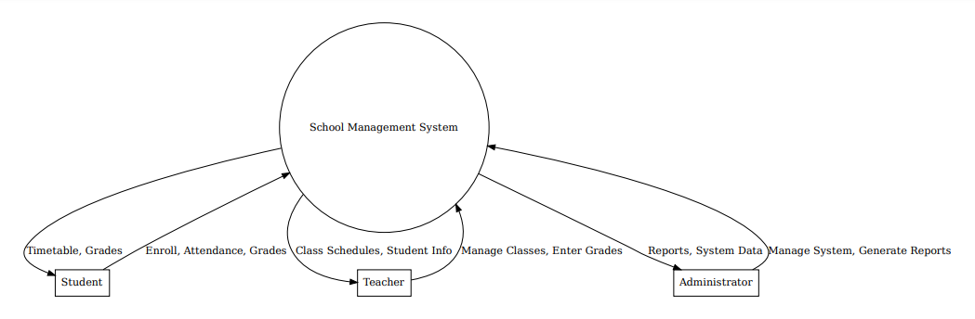
HIGH LEVEL DESIGNING

Slide 10
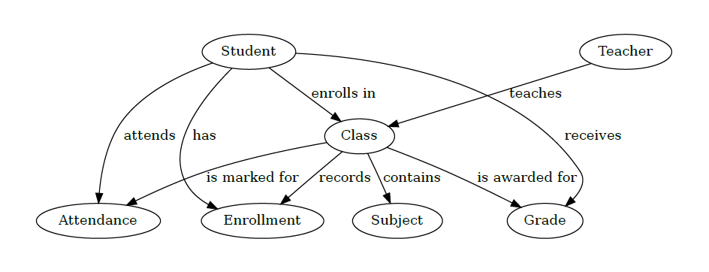
ONE LEVEL DFD

Slide 11
FUTURE SCOPE OF PROJECT
Named after the famous Nalanda University of Magadh, Ancient India, the Nalanda Open University (NOU) is the only University in the State of Bihar meant for imparting learning exclusively through the system of Distance Education. The University was established in March, 1987 by the Government of Bihar. Apart from Degree and Diploma courses at undergraduate as well as at post graduate level, the university offers certificate courses for six and nine months.
In future it is planned to develop our own web server to host the web application.
Building Android Application for the system is also one of the future scope’s of this project.

