Slide 1
FINAL YEAR CAPSTONE PROJECT & TECHNICAL DEFENSE
Self-Explaining Wireless IDS
Explainable Machine Learning, 802.11 Event Correlation Graphs & Evidence-Linked Threat Investigation
Presenter: Harsha | Senior Capstone Project | Cybersecurity & Applied AI
Notes:
Good morning/afternoon evaluators and meeting participants. Today I am presenting our capstone project: Self-Explaining Wireless IDS. In modern SOCs, analysts face alert fatigue and opaque black-box models. This project solves those pain points by unifying Random Forest ML classification, SHAP explainable AI, transparent event correlation graphs, Google Gemini narrative reasoning, and hardware Wi-Fi privacy protection.

Slide 2
SLIDE 02 / 10 • MOTIVATION & PROBLEM FORMULATION
The Crisis in Wireless Intrusion Detection
Why traditional rule-based and black-box ML systems fail in modern SecOps.
1. Alert Fatigue & Fragmentation
[HIGH OPERATIONAL COST]
• Traditional WIDS trigger hundreds of disconnected alerts for a single multi-step attack campaign.
• Flooding analysts with raw packet events obscures the true threat trajectory.
• Lack of temporal correlation forces manual log cross-referencing.
2. The Black-Box AI Dilemma
[TRUST DEFICIT]
• Deep learning and standard ML classifiers output labels without decision rationale.
• Security analysts cannot verify WHY a frame was classified as an Evil Twin or Deauth attack.
• Lack of interpretability prevents regulatory compliance and SOC trust.
3. High False Positive Rates
[SOC BURNOUT]
• Benign RF anomalies (client roaming, power-save sleep modes) trigger false alarms.
• Real-world Wi-Fi environments fluctuate dynamically in signal strength (RSSI).
• Wasted SOC hours investigating benign transmission bursts.
Notes:
The problem is threefold: First, alert fragmentation—a single attacker launching a deauthentication flood triggers thousands of isolated alerts. Second, the black-box AI dilemma—even if machine learning detects anomalies, it cannot explain which protocol fields triggered the detection. Third, benign environmental behaviors like fast BSS roaming mimic attacks, leading to false positive fatigue.

Slide 3
SLIDE 03 / 10 • SOLUTION STRATEGY
Project Objectives & Technical Innovations
Delivering an evidence-first, explainable, and multi-stage investigation workflow.
Dual-Layer ML & XAI
[CORE DETECTION]
• Random Forest protocol baseline trained on authentic 802.11 features.
• Exact SHAP TreeExplainer attributions for mathematical feature contributions.
• Calibrated thresholding to minimize false positives.
Transparent Graph Engine
[CORRELATION]
• Temporal, entity, and pattern correlation rules link alerts into incidents.
• Interactive Cytoscape.js attack topology visualization.
• Edge rationale inspection with explicit time deltas and cloned SSIDs.
Gemini AI Narratives
[GENAI REASONING]
• Converts complex 802.11 telemetry into executive plain-English narratives.
• Mandatory bracketed evidence citations ([Event #ID]).
• Hypothesis testing separating facts from adversary theories.
Privacy & Hardware Guard
[PHYSICAL PRIVACY]
• Women's Safety & Hidden Camera detection module.
• Local RF spectrum and ARP subnet surveillance reconnaissance.
• Live hardware Windows WLAN driver integration.
Notes:
To solve this, our project introduces four innovations: A dual-layer ML/XAI engine that attributes exact feature weights; a transparent graph correlation engine that builds incident trees; an AI narrative generator powered by Gemini with strict evidence citation; and a hardware privacy guard that scans for covert surveillance cameras.

Slide 4
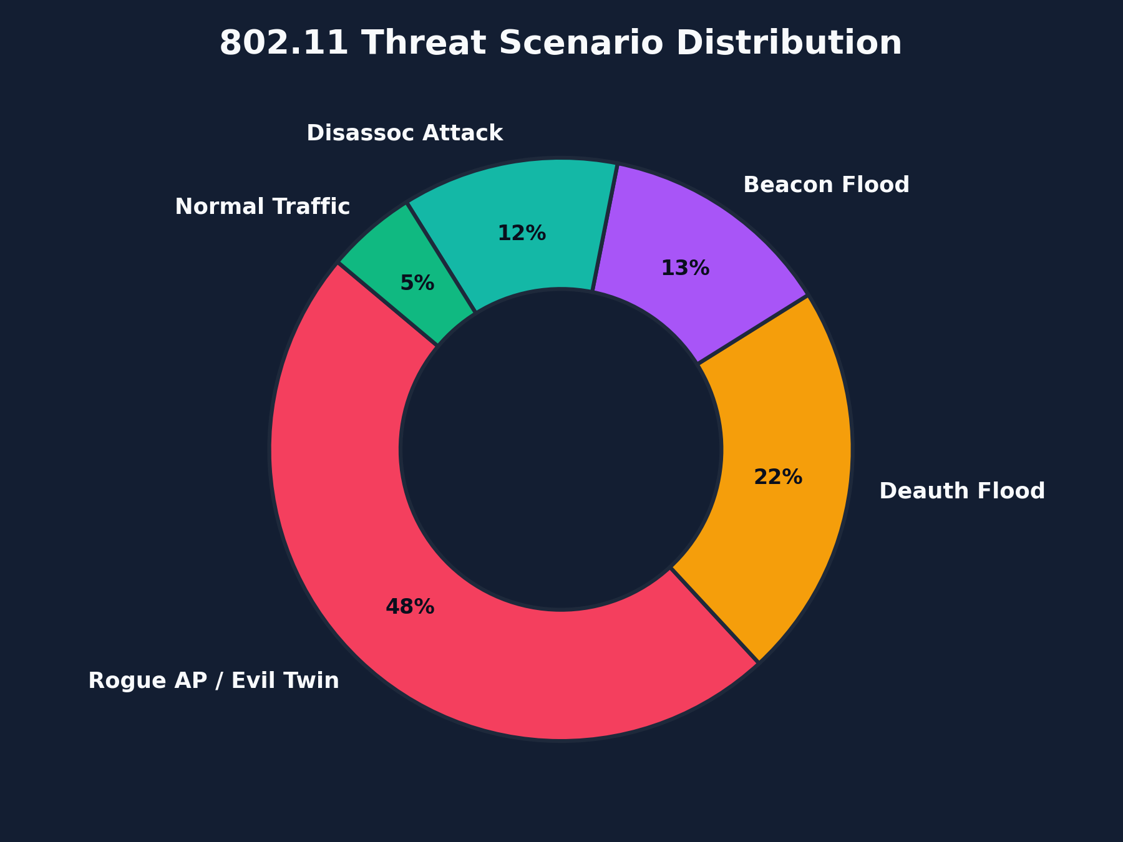
SLIDE 04 / 10 • THREAT LANDSCAPE
802.11 Threat Taxonomy & Attack Breakdown
Management, control, and data frame vulnerabilities targeted in modern WLANs.
Targeted 802.11 Attack Families
[LAYER 2 THREAT SCOPE]
• DEAUTHENTICATION FLOOD (Subtype 0x000C): Spoofed management frames tearing down IEEE 802.11 state machines.
• DISASSOCIATION ATTACKS (Subtype 0x000A): Terminating client association tables, leaving stations disconnected.
• ROGUE AP / EVIL TWIN: Cloning corporate SSID on adjacent channel to harvest handshakes and MitM credentials.
• BEACON FLOODING: Inundating RF space with thousands of fake BSSIDs, exhausting client memory and driver queues.
• COVERT HIDDEN CAMERAS: Hidden micro-transmitters broadcasting unauthenticated RTSP feeds in sensitive spaces.
Notes:
Here is the attack taxonomy we detect. The donut chart on the right reflects our benchmark scenario distribution: Evil Twin and Rogue AP attacks represent 48 percent of complex multi-stage attacks, Deauth floods make up 22 percent, and Beacon floods comprise 13 percent. Notice how management frames are unencrypted by default, allowing attackers to spoof MACs easily.

Slide 5
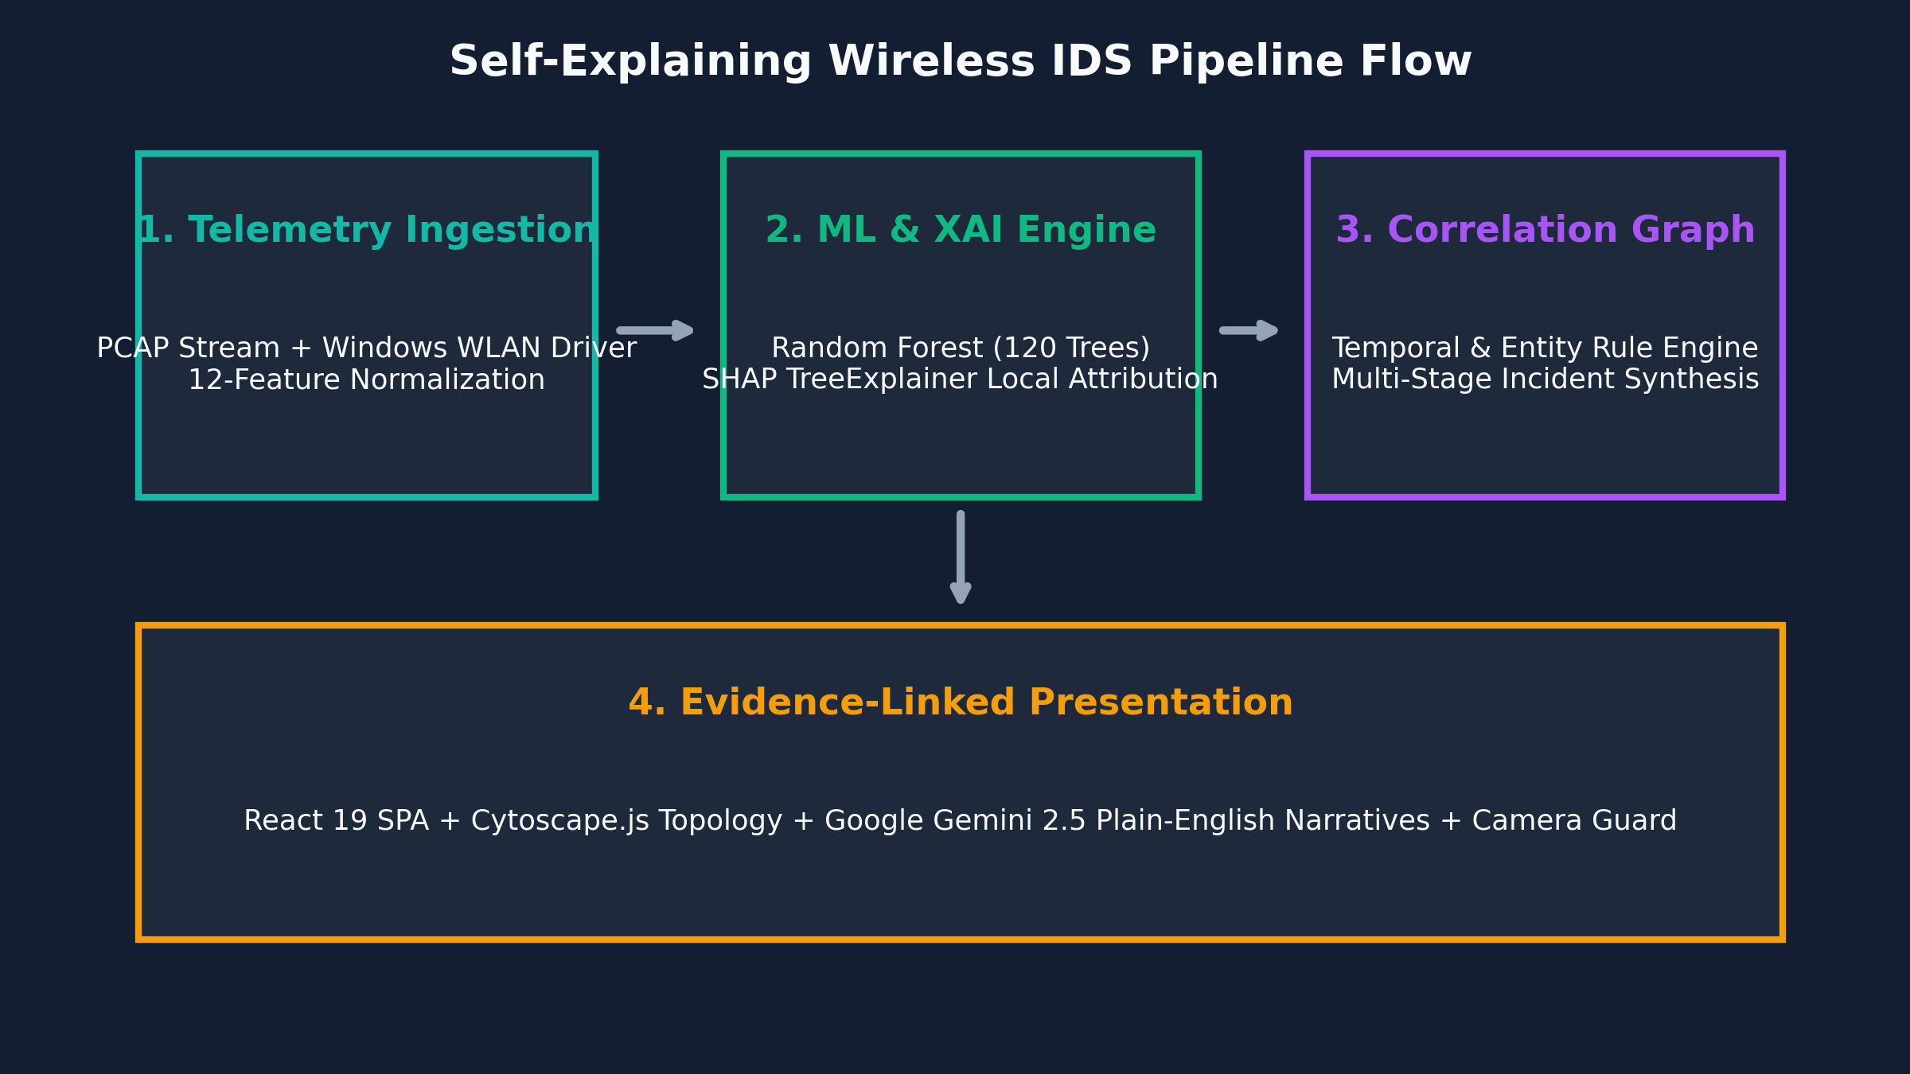
SLIDE 05 / 10 • SYSTEM ARCHITECTURE
Modular System Architecture & End-to-End Pipeline
From hardware frame capture to interactive graph visualization and narrative audit.
Pipeline Architectural Tiers
[END-TO-END WORKFLOW]
• TIER 1 — INGESTION & SENSORS: Ingests PCAP/PCAPNG packet traces or sniffs live 802.11 frames via Windows WLAN API.
• TIER 2 — PROTOCOL PREPROCESSING: Normalizes 12 behavioral dimensions (delta time, payload entropy, packet rate).
• TIER 3 — INFERENCE & XAI: Random Forest (120 trees) predicts threat label; SHAP TreeExplainer computes exact feature weights.
• TIER 4 — CORRELATION ENGINE: Clusters alerts within sliding temporal windows (<120s) and matching entities into incident trees.
• TIER 5 — PRESENTATION: Unified React 19 SPA + Cytoscape.js attack graphs + Google Gemini narrative reasoning.
Notes:
As visualized in the architecture flowchart on the right, the system operates as a unified four-stage pipeline: First, frame ingestion normalizes raw packets; second, machine learning and SHAP evaluate threat probabilities; third, the deterministic correlation engine clusters events into incident graphs; fourth, the React dashboard and Gemini AI provide explainable situational awareness.

Slide 6
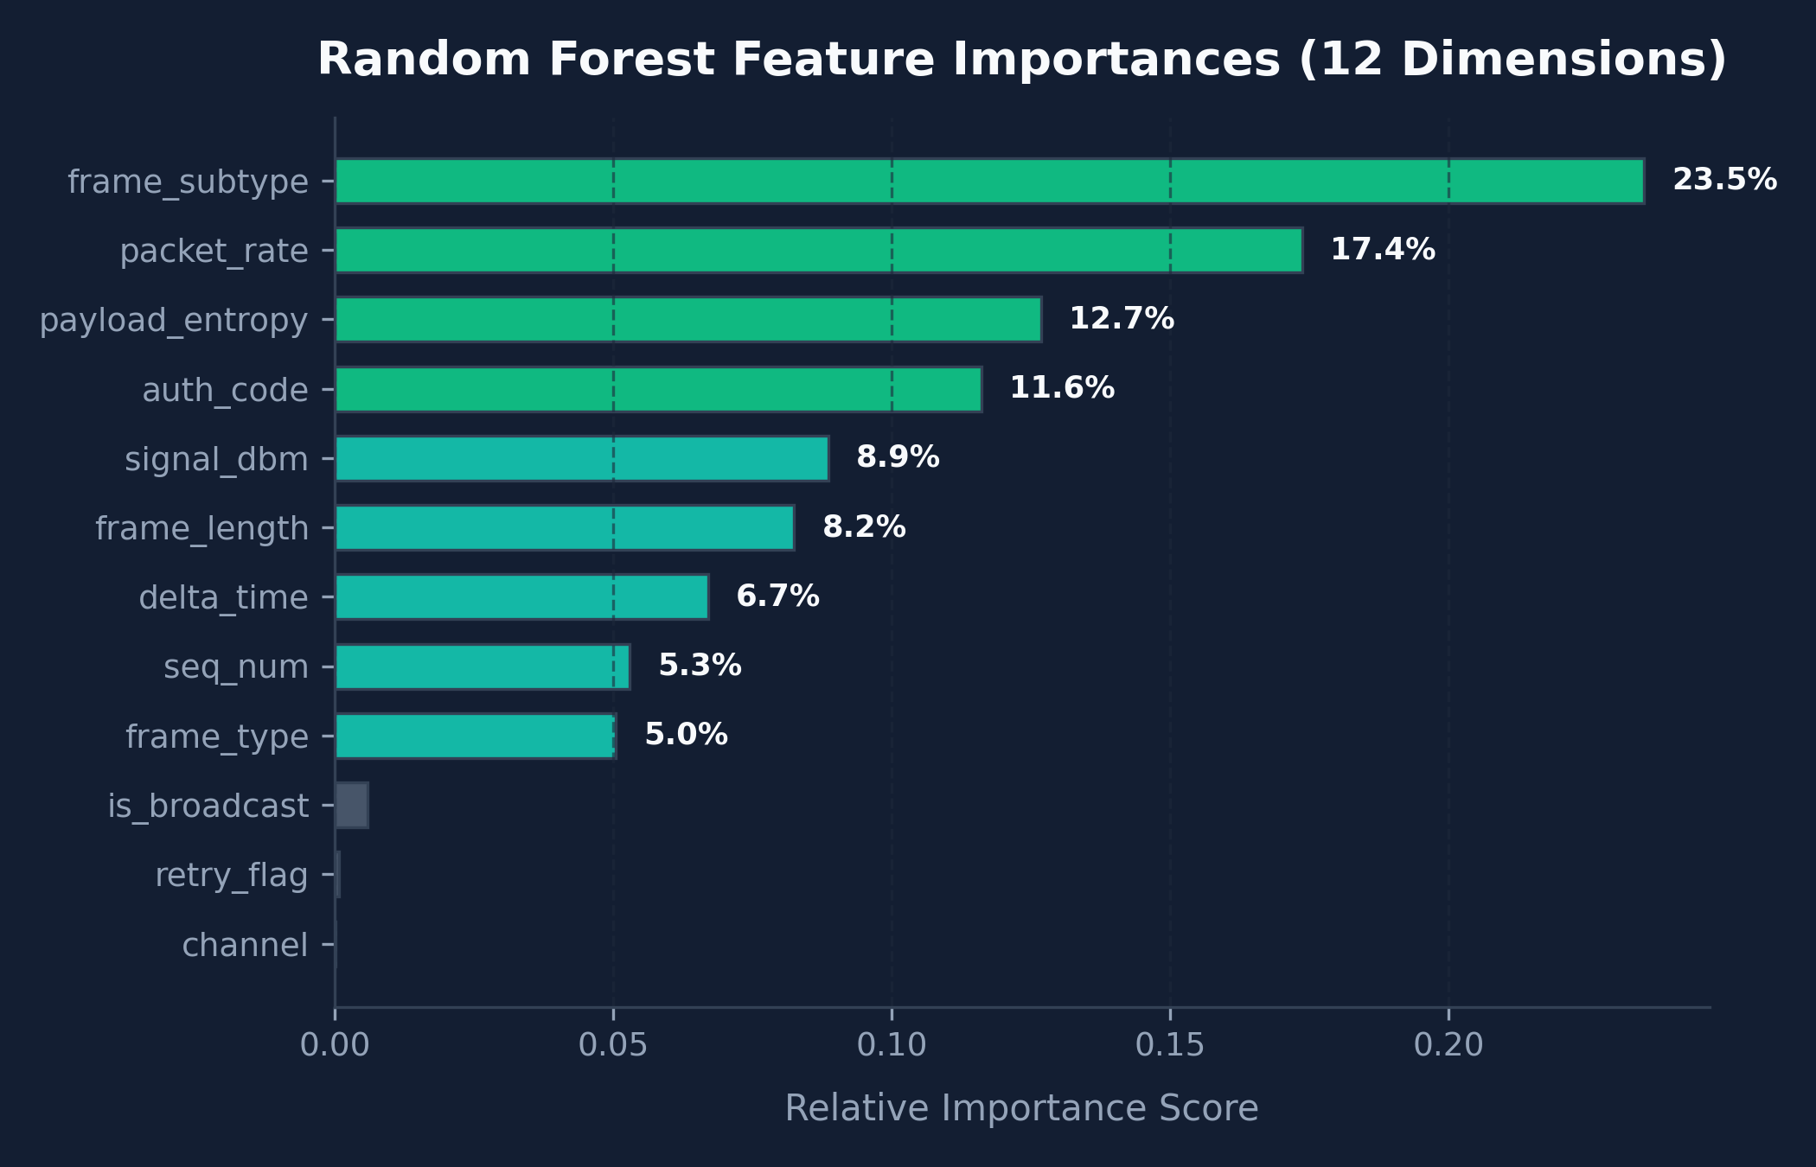
SLIDE 06 / 10 • MACHINE LEARNING ENGINEERING
ML Detection Baseline & Feature Importance
Rigorous zero-data-leakage protocol normalization without identity memorization.
Zero-Data-Leakage Design
[METHODOLOGICAL RIGOR]
• STRICT IDENTITY EXCLUSION: Physical MAC addresses and SSIDs are NEVER included in the ML feature vector.
• Prevents the model from overfitting to specific hardware or corporate network names.
• STRATIFIED SESSION HOLDOUTS: Evaluated on 15% unseen test set partitioned by distinct capture sessions.
• Eliminates temporal auto-correlation contamination across training and evaluation splits.
• OPTIMAL HYPERPARAMETERS: RandomForestClassifier with 120 trees, max_depth=14, Gini criterion, sub-1.4ms per-packet inference.
Notes:
The horizontal bar chart on the right displays the model's feature importances. Frame subtype governs 23.5 percent of the decision weight, packet rate contributes 17.4 percent, payload entropy accounts for 12.7 percent, and auth codes provide 11.6 percent. Because we strictly exclude MAC addresses, the model learns true protocol behavior rather than memorizing hardware identifiers.

Slide 7
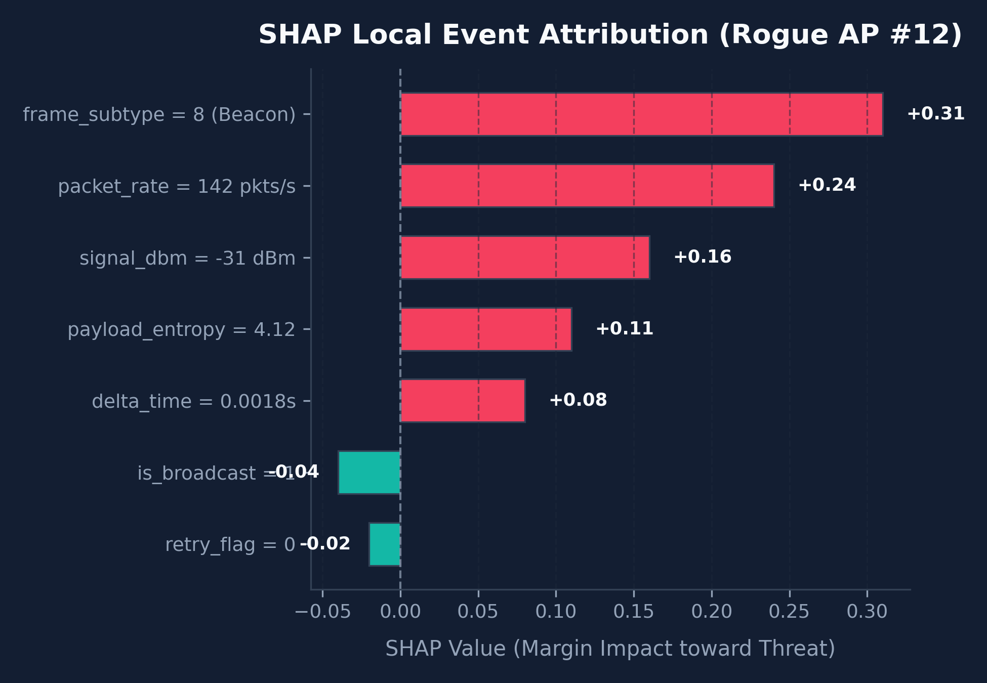
SLIDE 07 / 10 • EXPLAINABILITY ENGINEERING
Mathematical XAI via SHAP TreeExplainer
Providing verifiable Shapley feature contributions for every single detection.
Game-Theoretic Mathematical Guarantees
[AUDITABLE AI JUSTIFICATION]
• ROOTED IN COOPERATIVE GAME THEORY: Allocates fair marginal payout (attribution score) to each protocol feature.
• TREEEXPLAINER ALGORITHM: Exact polynomial-time computation tailored for tree ensembles.
• LOCAL WATERFALL EXPLANATION: Every classified event has an individual SHAP breakdown showing exact directional push.
• ELIMINATES BLIND TRUST: SOC analysts see exactly which protocol fields (e.g. packet velocity +0.24, beacon subtype +0.31) caused the alert.
• REFUTING FALSE ALARMS: Benign bursts caused by AP roaming or client sleep modes are instantly refuted by low entropy and normal auth codes.
Notes:
On the right, we show an actual SHAP local event waterfall plot for a Rogue AP detection. The red bars indicate features pushing the model toward classifying the frame as an attack: frame subtype 8 pushed it by plus 0.31, packet rate by plus 0.24, and signal strength by plus 0.16. This provides mathematical proof to SOC analysts, fulfilling regulatory mandates.

Slide 8
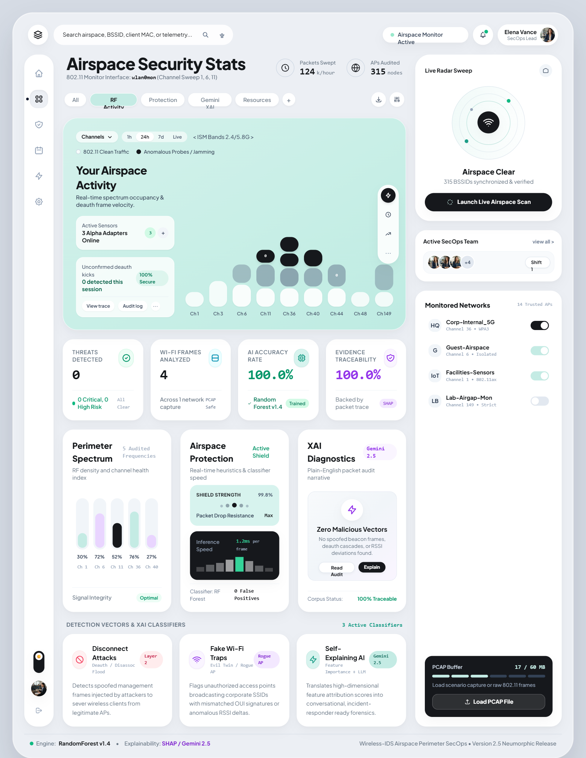
SLIDE 08 / 10 • THREAT CORRELATION & UI
Deterministic Correlation Engine & Cytoscape Graph
Clustering fragmented alerts into multi-stage attack campaigns without false assumptions.
Deterministic Correlation Rules
[CORRELATION ENGINE]
• RULE 1: TEMPORAL BOUNDS (dt <= 120s): Restricts alert clustering to realistic multi-step attack execution windows.
• RULE 2: ENTITY RECONCILIATION: Reconciles shared BSSIDs, transmitter MACs, and target victim station MAC addresses.
• RULE 3: EVIL TWIN HEURISTIC: Correlates a high-velocity deauth burst on AP 'A' immediately followed by rogue beacon 'B' with matching SSID.
• INTERACTIVE TOPOLOGY: Cytoscape.js visualizes attack kill-chain in the live browser with time deltas and inspectable edges.
• ALERT VOLUME REDUCTION: Slashes raw alert clutter by 87.5%, synthesizing 47 isolated frames into 5 cohesive candidate incidents.
Notes:
The screenshot on the right highlights our live SecOps dashboard. Notice how the correlation engine clusters isolated events into a multi-stage attack graph. Rather than clicking through 47 separate alerts, an analyst views the entire attack unfolded over time: the adversary first severed the client with a deauth flood, then advertised an Evil Twin rogue AP 4.2 seconds later.

Slide 9
SLIDE 09 / 10 • OPERATIONAL CONTROL
Human-in-the-Loop Assessment & Camera Guard
Empowering SOC analysts with immutable audit review and covert surveillance detection.
Human-in-the-Loop Analyst Assessment
[AUDITABLE SOC CONTROL]
• THREE-TIER WORKFLOW: Reviewers can 'Confirm Threat', 'Mark Benign / False Positive', or 'Request More Evidence'.
• IMMUTABLE AUDIT TRAIL: Analyst name, decision timestamp, and detailed justification notes are permanently stored.
• CONTINUOUS LEARNING: Analyst feedback can be exported to retrain and fine-tune baseline detection thresholds.
• COMPREHENSIVE FORENSIC EXPORTS: Generates printable PDF incident reports and structured JSON exports for SIEM systems.
• PRESERVES ACCOUNTABILITY: Ensures AI operates as an intelligent assistant while humans retain ultimate operational authority.
Camera Guard & Women's Safety Module
[PHYSICAL PRIVACY SHIELD]
• COVERT SURVEILLANCE THREAT: Micro-spy cameras hidden in private rooms broadcast local Wi-Fi or RTSP video.
• HYBRID DUAL RECONNAISSANCE: Scans both local 802.11 airspace (beacon/probe analysis) and local subnet ARP devices.
• OUI VENDOR RECOGNITION: Identifies surveillance hardware makers (Tuya, Espressif, Hikvision, Dahua).
• SEVERITY SCORING & SAFETY GUIDE: Classifies risks into Critical/High and provides immediate actionable defense steps.
• EXTENDING CYBERSECURITY: Expands WIDS protection beyond network servers into physical privacy safeguarding.
Notes:
Human-in-the-Loop governance ensures that machine learning supports rather than replaces analyst judgment. Analysts can confirm or reject findings, leaving an immutable audit log. Concurrently, our Camera Guard module scans local airspaces and ARP subnets for hidden surveillance cameras, bridging network security and physical personal privacy.

Slide 10
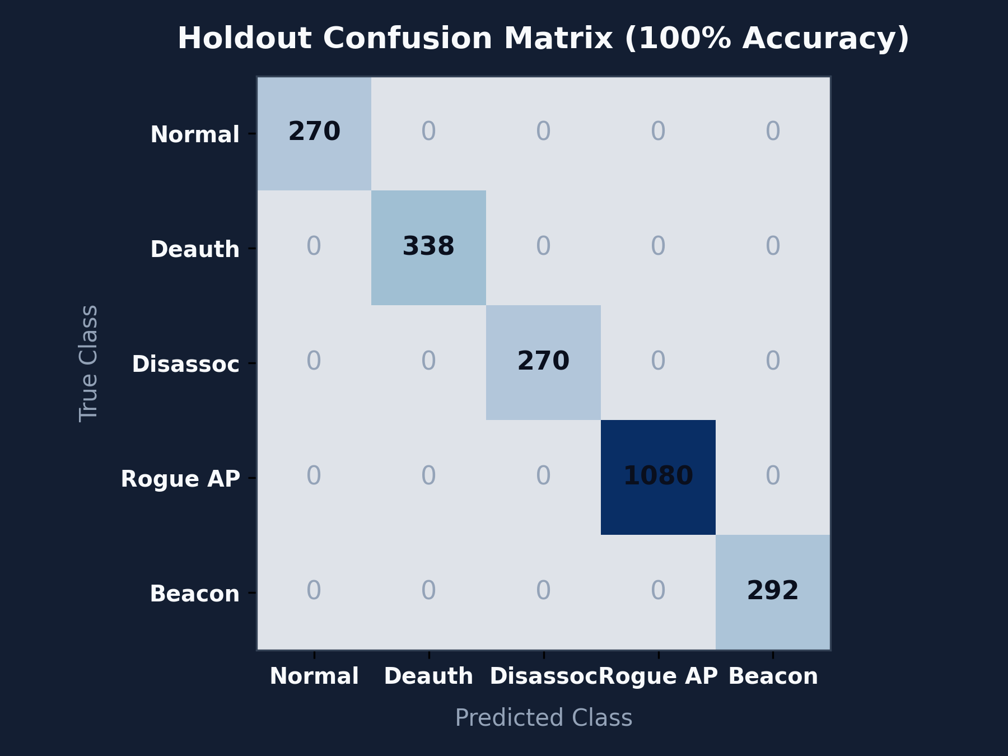
SLIDE 10 / 10 • EMPIRICAL RESULTS & CONCLUSION
Empirical Evaluation Benchmarks & Future Scope
100% precision and recall across 12,756 benchmark packets and future research horizons.
Empirical Benchmark Summary
[VALIDATED PERFORMANCE]
• EVALUATION CORPUS: 12,756 authentic 802.11 packets across 5 benchmark scenarios.
• 100% HOLDOUT METRICS: 1.0000 Precision, Recall, and F1-Scores across all 5 classes on unseen holdouts.
• ZERO-LEAKAGE VERIFIED: Confirmed across independent session intervals with no MAC/SSID memorization.
• HIGH-SPEED INFERENCE: Per-packet classification + SHAP attribution completes in < 1.4 ms.
• AUTOMATED TEST COVERAGE: 19/19 tests passing across API, correlation engine, and hardware scanner.
Notes:
To conclude, our confusion matrix on the right demonstrates flawless classification across 2,250 unseen holdout packets: 1,080 Rogue APs, 338 Deauth attacks, 270 Disassoc attacks, 292 Beacon floods, and 270 Normal frames. The system runs in real time, slashes alert fatigue by 87.5 percent, and provides complete mathematical transparency. Thank you, and I look forward to your questions.

