Slide 1
Data Structure & Analysis of Algorithms
SE (EXTC)
Prof. Vibha Wali (VSW)

Slide 2
What is Data Structure:
It can be define as arrangement of collection of data items so that they can be utilized efficiently
Data Structure is about knowing and understanding of how data will be stored and accessed during the execution of program inside the main memory.

Slide 3
What is Data Structure & Algorithm
The term Data structure is used to describe the way data is stored and the term Algorithm is used to describe the way data is processed.

Slide 4
Types of Data Structure:
Following are 2 types of data structure:
Primitive data structure:
It contains those data types which are already created by programming language
Example: int, float, char etc.
Non-Primitive data structure:
It contains those data structures which are created by
combining different primitive data structures. It has 2 types:

Slide 5
a. Linear data structure:
If the data is arranged in linear or sequential manner, then it is called as linear data structure
It has 2 types:
Static data structure:
It contains those data structure which has fix memory size Example: array
Dynamic data structure:
It contains those data structure, whose size can be dynamically updated during run time.
Example: Stack, Queue, Linked list etc.

Slide 6
b. Non-Linear data structure:
If the data is arranged in non-linear or hierarchical manner, then it is called as non linear data structure
Example: Tree, Graph etc.

Slide 7
What is Abstract Data Type (ADT):
An ADT is a logical description of how we view the data and the operations that are allowed without regard to how they will be implemented.

Slide 8
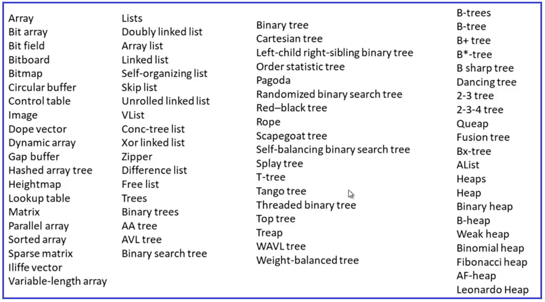
In today’s world, there are more than 500 to 600 known data structures. Some of them are showing in the below diagram.

Slide 9
List as Abstract Data Type (ADT):
List -> 8, 5, 4, 9, 3, 1, 2
0 1 2 3 4 5 6
Representation of Data –
1. Space for storing element
2. Capacity (Max capacity)
3. Size (length of the list)

Slide 10

Operations on data structure:
Append | Adding a new element at the end of the
Traversing | In this we can traverse or move from one element to another element in data structure
Searching | In this, we can check whether element in data structure is present or not
Insertion | In this, we can add or insert new element in data structure
Deletion | In this, we can delete or remove existing element from data structure
Sorting | In this, we can arrange elements of data structure in ascending or descending order
Merging | In this, we can join or merge 2 or more data structures.

Slide 11
Stack:
A Stack is a linear data structure that follows the LIFO (Last-In-First-Out) principle.
It contains only one pointer TOP pointing to the topmost element of the stack.
Whenever an element is added in the stack, it is added on the top of the stack, and only the top element can be deleted from the stack.
Insertion of new element into stack is called as PUSH operation, whereas deletion of existing element from stack is called as POP operation
PEEK operation represents retrieving topmost element from stack
While pushing element into stack we need to check “Stack Overflow” condition and while popping element from stack we need to check “Stack Underflow” condition

Slide 12
Example: ADT of Stack
PUSH Operation
Let ‘s’ is the stack with size ‘N’ and ‘x’ be the element inserted in a stack
if(top==N-1)
print “Stack Overflow”
else
top=top+1 s[top]=x

Slide 13
POP Operation
Let ‘s’ is the stack with size ‘N’ if(top== -1)
print “Stack Underflow”
else
x=s[top] top=top-1
print “x as deleted element”

Slide 14
Program:
Write a program to implement stack using array to perform following operations on stack
Push new element into stack
Pop existing element from stack
Peek topmost element from stack
Display contents of stack

Slide 15
Applications of Stack
Reversing a list
Parentheses checker
Conversion of an infix expression into a postfix expression
Evaluation of a postfix expression
Conversion of an infix expression into a prefix expression Evaluation of a prefix expression
Recursion

Slide 16
Application of Stack:
Reversing a String:
While reversing a string, we can push different characters of string into stack and after pushing all characters, we start popping every character from stack one by one, to get reverse of string
Example:
Number Conversion:
Stack is also used to convert decimal number to binary or octal or hexadecimal. In that case we need to store all reminders into stack and at the end pop all reminders from stack to get appropriate converted value of decimal number
Example:

Slide 17
Recursion:
When a function calls itself repeatedly, it is called as “Recursion”.
Recursive functions use something called “the call stack.” When a program calls a function, that function goes on top of the call stack. Then, when termination condition meets the values take off from top of stack.
Example:

Slide 18
Checking Correctness of Parenthesis:
A stack is a very effective data structure for evaluating arithmetic expressions for checking correctness of parenthesis in programming languages.
In addition to operands and operators, the arithmetic expression may also include parenthesis like "left parenthesis" and "right parenthesis". When left parenthesis occurs, we can push it into stack and when right parenthesis occurs, we can pop left parenthesis to check correctness.
Example: A + (B - C)
Program:
Write a program to check correctness of parenthesis of input expression using stack

Slide 19
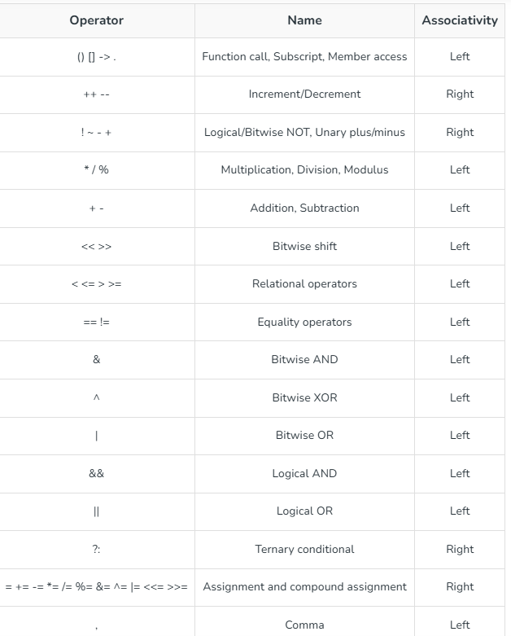

Slide 20
Polish Notation:
Stack is used to convert and evaluate following 3 types notations:
Infix Notation: In this, operator is used in between operands Example: A+B
Prefix Notation: In this, operator is used before operands Example: +AB
Postfix Notation: In this, operator is used after operands Example: AB+

Slide 21
Infix to Postfix Conversion:
A + B * C
M * N – J + K
Q – J * A + D / F – M * R M * J – (N + D ) / F * W + Z

Slide 22
Algorithm:
Scan the expression from left to right
If operand is encountered, then add it to the postfix expression
If left parenthesis ‘(’ encountered, then push it into the stack
If operator encountered then repeatedly pop element from stack and add it to postfix, if incoming operator has less than or equal priority than stack top and add incoming operator to stack
If right parenthesis ‘)’ encountered, then repeatedly pop element from stack and add it to postfix till left parenthesis ‘(’ encounters and remove left parenthesis.

Slide 23
M * J - ( N + D ) / F * W + Z
Infix | Stack | Postfix
M
*
J
-
(
N
+
D
)
/
F
*
W
+
Z
▪

Slide 24
Evaluation of Postfix Expression:
Algorithm:
Scan expression from left to right
If operand encounters, add it to the stack
If operator encounters, then:
Pop two operands from stack and perform the operation
Push the result into the stack

Slide 25
Queue:
A Queue is a linear data structure that follows the FIFO (First-In-First-Out) principle.
It contains two pointers i.e., front and rear
Whenever an element is added in the queue, it is added from rear end and an element can be deleted from front end
Insertion of new element into queue is called as ENQUEUE operation, whereas deletion of existing element from queue is called as DEQUEUE operation
While pushing element into queue we need to check “Queue Overflow” condition and
while deleting element from queue we need to check “Queue Underflow” condition

Slide 26
Example: ADT of Queue
ENQUEUE Operation
Let ‘q’ is the queue with size ‘N’ and ‘x’ be the element inserted in a queue
if(rear==N-1)
print “Queue Overflow”
else
rear=rear+1 q[rear]=x

Slide 27
DEQUEUE Operation
Let ‘q’ is the queue with size ‘N’ if(front==rear+1)
print “Queue Underflow”
else
x=q[front] front=front+1
print “x as deleted element”

Slide 28
Program:
Write a program to implement queue using array to perform following operations on queue
Insert new element into queue
Delete existing element from queue
Display contents of queue

Slide 29
Circular Queue:
There was one limitation in the array implementation of Queue.
If the rear reaches to the end position of the Queue, then there might be possibility that some vacant spaces are left in the beginning which cannot be utilized.
So, to overcome such limitations, the concept of the circular queue was introduced.
A circular queue is similar to a linear queue as it is also based on the FIFO (First In First Out) principle except that the last position is connected to the first position in a circular queue that forms a circle.
It is also known as a Ring Buffer.

Slide 30
Program:
Write a program to implement circular following operations:
Insert new element into queue
Delete existing element from queue
Display contents of queue
queue to perform

Slide 31
Priority Queue:
It is a special type of queue in which elements will be processed based on their priority It has 2 types:
Ascending priority queue: In this processing of elements of queue will be done in lower to higher priority
Descending priority queue: In this processing of elements of queue will be done in higher to lower priority
Normally we use Descending priority queue in which element with higher priority will be processed before element with lower priority
If 2 or more elements have same priority then they will be processed in FIFO manner
and if priority is not mentioned then, value of element will be considered as its priority.

Slide 32
Double Ended Queue (DEQUE):
Deque is a linear data structure in which the insertion and deletion operations are performed from both ends.
There are two types of DEQUE:
Input-restricted queue:
In input-restricted queue, the insertion is applied to one end while the deletion is applied from both the ends.
Output-restricted queue:
In an output-restricted queue, the deletion can be applied only from one end, whereas the insertion is possible from both ends.

Slide 33
Linked list/ Linear linked list/ Singly linked list:
A linked list is a linear of data structures, which contains different “nodes”, and they are connected via links.
Every node of linked list contains following:
Data: It represents data of that current node Next: It represents address of next node
Linked list can be accessed by “head” pointer which points to starting node of linked list.
The “next” part of last node is always “NULL” in linear linked list

Slide 34
Program:
Write a program to implement linear linked list to perform following operations:
Insert new node at beginning
Insert new node at end
Insert new node at specific position
Delete node from beginning
Delete node from end
Delete node from specific position
Count number of nodes
Search particular node
Sort linked list
Reverse the list
Display all nodes of linked list

Slide 35
Doubly Linked List:
A doubly linked list is a linear of data structures, which an be accessed in both directions i.e., forward as well as backward direction.
Every node of linked list contains following:
Data: It represents data of that current node Next: It represents address of next node Prev: It represents address of previous node
Linked list can be accessed by “start” pointer which points to starting node of linked
list.
The “next” part of last node and previous part of starting node is always “NULL” in doubly linked list

Slide 36
Program:
Write a program to implement doubly linked list to perform following operations:
Insert new node at beginning
Insert new node at end
Insert new node at specific position
Delete node from beginning
Delete node from end
Delete node from specific position
Display all nodes of linked list

Slide 37
Circular Linked List:
In a circular Singly linked list, the last node of the list contains a pointer to the first node of the list, it means the last node’s next pointer stores the address of first node of the linked list.
The circular liked list has no beginning and no ending. There is no null value present in the next part of any of the nodes.
Normally circular linked list will be accessed using last pointer which points to last node of circular linked list, so that insertion and deletion operations will become easier at beginning as well as at the end

Slide 38
Program:
Write a program to implement circular linked list to perform following operations:
Insert new node at beginning
Insert new node at end
Delete node from beginning
Delete node from end
Display all nodes of linked list

Slide 39
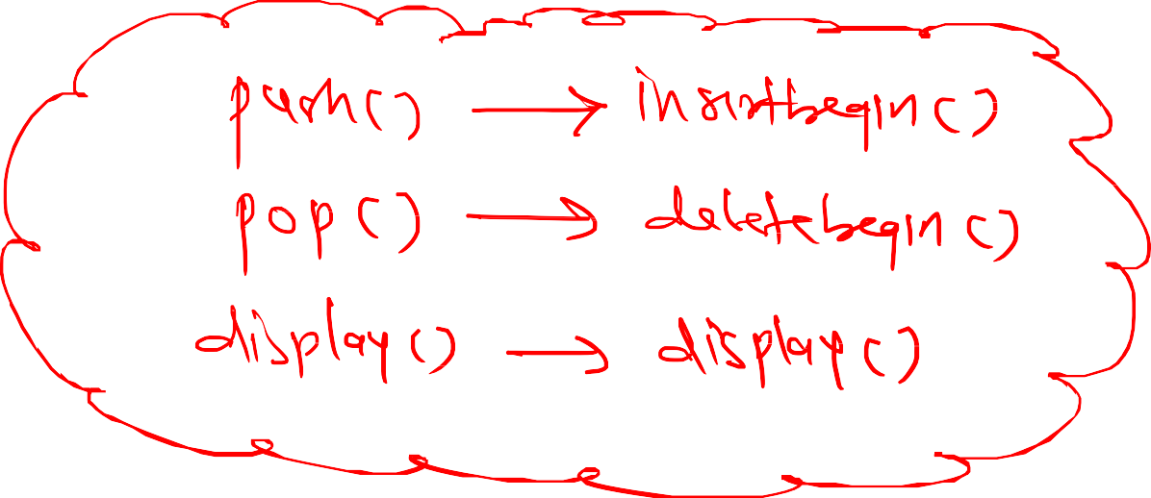
Program:
Write a program to implement stack using linked list
OR
Write a program to perform linked list implement of stack

Slide 40
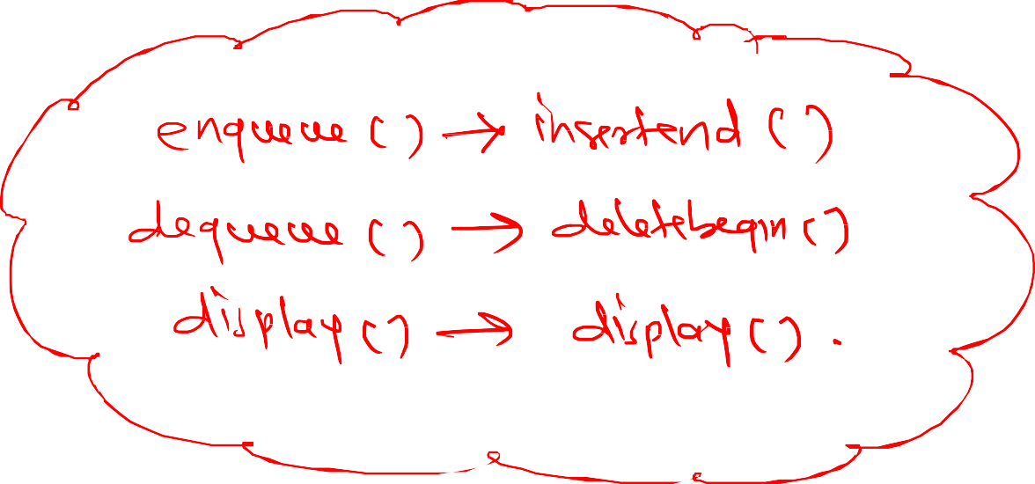
Program:
Write a program to implement queue using linked list
OR
Write a program to perform linked list implement of queue

Slide 41

Graph:
A graph (G) is non-linear data structure which comprises of set of vertices V(G) and set of edges E(G) which are used to connect those vertices. Here G=(V, E)

Slide 42

Following are different types of graph:
1. Undirected Graph:
If different edges of graph do not have any direction, then it is called as Undirected graph

Slide 43

2. Directed Graph:
If different edges of graph are having direction, then it is called as Directed graph

Slide 44

3. Complete Graph:
It is an undirected graph, in which every vertex has an edge to all other vertices. A Complete graph with N vertices has N*(N-1)/2 edges.

Slide 45

4. Weighted Graph:
If all edges are assigned some integer value, then it is called as Weighted graph

Slide 46
Representation of Graph:
A graph can be represented in computer memory using following 2 ways:
1. Sequential Representation (Array Representation):
In this, we represent a graph with the help of square matrix, having same order as that of number of vertices. Such matrix is called as “Adjacency Matrix (A)” and the matrix is formed as:
1, if there is edge between i to j
Aij
0, if there is no edge between i to j

Slide 47
2. Linked Representation (Adjacency List):
Here, a graph can be represented using linked list. A linked list contains different headers (start), same as that of different vertices of graph. Each header is connected to its adjacency list nodes for linked representation

Slide 48
Graph Traversal:
We can perform traversal of graph using following 2 techniques:
1. Depth First Search (DFS):
Algorithm:
Push starting node A into stack
Repeat step 3 and 4 until stack is empty
Pop the top node i.e., ‘n’ and process it
Push all the neighbors of ‘n’ into stack which are not visited
Stop

Slide 49
Program:
Write a program to implement DFS traversal

Slide 50
Breadth First Search (BFS):
Algorithm:
Insert starting node A into queue
Repeat step 3 and 4 until queue is empty
Delete the front node i.e., ‘n’ and process it
Insert all the neighbors of ‘n’ into queue which are not visited
Stop

Slide 51
Program:
Write a program to implement BFS traversal

Slide 52
Hashing:
It is a mechanism using which we can store data inside a particular storage
In this, the data which is to be stored is called as Key(K) and we need to store different keys inside a table called as Hash Table
In hashing, we need to apply different hash functions h(K) on different keys, which gives Hash Value on which we need to store a key inside hash table

Slide 53
Hash Functions/ Hashing Methods
Following are different types of hash functions which are used to provide hash value
1. Modulo-Division Method (Remainder Method):
Here, we calculate hash value using following formula:
h(K)=K mod N, where N represents size of hash table and normally kept as prime number
Example: K1=11 and K2=12 Suppose N=3 h(K1)=11%3=2 h(K2)=12%3=0

Slide 54
2. Mid-square Method:
In this, we find the square of a key and consider middle digits of a square as hash value Example: K1=11 and K2=12
𝐾1² =121
𝐾2² =144
3. Folding Method:
h(K1)=2
h(K2)=4
In this, we divide all digits of key into different folds, then we need to add all folds and the result of addition (ignoring carry) can be considered as hash value
Example: K1=123456789 and let Fold size=3 123
456
789
1368 h(K1)=368

Slide 55
Collision Resolution Techniques:
A. Open Addressing:
It has 2 types:
1. Linear Probing:
In this, if collision occurs, then the hash value will be computed using: h(K,i)=(K+i)%N
Here,
h: Hash function K: Key
i: Number of collision N: Size of hash table

Slide 56
2. Quadratic Probing:
In this, if collision occurs, then the hash value will be computed using: h(K,i)=[h1(K)+C1*i+C2*i²]%N
Here,
h, h1: Hash functions K: Key
i: Number of collision N: Size of hash table h1(K): K mod N
C1, C2: Constants where C1, C2 < N and C1, C2 != 0

Slide 57
B. Rehashing or Double Hashing:
In this, if collision occurs, then the hash value will be computed using: h(K,i)=[h1(K)+i*h2(K)]%N
Here,
h,h1,h2: Hash functions K: Key
i: Number of collision
N: Size of hash table h1(K): K mod N
h2(K): K mod N’ choose N’=N-1 or N-2

Slide 58

Tree:
A tree is non-linear data structure, in which data can be represented in the form of nodes. A tree can contain root node, intermediate node as well as leaf node.

Slide 59


Binary Tree:
It is a type of tree in which every node should have maximum 2 children. It is also defined as a tree in which every node can be classified into root node, left subtree or right subtree.

Slide 60
Representation of Tree:
A tree can be represented in computer memory using following 2 ways:
1. Sequential Representation (Array Representation):
In this, we represent a tree with the help of single dimensional array.
In this, a root node at level 0 is assigned a sequence number 0 and then nodes at level 1 are assigned sequence number in ascending order from left to right and so on.

Slide 61
2. Linked Representation:
Here, a tree can be represented using linked list. A linked list contains different nodes having two pointers i.e., left and right
left pointer stores the address of left child of a node where right stores the address of right child of a node

Slide 62
Traversal in binary tree:
In binary tree, we can perform traversal i.e., visiting different nodes using following techniques:
Inorder traversal (LVR)
Preorder traversal (VLR)
Postorder traversal (LRV)

Slide 63
Applications of tree:
1. Expression tree:
We can create a binary tree for any given expression
In this, the operator of the expression will become parent node, left operand form left sub tree whereas right operand form right sub tree
While creating expression tree, we also need to consider the priority of operators, it means higher priority operators will get converted to expression tree prior to lower priority operators
It is the application of binary tree and hence every node should have maximum 2 children

Slide 64
2. Huffman tree:
Huffman encoding is mainly used to compress text using lossless compression techniques
To perform Huffman encoding on any input, we need to find the frequency of occurrence of every character in a text
The main idea is a character with high frequency should get replaced with less number of bits and a character with low frequency should get replaced with more number of bits

Slide 65
Algorithm:
Create a leaf node for each character at the character along with its frequency of occurrence in priority queue
Repeat step 3 to 5 till total number of nodes in a queue is greater than or equal to one node
Remove two nodes that have lowest frequency
Create a new node by merging two nodes with frequency equal to sum of two node frequency
Add newly created node to the primary queue
Reverse the process till we get individual character as leaf node, assign value 0 to left subtree and 1 to right subtree.
Read characters from root node to leaf nodes to generate Huffman tree

Slide 66
Binary Search Tree (BST):
It is a type of binary tree where the value of left child of node is less than or equal to its parent node whereas value of right child node is greater than its parent node. When we apply inorder traversal on BST we will get all elements in ascending order.

Slide 67
Creating BST: Inputs: 7 24
16 44 3 2 20

Slide 68
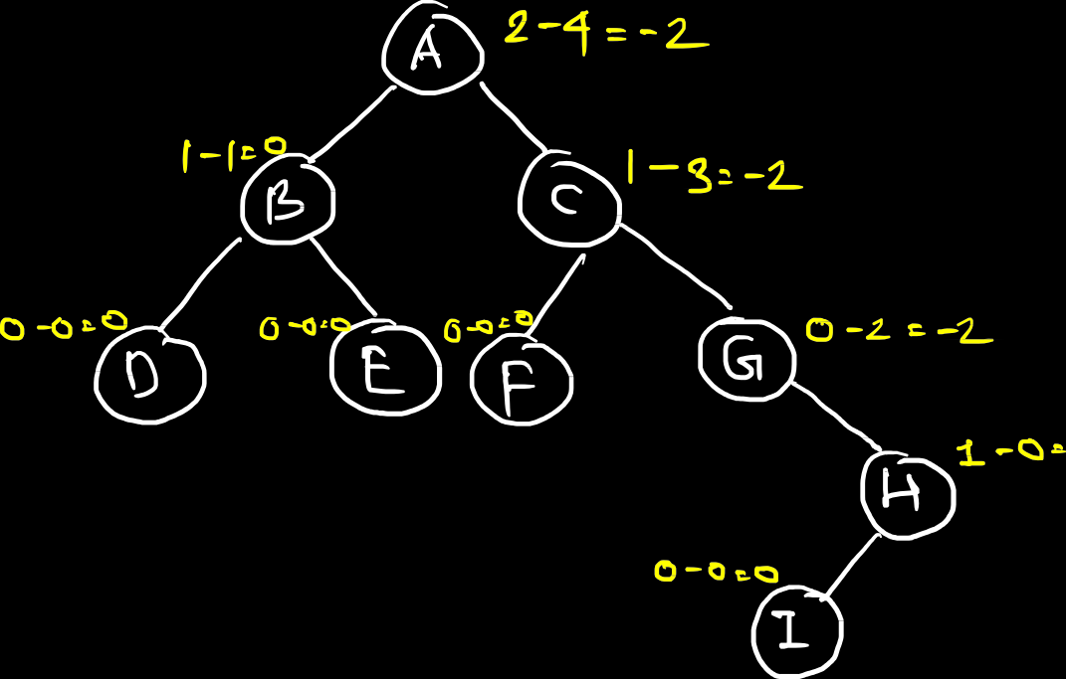
AVL Tree:
It is also called as Height Balanced tree
It is a special type of binary search tree, in which every node is height balanced i.e., height of every node should be in the range of {-1 , 0 , 1} The height of node is the subtraction of height of left sub tree with height
of right sub tree
H=HL-HR

Slide 69
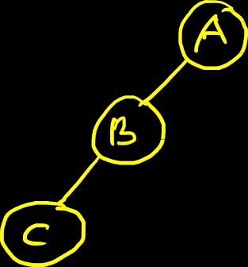
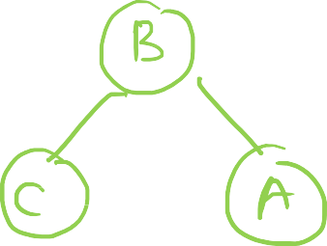

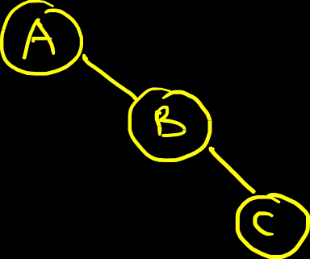
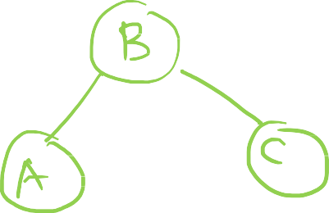

Many of times, different nodes do not fulfil the property of AVL tree, in that case we need to perform different rotations to convert it into AVL tree.
There are 4 types of rotations:
LL Rotation
RR Rotation

Slide 70
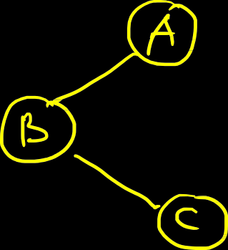
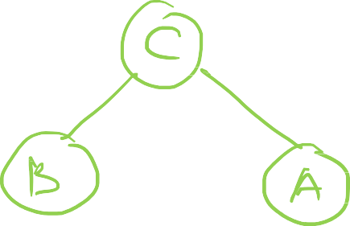

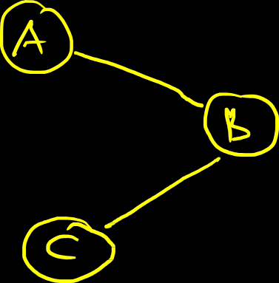
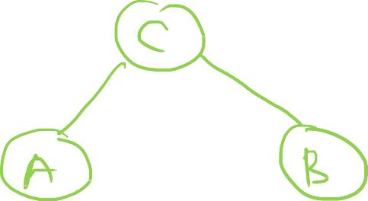

3. LR Rotation
2. RL Rotation

Slide 71
Create AVL tree for following inputs:
37 55 18 25 68 10 43 50 40 46 52 60

Slide 72
Create AVL tree for following inputs:
44 17 32 78 50 88 48 62 54

