Slide 1

MCA Final Year Project Title: Heart Disease Prediction using ML
Student Name: Yashwanth Honnatter
Register Number: 22P01093
Guide Name: Mrs. Veena S Badiger

Slide 2
CONTENTS
1.Abstract
2.Introduction
3.Present and proposed system
4.Tools
5.Requirements
6.Module description
7.System design
8.Screen shots
9.Future enhancement
10.Conclusion

Slide 3
1.Abstract
The Heart Disease Prediction project addresses the rising prevalence of heart disease by offering a user-friendly web-based application that allows individuals to assess their risk of developing heart disease. Built using Python frameworks like Flask and Streamlit, the app ensures secure user registration, leveraging data privacy techniques. Users input health metrics, which are analyzed by a machine learning model (logistic regression or decision trees) to predict their heart disease risk. Immediate feedback and personalized recommendations promote proactive health measures. The project emphasizes data security, usability, and future enhancements, aiming to improve public health outcomes through technology-driven insights and predictions.

Slide 4
2. Introduction
Cardiovascular Diseases (CVDs): CVDs are the leading cause of global mortality, accounting for 17.9 million deaths annually, with risk factors including unhealthy lifestyles, genetic predisposition, and delayed detection.
Project Overview: "Health Assistant: A Heart Disease Prediction and Prevention System" is a web-based application using machine learning to predict heart disease risk based on health parameters like age, blood pressure, and cholesterol levels.
Preventive Focus: The system not only predicts risk but also offers personalized health recommendations to help users adopt heart-healthy habits and reduce CVD risk.
Technology Integration: Leveraging machine learning, the application analyzes multiple factors for personalized, real-time risk assessment, offering a more holistic approach than traditional methods.
User-Friendly Design: The application serves as a digital health assistant, providing users with accessible predictions and preventive strategies to empower proactive health management.

Slide 5
3. Present and Proposed System
Present System :
Heart disease prediction is done through doctor visits, physical exams, and medical tests.
These methods can be slow, expensive, and often give general results, not tailored to individual needs.
Access to healthcare is limited for people in remote areas, and getting results takes time, delaying necessary actions.
Proposed System: The Heart Disease Prediction and Prevention System leverages machine learning and a web-based interface to provide real-time, personalized risk assessments and tailored health recommendations. This system ensures timely interventions and improves accessibility for proactive heart health management.

Slide 6
4. Tools
NumPy==1.26.3: Used for numerical computations and array handling, essential for data manipulation and performing mathematical operations efficiently.
Python: The programming language used for developing the application, including backend logic, machine learning tasks, and web functionality.
Scikit-learn==1.3.2: Provides tools for building machine learning models (e.g., logistic regression, decision trees) used in predicting heart disease risk.
Streamlit==1.29.0: A framework for building the interactive web application, allowing real-time input and display of prediction results.
Streamlit-option-menu==0.3.6: Used for creating navigational menus in the Streamlit app, improving user experience by offering easy navigation across different sections.

Slide 7
5. Requirements
Python 3.7 or higher: The code is written in Python, so you'll need Python installed on your system.
Streamlit: For building the interactive web interface.
Pandas: For handling the data and creating input Data Frames.
Pickle: For loading the saved machine learning model.
Scikit-learn: For loading the machine learning model saved in .sav file.
Database: The code uses a basic file-based system for storing user data (username, hashed password, email).
VS Code: Recommended for Python development, with support for extensions like Python, Streamlit, and Git integration.

Slide 8
6. Module Description
Predictive Model: Utilizes machine learning algorithms to analyze health data and predict heart disease risk.
Input Features: Accepts various health metrics, including age, sex, and cholesterol levels, for personalized assessments.
Real-time Feedback: Provides immediate risk predictions, enabling users to make informed health decisions and adopt preventive measures.

Slide 9
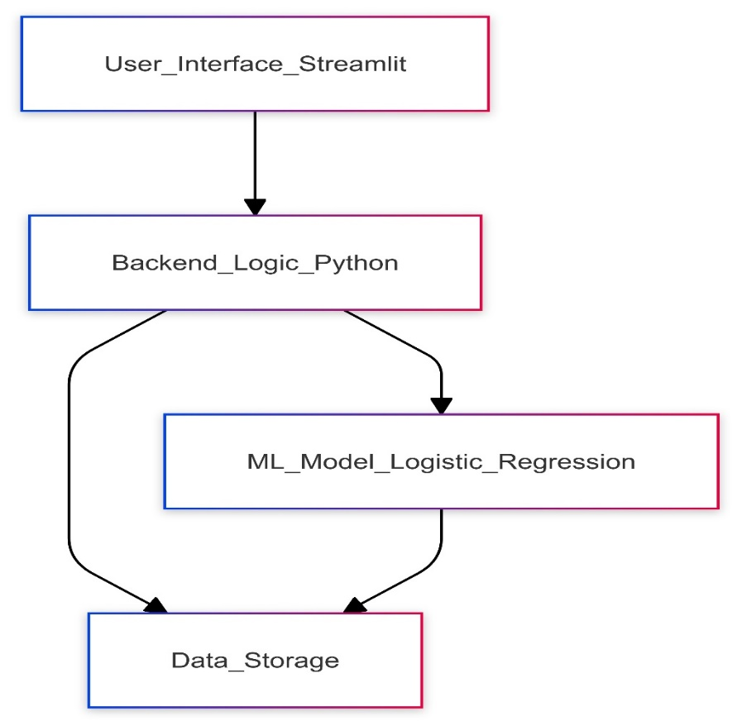
7. System Design
System Architecture: The system architecture consists of a web-based interface for user interaction, a secure backend for data processing and model prediction, and a database for storing user credentials and health information, ensuring seamless communication and efficient risk assessment..

Slide 10
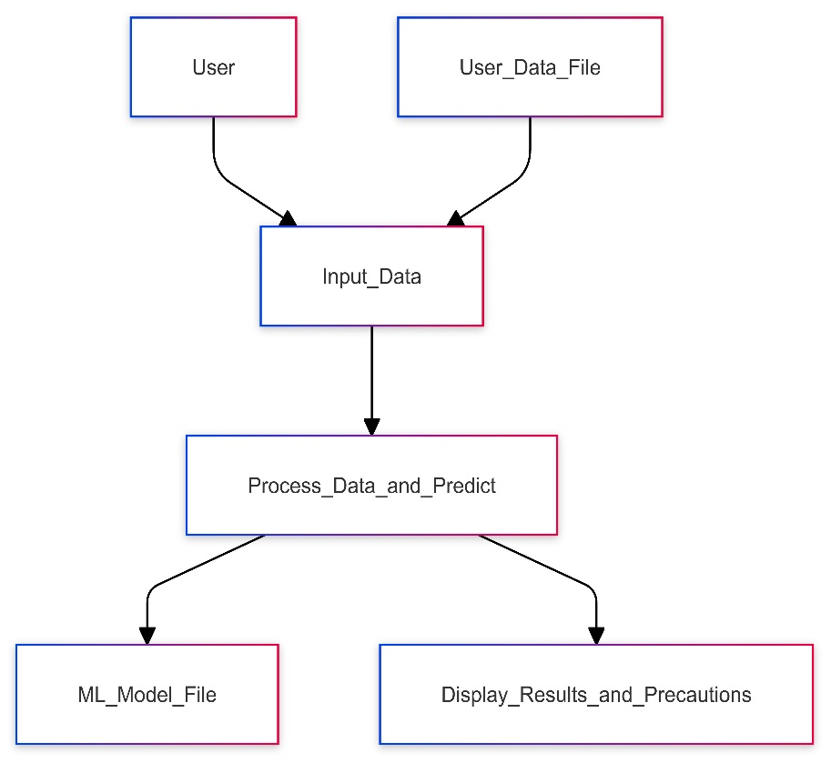
System Design
Data Flow: The Data Flow Diagram (DFD) illustrates the flow of information within the Heart Disease Prediction System, showing how user inputs, such as health metrics and credentials, are processed by the machine learning model to generate risk predictions and provide tailored health recommendations.

Slide 11
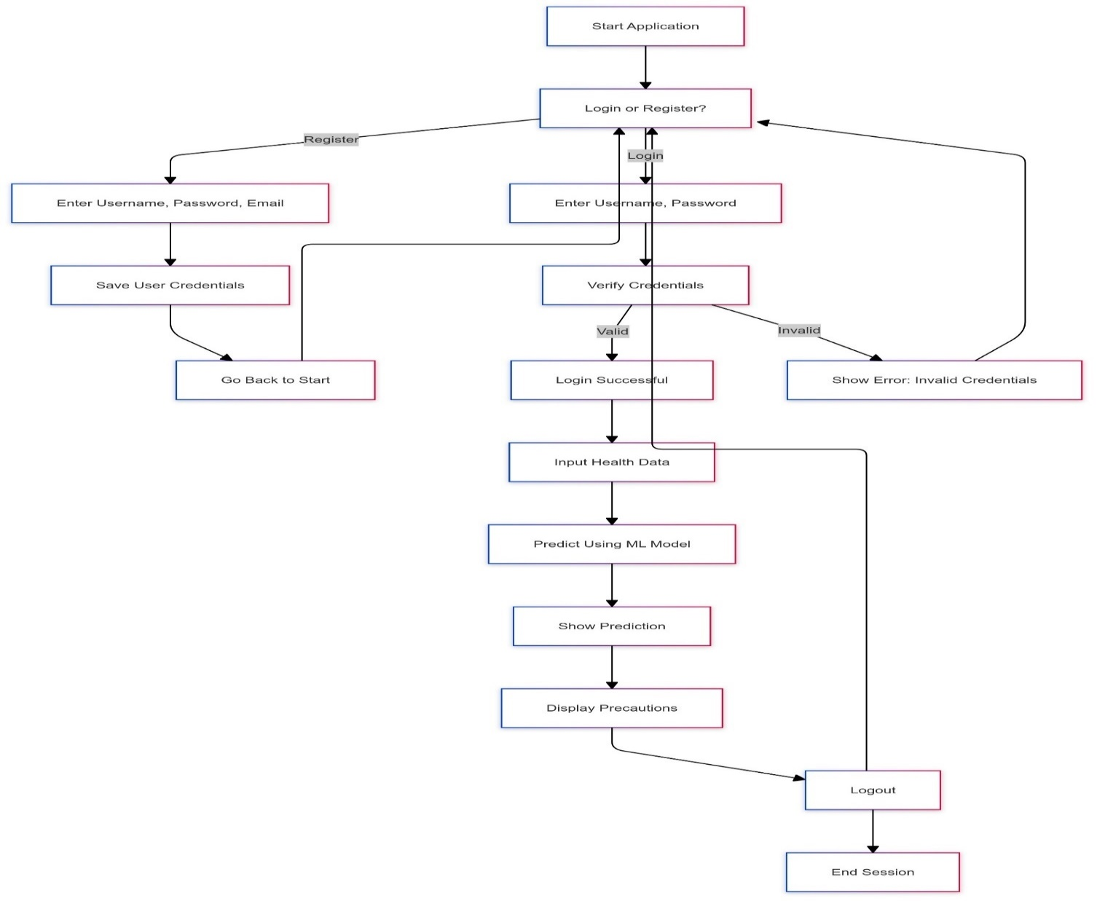
Control Flow Diagram:

Slide 12
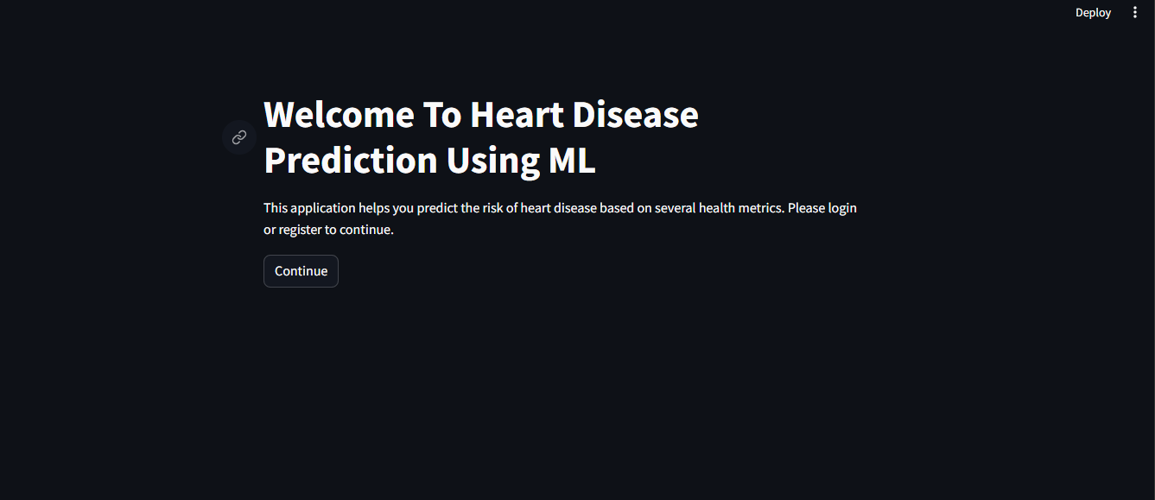
8. Screenshots
WELCOME PAGE:

Slide 13
Screenshots
HOME PAGE:

Slide 14
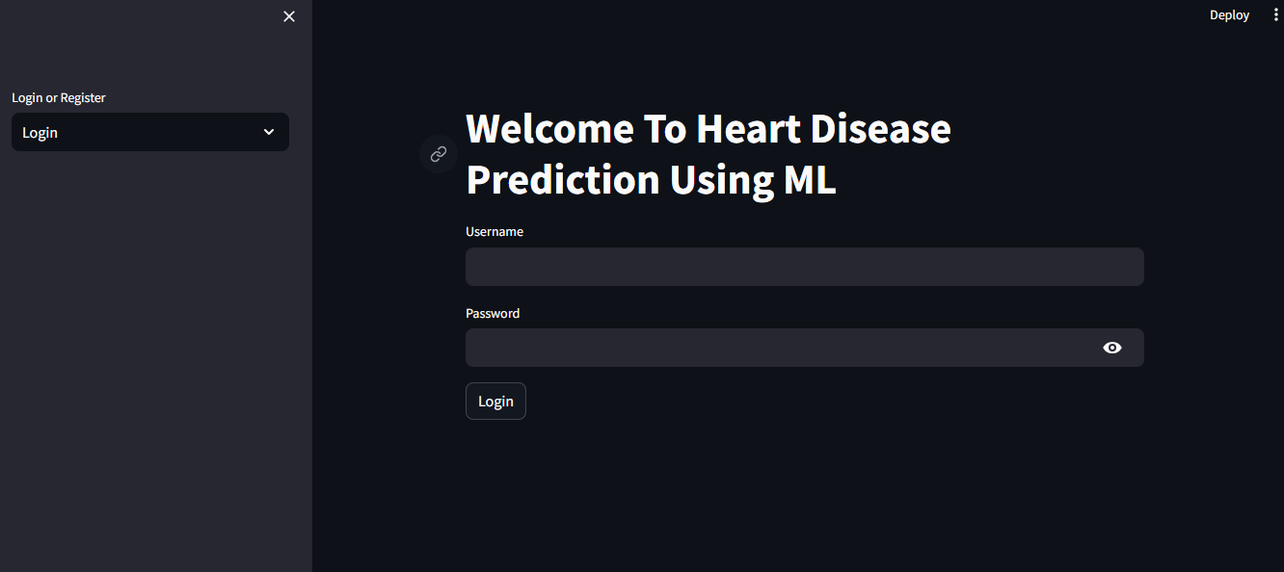
Screenshots
LOGIN PAGE:

Slide 15
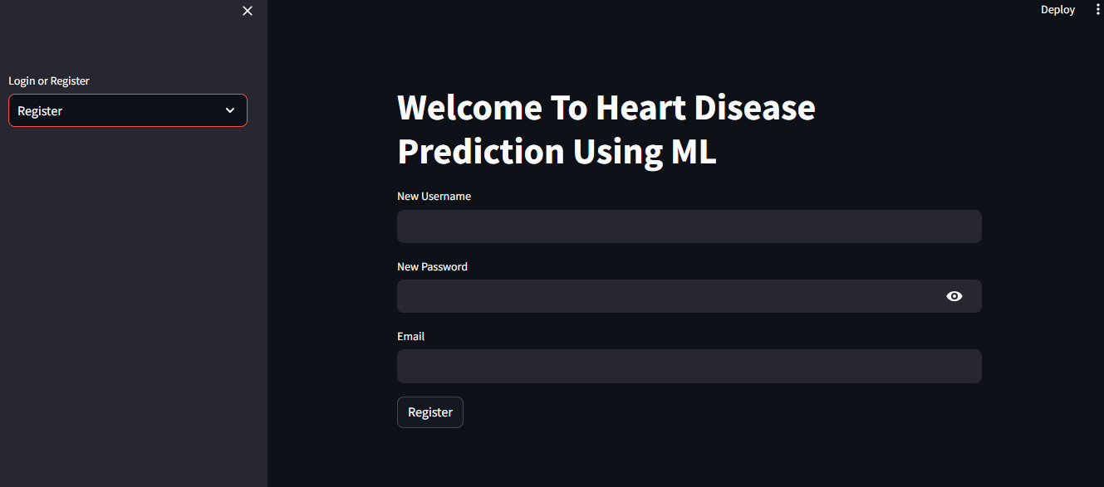
Screenshots
REGISTRATION PAGE:

Slide 16
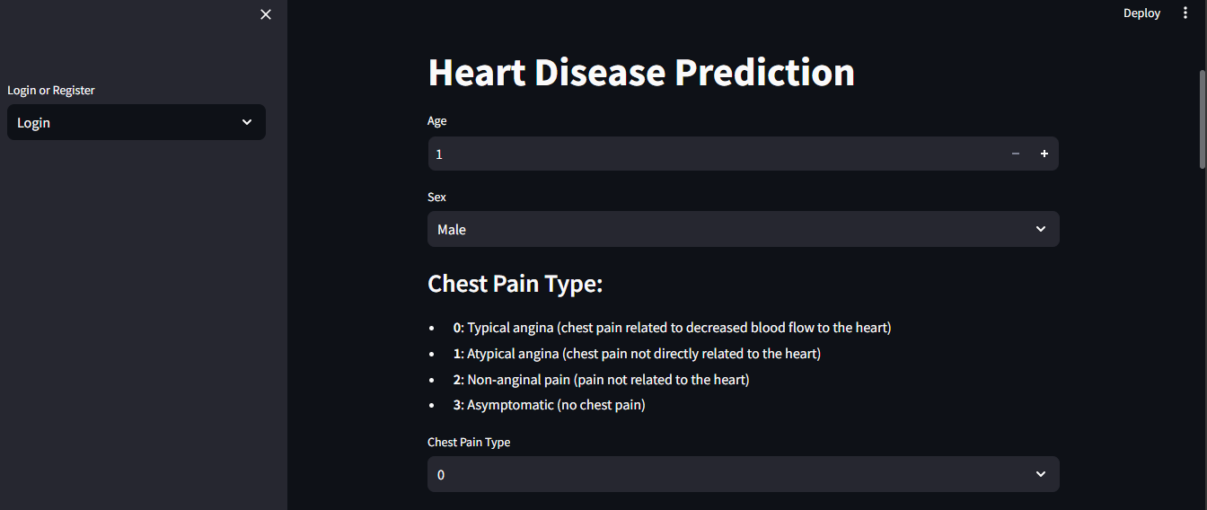
Screenshots
PREDICTION PAGE:

Slide 17
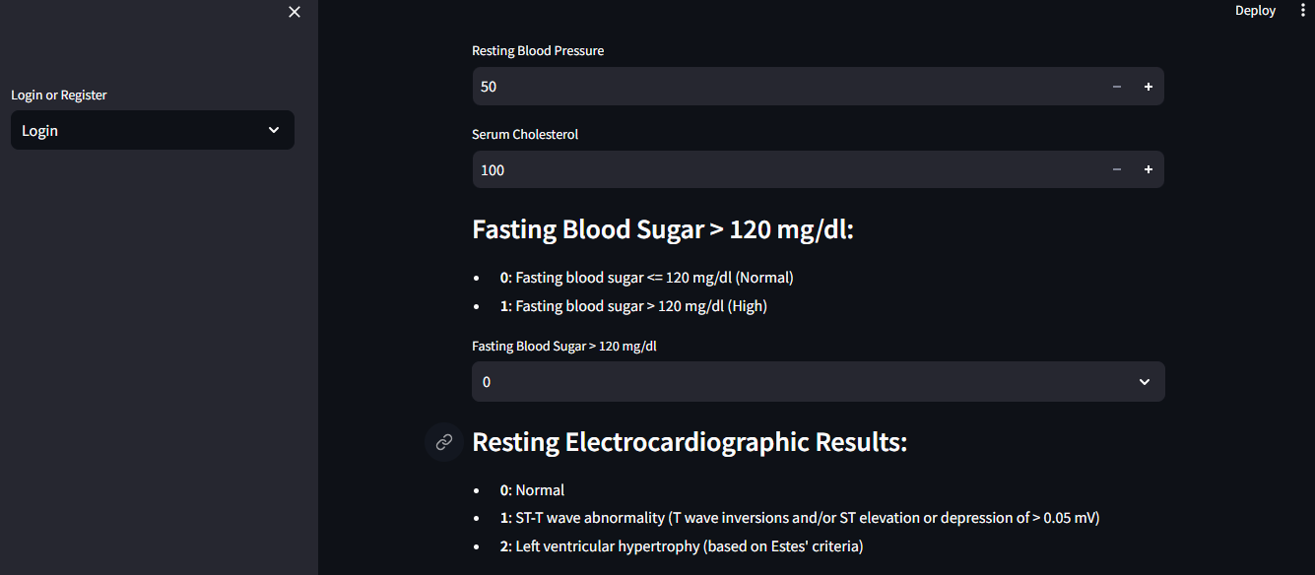
Screenshots
PREDICTION PAGE:

Slide 18
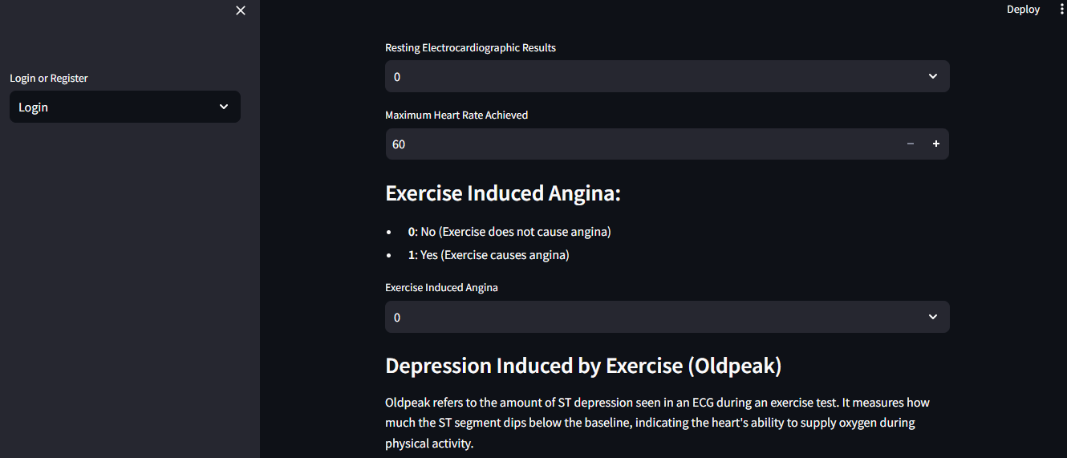
Screenshots
PREDICTION PAGE:

Slide 19
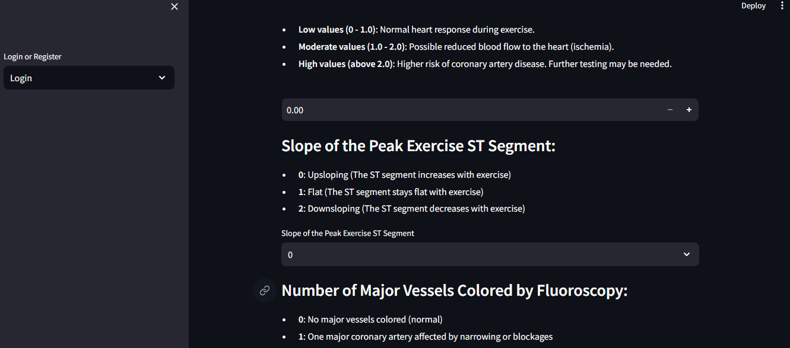
SCREENSHOT
PREDICATION PAGE:

Slide 20
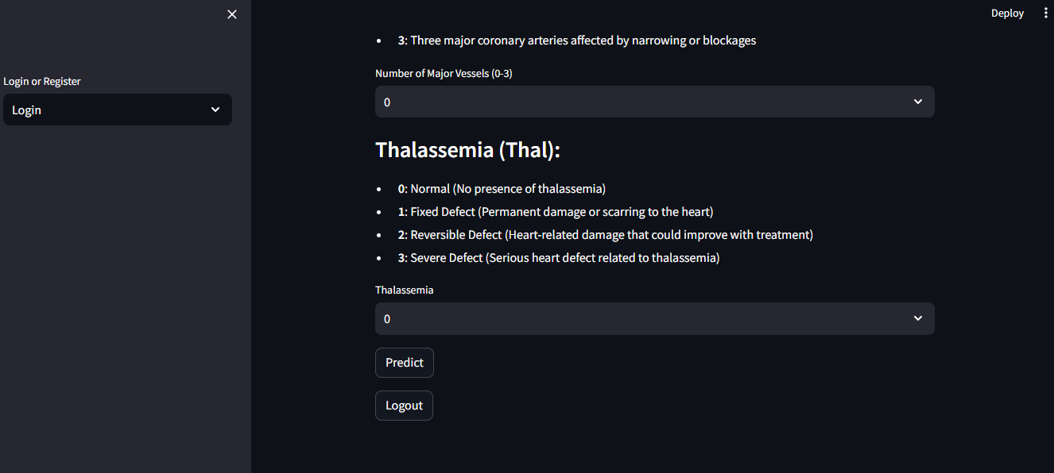
SCREENSHOT
PREDICTION PAGE

Slide 21
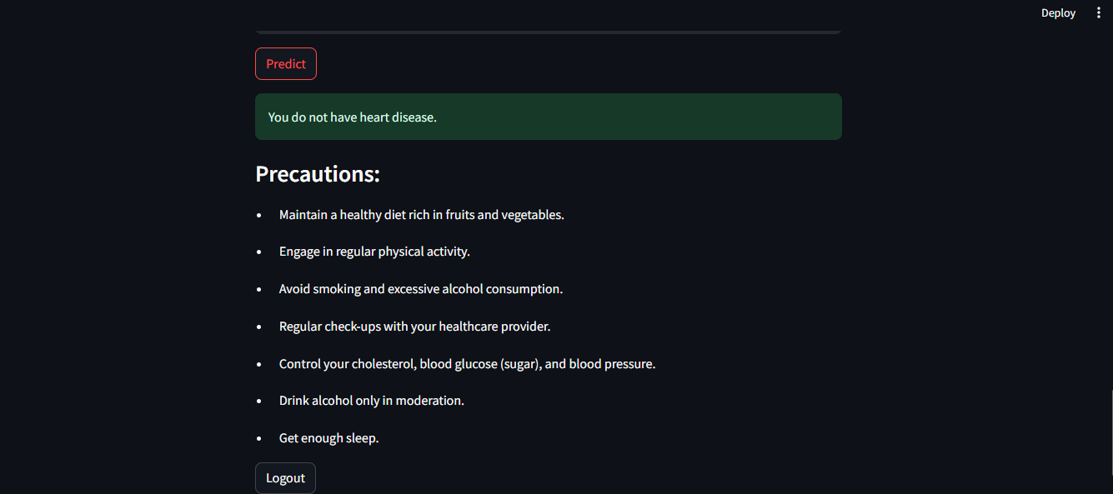
SCREENSHOT
OUTPUT PAGE

Slide 22
9. Future Enhancement
Enhanced User Authentication: Implement two-factor authentication (2FA) and a password reset option for increased security.
Improved User Interface: Develop a responsive design and visualized prediction results for better user engagement and interpretation.
Multi-Language Support: Add support for multiple languages to enhance global accessibility.
Mobile Application: Create a mobile app for Android and iOS to facilitate easy access to health predictions and tracking.
AI-Powered Chatbot: Implement a health assistant chatbot for interactive user queries and basic diagnostics.
Compliance with Healthcare Standards: Ensure HIPAA compliance for data security and privacy in healthcare settings.
Continuous Learning Model: Develop a self-learning model that improves prediction accuracy over time with new data inputs.

Slide 23
10. Conclusion
The Heart Disease Prediction project effectively leverages machine learning to provide users with personalized health assessments based on their input metrics. By integrating robust user authentication and an intuitive interface, it enhances accessibility and engagement. The application not only predicts heart disease risk but also offers tailored precautionary advice to promote proactive health management. Overall, it serves as a valuable tool for raising awareness and encouraging healthier lifestyle choices.

Slide 24
THANK YOU

