Slide 1

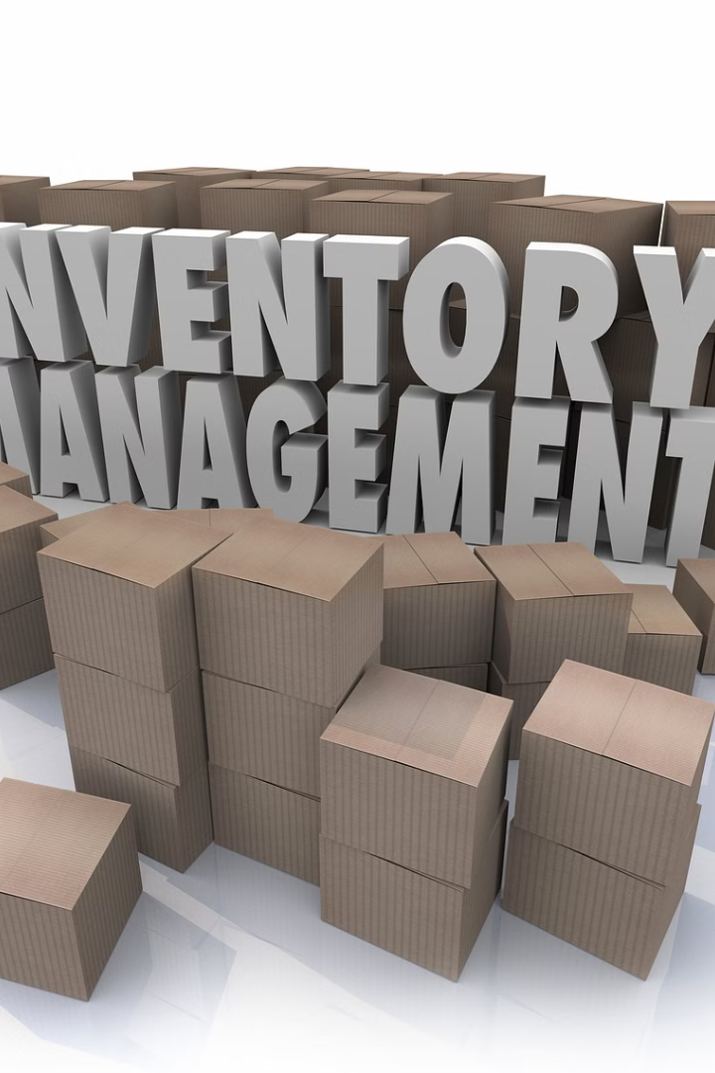
Inventory Predictions and Warehouse Distribution
Developing an AI model that provides precise inventory predictions and optimizes warehouse distribution strategies is crucial for enhancing supply chain efficiency.

Slide 2

Challenges in Current Inventory Management Systems
1
Inaccurate Predictions
2
Limited Data Visibility
3
Inefficient Warehouse Management
Current systems struggle to accurately predict inventory demands, leading to overstocking or stockouts.
Underlying data visibility issues often hamper the effectiveness of inventory management systems.
Inefficiencies in warehouse management impact the overall flow of inventory and distribution.

Slide 3
Developing an AI Model for Precise Inventory Predictions
Accurate
Efficient
Real-time
Accurate Predictions
Efficient Resource Allocation
Real-time Updates
The AI model will use advanced algorithms to provide precise predictions of inventory needs.
Constant real-time updates to inventory levels for proactive decision-making.
Optimizing the allocation of resources based on data-driven insights from the AI model.

Slide 4
Optimizing Warehouse Distribution Strategies Using AI
Automated Routing
Dynamic Inventory Allocation
Reducing Lead Time
AI will automate the route planning and optimization processes to streamline distribution.
AI will minimize lead time in warehouse operations, improving overall efficiency.
Ensuring optimal allocation of inventory within the warehouse based on demand and usage patterns.

Slide 5




Benefits of Implementing AI in Supply Chain Management
Enhanced Efficiency
AI will streamline operations, reduce errors, and enhance overall supply chain efficiency.
Cost Optimization
AI-driven strategies will optimize costs through accurate inventory predictions and efficient distribution.
Improved Customer Satisfaction
Enhanced inventory management will result in better service levels and customer satisfaction.

Slide 6

Conclusion: The Future of AI in Enhancing Supply Chain Efficiency
1
Evolution of AI
AI will continue to evolve, driving further efficiencies in supply chain operations.
2
Integration with IoT
The integration of AI with IoT will revolutionize real-time inventory and distribution management.
3
Data-Driven Decision Making
AI will lead to more data-driven, informed decisions, shaping the future of supply chain management.

Slide 7
Thank You
Team Cyberpunk _2
Leader Name:- Deepak Astaya
Member 1 :- Yash Shikhar
Member 2 :- Princy Ghetiya
Member 3 :- Mansingh Kushwah
Member 4 :- Kaushal Baghel

