Slide 1
Explore Pune
Yash Bhalerao(14415)
Pranav Pande (14479)

Slide 2
Project Title: | Explore Pune
Name Of Group Members: | 14415- Yash Bhalerao 14479- Pranav Pande
Technology Used: | HTML CSS JavaScript
Objective/Aim: | *To create a website that helps user to get Best Information about Pune to explore Pune *Provide best information about places to visit *Give information about Pune people *Detailed information About 1.Temples 2.Hotels 3.Places 4.Puneri Patya

Slide 3
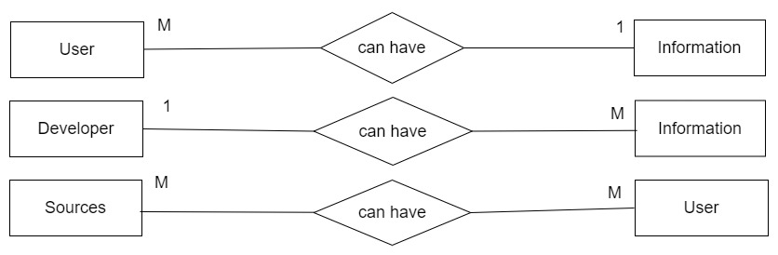
ERD:

Slide 4
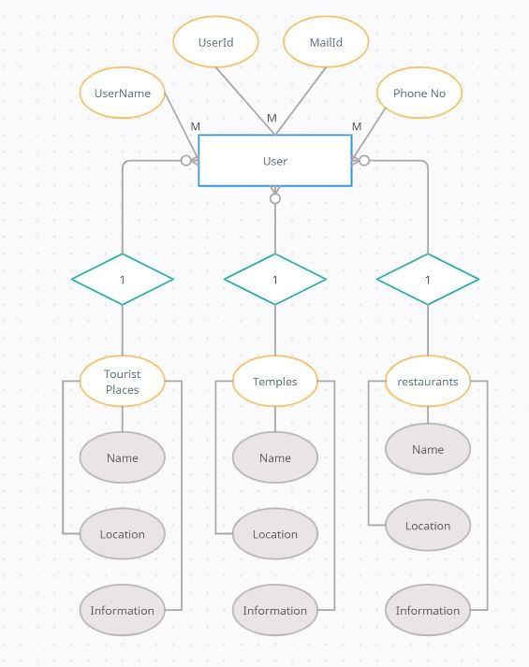
ERD:

Slide 5
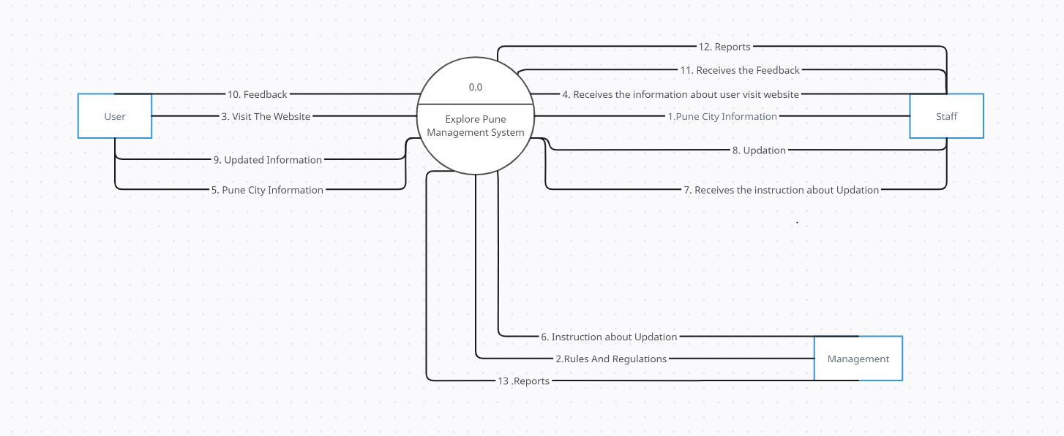
DFD:

Slide 6
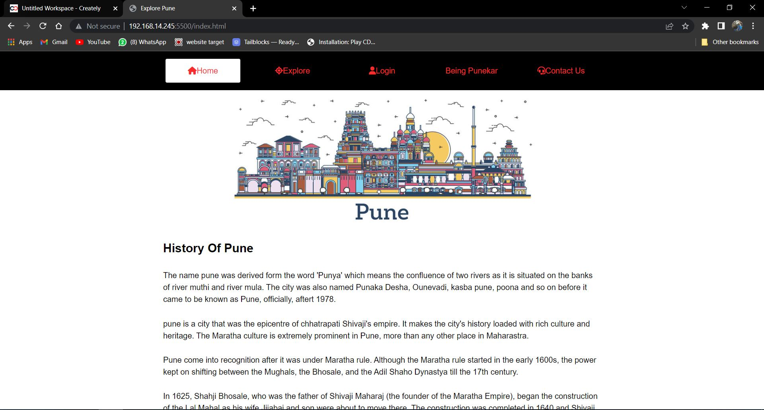
Home page:

Slide 7
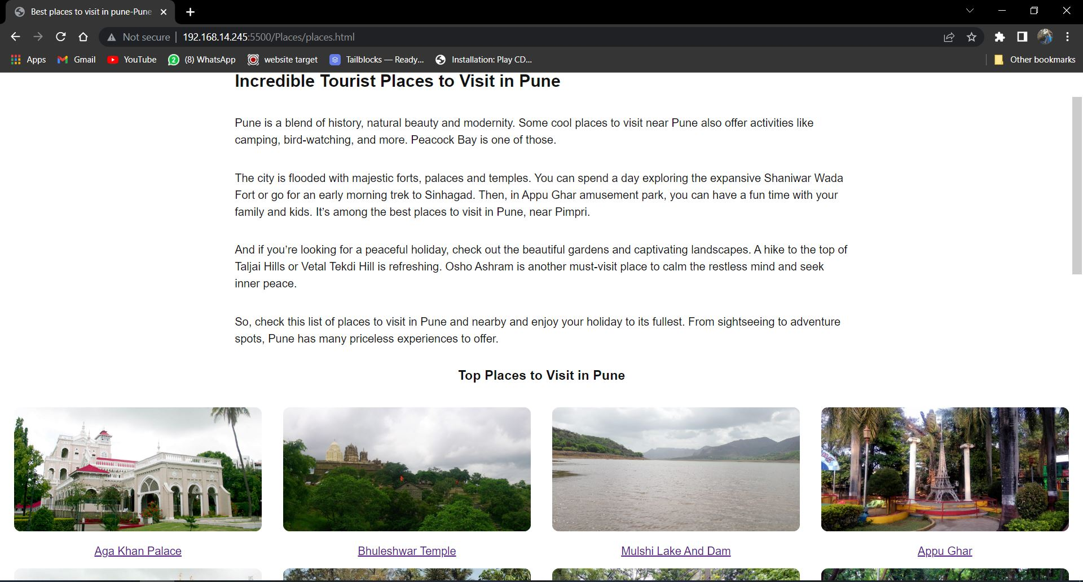
More Information Page:

Slide 8
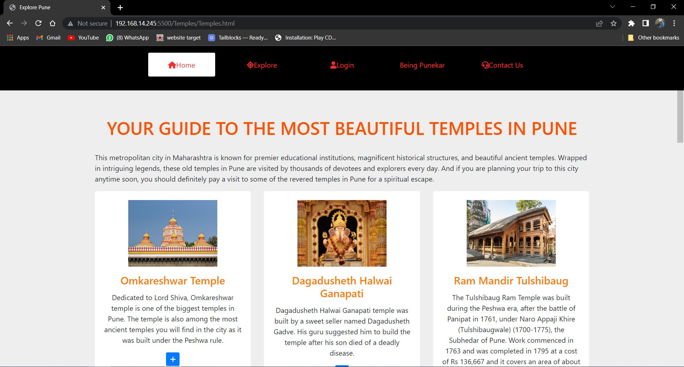

Slide 9
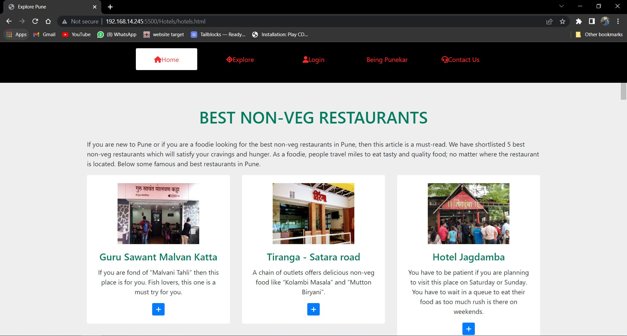

Slide 10
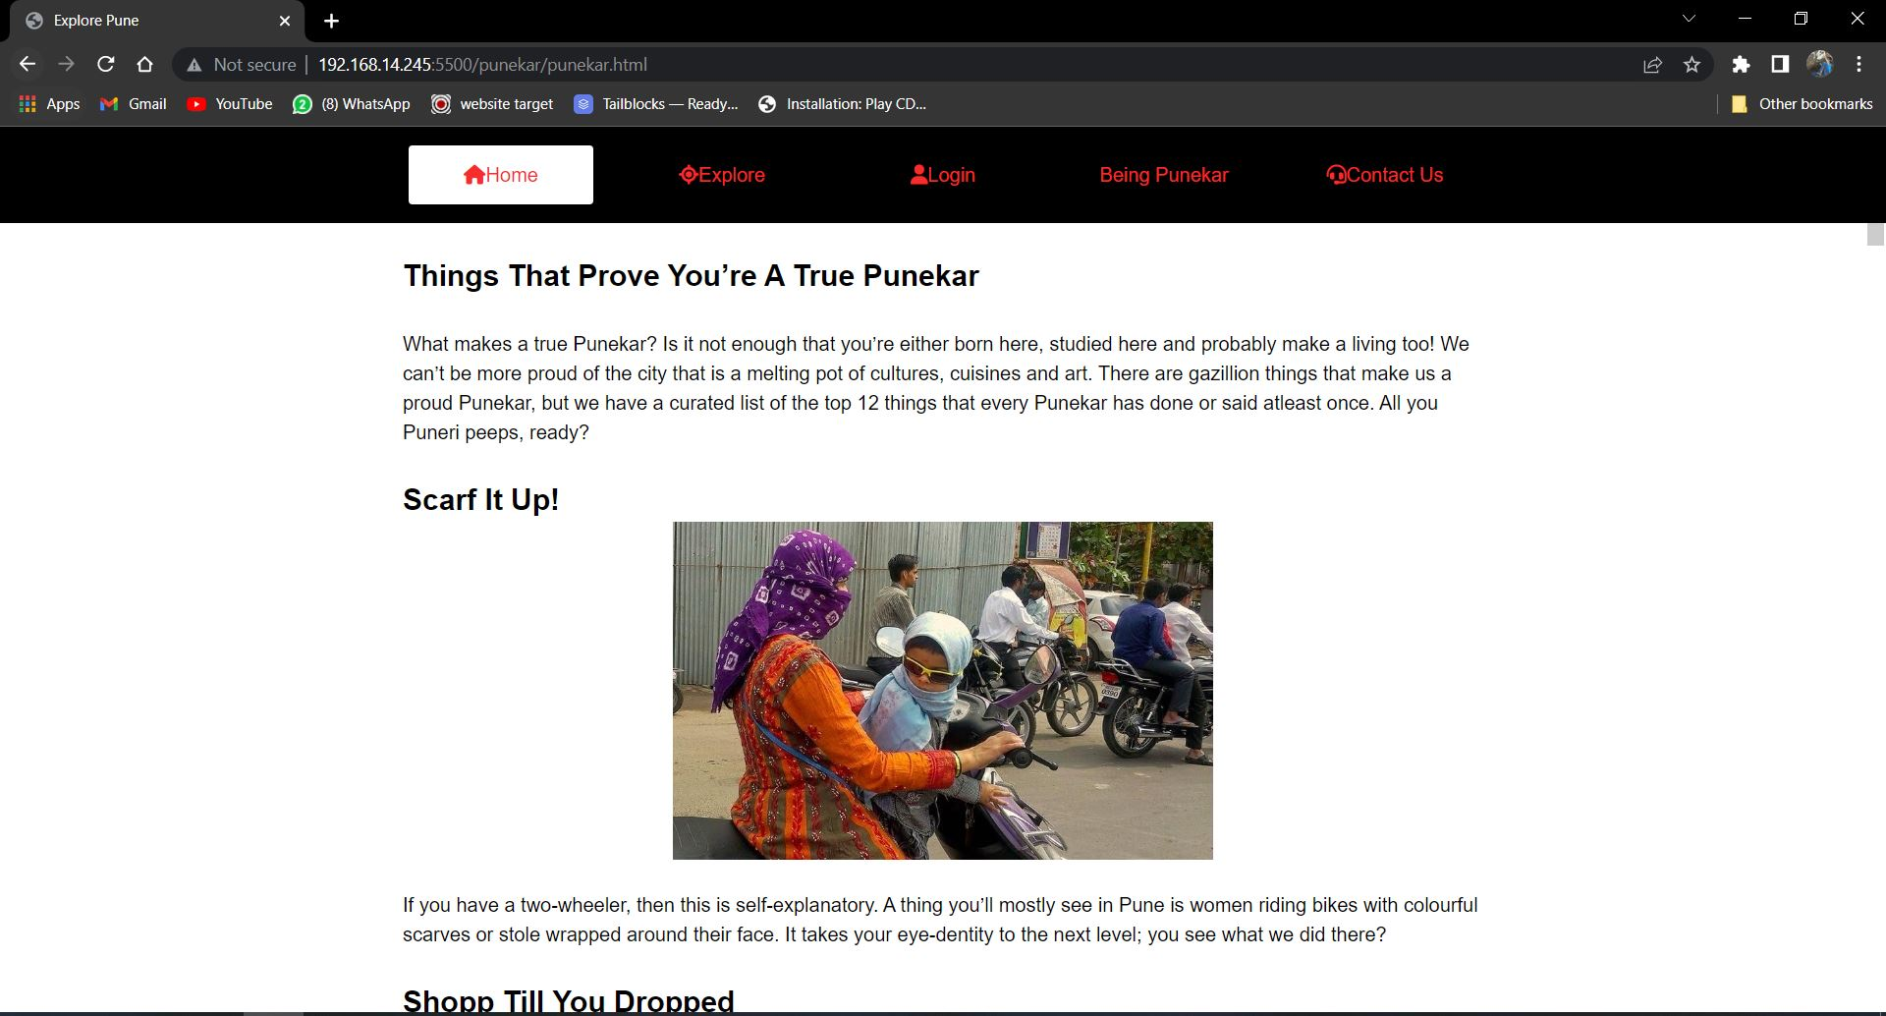
Rigveda Page:

Slide 11
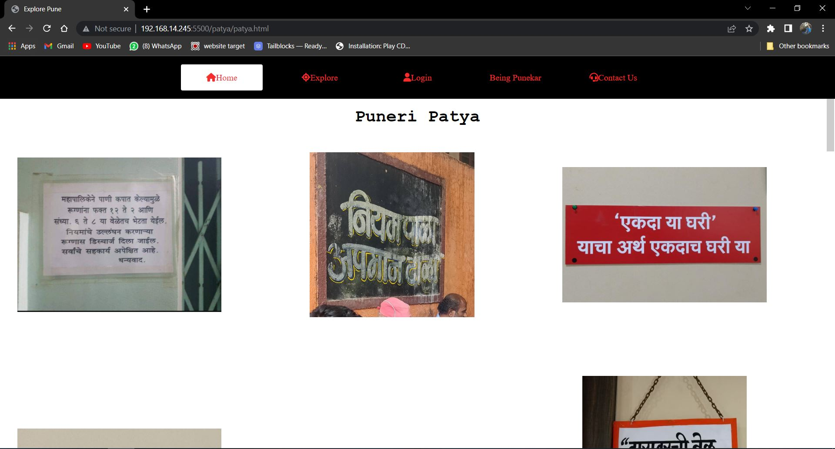

Slide 12
