Slide 1
RESUME PARSER

Slide 2



INTRODUCTION
Corporate firms and recruiting agencies have to process a large number of resumes and Working with a large volume of text data is usually time consuming and stressful.
So developing a practice that uses software to sort and store data from applicants resumes and helps hiring managers easily search for keywords, add specific search criteria to find the most qualified applicants and store resumes efficiently.

Slide 3


PROBLEM STATEMENT
People with diverse personalities come from a variety of fields and backgrounds. They've worked on a variety of projects, and each of them has unique qualifications. As a result, each resume is unique. People working in the human resources department will have to go through Hundreds of resumes on the internet. Executives summarize the resume, and then call the applicant for job counselling after obtaining the resume. An executive spent around 10-15 minutes on each resume summarizing it.

Slide 4
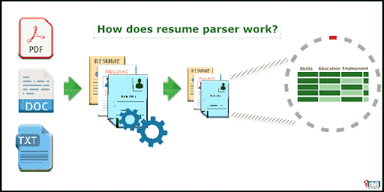


OBJECTIVES
In this project we try to develop a resume filtering mechanism for companies to hire qualified candidates.
We want to show the company that which candidate is the best fit for specific positions by finding keywords between resume and job descriptions.
Quickly sort resumes by searching for relevant keywords and qualifications automatically instead of manually searching each resume.

Slide 5



APPROACH
Using natural language processing and optical character recognition to parse information from resume files.
Python libraries, named entity recognition (NER), BERT NER and other ML based parsing techniques like keyword based & grammar based parsing techniques.

Slide 6



SCOPE OF THE PROJECT
The job market is becoming very much job-seeker-oriented, and that means you need to start thinking about your employer branding. Organizing a smooth and convenient job application process is a must.
Anyone who is in charge of hiring can benefit from adding resume parsing into their recruitment processes. The practice is widespread amongst job boards, hiring managers, internal HR teams, recruiters, and staffing firms alike.

Slide 7
EXISTING SYSTEM
EXPLANATION
Recruiters use resume parsers in order to streamline the resume and applicant screening process.
Parsing technology allows recruiters to electronically gather, store, and organize large quantities of resumes.
Once acquired, the resume data can be easily searched through and analyzed.
Resume parsing refers to the automated storage, organization and analysis of job resumes.
Resume parsing software provides companies an efficient way to identify keywords, skills, and so forth, in order to sort through large quantities of applications to identify the best applicants.

Slide 8
DRAW BACKS OF EXISTING SYSTEM
The task of interpreting language and information is extremely difficult.
Language is both highly varied and ambiguous.
The same word means different things in different contexts.
Effective resume parsing software must be smart enough to interpret the complex nuances of language.

Slide 9
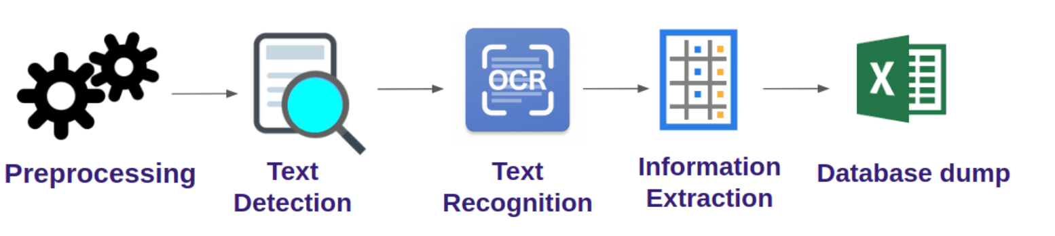
PROPOSED SYSTEM
The proposed system will give more accurate results with faster response time in an effective way and reduces the involvement of human errors while processing the text data

Slide 10
Advantages of Proposed System
Increased efficiency
Human Errors Eliminated
Quick and Easy Access to Candidate Data
Optimized Database of Resume Data
More Accurate recognition

Slide 11

METHODOLOGY
The following are some of the preprocessing steps:
1.Tokenization
2. Removing Stop words
3.Lemmatization
4. Lower casing

Slide 12
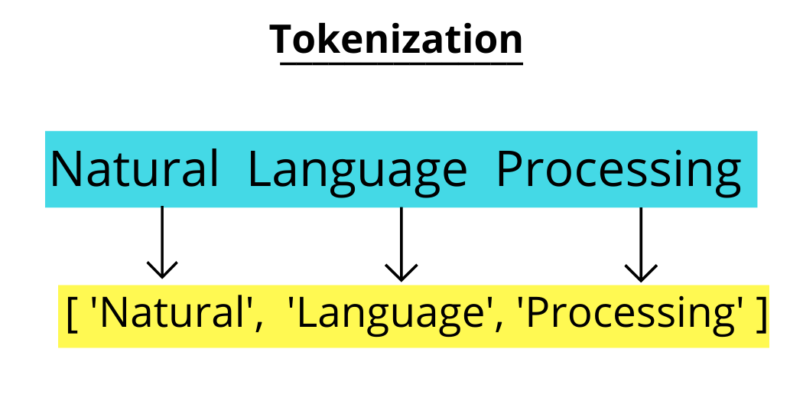
1. Tokenization:
The initial stage in text analysis is tokenization.
It enables to determine the text's core components.
Sentence tokenization:
Word tokenization:

Slide 13

2. Removing Stop words:
Stop words are the most frequently repeated words in a text that give no useful information
we can develop a customized set of stop words. Using the add technique, we can easily add any new word to a collection of terms.
The NLTK library includes a list of terms that are considered stop words in English.
[I, no, nor, me, mine, myself, some, such we, our, you'd, your, he, ours, ourselves, yours, yourself, yourselves, you, you're, you've, you'll, most, other]

Slide 14
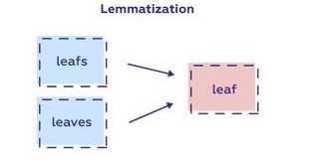
3. Lemmatization:
The process of reducing inflected forms of a word while verifying that the reduced form matches to the language is known as lemmatization.
Lemmatization uses a pre-defined dictionary to saves word context and verify the word in the dictionary as it decreases.
The inflection of a word can be used to communicate grammatical categories such as tense

Slide 15
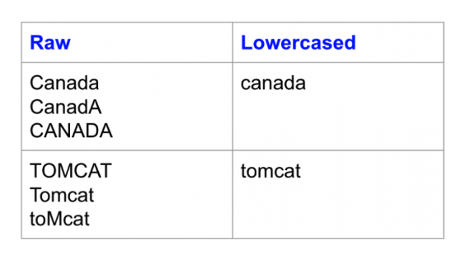
4. Lower casing:
When the text is in the same case, a computer can easily read the words since the machine treats lower and upper case differently.
In python lower () is a function that is mostly used to handle strings.
The lower () function accepts no parameters. It converts each capital letter to lowercase to produce lowercased strings from the provided string.

Slide 16
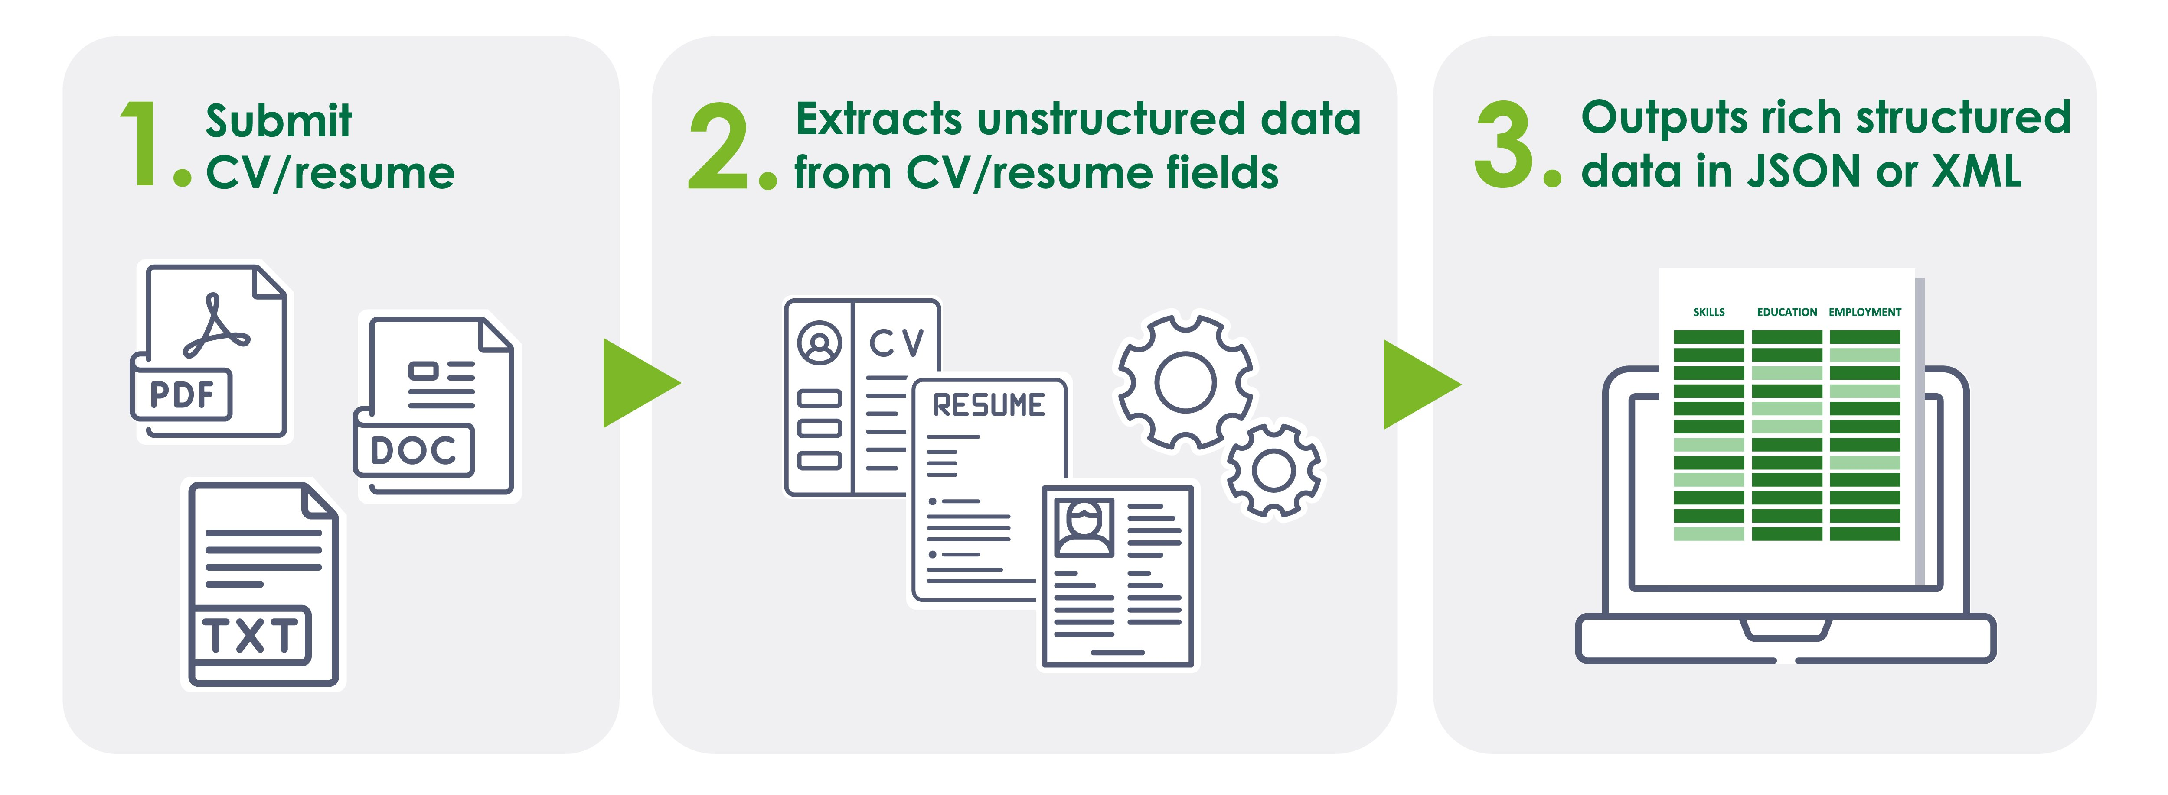
IMPLEMENTATION:

Slide 17
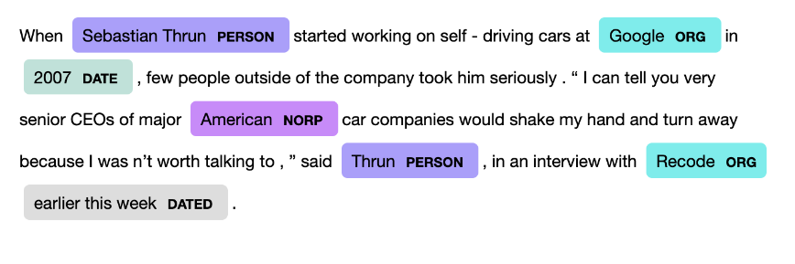
NAMED ENTITY RECOGNITION (NER) :
An NLP based technique to identify mentions of rigid designators from text belonging to particular semantic types such as a person, location, organization etc.

Slide 18
RESULTS AND DISCUSSIONS:
The result involves parsing the resume from /pdf/doc/docx format into plain document and tokenized data entities.
a company can simply specify their requirements while searching for a candidate.
They may specify the language or languages which should be known and the expertise level of a candidate which they need.
Once they submit their requirements, the candidates who fulfil the criteria are fetched from the Candidates table and displayed to the company .

Slide 19
CONCLUSION
A normal resume is a compilation of information about a person's work experience, academic background, qualifications, and personal details.
Machine works faster than human and their accuracy to do any task was also good. We have made a system which includes machine learning that extract the important information from resumes within a minute or less than a minute.
The model we propose efficiently shortlist the candidates according to the requirements of the company based on their resumes.
It is important that the candidates focus on the way they describe themselves in resumes to get shortlisted by the company for further process.

Slide 20
Thank you

