Slide 1
BLUESTOCK MUTUAL FUND ANALYTICS CAPSTONE PROJECT
Comprehensive Mutual Fund Data Analysis, Risk Analytics & Dashboard Development
Prepared By:
Yash Chowdhary
Individual Capstone Project
June 2026

Slide 2
Problem Statement & Objectives
Problem Statement:
The mutual fund industry generates large amounts of financial and investor data, making performance evaluation and investment analysis complex. Investors often struggle to compare schemes, assess risk, and make informed decisions due to fragmented financial information.
Objectives:
Build an ETL pipeline for mutual fund data processing
Perform exploratory data analysis (EDA)
Evaluate performance using Sharpe Ratio, Alpha, Beta & risk metrics
Develop interactive Power BI dashboards
Generate investment insights using analytics

Slide 3
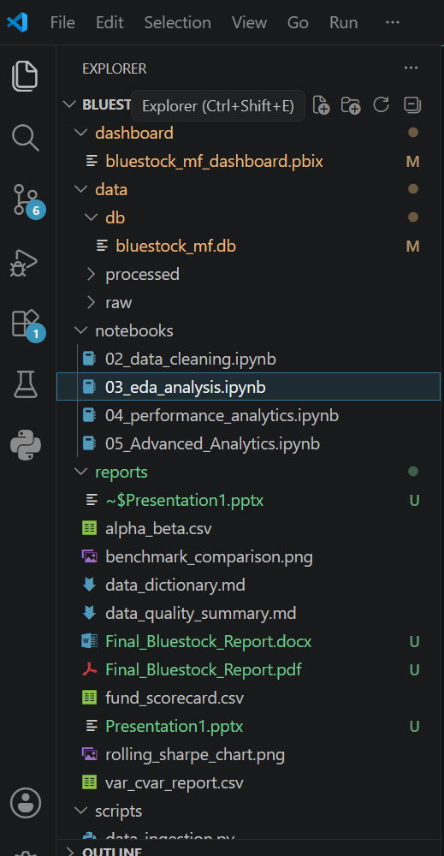
Data Sources
Datasets Used:
• Fund Master Data
• NAV History Data
• AUM by Fund House
• Monthly SIP Inflows
• Category Inflows
• Industry Folio Count
• Scheme Performance Data
• Investor Transaction Data
• Portfolio Holdings
• Benchmark Indices

Slide 4
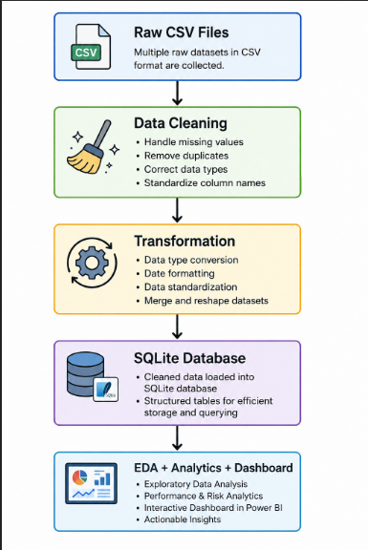

ETL Pipeline Architecture
The Extract, Transform, Load (ETL) pipeline was designed and implemented to automate the complete lifecycle of mutual fund data processing. Since the project involved multiple heterogeneous datasets containing scheme information, investor transactions, NAV history, SIP inflows, benchmark indices, and portfolio holdings, an efficient ETL framework was required to ensure consistency, reliability, and analytical readiness of the data. The ETL process plays a critical role in transforming raw and unstructured datasets into a clean, standardized, and structured format suitable for exploratory analysis, financial performance measurement, advanced analytics, and dashboard development.

Slide 5
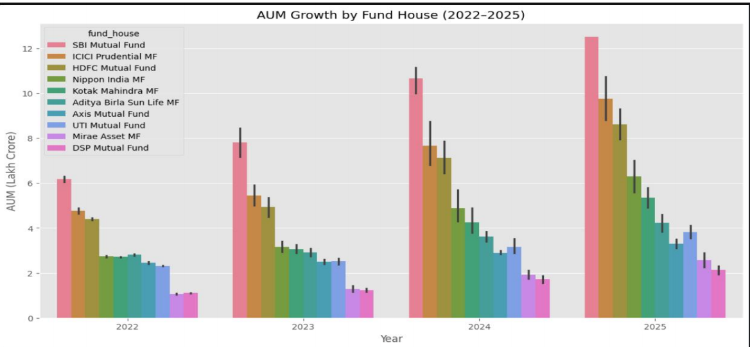
EDA Highlights

Slide 6
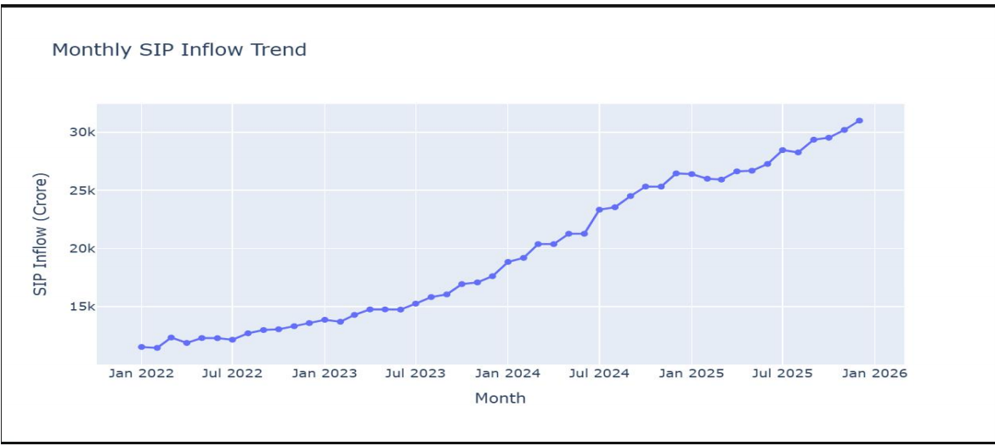
Highlight 2-

Slide 7
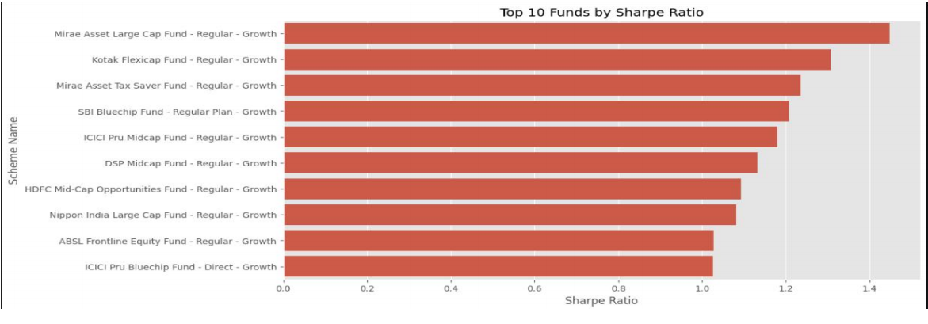
Performance Analytics
Sharpe Ratio was used to measure risk-adjusted returns of mutual fund schemes. It evaluates how much excess return is generated for every unit of risk undertaken. Higher Sharpe ratios indicate better risk-adjusted performance, whereas lower values indicate inefficient return generation relative to volatility. The analysis revealed differences in fund efficiency across categories, highlighting schemes that delivered stronger returns with relatively controlled risk exposure.

Slide 8
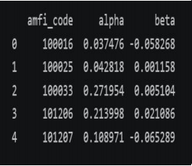
Performance Analytics 2-
Alpha measures a mutual fund’s ability to outperform its benchmark after adjusting for market risk. Positive Alpha values indicate that a scheme generated returns above benchmark expectations. The analysis showed that certain schemes consistently demonstrated superior active management performance by outperforming benchmark indices.
Beta analysis was conducted to measure fund sensitivity relativeto market movement.
• Beta > 1 indicates higher volatility than the market
• Beta < 1 indicates lower volatility than the market
• Beta = 1 indicates performance aligned with market movement
The results helped classify funds based on market sensitivity and investment risk characteristics.

Slide 9
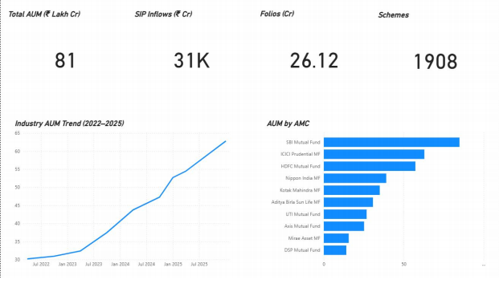
Power BI Dashboard
An interactive Power BI dashboard was developed to visualize fund performance, SIP trends, investor behaviour, and benchmark analysis using dynamic filters and KPI cards.

Slide 10
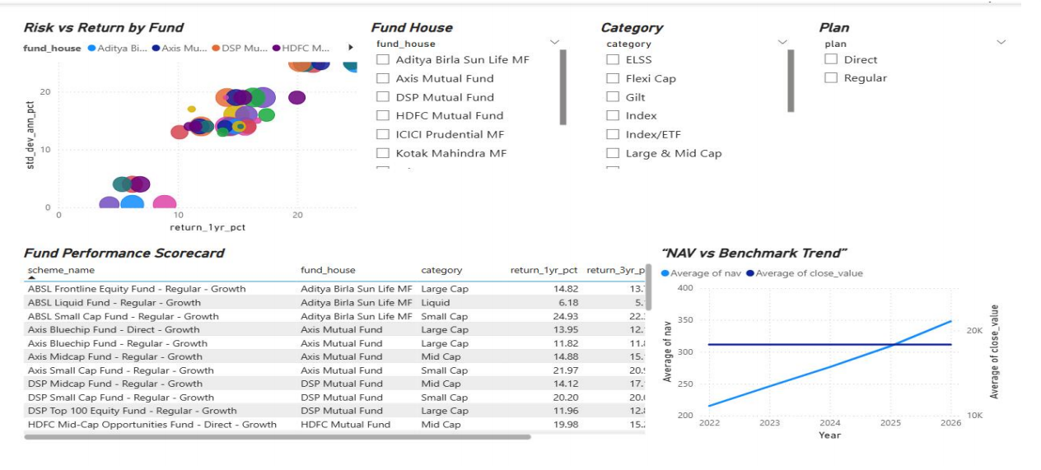
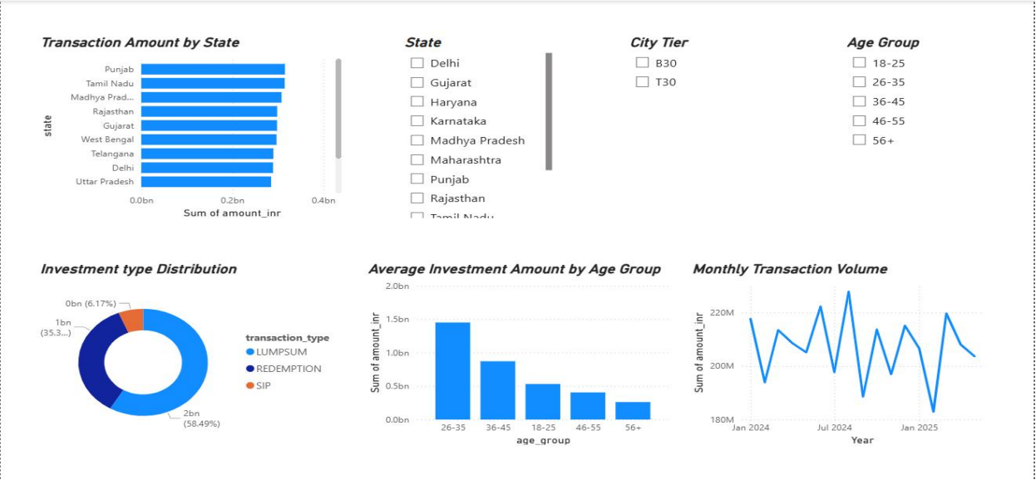

Slide 11
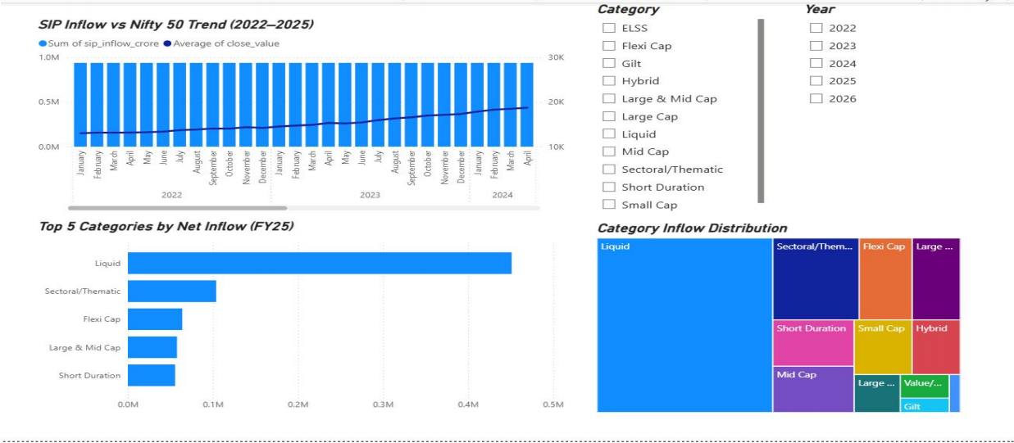

Slide 12
Key Findings
Strong Industry Growth Trend
Mutual fund AUM and SIP inflows increased significantly between 2022–2025, indicating growing investor participation and market confidence.
Market Leadership Concentration:
SBI Mutual Fund, ICICI Prudential, and HDFC Mutual Fund consistently held dominant market share in terms of AUM.
Risk–Return Trade-off:
Sharpe Ratio analysis showed that higher returns did not always result in better risk-adjusted performance.
Category-wise Investment Preference:
Liquid, Large Cap, and Sectoral/Thematic funds attracted higher investor inflows across the study period.
Investor Behaviour Insights:
Investment patterns varied across age groups, transaction types, and geographic regions.
Business Intelligence Impact:
The Power BI dashboard enabled interactive analysis through KPIs, slicers, and dynamic visualizations for better decision-making.

Slide 13
THANK YOU
Prepared by: Yash Chowdhary

