Slide 1
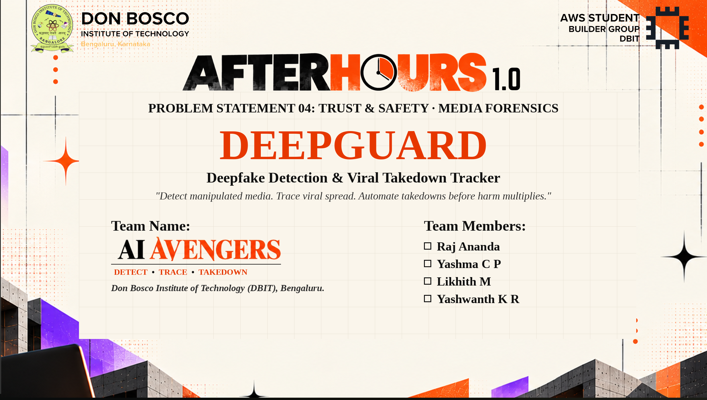



PROBLEM STATEMENT 04: TRUST & SAFETY · MEDIA FORENSICS
DEEPGUARD
Deepfake Detection & Viral Takedown Tracker
"Detect manipulated media. Trace viral spread. Automate takedowns before harm multiplies."
TEAM DETAILS
Team Name: AI Avengers
Don Bosco Institute of Technology (DBIT),
Bengaluru.
TEAM MEMBERS & ROLES
Raj Ananda
Yashma C P
Likhith M
Yashwanth K R

Slide 2
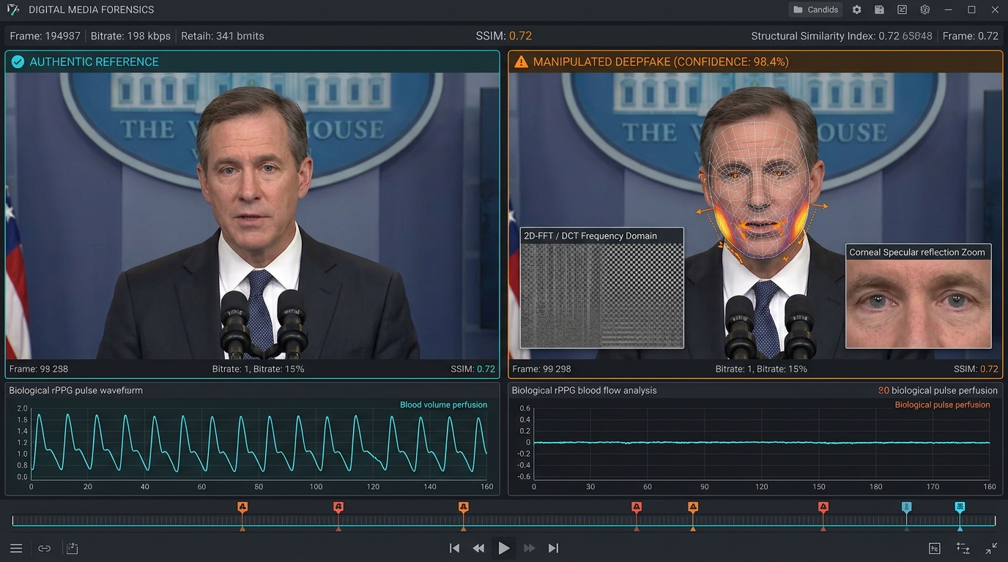

2/7
Problem Statement & Its Relevance
Deepfakes Move Faster Than Human Triage. A single fake clip reaches millions in minutes, destroying reputations before reports are seen.
THREAT VECTORS
AFFECTED PARTIES
EXACT PROBLEM
• Hyper-Realistic AI Fakes: Convincing face-swaps and voice clones created with zero barrier.
• Viral Spread Velocity: Altered copies are cropped, mirrored, and reposted in seconds.
• Asymmetric Triage: Victims face slow 72-hour manual reporting while damage compounds.
WHO FACES THIS PROBLEM?
• Public Figures & Leaders: Political disinformation, forged statements, and election tampering.
• Private Citizens & Students: Cyberbullying, identity theft, and non-consensual synthetic abuse.
• Newsrooms & Fact-Checkers: Need rapid verification for breaking viral video before broadcast.
• Trust & Safety Teams: Millions of daily uploads swamping manual human review queues.
URGENCY & SCALE
ATTACK LIFECYCLE
WHY DOES THIS MATTER?
• 550% Surge in Deepfakes: Over 500,000 synthetic attacks logged in 2024 alone.
• Irreversible Harm: 80% retain false narratives even after official retractions.
• Crippling Latency: Standard DMCA takes 3–5 days; viral damage occurs in <2 hours.
• Trust Crisis: Weaponized against elections, leaders, and private citizens.
① Creation ➔ ② Seed ➔ ③ Mirror ➔ ④ Harm ➔ ⑤ Triage
Without perceptual tracking, altered copies reappear indefinitely across platforms.
CORE CHALLENGE
"How might we automatically detect manipulated media with explainable confidence, trace its viral spread across altered copies, and empower victims with automated one-click takedowns?"

Slide 3
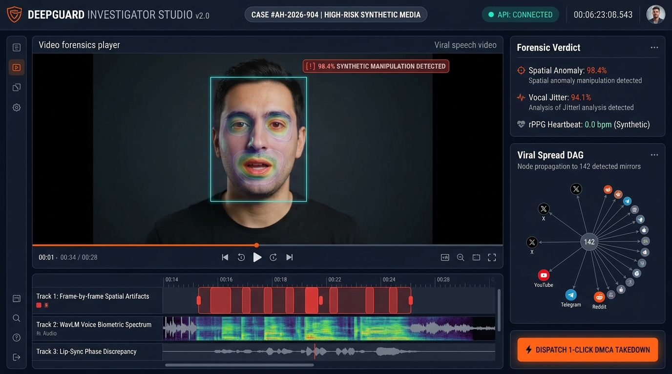
3/7
Proposed Solution & Innovation
DEEPGUARD – Multi-Modal Forensics & Automated Takedown Platform "Detect artifacts, trace viral spread, and halt harm in minutes."
CORE PLATFORM
WHAT ARE WE PROPOSING?
• Unified Forensics: Combines multi-modal detection, viral spread mapping, and legal takedowns.
• Perceptual Invariance: pHash & visual embeddings detect cropped, compressed, and mirrored copies.
• Automated DMCA: Dispatches verified C2PA legal notices to platform APIs in under 15 minutes.
PILLAR 01
PILLAR 02
PILLAR 03
1. Multi-Modal Forensic Fusion
EfficientNet-B4 spatial anomaly detection, WavLM audio spectral analysis, and DCT frequency heatmaps robust against re-compression.
2. Perceptual Hash Spread Graph
pHash and CLIP visual embeddings construct a directed propagation DAG mapping mirrored copies, formats, and patient-zero source.
3. Explainable Legal Takedown API
Generates C2PA-compliant cryptographic proof dossiers and dispatches automated, platform-specific DMCA notices via webhooks in <15 mins.
END-TO-END FLOW
⚡ [1] Ingestion ➔ [2] Forensics ➔ [3] Heatmap ➔ [4] pHash Index ➔ [5] Spread DAG ➔ [6] Legal Notice ➔ [7] Platform API
From video upload to automated DMCA platform filing and verifiable legal evidence in <15 minutes.

Slide 4
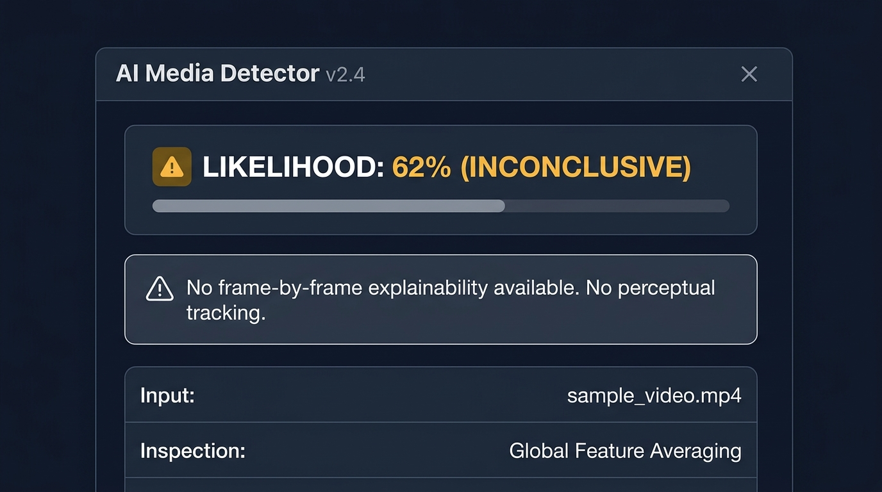
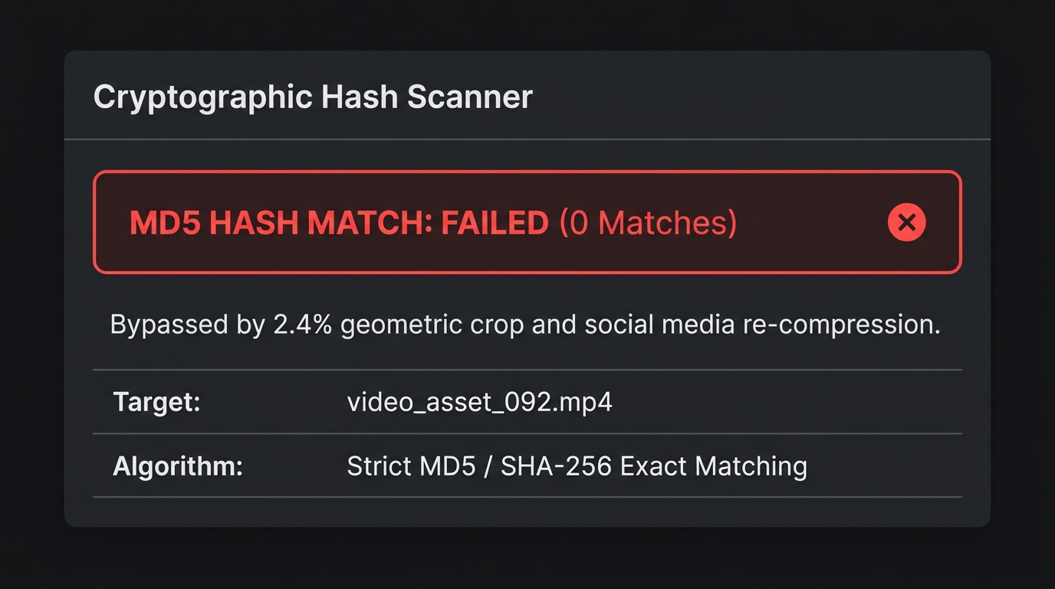
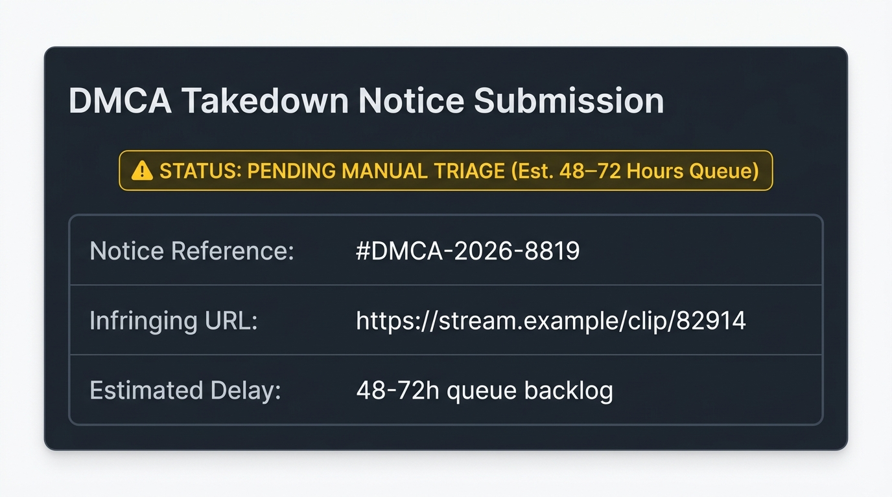
4/7
Existing Solutions & Differentiation
From Isolated Dashboards to an Integrated Takedown Ecosystem. Why legacy detectors fail on viral media — and how DeepGuard wins.
LEGACY SHORTCOMINGS
DEEPGUARD ADVANTAGE
EXISTING SOLUTIONS & LIMITATIONS
OUR SOLUTION: DEEPGUARD ADVANTAGES
✔ Multi-Modal Scope: Analyzes video frames, audio tracks, and EXIF metadata simultaneously.
✔ Bypass-Resistant: Perceptual hashing (pHash) matches cropped, compressed, and filtered copies.
✔ Viral Spread Mapping: Directed propagation DAG identifies patient-zero and all downstream mirrors.
✔ Automated Takedown: Pre-filled DMCA notices & API webhooks cut response time from 72h to <15m.
✔ Full Explainability: Generates Grad-CAM visual heatmaps and C2PA cryptographic audit trails.
Generic Online Detectors
• Vague % score with no explainable heatmap; zero viral spread tracking.
Platform Content-ID
• Exact hash match (MD5) easily bypassed by cropping, mirrors, or filters.
VS
Manual DMCA Filing Forms
• Tedious 48–72 hr forms per platform; copies keep spreading unchecked.
COMPETITIVE MOAT
🏆 Judges and investigators can inject a manipulated video, inspect real-time Grad-CAM heatmaps, trace all derivative re-uploads on the spread DAG, and dispatch simulated DMCA takedowns in seconds.

Slide 5
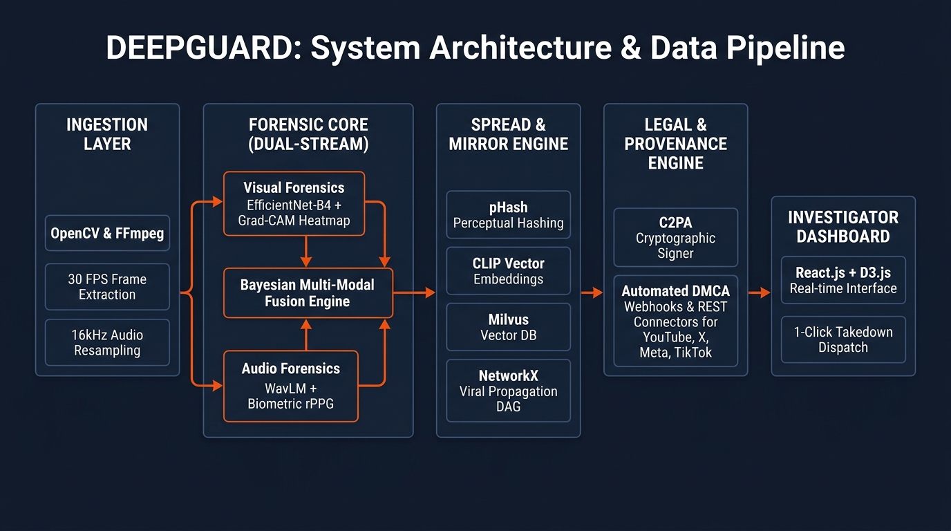
5/7
Technical Approach & Feasibility
A Working Forensic & Takedown Engine, Not Just a Visual Demo. Full-stack architecture, deterministic graph traversal, and 24-hour hackathon scope.
TECH STACK
AI RATIONALE
MVP SCOPE
🛠 TECHNOLOGIES USED
• Frontend: React.js, Tailwind CSS, D3.js, Canvas
• Backend API: Python 3.12, FastAPI, Celery, Redis
• Forensic ML: PyTorch, EfficientNet-B4, WavLM, OpenCV
• Search & Graph: Milvus Vector DB, NetworkX, pHash
• Cloud & Standards: AWS S3, SQLite, Docker, C2PA Standard
🤖 WHERE IS AI NEEDED?
• Subtle Artifacts: Deep neural nets detect sub-pixel boundary warping and synthetic vocal jitter invisible to rule engines.
• Invariant Matching: Embeddings match cropped, compressed, or speed-altered re-uploads across platforms.
• Deterministic Rules: Takedown filing and provenance validation use deterministic logic to prevent false claims.
🎯 HACKATHON MVP SCOPE
✔ Media Ingestion: Direct video upload & social URL parser.
✔ Forensic Scoring: Per-frame Grad-CAM heatmaps & verdict.
✔ Variant Matching: pHash detection of cropped/mirrored copies.
✔ Spread Graph: D3.js simulated viral propagation DAG.
✔ Automated DMCA: Pre-filled legal notice & C2PA manifest log.

Slide 6
6/7
Expected Impact & Execution Plan
Measure the Speed. Stop the Virality. Protect Victims at Scale. Quantifiable metrics, stakeholder benefits, and 24-hour milestones.
EXPECTED IMPACT
TARGET BENCHMARKS
KEY BENEFICIARIES
📈 QUANTIFIABLE OUTCOMES
• 95% Faster Takedown: Cuts triage from 72h to <15 mins.
• Viral Containment: Halts derivative mirrors before 100K views.
• Victim Agency: Free 1-click court-ready C2PA legal dossier.
• Scalable Workers: Stateless pipeline handles 10,000+ daily checks.
🎯 EVALUATION TARGETS
✔ >92% Detection F1: Benchmarked on DFDC & FaceForensics++
✔ <15 Min Takedown: Automated DMCA vs. 3-day manual triage
✔ >88% Variant Match: Identifies cropped & re-encoded social mirrors
✔ <3% False Positives: Validated against authentic broadcast news
👥 WHO BENEFITS?
• Targeted Victims: Instant removal of defamatory synthetic media.
• Platform Moderators: Automated triage eliminating manual review backlogs.
• Fact-Checkers: Rapid verification for breaking user-generated video.
• Legal Teams: Verifiable cryptographic chain of custody for court.
HACKATHON EXECUTION
EXPANSION PLANS
⏱ 24-HOUR HACKATHON MILESTONE ROADMAP
• Hours 00–04 (Setup): FastAPI ingestion, OpenCV frames, model weights.
• Hours 04–10 (Forensics): EfficientNet artifacts, WavLM biometrics, heatmaps.
• Hours 10–16 (Spread Graph): pHash indexing, Milvus vector search, NetworkX DAG.
• Hours 16–20 (UI & Legal): React dashboard, D3.js spread graph, DMCA notices.
• Hours 20–24 (Benchmarking): Attack simulation, latency tuning, final pitch demo.
🚀 FUTURE SCOPE & SCALABILITY
• Social Extension: Real-time deepfake warning badge overlay on video feeds.
• Decentralized Provenance: C2PA blockchain ledger for immutable origin logs.
• Moderation Webhooks: Direct push connectors to YouTube, X, and TikTok APIs.
• Live Stream Forensics: Sub-second audio-visual inspection for live broadcast feeds.

Slide 7
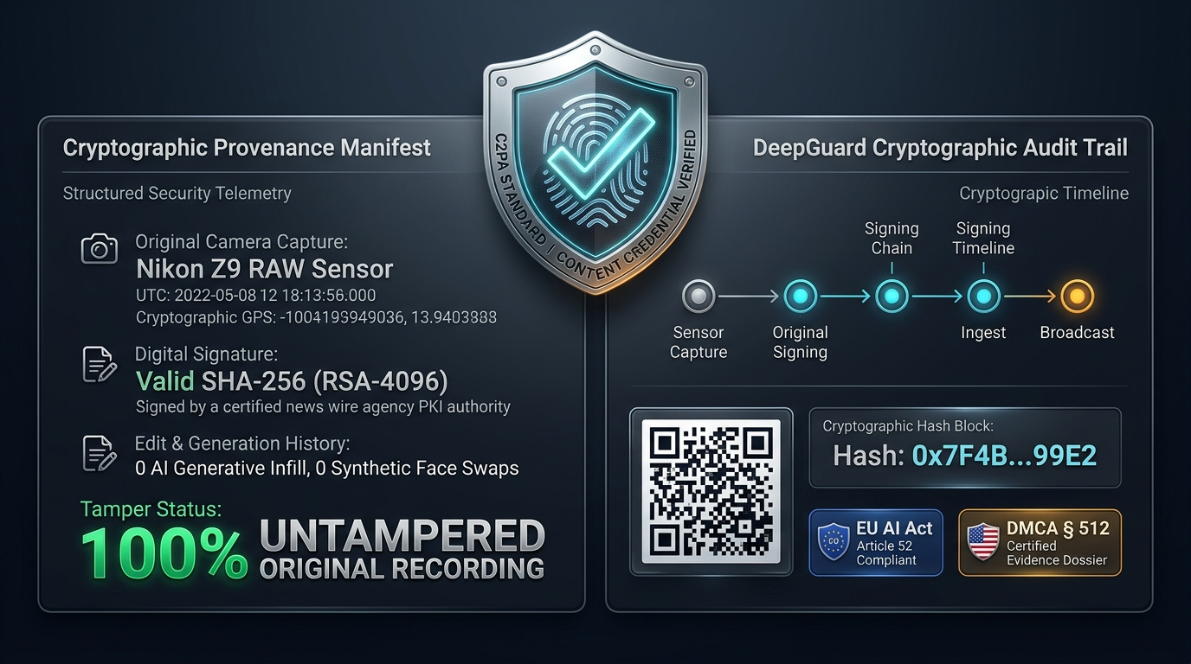
7/7
Conclusion & References
Protecting Truth, Identity, and Trust in the Age of Generative AI. "Shifting the balance of power from deepfake creators back to victims."
CORE SUMMARY
💡 KEY TAKEAWAYS
• Proactive Defense: DeepGuard transforms deepfake response from helpless manual reporting into automated viral containment.
• Multi-Modal Truth: Fuses visual artifacts, audio biometrics, and perceptual hashing to resist evasion transforms.
• Cross-Platform Mapping: Traces patient-zero source and every derivative mirror across networks on a directed DAG.
• Victim Empowerment: Equips non-technical users with court-ready C2PA evidence and 1-click legal DMCA filing.
ACADEMIC EVIDENCE
📚 VERIFIABLE REFERENCES & SCIENTIFIC BENCHMARKS
• 1. FaceForensics++ (ICCV): Learning to Detect Manipulated Facial Images across Deepfake Methods. [arXiv:1901.08971]
• 2. Meta AI / Kaggle DFDC: The DeepFake Detection Challenge Dataset and Benchmark Findings. [arXiv:2006.07397]
• 3. C2PA Standard: Coalition for Content Provenance and Authenticity Technical Specification (c2pa.org).
• 4. Sumsub Fraud Report: 550%+ Surge in GenAI Deepfakes across Social and Identity Platforms (2024).
• 5. IEEE TIFS: Perceptual Hashing & Robust Media Fingerprinting under Non-Linear Compression.
• 6. Legal Compliance: US Digital Millennium Copyright Act (17 U.S.C. § 512) & EU AI Act Annex IV.

