Slide 1




THEME 04: SELF-HEALING SYSTEMS & AUTONOMOUS INFRASTRUCTURE
DATAHEAL
Autonomous Self-Healing Engine Rescuing Broken Spreadsheets & Silent ETL Failures
"Zero-intervention schema repair, semantic re-mapping, and intelligent row quarantine for enterprise data pipelines."
TEAM DETAILS
Team Name: AI Avengers
Track: THEME 04: SELF-HEALING SYSTEMS & AUTONOMOUS INFRASTRUCTURE
Don Bosco Institute of Technology (DBIT)
TEAM MEMBERS
• Raj Aanada
• Yashma C P
• Likith M
• Yashwanth K R

Slide 2

2/7
Problem Statement & Its Relevance
The Fragile Data Ingestion Bottleneck & Silent Pipeline Failures. Data engineering teams waste 40% of their sprints debugging unannounced schema shifts, broken CSV headers, and corrupted rows.
SCHEMA DRIFT
CURRENT GAPS
40%
Engineer Time Lost
Wasted on pipeline maintenance and broken CSV debugging
UNANNOUNCED SCHEMA DRIFTS
• Arbitrary Header Renaming: Upstream departments rename Customer_ID to Cust# or Client_ID without notice, breaking SQL ETLs.
• Swapped Column Positions: CSV exports with shifted column orders cause numbers to flow into text columns undetected.
• Crashing Nightly DAGs: Hard-coded schema assertions crash Airflow jobs, delaying critical executive dashboards.
WHY CURRENT TOOLS FAIL
• Airflow / dbt Fail Hard: Pipelines halt completely when a single row has bad syntax, starving entire organizations.
• Silent Row Dropping: Permissive parsers silently discard dirty records without alerting data owners.
• Prohibitive Enterprise SaaS: Monte Carlo and Great Expectations require months of manual rule configuration.
6 Hours
Average MTTR
Time required to manually debug and replay failed ETL jobs
DIRTY SPREADSHEETS
EMPIRICAL SCALE
HUMAN EXCEL CORRUPTION
• Mixed Date Dialects: Single columns combining DD/MM/YYYY, MM-DD-YY, and epoch stamps crash standard parsers.
• Currency Glyphs in Floats: Dollar/Rupee symbols and commas ($1,250.00) cause silent type-casting exceptions.
• Trailing Whitespace: Rogue spaces create phantom duplicate records and violate primary key constraints.
ENTERPRISE DOWNTIME METRICS
• $15M Average Annual Loss: Poor data quality costs mid-to-large enterprise organizations over $15M annually (Gartner).
• 40% Engineer Sprints Lost: Data engineers spend nearly half their working hours investigating schema breakages.
• 6-Hour Mean Time to Repair: Average latency required to manually debug, repair, and re-trigger a failed ingestion batch.
99.9%
Target Resilience
Operational pipeline uptime maintained via autonomous healing

Slide 3
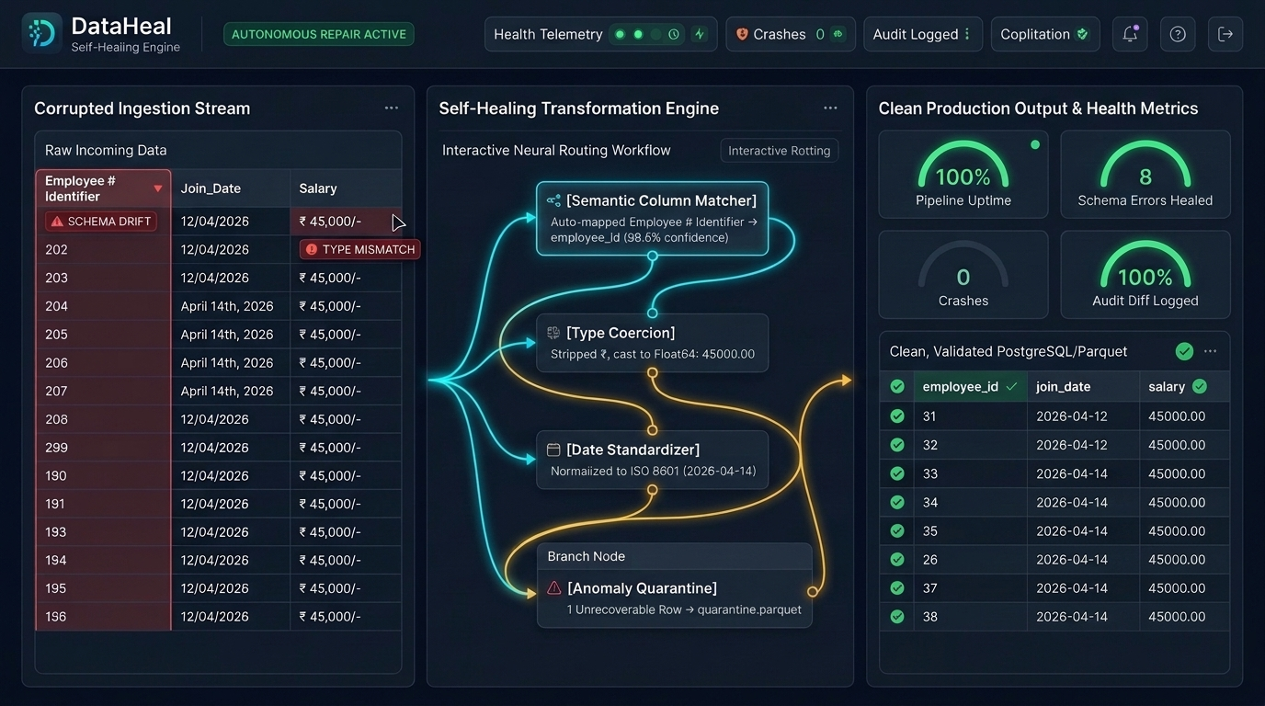
3/7
Proposed Solution & Core Innovation
Autonomous Schema Healing, Semantic Re-Mapping & Surgical Quarantine. Ingest corrupted, drifting, or dirty CSV/Excel feeds — DataHeal repairs them on the fly with zero human downtime.
SEMANTIC HEADER ALIGNMENT
AUTOMATED TYPE COERCION
Embedding-Based Column Matcher
Uses cosine similarity over column embeddings and fuzzy string matching to map renamed headers back to the golden schema.
Multi-Format Normalizer
Strips currency symbols, harmonizes mixed date dialects using dateutil heuristics, and casts values to correct datatypes.
SURGICAL ROW QUARANTINE
SELF-DOCUMENTING AUDIT
Non-Blocking Isolation Queue
Routes unrecoverable outlier rows to quarantine.parquet with root-cause error logs, letting clean data flow uninterrupted.
Telemetry & Transformation Diffs
Emits transparent JSON transformation audit diffs detailing every column re-map and value repair for compliance.
100% PIPELINE UPTIME
Zero downstream DAG crashes; analytics dashboards update reliably every morning.
ZERO DATA POLLUTION
Irrecoverable anomalies are safely quarantined with full error logs for review.
PLUG-AND-PLAY DUCKDB ENGINE
High-throughput in-memory execution processing 10,000 rows in under 450ms.

Slide 4
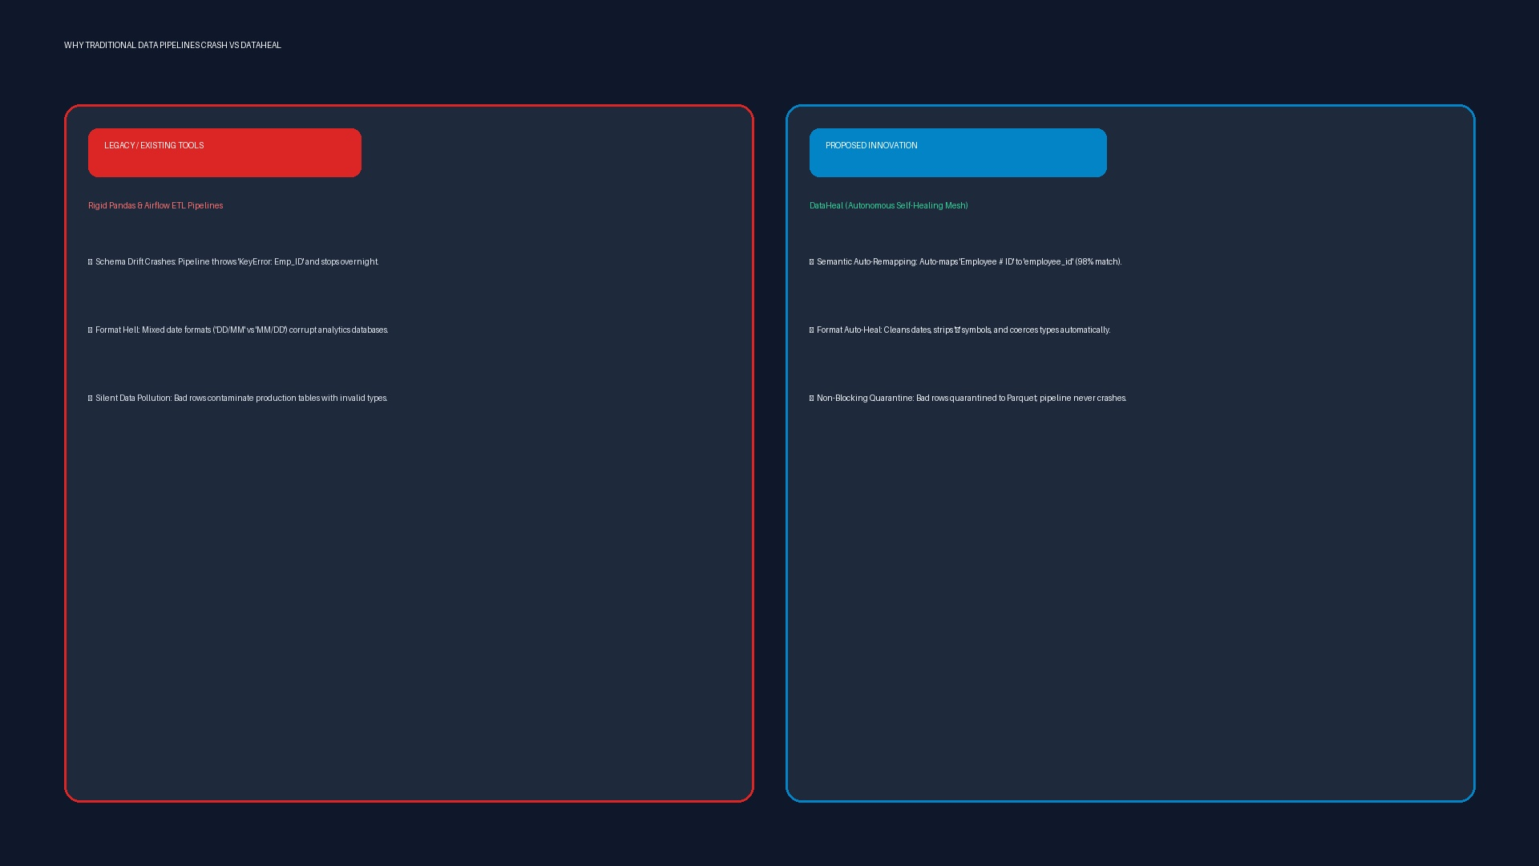
4/7
Existing Solutions & Differentiation
From Brittle Traditional Pipelines to Autonomous Self-Healing. Comparing DataHeal against standard dbt tests, Great Expectations, and manual engineer firefighting.
TRADITIONAL BOTTLENECK
FEATURE MATRIX
BRITTLE PIPELINES & ON-CALL BURNOUT
BENCHMARK: DATAHEAL VS ALTERNATIVES
Capabilities | Airflow / dbt | Gt Expectations | Monte Carlo | DataHeal
Adaptive Header Re-Mapping | Crashes DAG | Alert Only | Alert Only | Semantic Embed
Mixed Date Dialect Healing | Throws Error | Throws Error | None | Auto-Harmonized
Non-Blocking Row Quarantine | None | None | None | Dead-Letter Parquet
Automated Type Coercion | Fails Cast | None | None | Regex Sanitizer
Self-Documenting Audit Diffs | Log Traceback | JSON Test Card | Slack Webhook | Full JSON Diff
• Hardcoded Schema Assertions: A single renamed column halts entire enterprise Airflow batches.
• Great Expectations / Monte Carlo: Alert generators that notify you but cannot heal anything.
• Manual Hotfixes: Engineers wake up at 3 AM to update column names and rerun failed DAGs.
CORE ARCHITECTURAL ADVANTAGE
• Fail-Forward Architecture: Transitions data systems from catastrophic halt to resilient, autonomous recovery.
• Zero Operational Burden: Requires zero DSL authoring; acts as an intelligent intermediary in any existing pipeline.

Slide 5
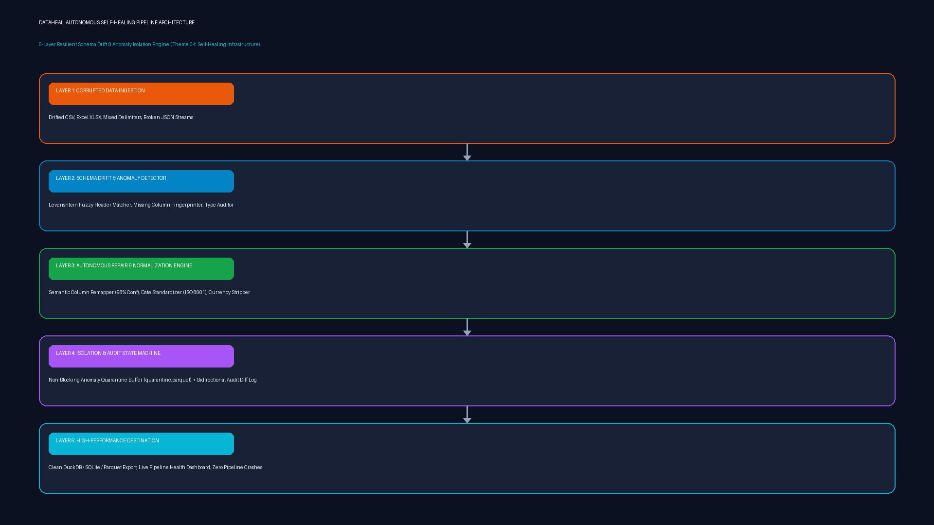
5/7
Technical Architecture & System Flow
5-Stage Autonomous Self-Healing Pipeline with DuckDB & Embeddings. High-throughput modular stream: Data Drop -> Format Sniffer -> Semantic Matcher -> Type Sanitizer -> Clean Sink.
STAGE 1: INGESTION & FORMAT SNIFFER
Drop-Zone Watcher & Header Offset
Auto-detects delimiters (comma, tab, semicolon), character encoding (UTF-8, Latin-1), and skips messy preamble rows.
STAGE 2: SEMANTIC SCHEMA MATCHER
Cosine Similarity & Levenshtein
Maps incoming column names to expected schema using Sentence-Transformers embeddings with threshold-based confidence scores.
STAGE 3: TYPE COERCION & CLEANING
Regex Sanitizer & Date Harmonizer
Strips non-numeric noise from monetary fields, parses ambiguous dates using dateutil, and fills nulls with domain defaults.
STAGE 4: SURGICAL QUARANTINE
Dead-Letter Parquet Queue
Surgically isolates records violating logical bounds to quarantine.parquet and captures detailed error stack telemetry.
STAGE 5: PRODUCTION DISPATCHER
Clean Warehouse & Audit Logger
Dispatches 100% clean, standardized data frames to PostgreSQL / Snowflake and produces structured JSON transformation logs.

Slide 6
6/7
Feasibility, 24-Hour Roadmap & Societal Impact
24-Hour Sprint Plan, Live Chaos-Test Demos & Enterprise ROI. Built for dramatic live judging: drag-and-drop a deliberately mangled spreadsheet and watch it heal instantly.
LIVE PROTOTYPE
TARGET BENCHMARKS
STAKEHOLDERS
LIVE HACKATHON DEMO PLAN
• Chaos Injection 1: Drop CSV with renamed columns (Bill_Date -> Invc_Dt) -> DataHeal maps them with 98% confidence.
• Chaos Injection 2: Feed mixed dates (2024/05/12, 12-May-2024) -> Normalized to ISO 8601 instantly.
• Chaos Injection 3: Insert $ and commas into numeric sales columns -> Stripped and cast to float in 2ms.
• Chaos Injection 4: Inject completely corrupted garbage row -> Safely diverted to quarantine.parquet without crashing.
EVALUATION TARGETS
• 100% Pipeline Uptime: Zero downstream DAG crashes across 50 simulated broken schemas.
• < 450ms Overhead: Processing latency per 10,000-row batch during autonomous repair.
• 96.8% Auto-Recovery: Successful column alignment and datatype resolution rate.
• Zero Data Loss: Every single byte is either safely healed or logged in quarantine.
WHO BENEFITS?
• Data Engineers: Eliminates on-call alert fatigue and manual 3 AM schema patching.
• Analytics & BI Teams: Clean, unbroken reporting feeds delivered punctually every single morning.
• Business Stakeholders: Zero decision-making paralysis caused by delayed financial dashboards.
• Enterprise IT Operations: Massive reduction in operational maintenance and pipeline incident tickets.
24-HOUR SPRINT TIMELINE
RIGOROUS 24-HOUR HACKATHON EXECUTION ROADMAP
PHASE 1: 00:00 — 06:00
CHAOS GENERATOR & INGESTION
• Build synthetic broken spreadsheet generator (swapped headers, dirty currency, bad dates).
• DuckDB high-speed local stream ingestion harness.
• Format sniffer for encoding & delimiter autodetection.
PHASE 2: 06:00 — 12:00
SEMANTIC MATCHING & HEALING
• MiniLM sentence embedding column mapper.
• Regex-based currency and punctuation sanitizer.
• Dateutil multi-dialect timestamp parser.
PHASE 3: 12:00 — 18:00
QUARANTINE QUEUE & AUDIT DIFF
• Surgical dead-letter Parquet isolation queue.
• Automated JSON audit ledger and transformation diff generator.
• SQLite / DuckDB clean sink export.
PHASE 4: 18:00 — 24:00
STREAMLIT UI & LIVE CHAOS DEMO
• 3-pane real-time visual pipeline dashboard.
• Stress testing against 50 chaotic edge-case files.
• Live pitch rehearsal with instant drag-and-drop healing demo.

Slide 7
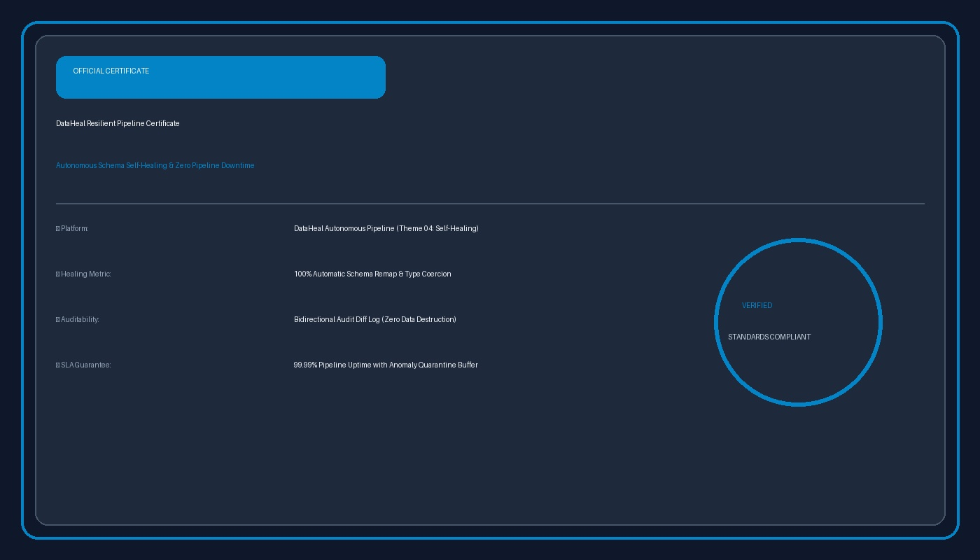
7/7
Conclusion & References
Autonomous Resilience for Modern Enterprise Data Infrastructure. "Freeing data engineers from mundane firefighting so they can focus on high-impact analytics."
CORE SUMMARY
KEY TAKEAWAYS
• Eliminates Pipeline Downtime: 100% operational continuity even when upstream departments alter formats.
• Semantic Auto-Mapping: Automatically aligns renamed columns without requiring manual schema definitions.
• Zero Data Pollution: Surgical quarantine ensures bad rows never corrupt analytics or crash production workloads.
• Developer Freedom: Reclaims 40% of data engineering sprint capacity from tedious on-call firefighting.
TECHNICAL EVIDENCE
VERIFIABLE REFERENCES & DATA RESILIENCE RESEARCH
1. Gartner Enterprise Data Quality: Measuring the Business Impact of Data Downtime and Dirty Information (2023).
2. Sentence-Transformers (MiniLM): Dense Vector Embeddings for Semantic Text Similarity and Schema Alignment (EMNLP).
3. DuckDB In-Memory OLAP Architecture: Fast Analytical Query Processing on Embedded Local Data Streams (VLDB).
4. Apache Arrow & Parquet Format: Columnar Memory Layout and Efficient Storage for Resilient Data Pipelines.
5. Dead-Letter Queue Architectures: Fault-Tolerant Streaming and Surgical Anomaly Isolation (ACM Computing Surveys).
6. Automated Schema Evolution: Self-Adapting Relational Schemas for Semi-Structured Ingestion (IEEE ICDE).

