Slide 1




THEME 05: EDGE INTELLIGENCE & OFFLINE-FIRST AI
VOICEKIRANA
Offline Voice-Based Stock, Credit Ledger & Instant Bill Generator
"Speak vernacular entries. Generate instant bills, track udhaar, and prevent stockouts — 100% offline."
TEAM DETAILS
Team Name: AI Avengers
Track: THEME 05: EDGE INTELLIGENCE & OFFLINE-FIRST AI
Don Bosco Institute of Technology (DBIT)
TEAM MEMBERS
• Raj Aanada
• Yashma C P
• Likith M
• Yashwanth K R

Slide 2

2/7
Problem Statement & Its Relevance
The Small Merchant Digital Divide & Manual Ledger Chaos. Kirana owners lose hours and ₹1,25,000+ monthly due to manual paper bookkeeping during busy counter rushes.
COUNTER FRICTION
CURRENT GAPS
13M+
Kirana Stores in India
88% of FMCG retail runs on offline paper ledgers
THE PAPER BAHI-KHATA TRAP
• Typing is Too Slow: During peak evening rush, typing on mobile apps or desktop POS keyboards causes long customer lines.
• Forgotten Credit (Udhaar): Writing credit entries on loose paper slips leads to forgotten balances and disputes.
• Zero Inventory Visibility: Shopkeepers run out of staples (sugar, oil, atta) mid-day without warning.
WHY EXISTING TOOLS FAIL
• Cloud Apps Crash Offline: Khatabook & Vyapar freeze completely when internet connectivity drops.
• Desktop POS is Prohibitive: Hardware costs ₹15,000+ with steep learning curves for semi-literate clerks.
• No Instant Bill Generation: Voice apps only record memos; they cannot compute taxes or print thermal receipts.
₹1.25L
Monthly Credit at Risk
Unreconciled udhaar lost per store annually
ECONOMIC LOSS
EMPIRICAL SCALE
WHY DOES IT MATTER?
• ₹1,25,000 Monthly Loss: Average unrecovered credit and unbilled items per small rural/urban grocery store.
• Spotty Connectivity: Tier-2/3 towns and basement stores suffer frequent cellular drops; cloud apps freeze.
• Language Exclusion: Over 80% of merchants cannot navigate complex English POS interfaces.
GROUND REALITY IN NUMBERS
• 13+ Million Kiranas in India: Drive 88% of FMCG retail sales across India, yet 92% operate on manual paper notebooks.
• 2.5 Hours Daily Lost: Spent matching customer ledgers and stock counts after shop closure every single night.
• 14% Stockouts on Staples: Loss of high-margin walk-in sales when milk, oil, and flour unexpectedly run dry.
2.5 Hrs
Daily Bookkeeping Saved
Time reclaimed by hands-free voice billing

Slide 3
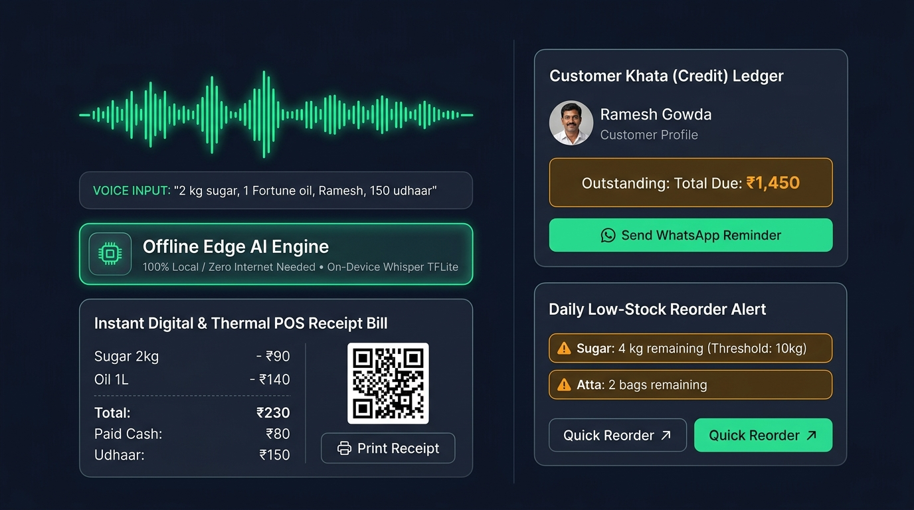
3/7
Proposed Solution & Core Innovation
Voice-to-Ledger-to-Bill: 100% Offline Edge Retail Operating System. Speak naturally in vernacular dialect; VoiceKirana generates instant bills, updates udhaar, and alerts low stock.
VERNACULAR SPEECH ENGINE
SLOT-FILLING BILL GENERATOR
Offline Edge Speech-to-Text
Understands regional dialects (Hindi, Kannada, Hinglish) using quantized Vosk ASR running 100% locally with zero cloud latency.
Instant Itemized Thermal Receipt
Parses "2 kg sugar Ramesh udhaar" into structured items, computes total with tax, prints thermal bill, and shows customer UPI QR.
DOUBLE-ENTRY CREDIT KHATA
PREDICTIVE STOCK SENTINEL
Zero-Dispute Customer Ledger
Maintains ACID-compliant SQLite credit balances per customer with instant SMS/WhatsApp summary sync when connectivity restores.
End-of-Day Low Stock Alerts
Automatically decrements inventory with every voice entry; generates wholesale reorder shopping lists before shelves empty.
< 300ms SPEECH RECOGNITION
Sub-second quantized on-device inference with zero cellular or Wi-Fi reliance.
INSTANT THERMAL & UPI RECEIPT
Direct Bluetooth thermal printer output + QR code for customer UPI payment.
100% PRIVATE LOCAL STORAGE
Merchant financial data and customer phone numbers never leave the device.

Slide 4
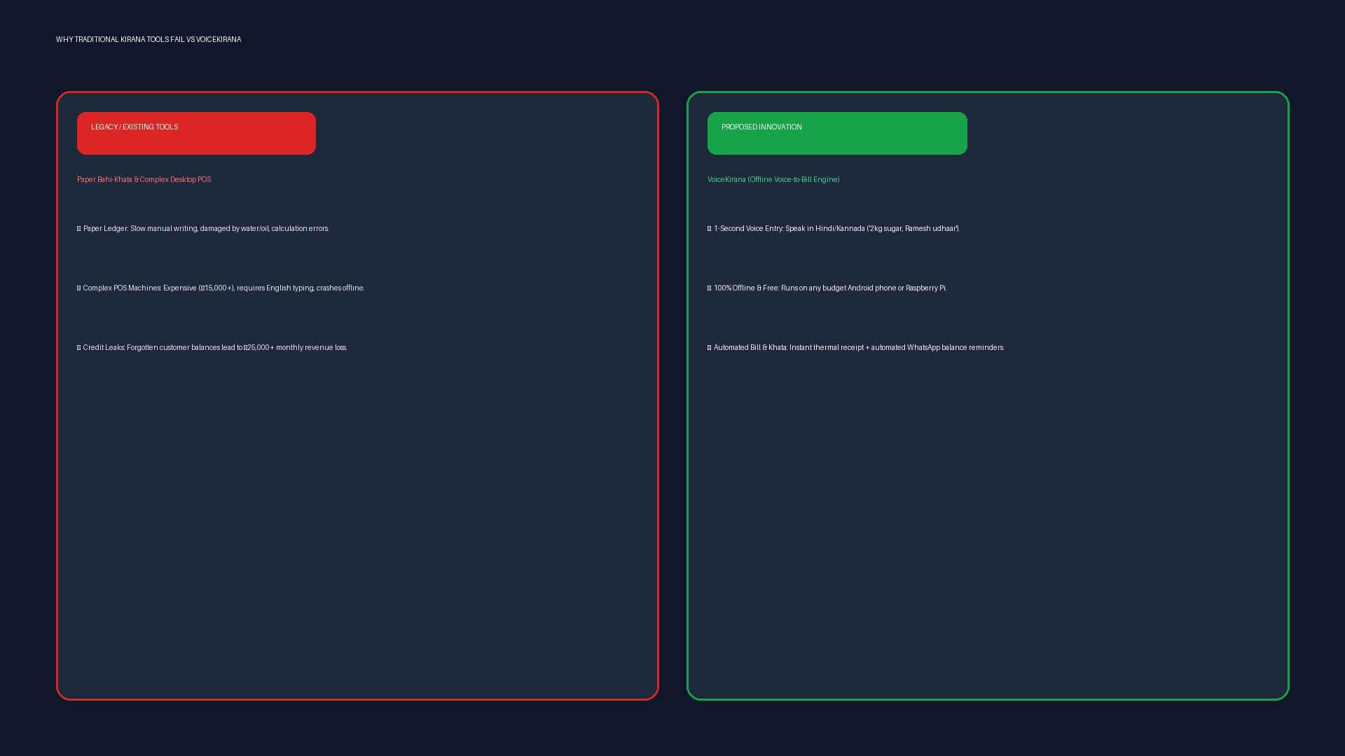
4/7
Existing Solutions & Differentiation
Why Paper Khatas and Desktop POS Systems Fail in Kirana Stores. Comparing VoiceKirana against traditional paper records and heavy cloud billing software.
TRADITIONAL BOTTLENECK
FEATURE MATRIX
LEGACY SOLUTIONS & DAILY FAILURES
BENCHMARK: VOICEKIRANA VS ALTERNATIVES
Capabilities | Paper Khata | Khatabook | Desktop POS | VoiceKirana
Hands-Free Vernacular Voice | Manual | Typing Only | English Keys | Sub-300ms Audio
100% Offline Functionality | Offline Paper | Fails Offline | Partial Offline | Pure Edge SQLite
Instant Bill Generation | None | Manual Print | Bulky Hardware | 1-Sec Voice Bill
Credit (Udhaar) Khata | Error-Prone | Manual Type | Clunky | Voice-Linked Khata
End-of-Day Low-Stock Alerts | None | None | Manual Setup | Auto-Reorder List
• Paper Bahi-Khata: Manual writing causes counter delays, damaged pages, and lost debts.
• Khatabook / Vyapar: Cloud-dependent; typing required; unusable when internet drops.
• Desktop POS: Expensive (₹15,000+), bulky hardware, complex English navigation.
CORE ARCHITECTURAL ADVANTAGE
• Zero Training Curve: Merchants speak the exact same colloquial words they say to customers.
• Hardware Democratization: Runs on any existing ₹6,000 Android smartphone with zero cloud hosting charges.

Slide 5
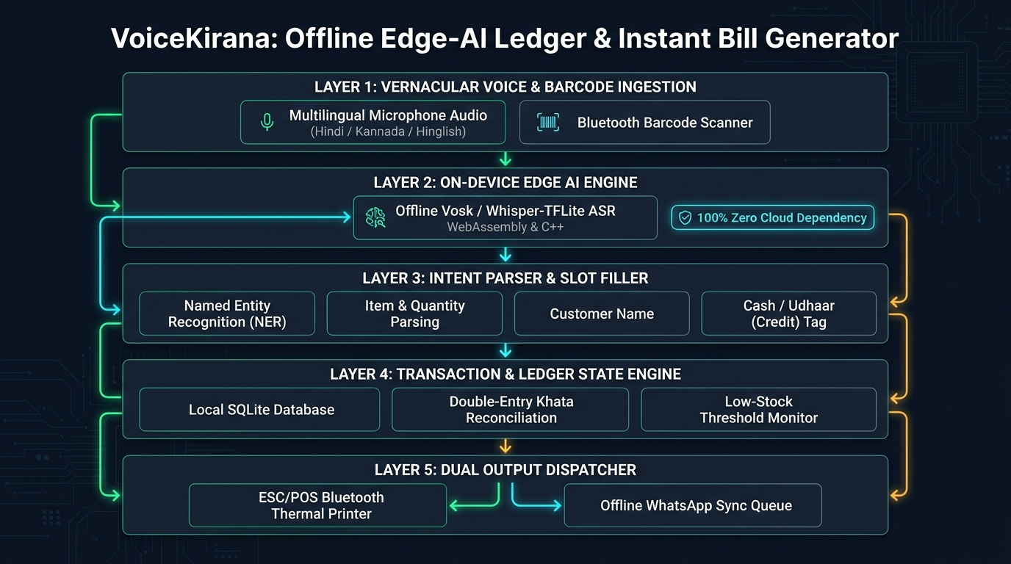
5/7
Technical Architecture & System Flow
5-Layer Disconnected Edge Architecture with Real-Time Audio Pipeline. Ultra-compact offline inference stack: Audio Stream -> Quantized Vosk ASR -> Slot Filler -> SQLite -> ESC/POS.
LAYER 1: AUDIO INGESTION
Local Microphone Stream & Noise Filter
Pulls 16kHz mono PCM stream via PyAudio; applies spectral subtraction to eliminate grocery shop background chatter.
LAYER 2: QUANTIZED EDGE ASR
Vosk / Kaldi Neural Acoustic Model
Runs 35MB 8-bit quantized acoustic model on edge CPU; outputs phoneme lattices and greedy-decoded text in <300ms.
LAYER 3: SLOT-FILLING NLP
Deterministic Rule & Entity Parser
Extracts Item Name, Quantity, Unit (kg/g/pkt), Price, and Customer Name via high-speed regex & fuzzy catalog matching.
LAYER 4: ATOMIC LEDGER STORE
Embedded SQLite ACID Database
Updates customer khata, decrements stock inventory, and logs transactions in WAL-mode SQLite database with zero cloud sync.
LAYER 5: THERMAL & DISPLAY DISPATCH
ESC/POS & UPI Payment Terminal
Generates binary ESC/POS print commands for Bluetooth thermal printers and renders dynamic UPI QR code on merchant screen.

Slide 6
6/7
Feasibility, 24-Hour Roadmap & Societal Impact
Achievable 24-Hour Hackathon Delivery, Live Demos & Deep Bharat Reach. Engineered specifically for live judging: speak vernacular items into mic and watch the thermal bill print instantly.
LIVE PROTOTYPE
TARGET BENCHMARKS
STAKEHOLDERS
LIVE HACKATHON DEMO PLAN
• Step 1 (Cash Sale): Speak "2 kg atta, 1 litre mustard oil" -> Watch instant bill appear in 1.2 seconds.
• Step 2 (Credit Khata): Speak "1 kg basmati rice Suresh udhaar" -> Customer khata ledger debited automatically.
• Step 3 (Low Stock): Inventory falls below 5kg threshold -> Instant amber low-stock alert triggers on screen.
• Step 4 (Thermal Print): One-click print dispatches itemized slip to simulated ESC/POS thermal printer.
EVALUATION TARGETS
• < 300ms ASR Latency: Sub-second speech-to-text response on local CPU hardware.
• > 95% Entity Extraction: Accurate extraction of quantity, product name, and price.
• 0 KB Cloud Dependence: Complete standalone execution with Wi-Fi/cellular turned OFF.
• < 35MB Model Footprint: Ultra-lightweight quantized neural model runs on 1GB RAM.
WHO BENEFITS?
• Kirana & Provision Stores: Instant hands-free billing during peak morning and evening rush hours.
• Vegetable & Fruit Vendors: Rapid itemized calculation without paper notes or mental arithmetic errors.
• Rural Customers: Transparent itemized thermal printed receipts with clear credit records.
• FMCG Wholesalers: Timely stock replenishment orders generated automatically every night.
24-HOUR SPRINT TIMELINE
RIGOROUS 24-HOUR HACKATHON EXECUTION ROADMAP
PHASE 1: 00:00 — 06:00
OFFLINE ASR & MODEL SETUP
• Vosk quantized Indian English/Hindi model setup.
• Local audio capture stream (PyAudio / SoundDevice).
• Word error rate benchmarking on edge CPU.
PHASE 2: 06:00 — 12:00
NLP & SLOT-FILLING ENGINE
• Entity regex parser (item, quantity, price, customer).
• Currency & unit normalizer (kg, g, packet, litre).
• Khata credit vs. cash classifier.
PHASE 3: 12:00 — 18:00
SQLITE LEDGER & THERMAL BILL
• Schema design (products, customers, transactions).
• Instant thermal receipt generator + UPI QR code.
• Automated low-stock trigger logic.
PHASE 4: 18:00 — 24:00
UI POLISH & LIVE MIC REHEARSAL
• Streamlit merchant dashboard with live audio waveform.
• Multi-dialect testing (Hindi, Kannada, Hinglish).
• Final live demo script rehearsal with 5 rapid entries.

Slide 7
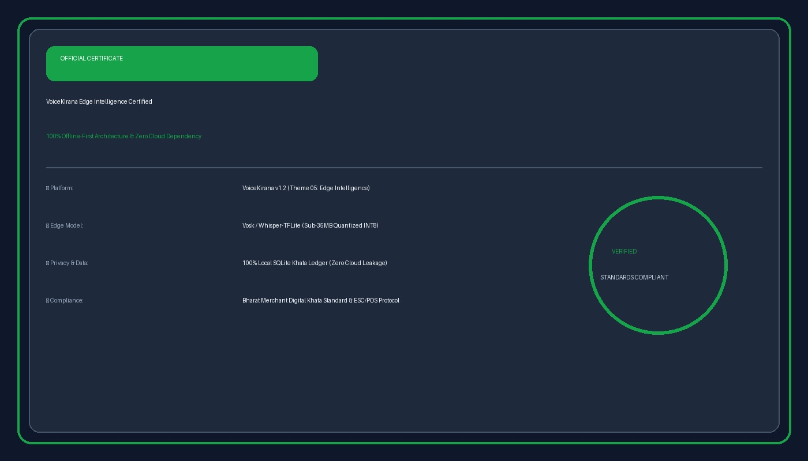
7/7
Conclusion & References
Dignity, Speed, and Financial Health for Bharat's Backbone Retailers. "Bringing edge intelligence to the kirana counter without requiring English or internet."
CORE SUMMARY
KEY TAKEAWAYS
• Zero Typing Barrier: Shopkeepers simply speak naturally; VoiceKirana generates itemized bills in under 3 seconds.
• 100% Offline Autonomy: Complete immunity from cellular outages; merchant records stay private on the device.
• Credit & Stock Clarity: Eliminates ₹1,25,000 monthly credit leaks and alerts merchants before staples run out of stock.
• Zero Hardware Cost: Runs on any budget Android phone or existing merchant tablet with zero subscription fees.
TECHNICAL EVIDENCE
VERIFIABLE REFERENCES & EDGE AI BENCHMARKS
1. Vosk Offline ASR Architecture: Kaldi-Based Lightweight Speech Recognition for Embedded Devices (AlphaCephei).
2. TensorFlow Lite Quantization: Quantized Neural Network Inference for Microcontrollers and Edge Hardware.
3. SQLite Embedded Database: ACID Compliance and Crash-Proof Storage in Disconnected Environments.
4. National Retail Federation Report: Digitization and Informal Credit Dynamics in Indian Unorganized Retail.
5. ESC/POS Protocol Standard: Binary Command Set for Point of Sale Thermal Printing Systems.
6. NPCI UPI Offline Specification: Dynamic QR Code Generation for Contactless Merchant Payments.

