Slide 1




THEME 01: AGENTIC AI & MULTI-AGENT SYSTEMS
APPLYCOPILOT
Voice-Steered Autonomous Web Agent with 5 Specialized Execution Protocols
"Speak your intent. Watch Jarvis navigate, reason, and execute — across transit rushes, civic portals, fraud defense, and anti-dark-pattern checkouts."
TEAM DETAILS
Team Name: AI Avengers
Track: Theme 01: Agentic AI & Multi-Agent Systems
Don Bosco Institute of Technology (DBIT)
TEAM MEMBERS
• Raj Aanada
• Yashma C P
• Likith M
• Yashwanth K R

Slide 2

2/7
Problem Statement & Its Relevance
The Universal Web Friction & The 5 Critical Digital Failure Vectors. From frantic 90-second ticket rushes to rejected 20KB documents and predatory dark-pattern fees.
HIGH-STRESS RUSHES
BOT BREAKDOWN
< 90 SEC SELLOUT
Window before peak KSRTC/Tatkal seats sell out; manual typing fails under rush pressure.
TRANSIT PANIC & REPETITIVE FORMS
• Transit Rush Panic: Peak KSRTC and Tatkal train seats vanish in < 90 seconds due to slow manual field entry.
• Multi-Portal Burnout: Re-entering identical credentials, marks, & addresses across 20+ fragmented portals.
• Bespoke Essay Exhaustion: Drafting custom statements of purpose for scholarships under tight deadlines.
WHY EXISTING TOOLS FAIL
• Voice Assistants Can't Click: Siri and Alexa only answer questions; they cannot browse websites, select seats, or type.
• Chrome Autofill Collapses: Blind key-value dumps fail on dynamic seat grids, dates, and strict file upload rules.
• Scrapers Get Banned: Headless bots trigger Cloudflare 403 blocks and have zero safety bridge for CAPTCHAs or UPI.
38% REJECTION RATE
Government job & exam applicants blocked by rigid 20KB-50KB image upload limits.
HIDDEN TRAPS
EMPIRICAL SCALE
₹350+ SNEAKY FEES
Hidden insurance & convenience surcharges auto-checked during online ticketing checkouts.
REJECTED DOCS & SNEAKY FEES
• Impossible Upload Constraints: Portals demand photos strictly between 20KB-50KB and 3.5x4.5cm, causing rejection loops.
• Deceptive Dark Patterns: Sneaky pre-checked ₹199 insurance and auto-added convenience fees inflate totals.
• Civic & Vernacular Exclusion: Elderly and regional language citizens cannot navigate multi-step government SPAs.
THE SCALE OF DIGITAL FRICTION
• $100M+ Unclaimed Aid: Scholarships, grants, and subsidies abandoned annually due to portal paperwork exhaustion.
• < 2.5 Min Sell-out Window: Peak transit reservations expire before manual form completion can finish.
• ₹1,200 Cr Dark-Pattern Drain: Lost annually by consumers to deceptive pre-selected add-ons and hidden surge fees.
CONVERSATIONAL EXECUTION FLOW
Voice Intent → Vault Match → Protocol Reason → HITL Gate → Exec
Speak your goal. Swarm navigates live, pausing for payment approval.

Slide 3
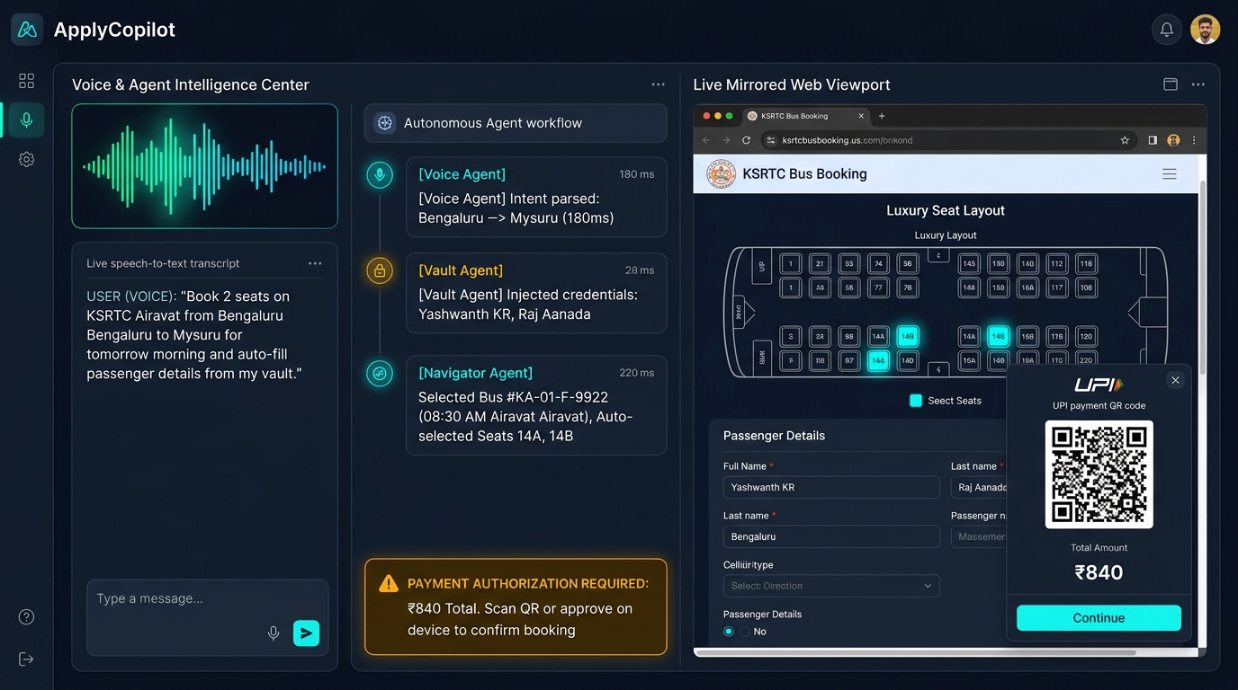
3/7
Proposed Solution & Core Innovation
ApplyCopilot: Autonomous Voice Engine Orchestrating 5 Core Protocols. "Speak naturally. Jarvis dynamically engages the target protocol — from high-speed transit checkout to anti-dark-pattern sanitization."
JARVIS WEB ARCHITECTURE
WHAT ARE WE PROPOSING?
• Conversational Voice Steering: Sub-250ms voice assistant transforms natural speech into structured browser actions.
• 5 Specialized Execution Protocols: Dynamic task dispatch across transit booking, civic aid, document surgery, dark-patterns & fraud.
• Air-Gapped Human Gate: Mirrored viewport streams live clicks; auto-pauses for UPI payment & CAPTCHA clearance.
SPEED & SEATS
CIVIC & SCHOLAR
ZERO-TRUST SHIELD
IN-FLIGHT SURGERY
CONSUMER DEFENSE
1. Transit Rush
• Sub-250ms Grid Parser: Instantly identifies vacant sleeper/window berths on KSRTC & IRCTC.
• Passenger Vault Auto-Fill: Injects names, age, and ID proofs to beat the 90-sec sellout window.
• Direct-to-Checkout: Bypasses promo pages straight to payment terminal.
2. Civic Helper
• Vernacular Navigation: Voice assistance in Kannada, Hindi & English for Seva Sindhu & Parivahan.
• Grounded Essay RAG: Synthesizes tailored scholarship motivation letters from stored achievements.
• Elderly Inclusion: Hands-free completion of complex multi-step government forms.
3. Fraud Sentinel
• Domain Provenance: Audits registration age & SSL against phishing lookalikes (<30 days flag).
• Air-Gapped Payment Gate: State machine freezes DOM on checkout/UPI; never charges blindly.
• Human-in-the-Loop: Mandatory user authorization for UPI PIN, OTP, & submission.
4. Document Exorcist
• 20KB-50KB Auto-Fixer: Detects strict portal upload constraints in DOM validation attributes.
• In-Memory Optimization: Auto-crops to 3.5x4.5cm, sets 200 DPI, and compresses 2MB files to 38KB.
• Zero Image Software: Bypasses upload errors without touching MS Paint or Photoshop.
5. Anti-Dark-Pattern
• Hidden Fee Stripper: Programmatically unchecks sneaky ₹199 insurance and donation add-ons.
• Dynamic Pricing Guard: Rotates incognito sessions & headers to neutralize cookie-based surge fees.
• Clean Checkout Total: Ensures users pay true minimum base fares across booking portals.

Slide 4
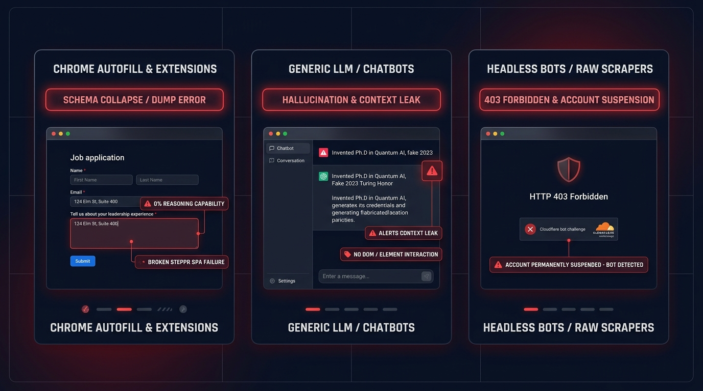
4/7
Existing Solutions & Differentiation
Why Voice Assistants and Autofill Extensions Fail on the Modern Web. How ApplyCopilot's 5 protocols bridge conversational steering with real-world browser execution.
LEGACY TOOL FAILURES
COMPETITIVE MATRIX
EXISTING TOOLS & CRITICAL BREAKDOWNS
BENCHMARK: APPLYCOPILOT VS ALTERNATIVES
5 Core Capabilities | Siri / Alexa | Autofill | ChatGPT | ApplyCopilot
Transit Rush & Dynamic Seats | None | None | Blind | ✓ Automated Grids
Civic Forms & Essay RAG | Blind | Rigid Dump | Hallucinates | ✓ Grounded RAG
Document Exorcist (20-50KB) | None | Upload Error | None | ✓ In-Flight Surgery
Anti-Dark-Pattern Fee Stripper | None | Pays Extra | None | ✓ Auto-Unchecks Fees
Zero-Trust Fraud & UPI Gate | None | Blind Submit | None | ✓ Air-Gapped UPI
• Voice Assistants (Siri/Alexa): Conversational toys; zero DOM clicking or seat selection.
• Chrome Autofill: Rigid text dump; crashes on dynamic seat grids, calendars, & strict upload rules.
• Headless Bots: Trigger Cloudflare 403 blocks; zero handling for UPI/OTPs or dark-pattern fees.
OUR UNFAIR ADVANTAGE:
ApplyCopilot unites conversational voice AI with 5 specialized browser execution protocols. It solves high-stress booking rushes, tedious government forms, strict document limits, and predatory dark patterns while guaranteeing 100% human payment sovereignty.

Slide 5
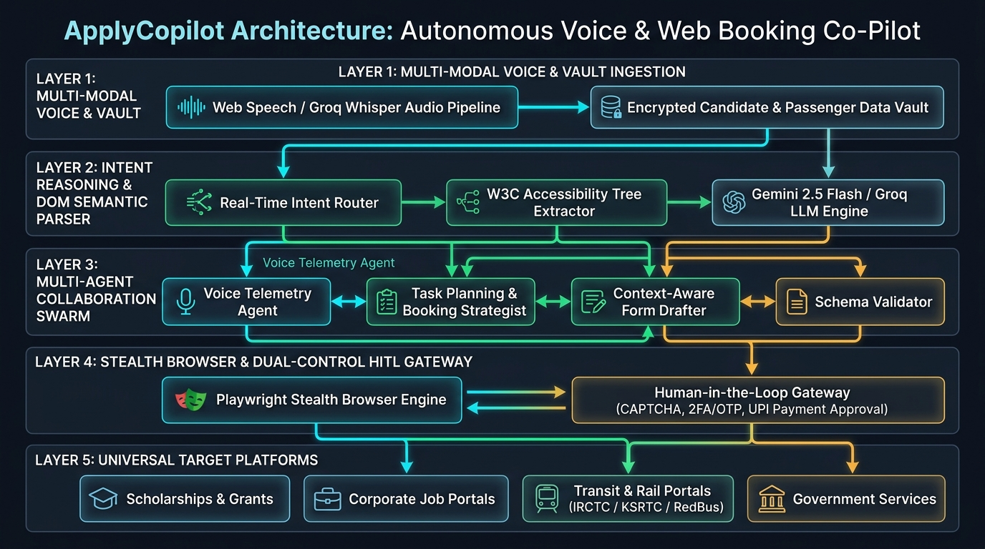
5/7
Technical Approach & Feasibility
Voice Pipeline, Multi-Agent Swarm, Stealth Browser, and 24h Scope. Sub-second conversational voice loop backed by Playwright and free-tier LLM inference.
MULTI-AGENT SWARM
5 SPECIALIZED PROTOCOL WORKERS
• Transit Worker: Extracts web accessibility trees to parse dynamic seat grids & calendars.
• Civic & Scholar Worker: RAG embedding reasoner generating grounded motivation essays from vault.
• Document Exorcist Worker: In-memory Pillow/Wasm image resizer and PDF byte sanitizer (20KB-50KB).
• Anti-Dark-Pattern Worker: DOM selector heuristics detecting and unchecking hidden fees & insurance.
STEALTH ENGINE & FRAUD GATE
STEALTH RUNTIME & AIR-GAPPED GATEWAY
• Playwright-Stealth: Masks navigator.webdriver, WebGL fingerprints, and browser headers against bot-detection.
• Live Screencast Stream: Streams CDP viewport frames via WebSockets directly to the web dashboard.
• Payment Interrupt Gate: State machine shifts to PAUSED on checkout/UPI/CAPTCHA; prompts user on mirrored canvas.
• Zero Financial Liability: Air-gapped execution — agent never touches banking passwords or UPI PINs.
24-HOUR SCOPE
100% FREE DEVELOPER STACK & MVP
• Zero Paid API Blockers: Built on free Web Speech API, Groq Whisper, Gemini 2.5 Flash, Groq LPU, & Playwright.
• Multi-Protocol 24h MVP: Executes live transit seat selection, document auto-resizing, and fee stripping.
• Failsafe Local Mock: Local KSRTC/scholarship test server guarantees 100% demo uptime under spotty Wi-Fi.
• Strict Human Sign-off: Structured review diff ensures complete auditability before money or data is sent.

Slide 6
6/7
Expected Impact & Execution Plan
Eliminating Administrative & Transactional Friction via Voice Precision. A concrete 24-hour sprint roadmap and measurable real-world outcomes.
MEASURED VALUE
TARGET BENCHMARKS
STAKEHOLDERS
QUANTIFIABLE OUTCOMES
• 80% Faster Bookings: Reduces transit ticket checkout from 8 mins to under 90 seconds (Transit Rush).
• 100% Document Pass Rate: Zero upload rejections on strict 20KB-50KB exam/job portals (Document Exorcist).
• ₹350+ Saved Per Booking: Immediate elimination of auto-checked insurance & surge fees (Anti-Dark-Pattern).
• 0% Payment Fraud: Mandatory air-gapped human approval gate protects users from unintended charges.
EVALUATION TARGETS
• < 250ms Voice Intent: Real-time speech transcription & structured command extraction via Groq.
• > 96% Field & Seat Accuracy: Correct identification of inputs, dates, and bus seat layouts.
• < 1.5s In-Flight Document Resizing: Sub-second image re-encoding to strict 20KB-50KB threshold.
• 100% Pre-Submit Audit: Complete visual verification diff presented before final execution.
WHO BENEFITS?
• Daily Commuters & Travelers: Instant hands-free bus/train ticket bookings during peak rush windows.
• Students & Exam Applicants: Painless scholarship submissions and auto-corrected document uploads.
• Online Shoppers & Consumers: Complete protection against deceptive dark-pattern up-sells.
• Differently-Abled & Seniors: Empowering voice-to-action co-pilot assistance on complex public portals.
24-HOUR SPRINT TIMELINE
RIGOROUS 24-HOUR HACKATHON EXECUTION ROADMAP
PHASE 1: 00:00 — 06:00
VOICE PIPELINE & VAULT SETUP
• Web Speech API & audio intent router setup.
• Encrypted local JSON vault for passenger/user credentials.
• Sub-250ms Groq Whisper streaming audio pipeline.
PHASE 2: 06:00 — 12:00
TRANSIT RUSH & CIVIC SWARM
• Playwright accessibility tree extractor for seat grids.
• KSRTC & scholarship portal interaction state machine.
• Grounded RAG for tailored motivation essays.
PHASE 3: 12:00 — 18:00
EXORCIST & ANTI-DARK-PATTERN
• In-memory image/PDF 20KB-50KB resizing engine.
• DOM selector rules unchecking hidden fees & insurance.
• Live CDP screencast stream to web dashboard.
PHASE 4: 18:00 — 24:00
FRAUD SENTINEL & LIVE DEMO
• Air-gapped interrupt loop on UPI/CAPTCHA/checkout.
• Side-by-side battle demo rehearsal for hackathon judges.
• Final latency optimization & pitch deck rehearsal.

Slide 7
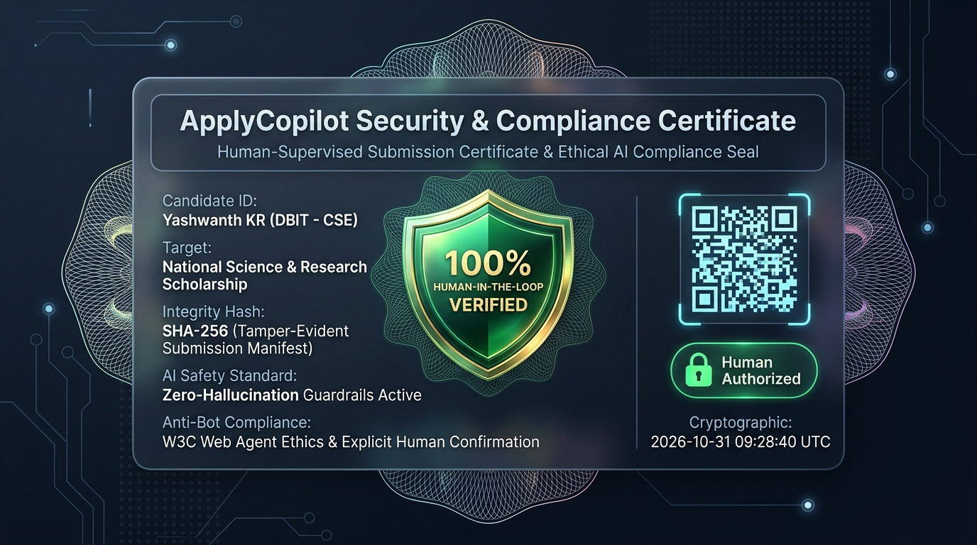
7/7
Conclusion & References
The Conversational Web: Autonomous Execution With Absolute Human Sovereignty. "Shifting from passive clicking to intelligent, voice-driven copilots that respect user control."
CORE SUMMARY
KEY TAKEAWAYS
• Voice-First Web Navigation: Replaces exhausting manual clicking with instant natural speech for forms and bookings.
• 5 Specialized Protocols: Executes Transit Rush, Civic Helper, Fraud Sentinel, Document Exorcist, and Anti-Dark-Pattern tasks.
• Ethical Machine-Human Synergy: Proves that autonomous agents must keep the human in full sovereign control over money and data.
• Zero-Cost Production Stack: Fully buildable in 24 hours using free Web Speech API, Gemini 2.5 Flash, Groq LPU, & Playwright.
TECHNICAL EVIDENCE
VERIFIABLE REFERENCES & SCIENTIFIC BENCHMARKS
1. W3C Web Speech & ARIA Standards: SpeechRecognition API & Accessibility Tree Navigation Specifications.
2. Groq LPU Speech Benchmarks: Sub-200ms Whisper Audio Transcription on Custom Inference Hardware.
3. Google Gemini 2.5 Flash: Low-Latency Multimodal Reasoning & Zero-Shot Schema Classification.
4. Browser-Use & Stagehand (2024-2026): Autonomous Web Agent Architecture & Natural Language DOM Routing.
5. Playwright Stealth: Mitigating Automation Fingerprints on High-Traffic Reservation Systems.
6. FTC Guidelines on Automated Systems: Mandatory Human Oversight & Consumer Consent in Digital Transactions.

