Slide 1

ATULYA
Name : Yash Gaikwad
Adm no. : 21JE1071
IOT Problem Statement

Slide 2
THIS PROJECT IS REGARDING THE CHANGE IN TEMPERATURE IN SURROUNDING

Slide 3
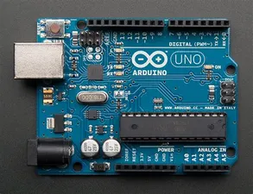
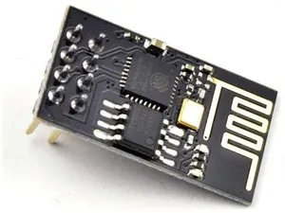
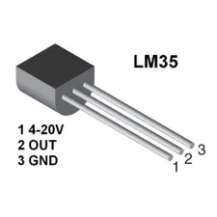
COMPONENTS REQUIRED
(1)Arduino UNO :
(2)Temperature Sensors LM35 :
(3)ESP 8266 WiFi Module :
(4)Breadboard :
(5)Jumper Wire :

Slide 4
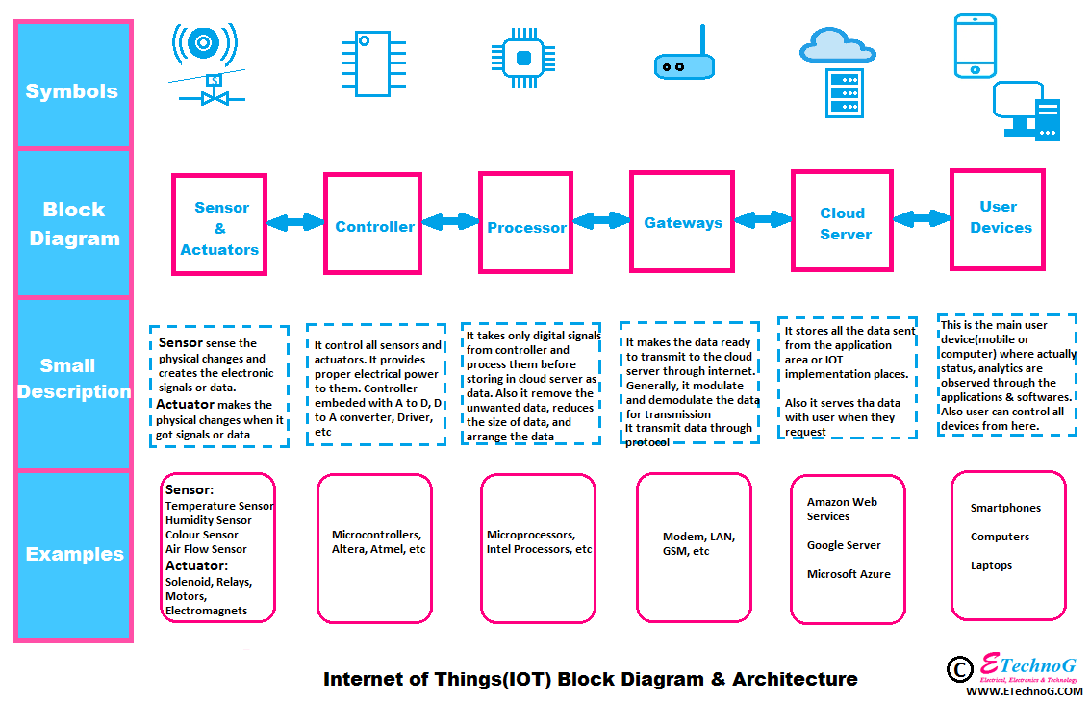
BLOCK DIAGRAM
Temperature Sensor
(LM35)
Controller Arduino UNO
Gateways
Modem,LAN
User device
Cloud Server, Google Sheet

Slide 5
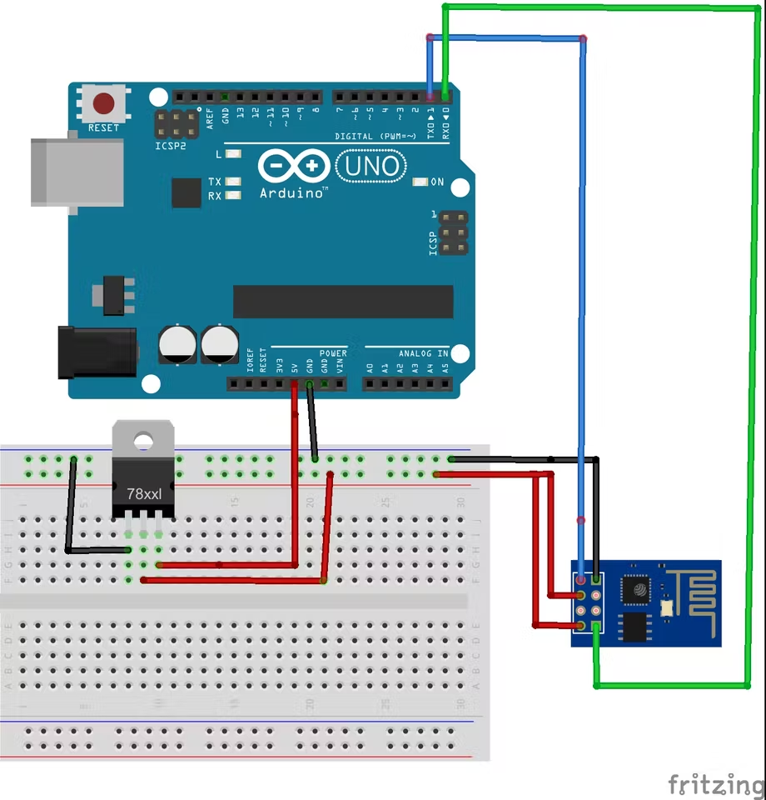
CIRCUIT DIAGRAM
LM35

Slide 6
PSEUDOCODE
Github link :https://github.com/yash21je/Code-for-Iot

Slide 7
RESOURCES
(1)https://www.instructables.com
(2)Roboism workshops
(3)Youtube Channel(https://www.youtube.com/c/StechiezDIY)
(4)https://create.arduino.cc/
(5)https://circuitdigest.com/
Self
Youtube
Websites

Slide 8
TAKEAWAY
In this project I understood basics of sensors,how it works.Also learned how to code on Arduino ide.Adding to list I learned to make circuit diagrams on fritzing.
The main problem I faced during this was of coding part.For this I took help from internet,searching various sites ,watching tutorials on youtube and so on.
I look forward to working new projects like this.

Slide 9
THANK YOU
That’s it from my side
Hope you liked the project
Please provide your valuable feedback

