Slide 1
MEDISCAN
AI
Clinical clarity
when symptoms feel uncertain.
An explainable, physician-in-the-loop triage platform
for safer first decisions.
FULL-STACK ? XAI ? CLINICAL WORKFLOW
Yash Vijay | Solo project | JECRC Foundation, Jaipur
PROJECT PITCH DECK
JECRC FOUNDATION ? JAIPUR
01 / 12

Slide 2
THE MOMENT
The first decision should not be a dead end.
People need direction before they can reach the right care.
01
Static checklists
02
Black-box outputs
03
No clinical handoff
Long forms create fatigue. Missing one symptom can distort the entire picture.
A label without reasoning creates anxiety?not confidence.
Most tools stop at a prediction. Care teams need a reviewable case.
MediscanAI turns symptom uncertainty into an explainable, reviewable next step.
MEDISCANAI
02 / 12

Slide 3
THE ANSWER
One workflow. Three layers of trust.
Adaptive intake ? explainable prediction ? physician review.
01
02
03
ADAPT
?
EXPLAIN
?
REVIEW
Ask only the next relevant question.
Show what influenced the prediction.
Keep a clinician in the loop.
The product is not ?AI replaces a doctor.?
It is ?AI makes the next human decision better informed.?
MEDISCANAI
03 / 12

Slide 4
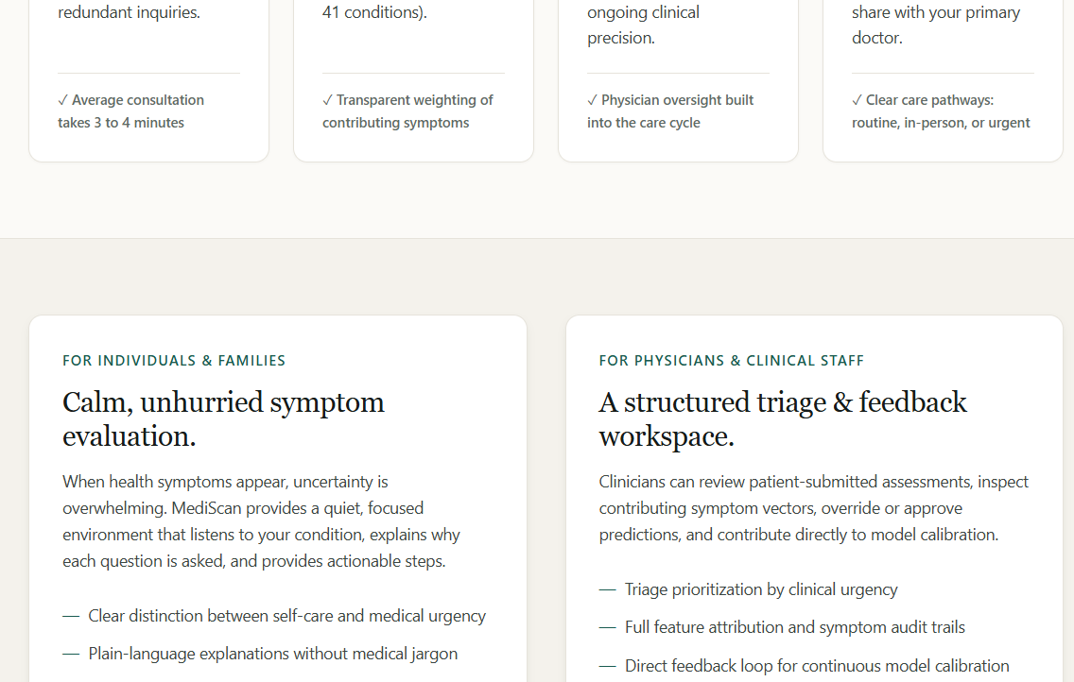
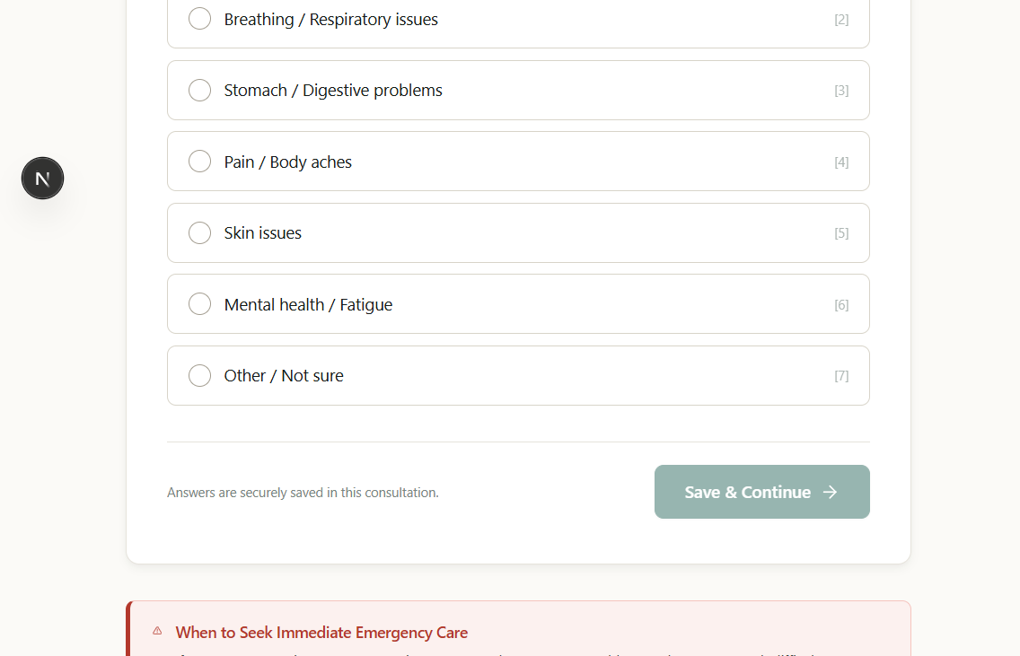
PRODUCT IN ACTION
A patient journey designed for momentum.
Every screen answers: what do I do next, and why?
Landing experience: safety-first positioning
Adaptive questionnaire: focused intake
PATIENT EXPERIENCE
Clear entry point ? low-friction questions ? actionable report
MEDISCANAI
04 / 12

Slide 5
THE DIFFERENTIATOR
A prediction you can interrogate.
MediscanAI pairs a top-three differential with symptom-level evidence.
MODEL OUTPUT
WHY IT RANKED
Top differential
+
Reported symptom
Condition A
78%
+
Supporting feature
Condition B
54%
?
Missing feature
Condition C
31%
!
Safety guidance
Confidence is a signal?not a verdict.
Explainability reduces the ?black box? gap between a model and a clinician.
MEDISCANAI
05 / 12

Slide 6
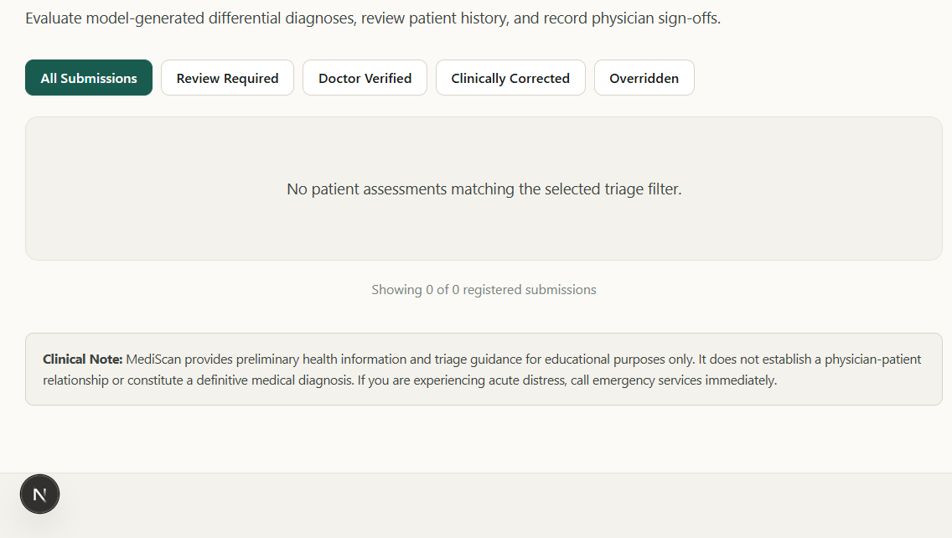
HUMAN-IN-THE-LOOP
The model recommends. The clinician decides.
A review queue turns predictions into accountable care workflows.
?
Review
Inspect symptoms, evidence, and severity context.
?
Decide
Approve, correct, or override the AI output.
?
Learn
Feedback becomes a durable audit trail.
Doctor submissions: triage queue and review status
MEDISCANAI
06 / 12

Slide 7
BUILT TO SHIP
A modular architecture with clear boundaries.
Next.js experience. Express coordination. Python intelligence. PostgreSQL memory.
/predict
FLASK AI ENGINE
:5000
PATIENT / DOCTOR
BROWSER
HTTP
JSON
?
NEXT.JS
CLIENT :3000
?
EXPRESS REST API
:3001
?
SQL
POSTGRESQL
:5432
Containerized locally with Docker Compose ? deployable via Vercel + Render
MEDISCANAI
07 / 12

Slide 8
MODEL CARD, IN ONE SLIDE
Practical ML with transparent boundaries.
A strong baseline, made useful by the surrounding product design.
4,920
132
41
TOP 3
training records
symptom features
disease classes
differential output
?
Inputs
?
Inference
?
Output
Structured symptom vectors from adaptive intake.
Random Forest + serialized preprocessing artifacts.
Attributions, confidence, descriptions, precautions.
MEDISCANAI
08 / 12

Slide 9
TRUST IS A FEATURE
Designed for sensitive workflows from day one.
Security, safety guidance, and auditability are product capabilities?not afterthoughts.
01
Protect
02
Control
03
Account
AES-256-GCM field encryption
Bcrypt password hashing
HTTP-only JWT cookies
Role-based access
Zod validation
CORS + Helmet + rate limits
Append-only audit events
Doctor approval / override
Explicit medical disclaimer
Safety boundary: this is triage assistance?not diagnosis, treatment, or emergency care.
MEDISCANAI
09 / 12

Slide 10
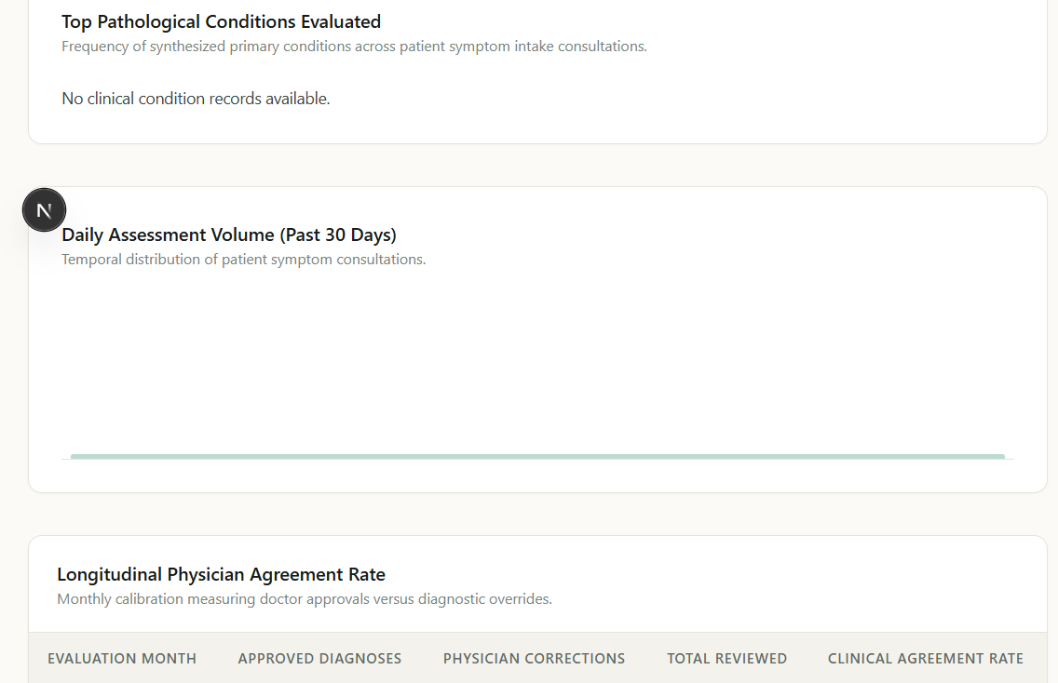
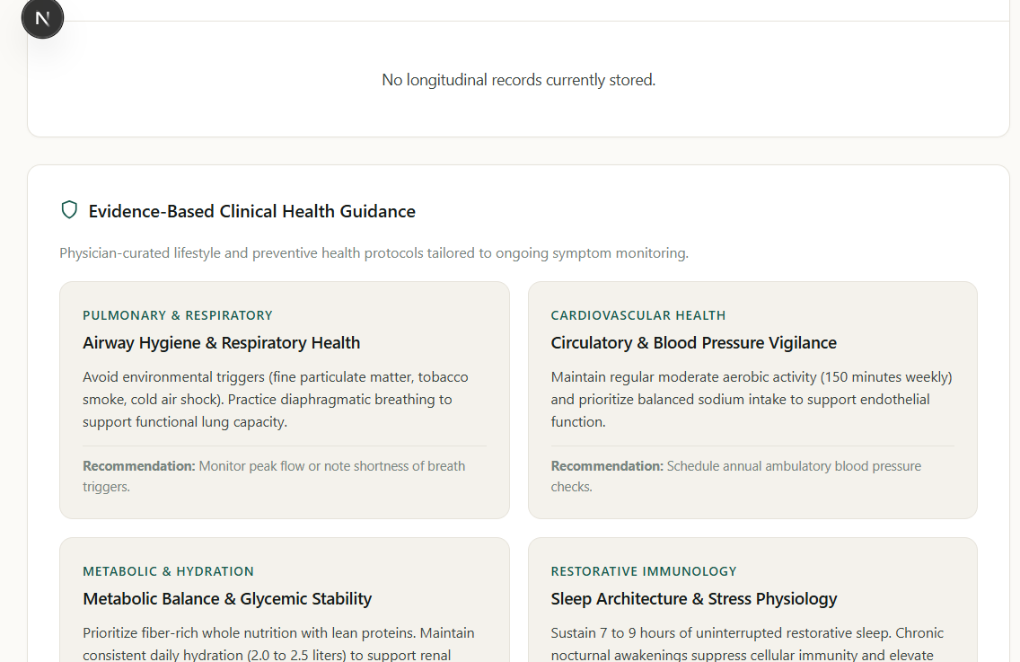
PROOF, NOT PROMISES
A working product with a repeatable evidence pack.
The repository includes browser journeys, responsive screenshots, tests, and deployment manifests.
Clinical analytics: a reviewable system of record
Health report: patient-facing summary and next steps
EVIDENCE PACK
QA journey ? screenshots ? video storyboard ? Jest ? Python tests ? Docker ? Render ? Vercel
MEDISCANAI
10 / 12

Slide 11
WHY THIS CAN WIN
The product closes the loop other symptom checkers leave open.
It is not just a model demo?it is a usable, explainable, accountable workflow.
TODAY
NEXT
Adaptive symptom intake
Calibrate probabilities on broader clinical data
Top-three explainable prediction
Measure clinician agreement and time saved
Clinician review and audit trail
Add multilingual and accessibility-first flows
Responsive, deployable web stack
Connect approved referrals and follow-up care
From ?What might this be??
to ?What should happen next??
MEDISCANAI
11 / 12

Slide 12
The next step in healthcare AI
is not louder certainty.
It is better clarity, shared with the people
who make the final decision.
MEDISCANAI
Yash Vijay ? JECRC Foundation, Jaipur
Architecture + presentation links can be added in the README before submission.
THANK YOU
12 / 12

