Slide 1
CANCER CLASSIFICATION
AND PREDICTION USING NEURAL NETWORKS
Machine Learning Project Presentation
Student: YASH RANA Course: ARTIFICIAL INTELLIGENCE

Slide 2
Project Overview
• Goal: classify samples as benign or malignant using measured cell features.
• Dataset: Breast Cancer Wisconsin Diagnostic dataset.
• Approach: data preparation → neural-network training → test-set evaluation.
• Reported test accuracy from completed Colab run: 96.49%.
Cancer Classification Using Neural Networks | 2

Slide 3
Problem Statement & Objectives
• Build a supervised binary classifier for the dataset target label.
• Inspect data and understand the target classes.
• Preprocess and scale numerical features.
• Train a feed-forward neural network.
• Evaluate performance and explain limitations responsibly.
Cancer Classification Using Neural Networks | 3

Slide 4
Dataset Description
• Public dataset available through scikit-learn.
• Common version: 569 samples and 30 numeric features.
• Features include radius, texture, perimeter, area, smoothness, compactness, concavity and symmetry measurements.
• Target labels: malignant and benign.
• This dataset does not represent every clinical population.
Cancer Classification Using Neural Networks | 4

Slide 5
Tools & Technologies
• Python — programming language.
• Google Colab / Jupyter Notebook — execution environment.
• NumPy and Pandas — data handling.
• Matplotlib and Seaborn — visualisation.
• Scikit-learn — dataset, preprocessing and evaluation.
• TensorFlow / Keras — neural-network model.
Cancer Classification Using Neural Networks | 5

Slide 6
Project Workflow
• 1. Load libraries and dataset.
• 2. Inspect features and target labels.
• 3. Split into training and test sets.
• 4. Apply preprocessing and feature scaling.
• 5. Build and train the neural network.
• 6. Predict test labels and calculate metrics.
• 7. Review confusion matrix and learning curves.
Cancer Classification Using Neural Networks | 6

Slide 7

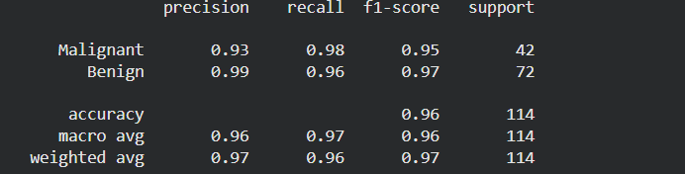
Neural Network Model
• Input: numerical feature vector for each sample.
• Hidden dense layers learn combinations of input features.
• Dropout, if included in the model, can reduce over-reliance on individual units.
• Output layer produces a score for binary classification.
• Parameters are learned from training examples.
Cancer Classification Using Neural Networks | 7

Slide 8
Training & Evaluation
• Training data is used to fit model parameters.
• Training/validation curves help monitor learning.
• Test data estimates performance on held-out examples.
• Accuracy = correctly classified test samples ÷ all test samples.
• Precision, recall, F1-score and confusion matrix provide complementary information.
Cancer Classification Using Neural Networks | 8

Slide 9
Result: Test Accuracy
• Observed test accuracy: 96.49%.
• Approximately 96.49% of test examples were classified correctly in this run.
• Accuracy alone does not describe the types of errors.
• Use actual notebook output for precision, recall, F1-score and confusion-matrix counts.
96.49%
Cancer Classification Using Neural Networks | 9

Slide 10
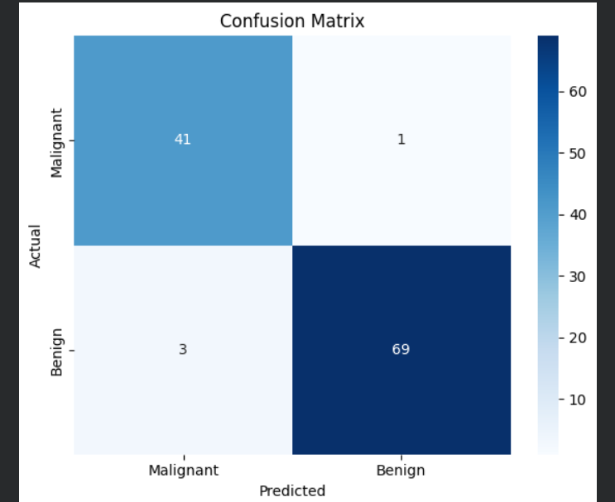
Understanding the Metrics
• Accuracy: overall proportion of correct predictions.
• Precision: how often positive predictions are correct.
• Recall: how many actual positive cases are identified.
• F1-score: balance between precision and recall.
• Confusion matrix: correct and incorrect predictions by class.
Cancer Classification Using Neural Networks | 10

Slide 11
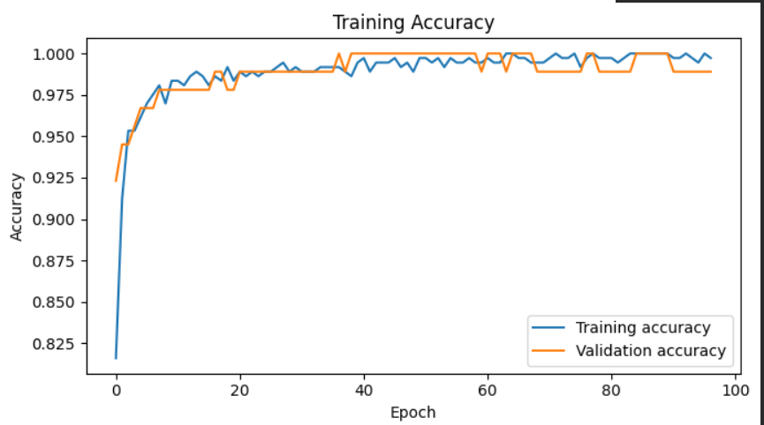
Screenshots for Project File
• Dataset preview and class distribution.
• Neural-network model summary.
• Training output and final evaluation metrics.
• Confusion matrix.
• Training/validation accuracy and loss curves.
• Use screenshots from your own Colab run; illustrative examples are not real outputs.
Cancer Classification Using Neural Networks | 11

Slide 12
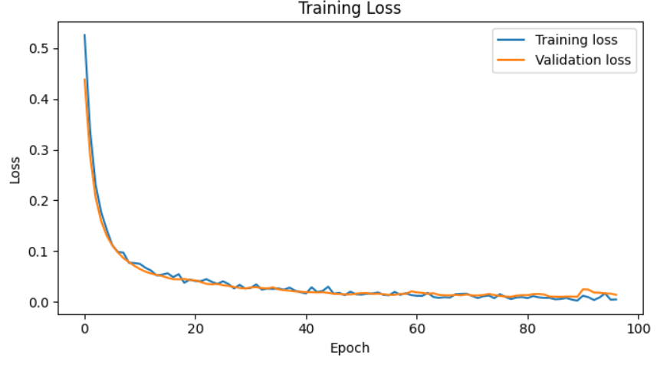
Limitations & Responsible Use
• This is an educational demonstration, not a clinical diagnostic system.
• Dataset size and composition limit generalisation.
• A single train/test split can produce variable results.
• False negatives and false positives have different consequences.
• Clinical use requires rigorous independent validation, expert oversight and regulatory review.
Cancer Classification Using Neural Networks | 12

Slide 13
Future Improvements
• Use stratified cross-validation and report variability.
• Compare against logistic regression, SVM and tree-based models.
• Report sensitivity, specificity, ROC-AUC and calibration.
• Perform error analysis and test on independent data.
• Improve reproducibility through fixed seeds and versioned dependencies.
Cancer Classification Using Neural Networks | 13

Slide 14
Conclusion
• The project demonstrates an end-to-end neural-network classification workflow.
• The completed run achieved 96.49% test accuracy.
• Preprocessing, training and evaluation are all essential.
• The result must be interpreted carefully; this model must not be used for medical decisions.
Cancer Classification Using Neural Networks | 14

