Slide 1
MNIST Handwritten Digit Recognition
Project Presentation
Deep Learning Project
Student: YASH RANA
College: NAVIOTECH SOLUTION

Slide 2
Project Overview
Recognize handwritten digits from 0 to 9.
Use labeled images from the MNIST dataset.
Train a neural network and evaluate it on unseen test images.
Demonstrate a prediction and save the trained model.

Slide 3
Problem Statement
Handwritten digits vary in shape, thickness, and writing style.
Classify each input image into one of ten classes (0–9).
Generalize to images that were not used during training.

Slide 4
Project Objectives
Load and preprocess the MNIST dataset.
Build and train a neural-network classifier.
Measure test accuracy and test loss.
Show sample predictions and save the trained model.

Slide 5
Dataset: MNIST
Grayscale handwritten digit images labeled 0 through 9.
Images are commonly 28 × 28 pixels.
Training data teaches patterns; test data measures generalization.
Insert a screenshot of sample MNIST images from your notebook here.

Slide 6
Tools and Technologies
Python
Google Colab / Jupyter Notebook
TensorFlow / Keras (confirm against notebook imports)
MNIST dataset
GitHub for sharing and version control

Slide 7
Workflow
1. Load dataset → 2. Preprocess images → 3. Build neural network
4. Train for 5 epochs → 5. Evaluate on test set → 6. Predict sample digits
Insert a simple workflow diagram or notebook screenshot here.

Slide 8
Model Training
The model was trained for 5 epochs.
Final reported validation accuracy: 97.53%.
Training accuracy increased across the displayed epochs.
Insert your actual training-history screenshot here.

Slide 9
Evaluation Results
Actual Notebook Results
Test accuracy: 97.22%
Test loss: 0.0916
Final validation accuracy: 97.53%
Values are from the completed Google Colab run.

Slide 10
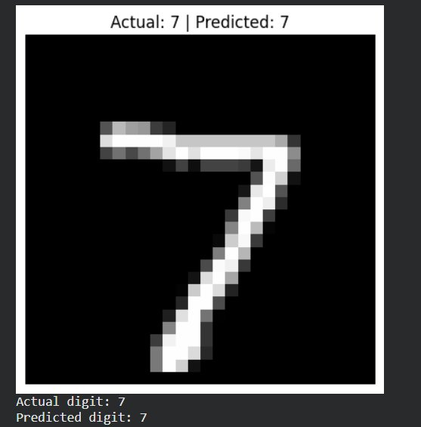
Sample Prediction
The displayed sample image was digit 7.
The model predicted 7 for that sample.
Insert your actual prediction screenshot here.
One correct example illustrates the workflow; test accuracy measures broader performance.

Slide 11
Conclusion and Future Work
The notebook trained and evaluated an MNIST digit classifier.
The model achieved 97.22% test accuracy.
Future work: confusion matrix, review misclassifications, compare architectures, and build an interface.

Slide 12
Thank You
MNIST Handwritten Digit Recognition
Questions?
Repository: https://github.com/yash230906/mnist-digit-recognition
Student: ____________________

