Slide 1

DARSHAN UNIVERSITY
YASH PIPALAVA
23010101208
SEMESTER:3
BRANCH:CSE
DARSHAN UNIVERSITY

Slide 2
ABOUT DARSHAN UNIVERSITY
Darshan University (DU), is a prominent organization offering a broad slate of academic programs and professional courses for undergraduate, graduate and postgraduate programs in Engineering, Science & Technology. The University is located in peaceful and sylvan surroundings with distinctive collegiate structure, about 19 km from Rajkot, Gujarat, India. It was established as an Engineering Institute in the year 2009, by Shree G. N. Patel Education & Charitable Trust with the objective to impart quality education and training in various fields of Engineering and Technology. It has now been transformed to the DARSHAN UNIVERSITY through an Act by the Government of Gujarat under Gujarat State Private Universities (Amendment) Act, 2021 (Act no. 15).
From its inception, the organization has grown steadily and created a unique identity in the field of Engineering & Technology by implementing skill and training-based foundation for education. The academic environment at the campus creates an ambience to promote creativity and exploration of technical skills. Darshan University is committed to the generation of knowledge, innovations and its contribution towards the development of the Nation.

Slide 3

OUR MOTTO
This verse advises us to perform our allocated duty excellently. Kaushalam signifies doing work with devotion and without attachment. Such detached attitude enhances its values and improves the concentration and skill of the worker. If we work with elegance, fortitude, and skill our Body-Mind-Soul will co-operate with our hands. Any work becomes valuable if carried out with full concentration, dedication, and abilities and also helps us to become valuable to others as well as to society

Slide 4
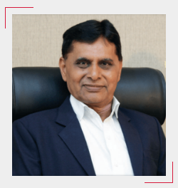

ADMINISTRATIVE LEADERSHIP
Dr. Ramnik G. Dhamsaniya, the vibrant and visionary President of Darshan University and prominently recognized as a pivotal pillar and an outstanding administrator in the field of education. Upon completing his Bachelor of Civil Engineering from Lukhdhirji Engineering College, Morbi, Master of Engineering in Structural Engineering & Ph.D. in Concrete Technology from Birla Vishvakarma Mahavidyalaya (BVM), Sardar Patel University.
He has started his career as a lecturer at L. E. College Morbi and worked for 10 years. In 1996, he has moved to V. V. P. engineering college where he has played vital role in the infrastructural & academic development of the institute. He has also worked as a Principal in Atmiya Institute of Technology and Science for Diploma Studies for 2 years.
During 40 years of his career, He has notably contributed to the development of a quality-focused educational system and institutional governance. Being a powerful blend of distinguished academician and profound visionary, he has successfully contributed to bridging the gap between academics and industries. With the notion of skill-based education, he has established Darshan University, which is committed to developing a conducive learning environment, strengthening student progression and promoting value-based education.

Slide 5
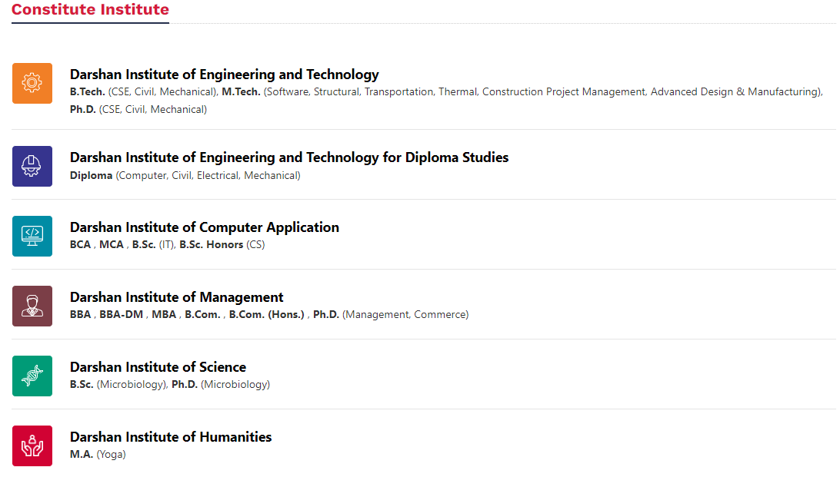
CONSTITUTE INSTITUTE

Slide 6
GOVERNMENT LICENSES
Sr . | Authorization / Certification | Approving Organization
1 | Electrical Contractor | Government of Gujarat
2 | Energy Auditor | Government of Gujarat
3 | Energy Audit Consultant | Gujarat Energy Development Agency (GEDA)
4 | ESCO Grade “BEE Grade – 3” | BEE (Bureau of Energy Efficiency), Ministry of Power, Government of India
5 | SI Grade – “SP 3B” | ICRA assigned System Integrator for MNRE, Government of India
6 | Energy Auditor | Government of Mauritius
7 | NGOs / Non-Profit Organizations | MNRE, Government of India
8 | Environmental Auditor (Schedule-I) | Gujarat Pollution Control Board approved Environment Auditor for Schedule-I category Industry
9 | Structural Designer | RMC - Rajkot Municipal Corporation
10 | Material Testing Laboratory | R & B - Road & Building department(Government of Gujarat)
 |  | RUDA - RajkotRUDA - Rajkot Urban Development Authority Urban Development Authority
 |  | NABL - National Accreditation Board for testing and calibration laboratories

Slide 7

ABOUT ASWDC (SKILL DEVELOPMENT)
The department is proud to announce its "ASWDC - Apps, Software & Website Development Center". ASWDC is established by the Department of Computer Engineering, where students work on live projects under the guidance of faculty and industry experts. Students are getting extensive knowledge and industrial experience of cutting edge technologies.
ASWDC fills the gap between academic curriculum and industry expectations. The centre fulfils the software & website requirements of the Institute. Some of the developed programs are DLib – Darshan Library Management Software, TTMS – Time Table Management Software, Fees Collection Software, Attendance Manager, etc. A team of faculty and students has developed iPhone, Android and Windows APPS for the library, Students details for parents (DParent) and Engineering Admission (ACPC).

Slide 8
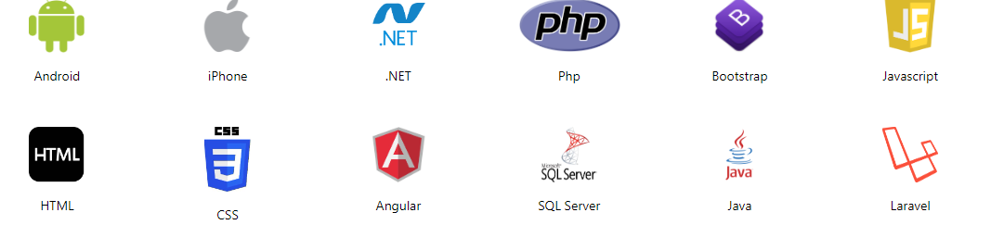
TECHNOLOGIES WE WORK

Slide 9
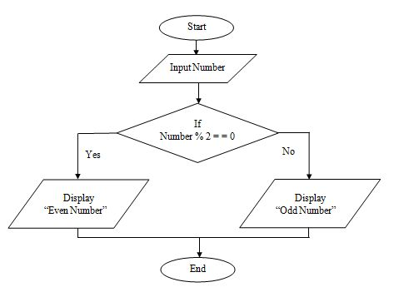
FLOWCHART (ODD/EVEN)

Slide 10

CURRICULUM
 | For DU students | Exam Result Darshan University MA Semester-2 & 4 Regular Summer-2024 Exam result has been declared on 12 August 2024. The last Date for the application and fee payment (Online) of Recheck/Reassessment is 15 August 2024.
 | For DU students | Exam Result Darshan University MBA Trimester-3 Remedial Autumn-2024 Exam result has been declared on 12 August 2024. The last Date for the application and fee payment (Online) of Recheck/Reassessment is 15 August 2024.
 | For DU students | Exam Result Darshan University MBA Trimester-4 Regular Autumn-2024 Exam result has been declared on 12 August 2024.
 | For DU students | Academic Calendar Academic Calendar - A.Y. 2024–25 - Semester 1 - B.Sc. - IT, B.Sc. (Hons.) - CS, B.Sc. - Microbiology, MCA

