Slide 1

Self-Evolving Deployment Validation System
Aself-evolving,end-to-enddeploymentvalidation systemthat fuses
blockchain immutability,AI-driven securityintelligence,andmulti-agent consensus tocreateacontinuously adaptingand future-proof deployment pipeline.

Slide 2
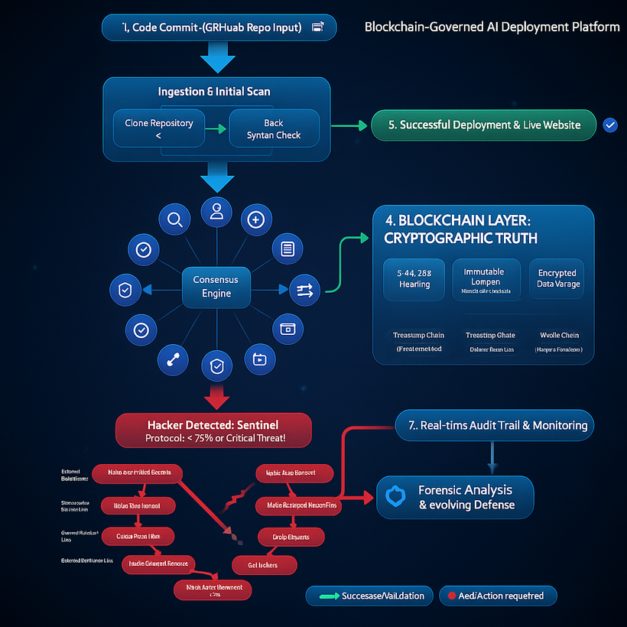
Flowchart of our Self-Evolving Deployment Validation System

Slide 3
Our Mission
Prevent Malicious Code
Ensure Compliance
Blockthreatsbeforetheyreachproduction environments
Automaticregulatorycompliance across all deployments
Immutable Audit Trails
AI Consensus
algorithms
Cryptographicallyverifiedrecords of every decision
Morereliablethanhuman judgment through advanced

Slide 4

13 Specialized AI Agents
Our revolutionary multi-agent system uses 13 specialized AI agents
working in parallel to validate every deployment with mathematical
precision.

Slide 5


Blockchain Construction & Validation
Immutable hash chaining
SHA-256 cryptographicsecurity AI-agent consensus validation
Block Hash = SHA256(previous_hash + current_data + timestamp + nonce)

Slide 6
The Agentic AI Approach
Autonomous Agents
Multi-Agent Systems
Self-governingAIentitiescapable of independent action, learning, and adaptation within dynamic environments.
Frameworks wheremultipleautonomous agents interact and
coordinate to achieve common goals, leveraging distributed intelligence.
Collaborative Decisions
Complex Problem Resolution
Agents employsophisticated protocols and frameworks to share information, negotiate, and collectively arrive at optimal solutions.
Byworkingsynergistically,thesesystems can tackle highly
intricate and large-scale challenges beyond individual agent capabilities.

Slide 7

The Future of Secure Deployments
1
Zero-TrustArchitecture
No single point of failure through distributed consensus
2
Mathematical Guarantees
Cryptographicverificationofeverysecurity decision
3
Immutable Audit
Blockchain-recorded deployment history
4
AI Evolution
Continuous learning and threat adaptation
Transforming deployment security from reactive to proactive, predictive,
and mathematically guaranteed.

Slide 8
Research Paper link-
https://www.sciencedirect.com/science/article/pii/S2096720922000070?utm_source=chatgpt.com
https://cybersecurity.springeropen.com/articles/10.1186/s42400-024-00324-7?utm_source=chatgpt.com

Slide 9
Security Concerns examples links
https://www.biometricupdate.com/202509/misconfigured-servers-expose-252-million-identity-records-across-seven-nations?utm_source=chatgpt.com
https://www.forthepeople.com/blog/morgan-morgan-investigating-talenthook-data-breach-may-have-exposed-over-26-million-resumes/
https://techcrunch.com/2025/03/31/api-testing-firm-apisec-exposed-customer-data-during-security-lapse/
https://www.theguardian.com/australia-news/2025/sep/10/nsw-government-leaked-confidential-medical-documents-doctors-outraged-personal-professional-data-online

