Slide 1

Customer Existing Rule Test

Slide 2
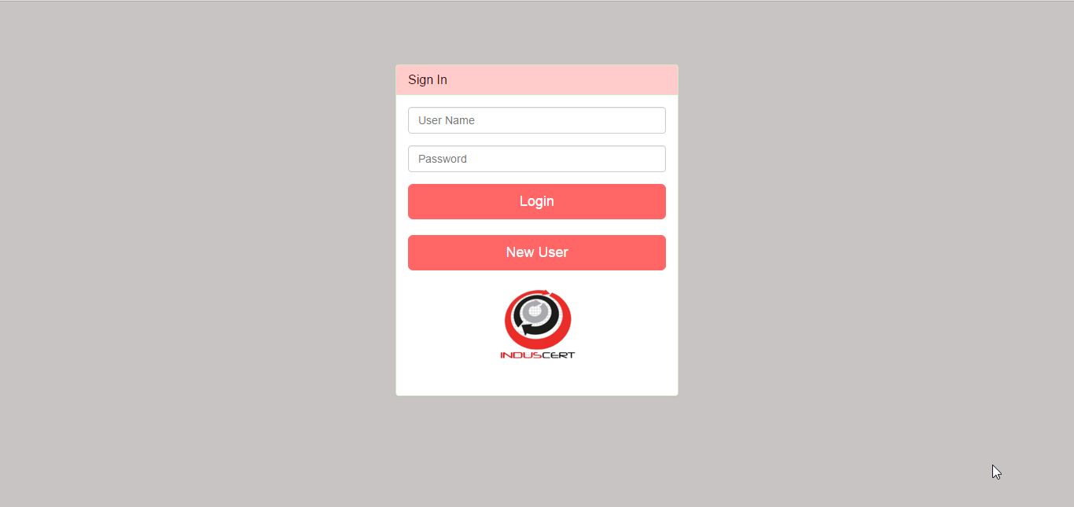
Login

Slide 3
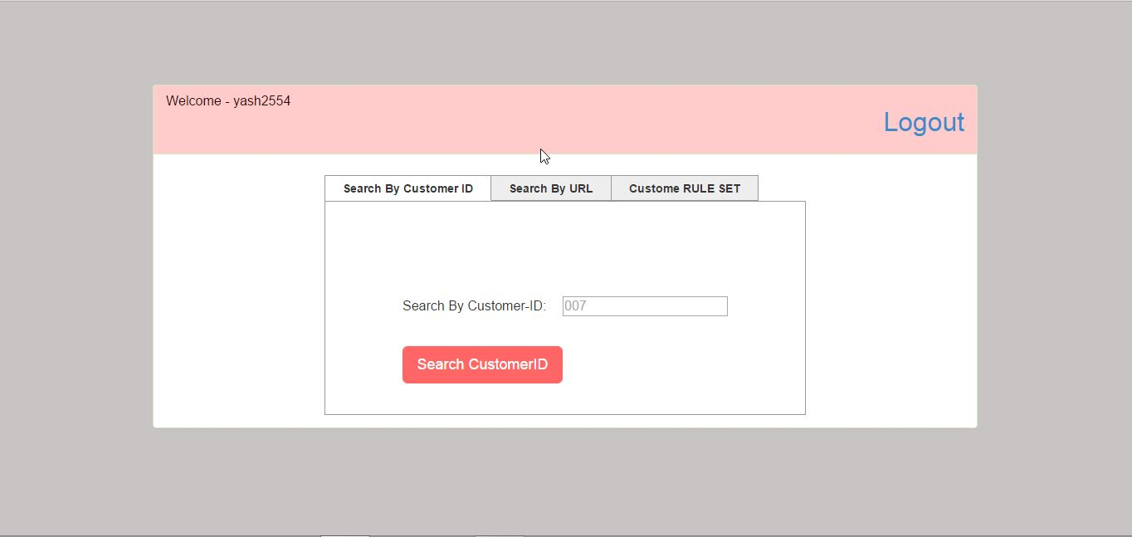
User’s Dashboard

Slide 4
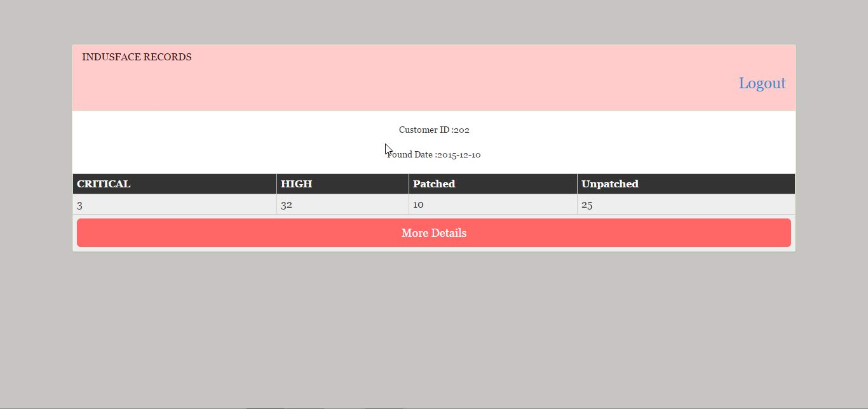
Display Summary

Slide 5
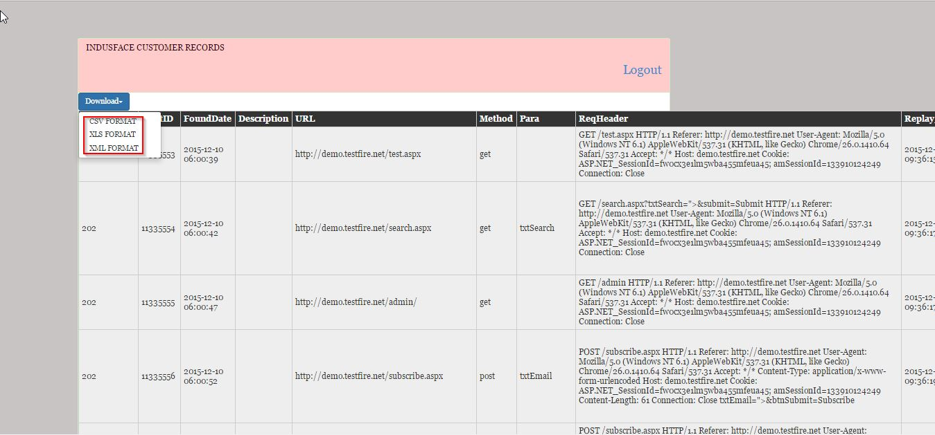
Detailed Report

Slide 6
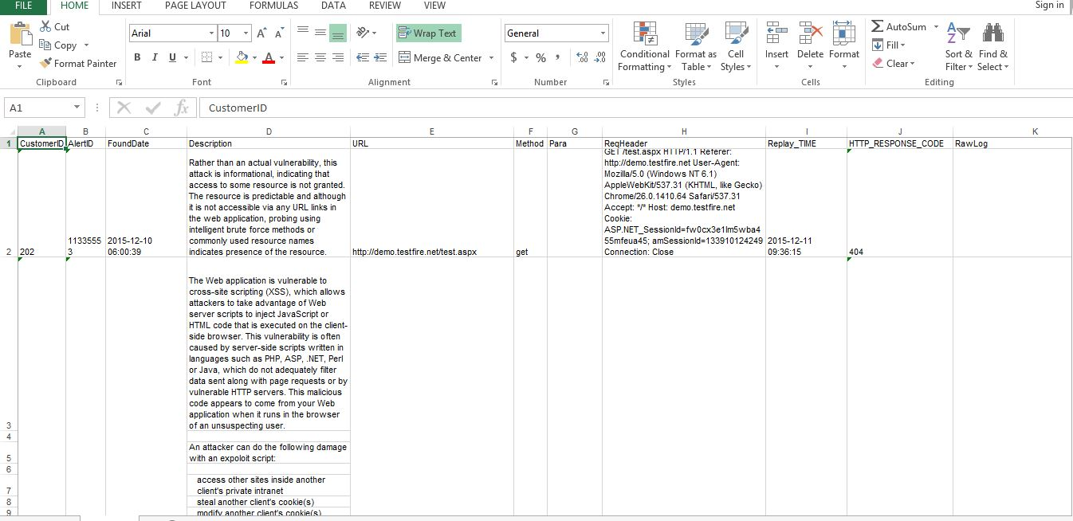
Exported Report ( CSV | Excel | XML )

Slide 7
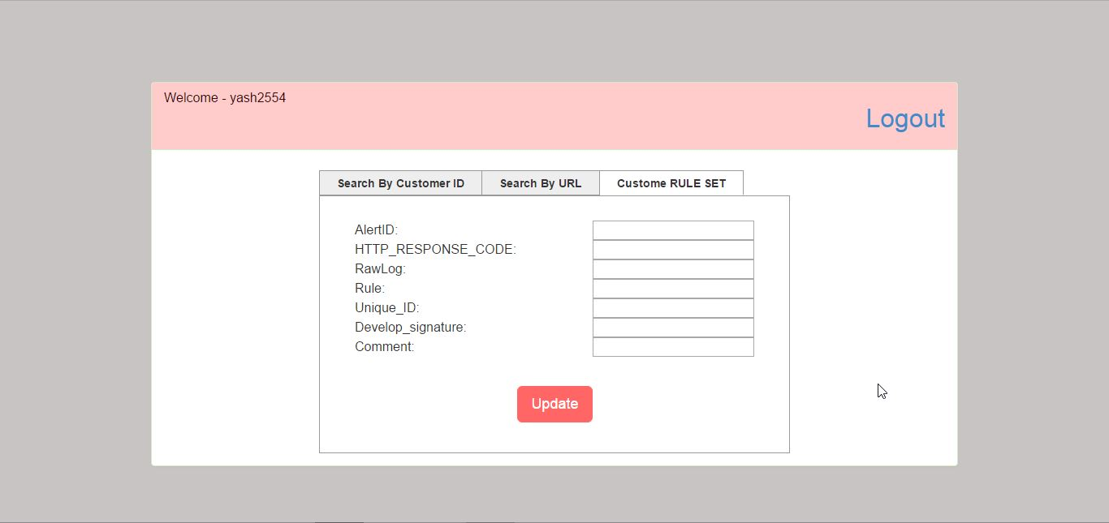
Custom Rule Update

Slide 8
Thank You

Slide 9
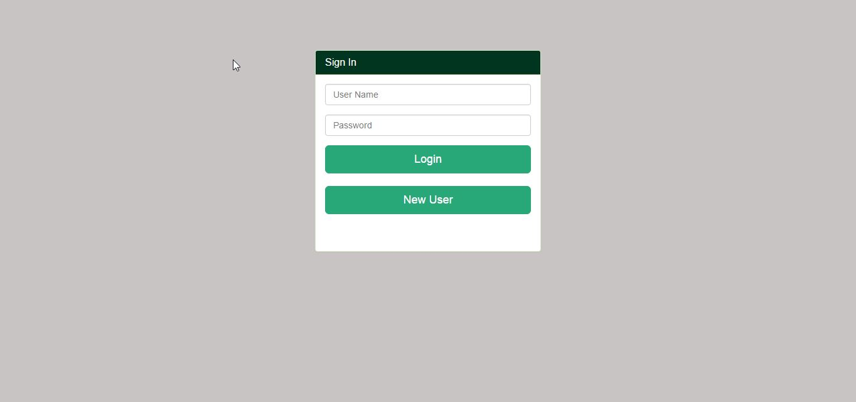
AutoIT-RuleGenerator

Slide 10
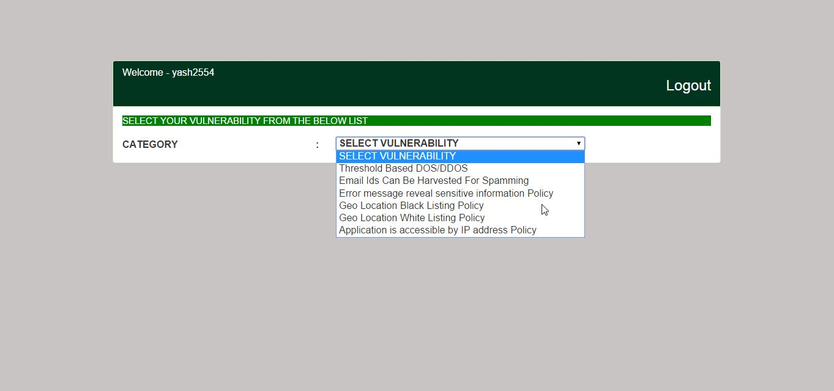
User’s Dashboard

Slide 11
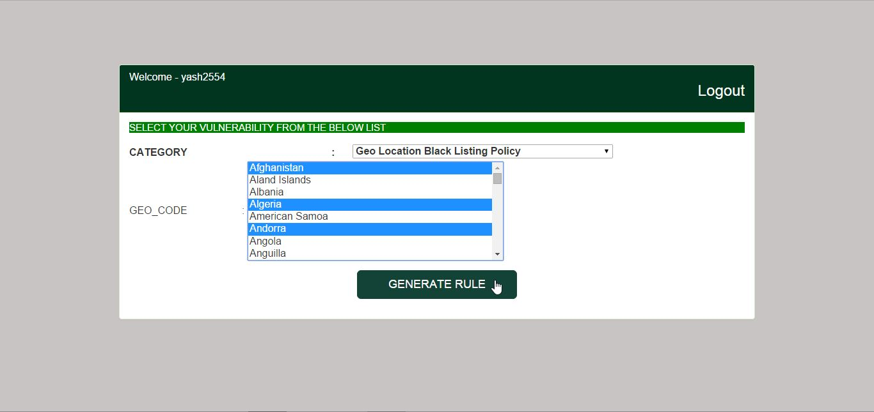
Example for Black listing specific country

Slide 12
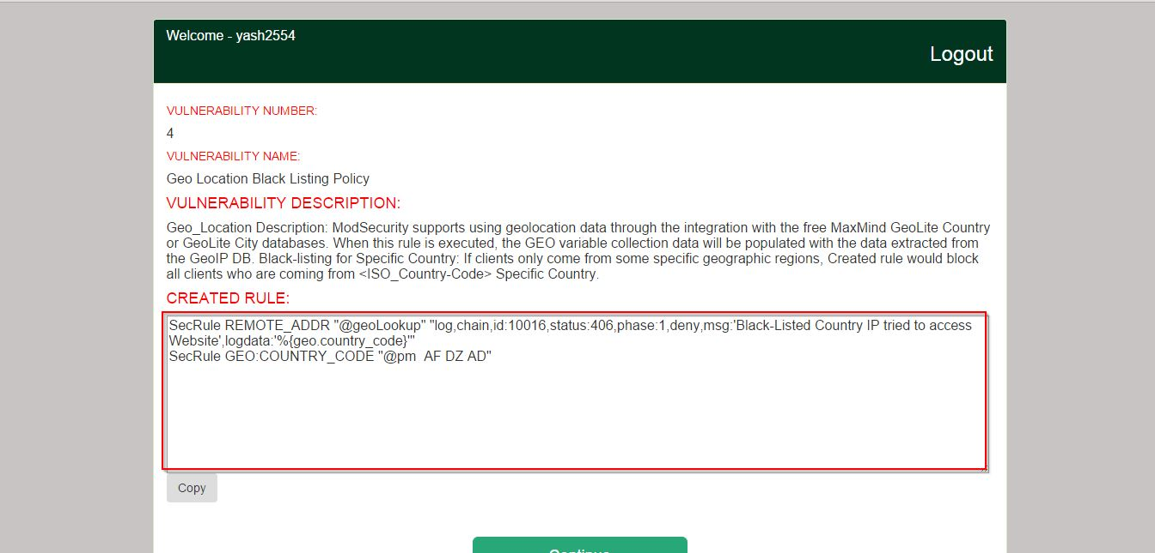
Generated Rule ( with necessary description )

Slide 13
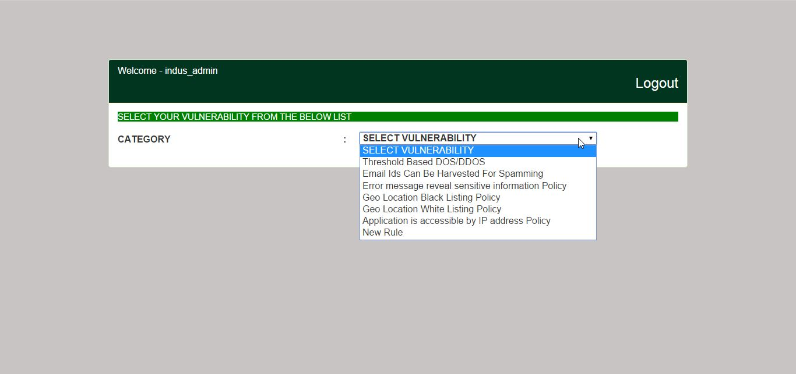
Admin Panel

Slide 14
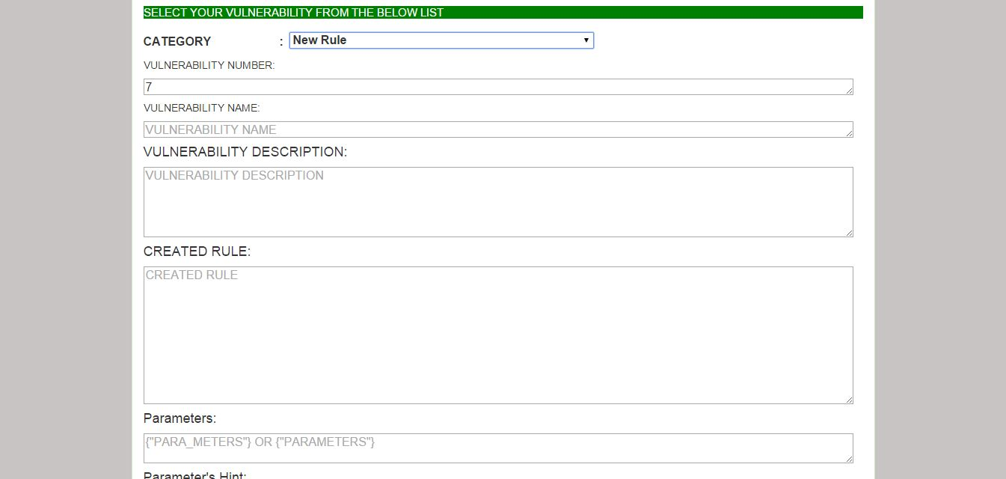
Insert New Rule

Slide 15
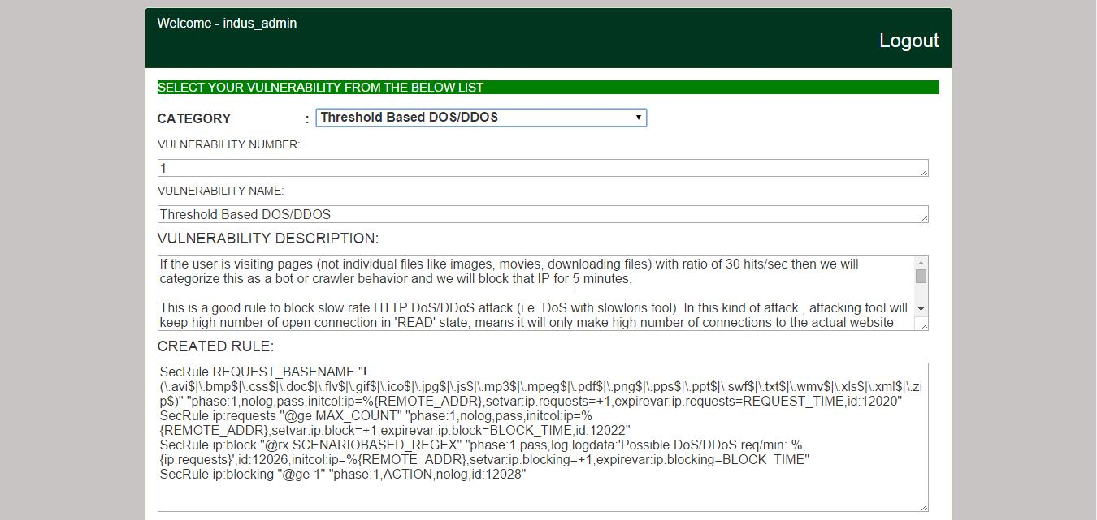
Update Existing Rule

Slide 16
Thank You

