Slide 1
Network Aware Defenses for Intrusion Recognition and Response
(N.A.D.I.R.)
Assawakomenkool, Nont
Patel, Yash
Notes:
Greetings !
Introduce authors and project definition.

Slide 2
Introduction
Computer networks is important
Number of people who attempt to break into the network is increased too!
Difficult to monitor the computer networks as they have grown in scale
Reactions to attacks are delayed
How to provide earlier notification of potential network attacks?
Notes:
Computer networks is become more important of people’s everyday lives.
Big company!, small company, grocery, local store, or even people’s house everywhere have computer networks, either small or large scale.
Since people agree with the important of computer networks, they also agree with the increasing of attackers or hackers.
People love to challenge something that’s hard to get. We can say this group of people attack the computer network just for fun or to prove themselves.
But, they also have another group who make it for money.
So, with these two basic reasons, it makes people have a hard time to monitor the computer networks and make a good reaction.

Slide 3
Previous work
IDS/IPS – Anomaly Detection
- F. Iglesias and T. Zseby, “Analysis of network traffic features for anomaly detection,” Machine Learning, vol. 101, no. 1, pp. 59–84, 2015. [Online]. Available: http://dx:doi:org/10:1007/s10994-014-5473-9
Port Hoping
- Y.-B. Luo, B.-S. Wang, and G.-L. Cai, “Analysis of port hopping for proactive cyber defense1,” SERSC International Journal of Security and Its Applications, vol. 9, no. 2, pp. 123–134, 2015
Honeypots
L. Spitzner, “Honeypots: Catching the insider threat,” Honeypot Technologies Inc
Can we have advantages of honeypots without overhead?
Notes:
Now-a-day, we have many technologies or devices in the area of network security. Intrusion Detection, Intrusion Prevention System and Honeypots are members of this group.
The idea of IDS/IPS is to detect or prevent the malicious traffic, and Honeypots is a computer system that act as a decoy to detect and study attempts to gain unauthorized access
Threat detection and vulnerability patches are important though the easiest way to defend machine is to hide information or make the machine invisible into the network.
Port hoping is the defense technology which hides service information of the system and confused attackers when they try to reconnaissance by altering services ports
So, can we have the advantages of these two things?

Slide 4
Our Approach
Create a tool by utilizing existing network infrastructure feature in order to provide N.A.D.I.R. (Network Aware Defenses for Intrusion Recognition and Response )
The idea of N.A.D.I.R. system is to provide earlier notification by using deceptive network service information as decoy
Transform legitimate server into a “Honeypot” without setting up a fake network infrastructure
Services on the server is up-to-date (not vulnerable)
A vulnerable software versions will be advertised when a potential attack is detected
By fake vulnerable points;
Collect information about attacks earlier in the reconnaissance phase
Potentially catch attackers in the act without exposing any actual system weakness
Notes:
Our approach is to create the tool that can provide an earlier notification.
With this point, we use the advantages of honeypot combine with the intrusion detection system.
The NADIR system will help the legitimate server to identify between normal and abnormal traffic.
If the attack is detected, the NADIR system will announce the vulnerable services. Or we can say, the legitimate server will act as a Honeypot.
And again, with the advantage of the Honeypots, we can study or collect the information about attacks in the observation phase.
The services on the service are up-to-date versions at all times
With the fake weak point, the attacks against these services will be unsuccessful because the services on our server are not actually vulnerable service

Slide 5
Threat Modeling
Remote attack
Cannot get into a target server physically
Adversaries do not know about N.A.D.I.R. system
Attack the target server with no suspect
Notes:
The condition of attack is base on remote attack.
And, our system is hidden. So, the attacker will know nothing about it.

Slide 6
Experiment
Network setup and launching attack
Dataset preparation
Data modeling and Machine learning
Snort configuration
Notes:
In the experiment section, we will divide it into four subsections which are listed below

Slide 7
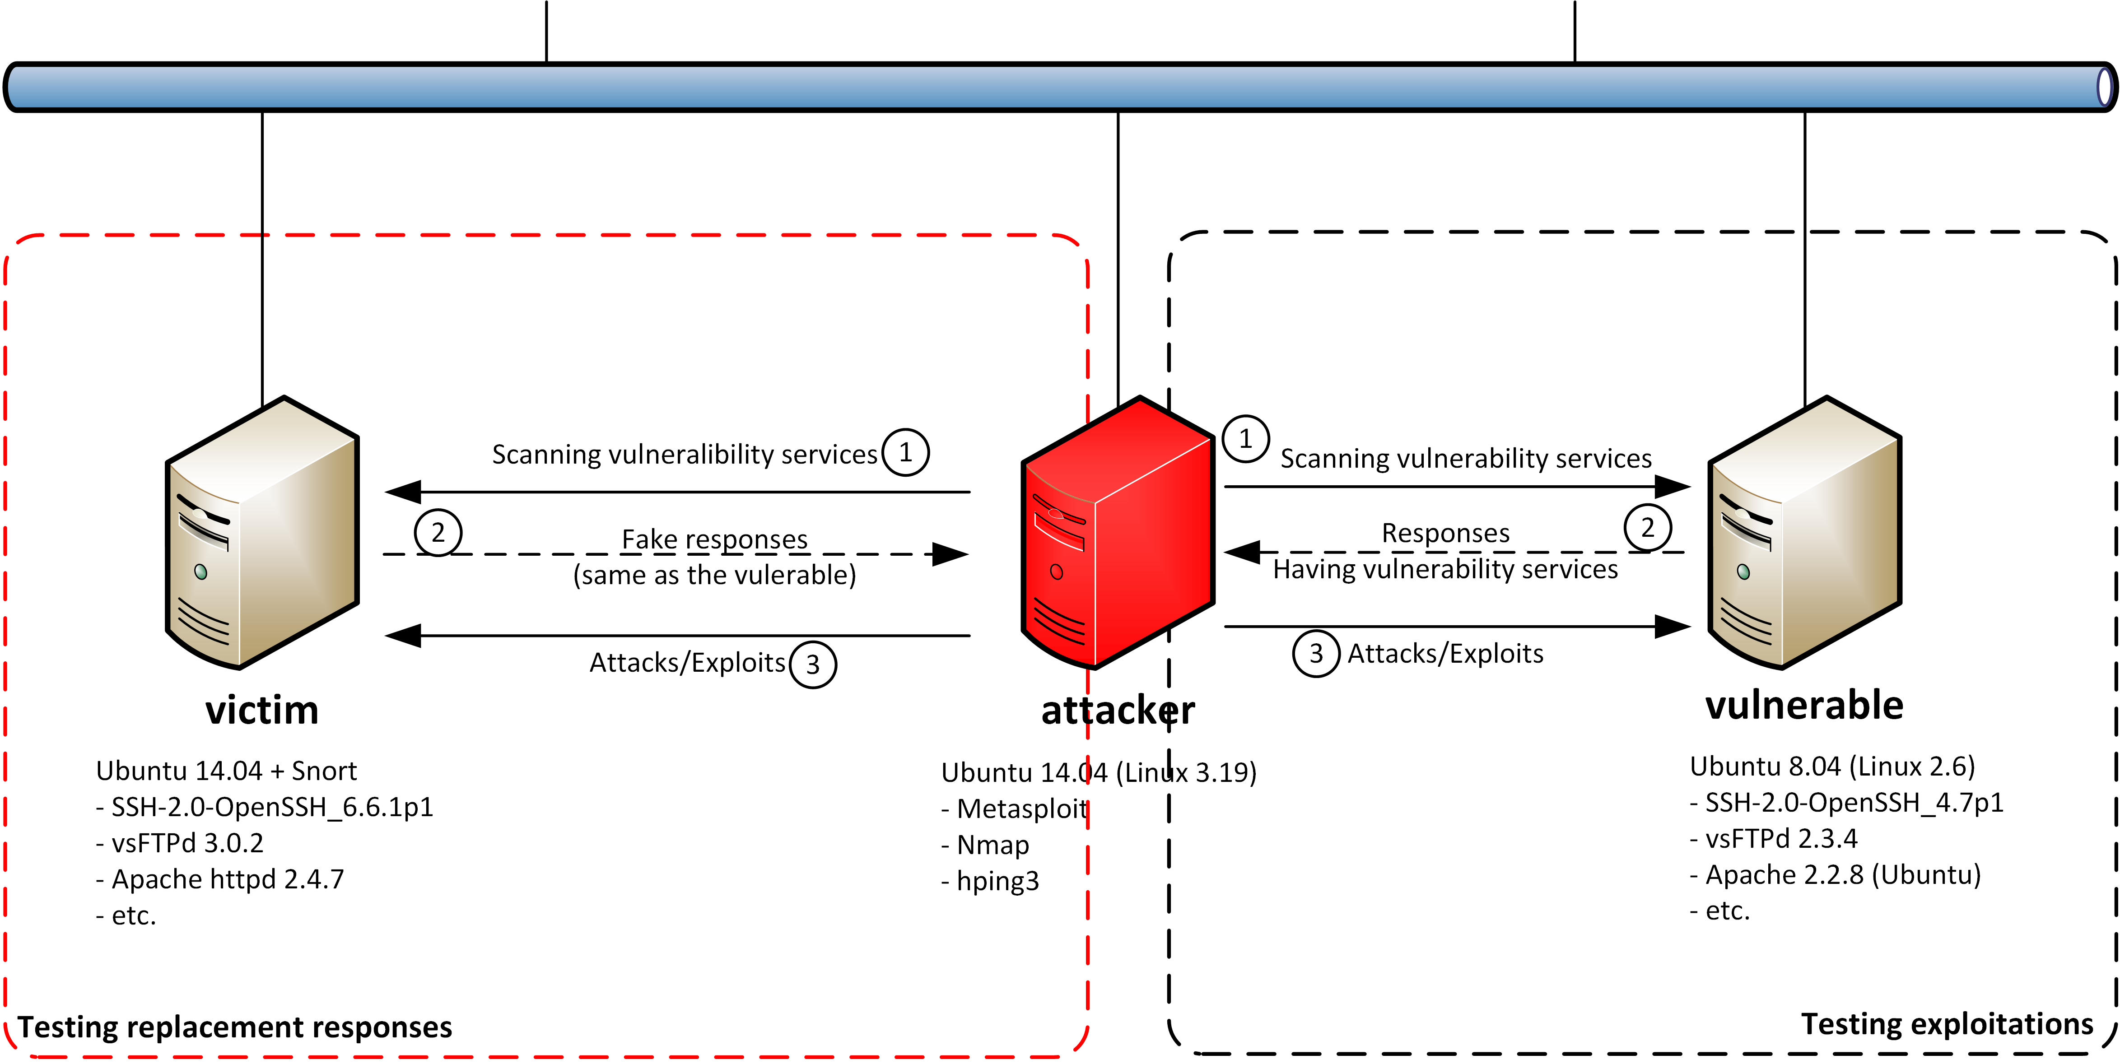
Experiment (Network setup and launching attack)
Network setup: three virtual machines – Victim, Attacker, Vulnerable
Vulnerable: we use “Metasploitable2”
Attacker: contains penetration testing software
Victim: N.A.D.I.R. and Snort
Notes:
Let’s see the first subsection “Network setup and launching attack”
In setting up phase:
We setup three virtual machines on the individual server that located at Old Westbury campus, and named them Victim, Attacker, and Vulnerable
On the Vulnerable, we run Metasploitable2 for testing purpose in succeed in attacking
The Attacker server that we use for exploitation against the Victim and Vulnerable
The last one is Victim that run our NADIR system (Network aware defenses for intrusion recognition and response)
What is Snort? It is a well-known standard open source Intrusion Detection
What is Metasploitable? Metasploitable is an intentionally vulnerable Linux virtual machine that we can use for penetration testing and etc.

Slide 8
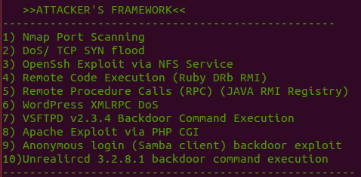
Experiment (Network setup and launching attack)
Launching attack
Port Scanning (Probe):- scanning the target to learn network service information
Denial of Service (DoS):- flooding a number of packets to down the service
Remote to local (R2L):- exploiting the target via vulnerability service
Notes:
The launching attack phase:
- We picked 10 different attacks which can be categorized into 3 groups, Port Scanning, Denial of service, and Remote to local attack.

Slide 9
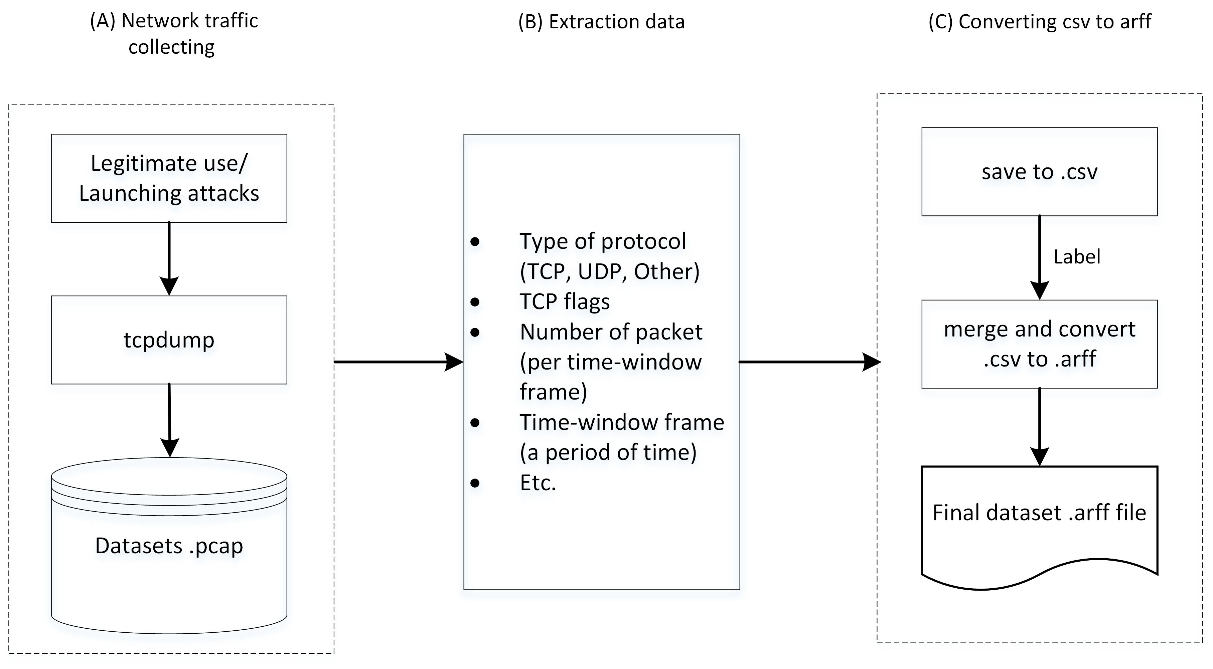
Experiment (Dataset preparation)
Collect network traffic
Legitimate
Malicious
Extract data
Type of protocol
TCP flags
Time-window frame
Etc.
Convert to particular format
Label normal and abnormal traffic
Convert the final dataset to Attribute-Relation File Format (ARFF)
Notes:
In the dataset preparation subsection, we firstly start collecting the network traffic separately, legitimate and malicious.
After we have the network traffics in packet capture format (pcap), we extract and convert them into csv format. Then, we label the abnormal traffic as we know the direction and timestamp when we launch the attack.
The last step of dataset preparation is merging the labeled normal and abnormal traffic together and convert it into Attribute-Relation File Format

Slide 10
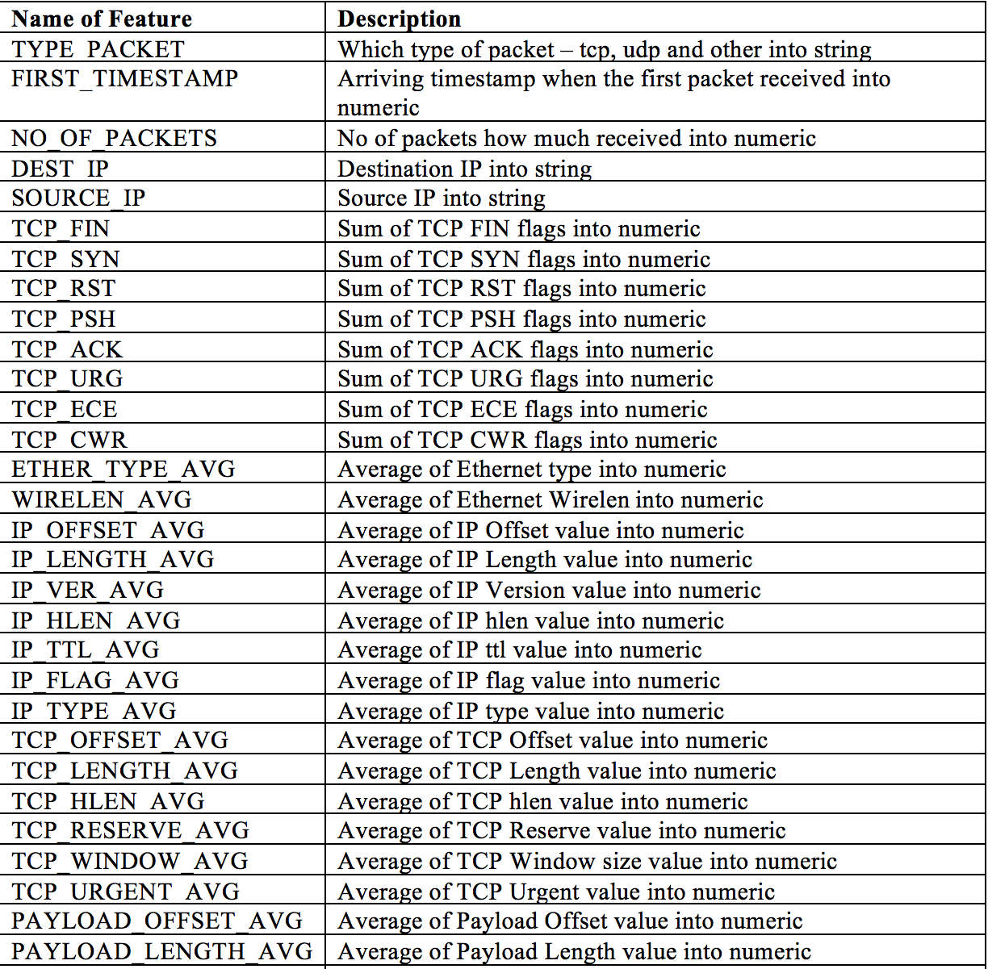
Feature table
Features selected from the previous work
Notes:
This table shows the features that we use in our dataset.
Their are many features that are very useful in our work such as type_packet, no_of_packet, and tcp_flag

Slide 11
Experiment (Data modeling and machine learning)
Weka toolkit and library
J48 classifier algorithm (Decision tree)
Predict between normal and abnormal pattern base on “ANORMALY_SCORE”
Snort rule template
Look at abnormal pattern and its classified feature values
rule = “alert "+type_packet+" $EXTERNAL_NET any -> $HOME_NET any (msg: \""+msg+" on "+tcp_syn+"\"; flags:"+tcp_syn+"; flow: to_server; threshold: type both, track by_dst, count ”+syn_count+", seconds 4; sid:";
Notes:
We use Weka library which is a well know machine learning toolkit in our work to learn and classify the dataset.
We use J48 classifier algorithm which is a decision tree to predict the result. However, The Weka toolkit support many classifier algorithm.
What is Weka? It is a well known machine learning toolkit
Why use J48? Though we have many other machine learning algorithms which we could use for anomaly detection base intrusion detection system, but we used J48 decision tree Because this classifier algorithm gives good results and less FP rate and its easy to convert into the snort rule.

Slide 12
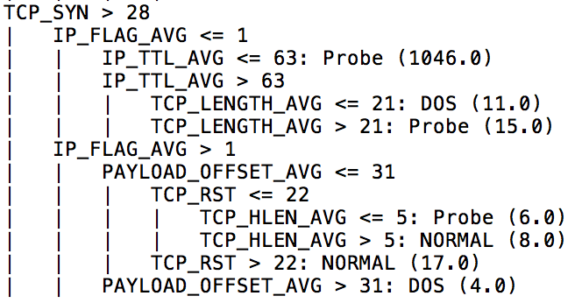
Sub part of pruned tree J48 Decision
Notes:
This picture shows an example of J48 decision tree output from our dataset
We can see on the top row, if the number of tcp_syn is greater than 28, ip_flag_avg is lower or equal to 1, and ip_ttl_avg lower or equal to 63, the packets will be classified as Probe attack
Such as we can use this conditional rule and easily convert this into snort rule.

Slide 13
Experiment (Snort configuration)
Snort In_line mode – nfnetlink queue library
Three interfaces (two for bridging)
Two snort instances
Notes:
Snort IDS can be changed as an IPS by using Iptables and snort configuration. To push this experiment by changing snort configuration and Iptables our SNORT works in IN_LINE QUEUE mode.
At this point we also looked at snort performance at the time of updating new rules and to handle IDS/IPS restart service without any packet loss and delay in system we uses three interfaces and two different snort instance (init script) with same execution command
Primary interface is visible to the user and other two interfaces are works as a bridged interface just to handle snort service at reload.

Slide 14
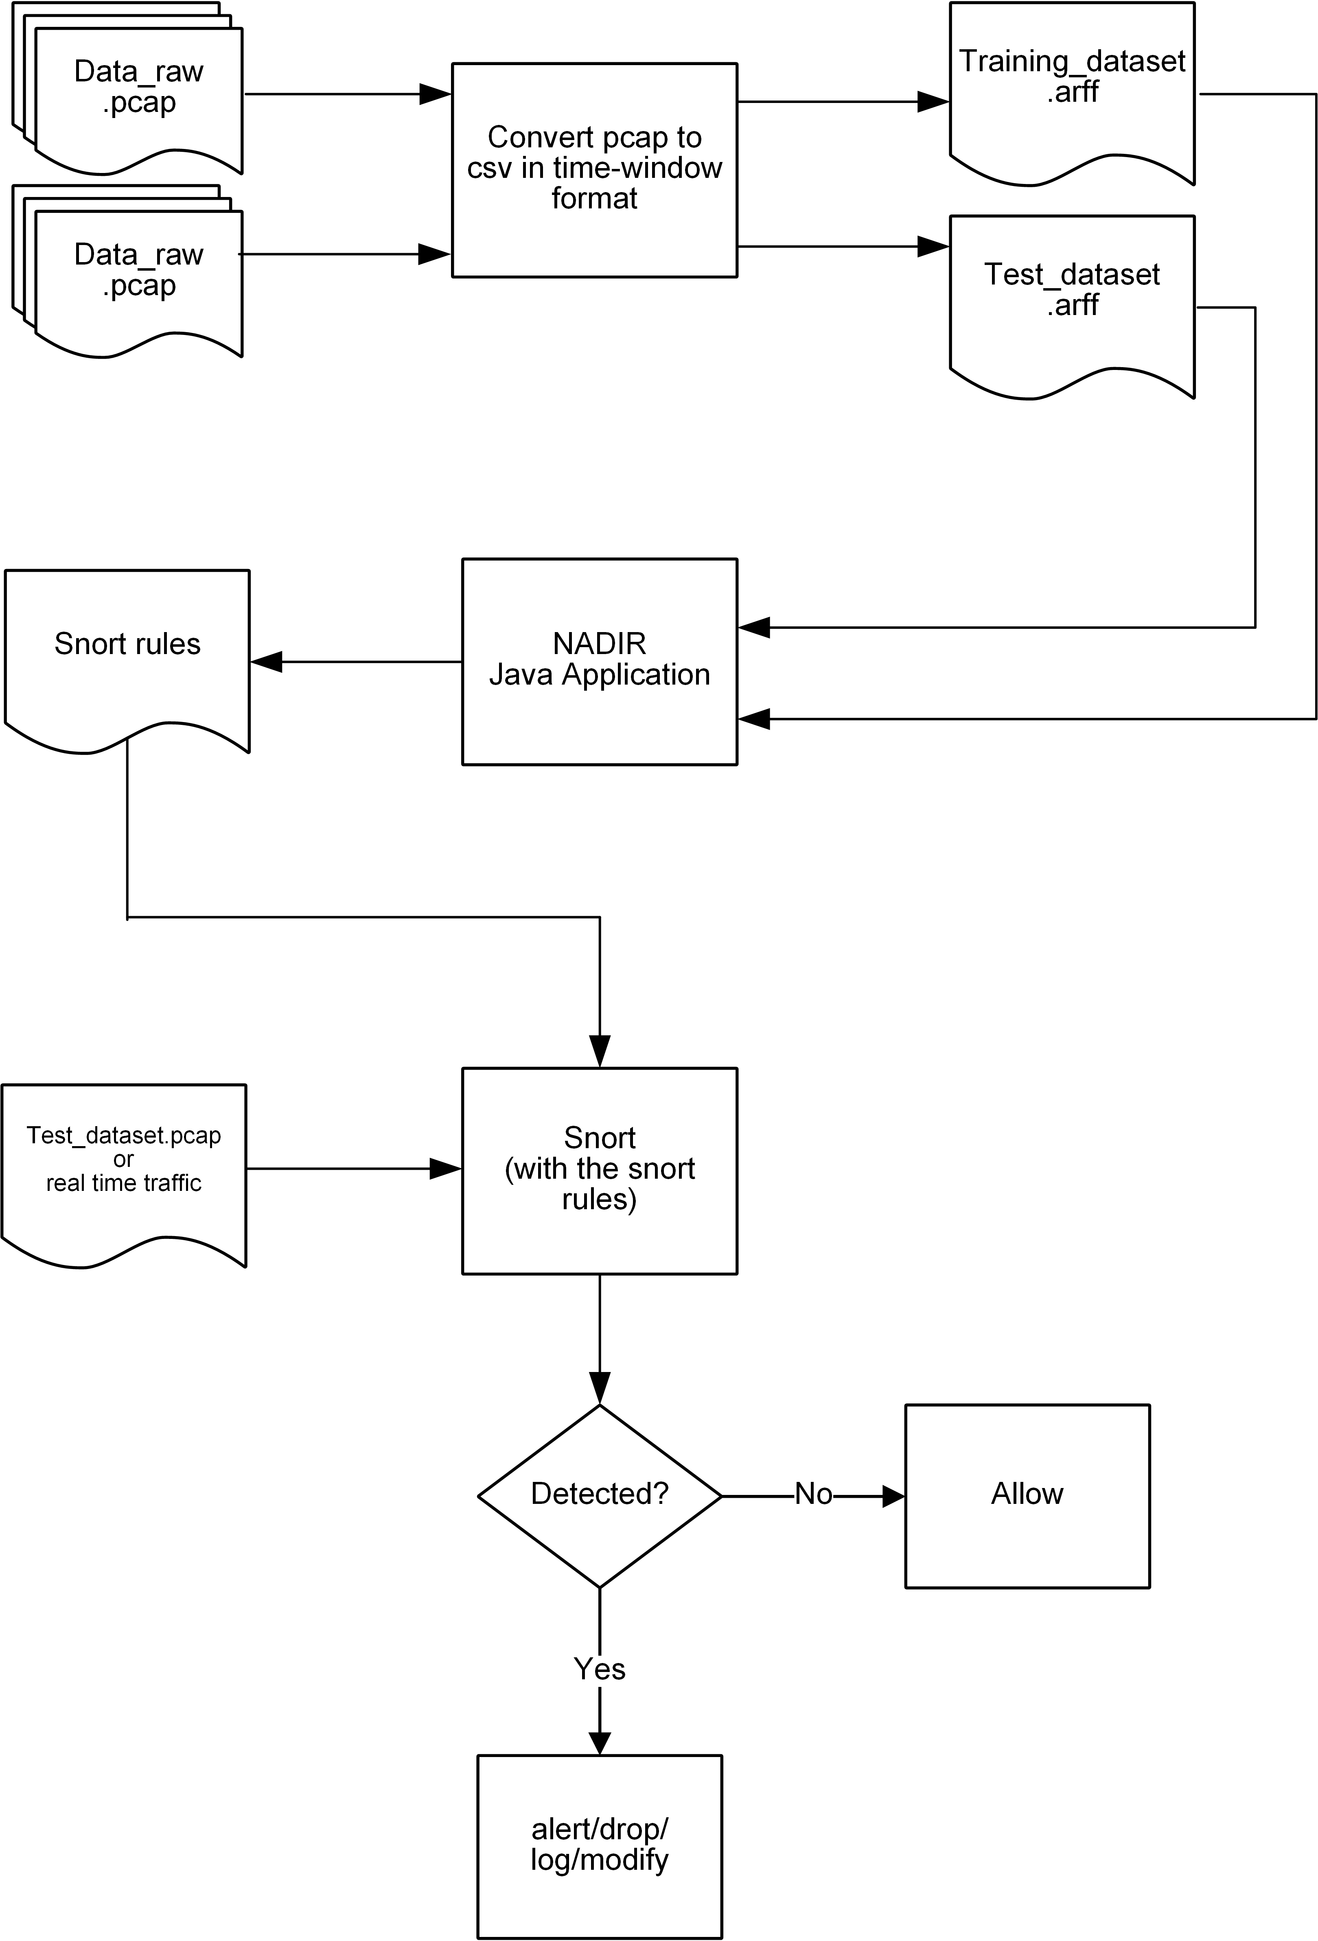
Overall system
Notes:
On the top part is the dataset preparation process.
The middle part is the part that our NADIR system take the feeding dataset as inputs to produce the Snort rules.
The bottom part is the processing of the Snort service to analyze the computer networks traffic

Slide 15
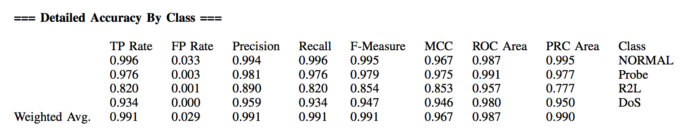
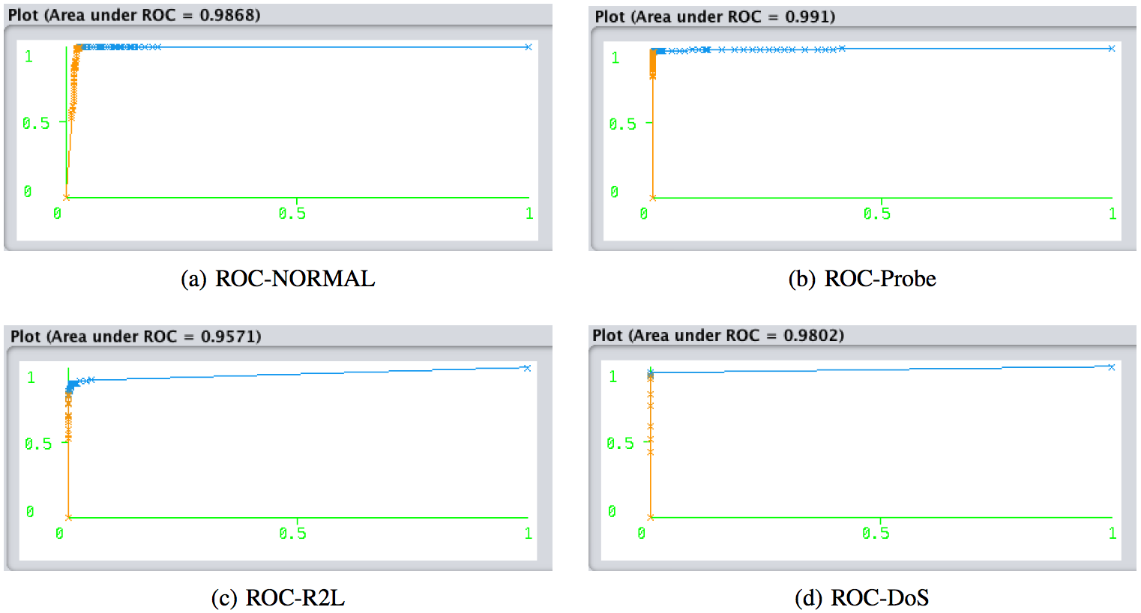
Machine Learning Testing Results
X-Axis: False Positive Rate(FPR)
Y-Axis: True Positive Rate (TPR)
Notes:
These pictures show the result of machine learning testing. And, we got a good results.
However, our research is not to create a good machine learning system, but to create a tool that not just only detect the abnormal traffic but also respond back to the attacker. And can provide the earlier notification in the reconnaissance phase

Slide 16
Demo
https://youtu.be/70HTwxRgkUM - Network Aware Defenses for Intrusion Recognition and Response (N.A.D.I.R.)

Slide 17
Pending Publication
N. Assawakomenkool, Y. Patel, J. Voris. “Network Aware Defenses for Intrusion Recognition and Response (N.A.D.I.R.),” Under Submission to the 38th IEEE Sarnoff Symposium, 2017.
Notes:
We have submitted our research to the 38th IEEE Sarnoff Symposium, 2017.

Slide 18
Conclusion
Current network attack mitigation strategies have shortcomings
NADIR can provide benefits of honeypots at lower overhead
Set up experimental test-bed
Developed system for modifying packet responses in real time
Tested end-to-end system with A-NIDS
Research demonstrates the plausibility of deceptive service as network attack mitigation strategy (paraphrase)

