Slide 1

IILM UNIVERSITY
WEB DEVELOPMENT
INTERNSHIP PRESENTATION
PRODIGY INFOTECH
Student Details
Internship Details
Name: Yash Raj
Roll No.: 25SCS1003005512
Program: B.Tech CSE
Specialisation: Cloud Computing
Semester: 3rd Semester
Academic Year: 2026–27
Domain: Web Development
Duration: 01 August 2026 – 01 September 2026
Projects Completed: 5
Focus: Responsive & Interactive Web Applications
Web Development Internship • Yash Raj
1

Slide 2
INTERNSHIP OVERVIEW
Organisation
Role
Duration
Prodigy InfoTech
Web Development Intern
01 August 2026 – 01 September2026
Domain
Work Completed
Practical web development using HTML, CSS and JavaScript, with a focus on responsive and interactive web applications and basic API integration.
Five web projects were developed during the internship, covering responsive design, JavaScript-based applications, games, portfolio development and weather data integration.
Web Development Internship • Yash Raj
2

Slide 3
OBJECTIVES
• Gain practical experience in front-end web development.
• Strengthen understanding of HTML, CSS and JavaScript.
• Build responsive and user-friendly web pages.
• Implement interactive functionality using JavaScript.
• Understand basic API integration through a weather application.
• Improve problem-solving, debugging and project-building skills.
Web Development Internship • Yash Raj
3

Slide 4
TECHNOLOGIES & TOOLS USED
HTML5
CSS3
JavaScript
Front-end structure for web pages and application elements.
Styling, layout, responsiveness and visual presentation.
Client-side interactivity, application logic and dynamic behaviour.
VS Code
GitHub
Weather API
Primary code editor used to develop and debug projects.
Repository management and versioned project work.
API integration for retrieving weather information.
Canva
MS Office
Used for presentation and visual design work.
MS Word, PowerPoint and Excel used for documentation and presentation work.
Web Development Internship • Yash Raj
4

Slide 5
PROJECTS COMPLETED
01
Responsive Landing Page
02
Stopwatch Web Application
03
Tic-Tac-Toe Web Application
04
Personal Portfolio Website
05
Weather Application
Web Development Internship • Yash Raj
5

Slide 6
RESPONSIVE LANDING PAGE
• Designed a responsive landing page using HTML, CSS and JavaScript.
• Included navigation and multiple content sections.
• Focused on a clean, user-friendly layout.
• Made the page adaptable to different screen sizes.
• Tools & Languages Used: HTML5, CSS3, JavaScript, VS Code, GitHub.
PROJECT 01
Web Development Internship • Yash Raj
6

Slide 7
STOPWATCH WEB APPLICATION
• Developed an interactive stopwatch using JavaScript.
• Implemented Start, Stop, Reset and Lap functionality.
• Used JavaScript timing and event handling.
• Improved understanding of interactive web application logic.
• Tools & Languages Used: HTML5, CSS3, JavaScript, VS Code, GitHub.
PROJECT 02
Web Development Internship • Yash Raj
7

Slide 8
TIC-TAC-TOE WEB APPLICATION
• Created an interactive Tic-Tac-Toe game using HTML, CSS and JavaScript.
• Implemented turn-based game logic.
• Added winner checking and game reset functionality.
• Focused on simple and engaging user interaction.
• Tools & Languages Used: HTML5, CSS3, JavaScript, VS Code, GitHub.
PROJECT 03
Web Development Internship • Yash Raj
8

Slide 9
PERSONAL PORTFOLIO WEBSITE
• Designed a personal portfolio website using HTML, CSS and JavaScript.
• Included About, Skills, Projects, Education and Contact sections.
• Added responsive navigation and interactive page behaviour.
• Created the portfolio to present academic and technical work professionally.
• Tools & Languages Used: HTML5, CSS3, JavaScript, VS Code, GitHub, Canva.
PROJECT 04
Web Development Internship • Yash Raj
9

Slide 10
WEATHER APPLICATION
• Developed a weather application using a Weather API.
• Allows users to search for weather by city.
• Displays current weather information such as temperature and conditions.
• Practised basic API integration and dynamic data display.
• Tools & Languages Used: HTML5, CSS3, JavaScript, Weather API, VS Code, GitHub.
PROJECT 05
Web Development Internship • Yash Raj
10

Slide 11
KEY LEARNINGS
• Improved practical skills in HTML, CSS and JavaScript.
• Learned to create responsive and interactive web pages.
• Understood JavaScript logic, events and application behaviour.
• Gained basic experience with API integration through the Weather Application.
• Practised using GitHub for project repositories and versioned work.
• Improved debugging, problem-solving and confidence in web development.
Web Development Internship • Yash Raj
11

Slide 12
INTERNSHIP OUTCOME
Technical Growth
Professional Growth
The internship strengthened my practical understanding of front-end development and helped me apply HTML, CSS and JavaScript to real project-based tasks.
Working through multiple projects improved my ability to plan, build, test and refine web applications.
Overall Outcome
The internship provided valuable hands-on exposure to web development and strengthened my foundation for further learning in full-stack development, Cloud Computing, DevOps and modern technologies.
Web Development Internship • Yash Raj
12

Slide 13
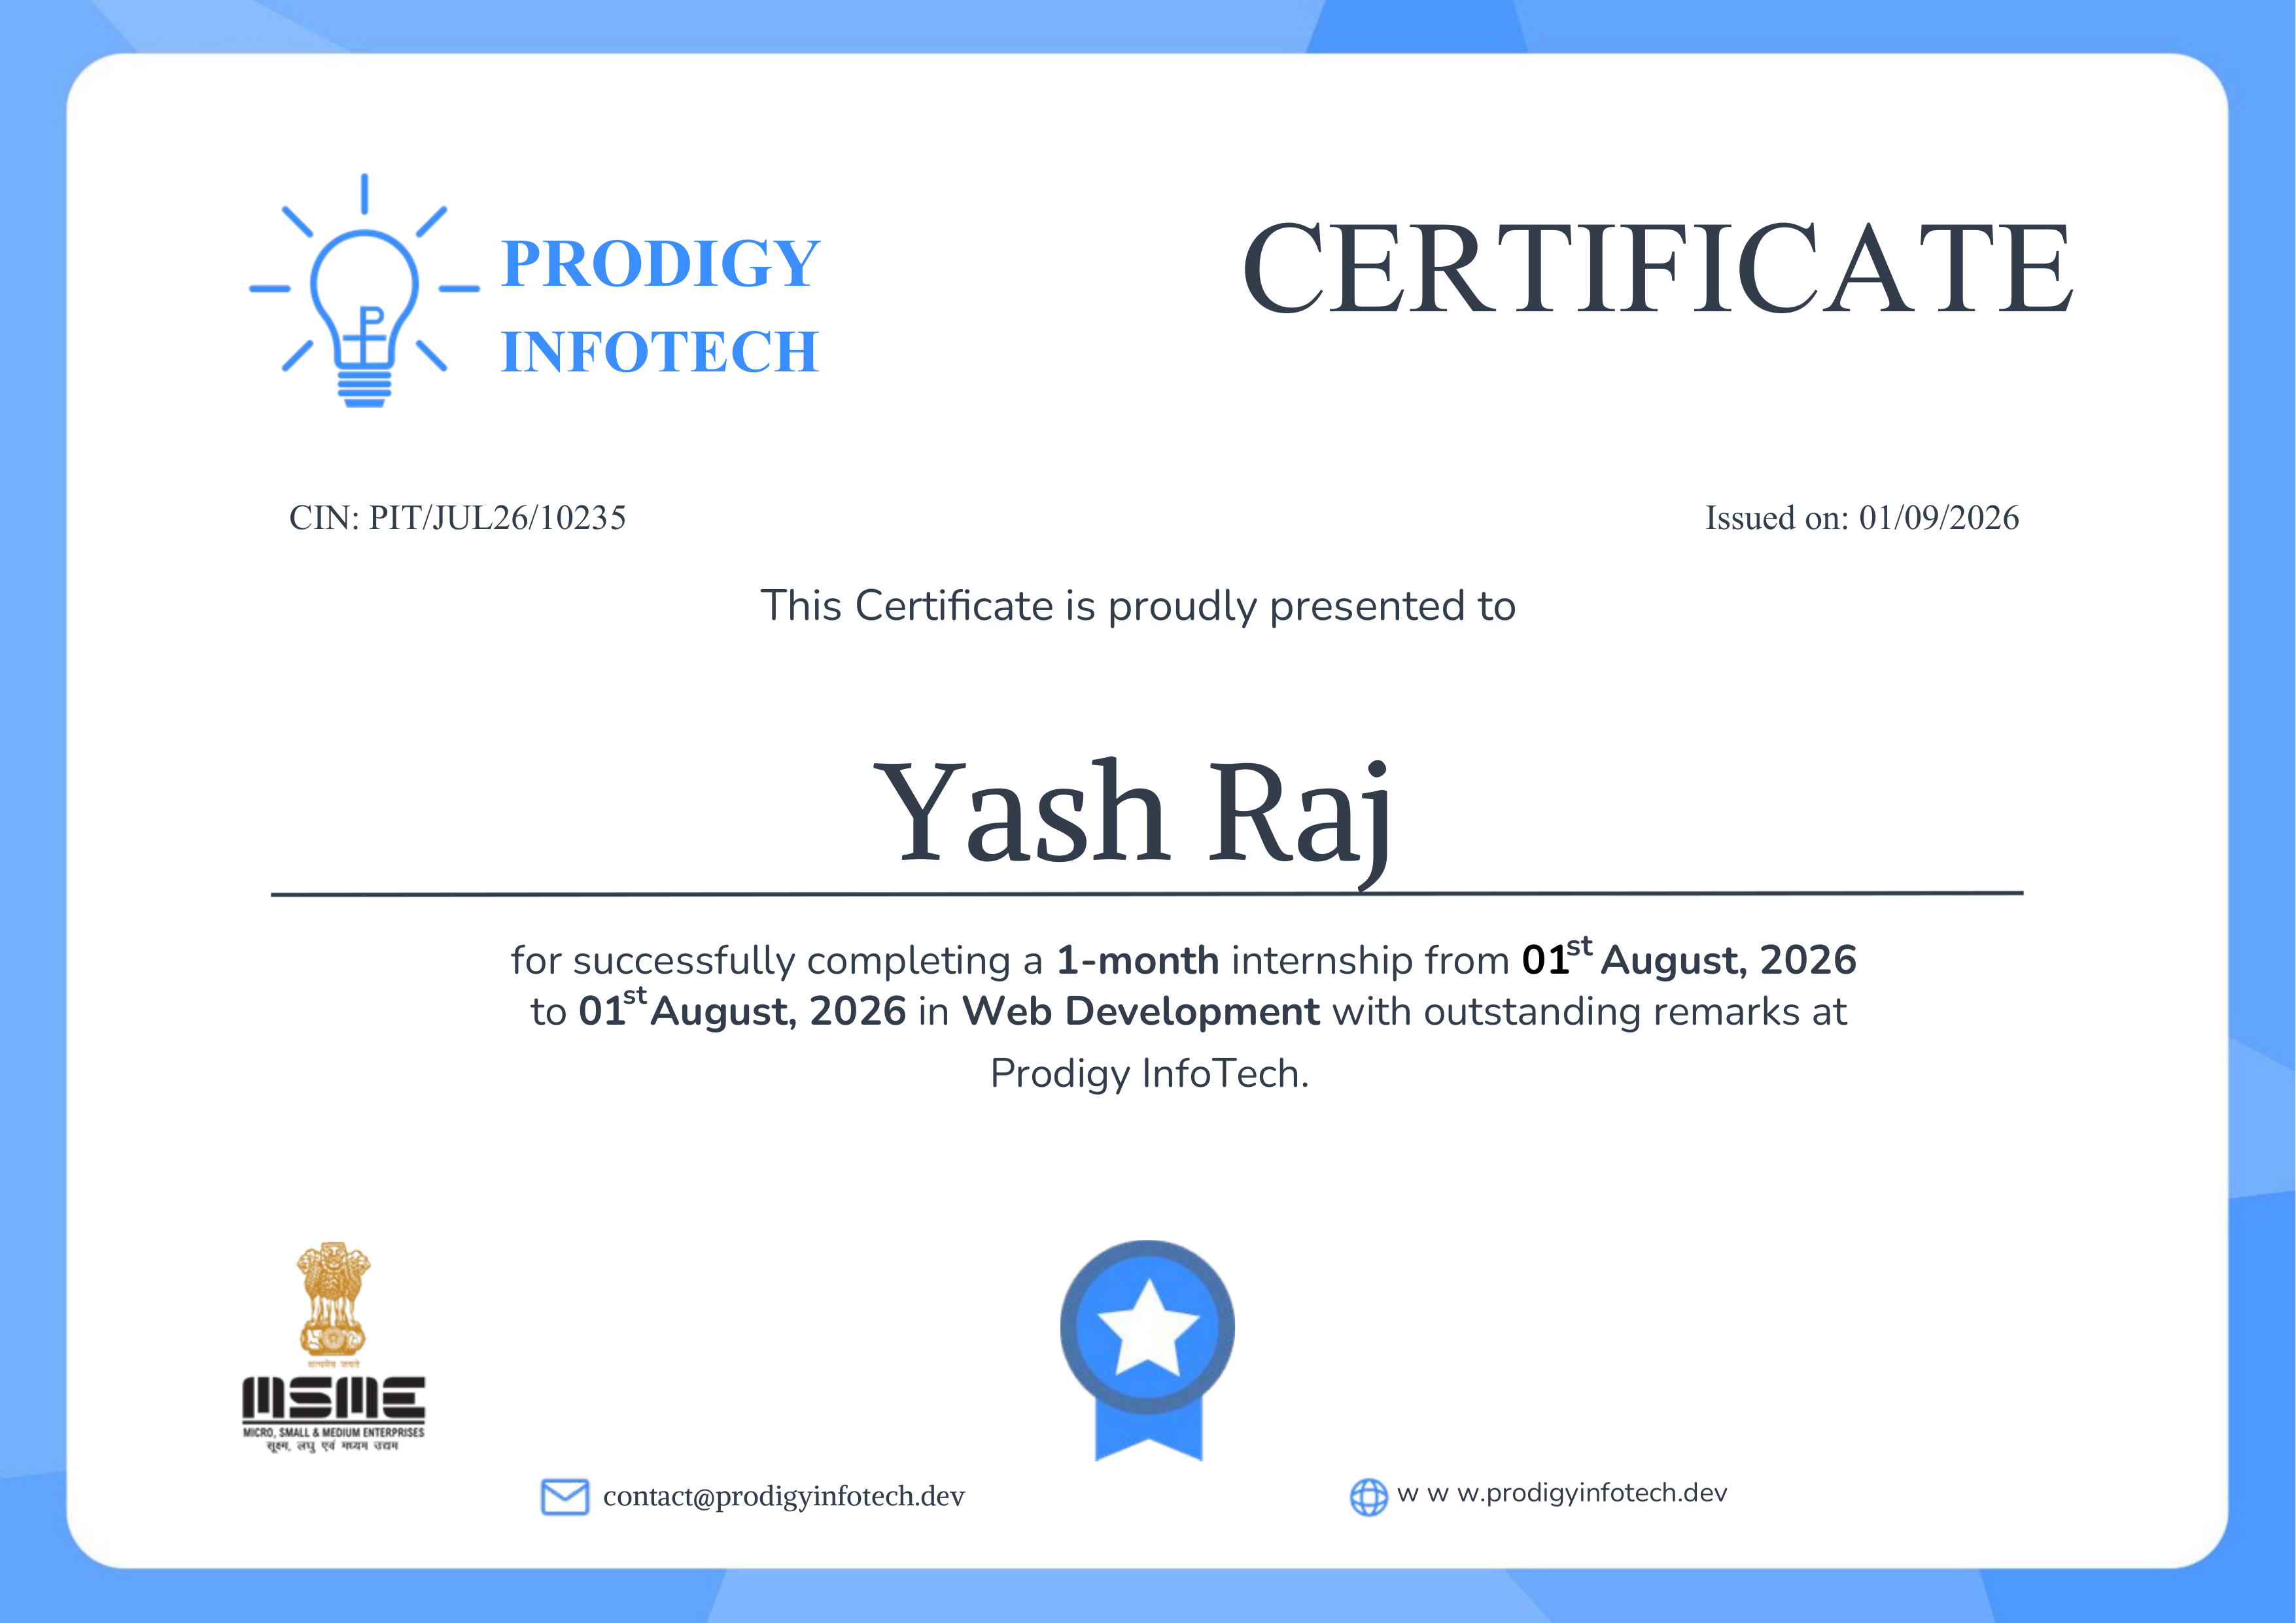
INTERNSHIP COMPLETION CERTIFICATE
Web Development Internship • Yash Raj
13

Slide 14
THANK YOU
Thank You
Yash Raj
B.Tech CSE • Cloud Computing Specialisation
Web Development Internship • Yash Raj
14

