Slide 1


EDUMANAGE
By Yash Pardeshi

Slide 2

INTRODUCTION
Managing an educational institute involves handling multiple tasks, such as student enrollment, trainer allocation, attendance tracking, task submissions, and batch management. Traditional methods often lead to inefficiencies and inconsistencies in data management.
To address these challenges, EduManage is developed using Java (Spring Boot) for the backend and Angular for the frontend. This web-based platform automates and streamlines institute operations, ensuring an efficient and seamless experience for administrators, trainers, and students.

Slide 3
BACKGROUND
In educational institutes, student management, trainer allocation, and task tracking are critical but often handled inefficiently using traditional methods such as spreadsheets or paper-based systems. These methods have several drawbacks:
Manual Errors – Increased risk of incorrect data entry.
Lack of Automation – Tedious processes for attendance tracking and submission management.
Data Redundancy – Inefficient storage and retrieval of student/trainer records.
Limited Accessibility – Paper records cannot be accessed remotely.
EduManage resolves these issues by digitizing and automating the workflow, improving data accuracy, accessibility, and operational efficiency.

Slide 4
PROJECT GOALS
The primary objective of this project is to develop a user-friendly and automated system for managing an educational institute, focusing on:
Seamless Student Management – Student registration, profile updates, and batch enrollment.
Trainer Allocation – Assign trainers to batches and track their schedules.
Task & Assignment Management – Allow trainers to allocate assignments, monitor submissions, and provide feedback.
Attendance Tracking – Automated or manual attendance logging for students and trainers.
Secure Authentication & Authorization – Role-based access control using JWT authentication.
User-friendly Dashboard – Intuitive UI for students, trainers, and administrators.

Slide 5



PROJECT DESIGN
The system follows a three-tier architecture:
1. Frontend (Presentation Layer - Angular)
Developed using Angular for a dynamic UI.
Interacts with the backend via RESTful APIs.
Implements role-based access control for different users.
2. Backend (Business Logic Layer - Spring Boot)
Built with Spring Boot for scalability and maintainability.
Implements JWT authentication for security.
Exposes RESTful APIs for communication with the frontend.
3. Database (Persistence Layer - MySQL)
Stores relational data using MySQL.
Uses JPA (Hibernate) for database interactions.
Ensures data consistency with constraints.

Slide 6
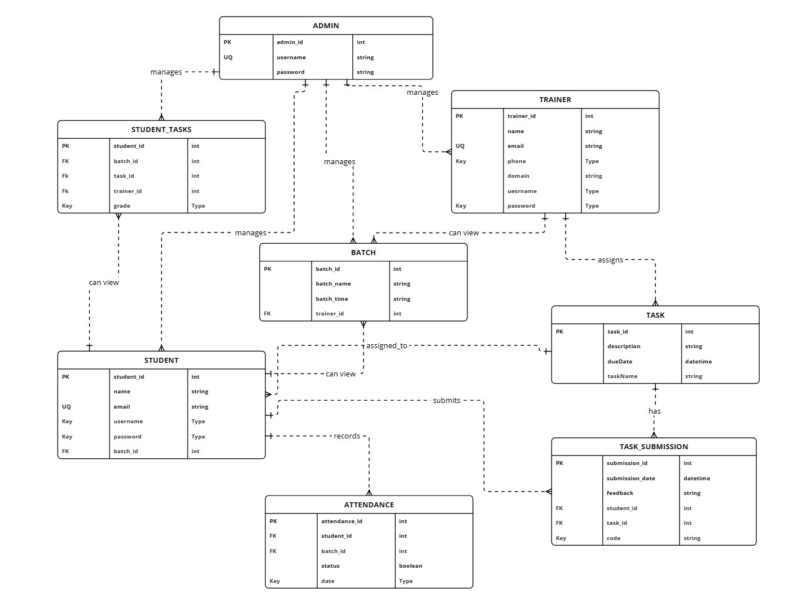
DATABASE DESIGN

Slide 7
SYSTEM FEATURES & MODULES
User Management – Registration, authentication, and role-based access.
Batch Management – Creation, assignment, and scheduling of batches.
Trainer Management – Allocation of trainers to specific batches.
Task & Assignment Tracking – Creation, submission, and review of assignments.
Attendance Monitoring – Logging attendance for students and trainers.

Slide 8
SYSTEM WORKFLOW
1. User Authentication & Role-Based Access
Users log in as Admins, Trainers, or Students.
JWT is used for secure authentication.
2. Dashboard & Navigation
Admin manages trainers, students, batches, and tasks.
Trainers allocate tasks, track attendance, and review submissions.
Students complete assignments, track progress, and view attendance.
3. Task & Attendance Management
Trainers assign tasks, and students submit them through the portal.
Attendance is recorded digitally.

Slide 9
FUTURE SCOPE
Blockchain for Certifications – Issue verifiable, tamper-proof digital certificates using blockchain.
Native or Cross-Platform Apps – Develop Android/iOS apps for seamless access to materials, task submissions, and notifications.
Push Notifications – Instant alerts for students about deadlines, announcements, and attendance.
Load Balancing & Caching – Optimize system response times with caching mechanisms like Redis and load balancers.

Slide 10
CONCLUSION
EduManage provides an efficient, scalable, and secure platform for managing an educational institute. By automating student management, trainer allocation, and task tracking, it eliminates manual inefficiencies and enhances the learning experience. Future enhancements such as mobile app integration will further improve the system’s usability and effectiveness.

Slide 11
THANK YOU

