Slide 1
UK Road Safety Accident Analysis Dashboard
Yashwanth Reddy Shyamakura
Master's in Data Science
University of Europe for Applied Sciences
Data Visualization Project

Slide 2
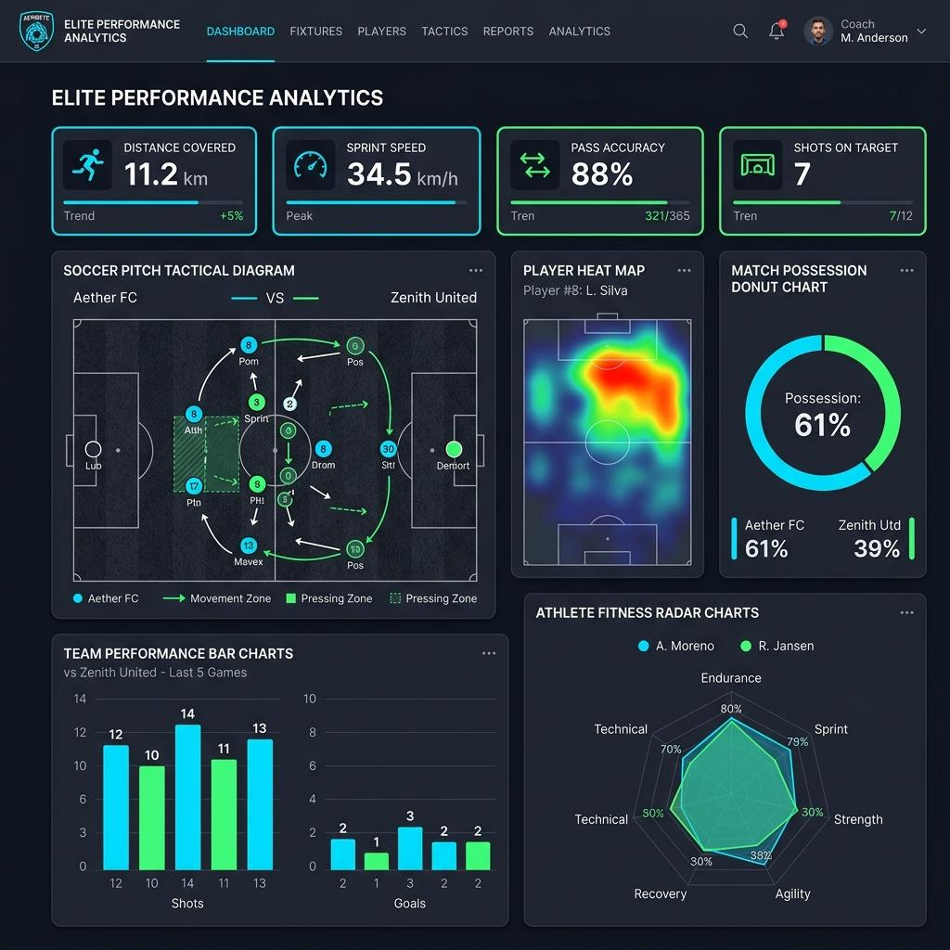
Project Overview
• Analyze UK Road Safety accidents and vehicle data
• Build an interactive Streamlit dashboard
• Perform exploratory data analysis (EDA)
• Visualize accident trends using Plotly

Slide 3

Dataset & EDA
• Dataset: UK Road Safety Accidents and Vehicles
• Cleaned missing values and inspected data quality
• Created Month, Day, Hour, Time Period and Vehicle Age features
• Applied interactive filters

Slide 4
Questions 1–3
1. Accident Severity Distribution
2. Monthly Accident Trend
3. Weather Conditions vs Accidents

Slide 5
Questions 4–6
4. Road Type Analysis
5. Light Conditions Analysis
6. Speed Limit Analysis

Slide 6
Questions 7–10
7. Vehicle Age Group Analysis
8. Engine Capacity Analysis
9. Urban vs Rural Accidents
10. Correlation Heatmap

Slide 7
Streamlit Dashboard
• Interactive filters (Year, Severity, Weather)
• KPI cards
• 10 interactive Plotly visualizations
• Easy exploration of road accident statistics

Slide 8
Conclusion
• Identified major accident trends
• Compared accident trends across months
• Explored relationships between weather, speed limits and accident severity
• Built an interactive dashboard for road safety analysis

Slide 9
References
Kaggle. UK Road Safety: Traffic Accidents and Vehicles.
https://www.kaggle.com/datasets/tsiaras/uk-road-safety-accidents-and-vehicles
Plotly Python Documentation - https://plotly.com/python/
Streamlit Documentation - https://docs.streamlit.io/
Pandas Documentation - https://pandas.pydata.org/docs/
NumPy Documentation - https://numpy.org/doc/

