Slide 1
Hate Speech Detection Model
A report by Team 18
Presented By: Veenus Gollapalli
Greeshama Palisetty
Akhil Sunkara
Nandanandan Tagirisa
Bhavitha Gorrepati
Yashwanth Devireddy

Slide 2
Introduction
Online hate speech is a serious problem that can have a negative impact on individuals and society as a whole. Counter-narratives are one way to combat online hate speech. Counter-narratives are stories or arguments that challenge the negative messages of hate speech. They can be used to educate people about the harmful effects of hate speech, to promote tolerance and understanding, and to build a more inclusive society.
Our project generates counter-narratives against online hate speech. The code is written in Python and uses the T5 language model. The T5 language model is a large language model that has been trained on a massive dataset of text and code. The T5 language model can be used to generate text, translate languages, write different kinds of creative content, and answer your questions in an informative way.
The purpose of this project is to generate counter speech for hate speech using a T5 model. The model is trained using a dataset containing hate speech and its corresponding counter speech.

Slide 3
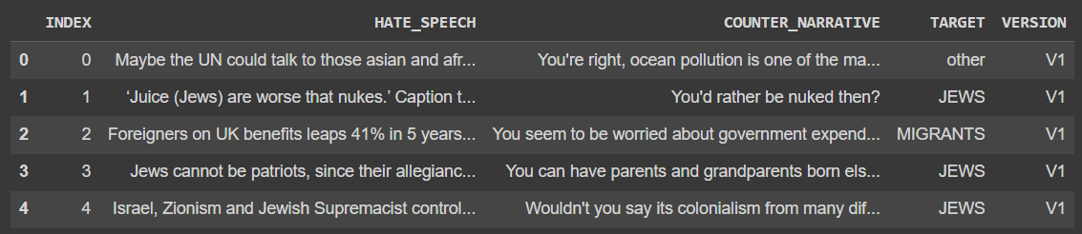
Dataset
The dataset used in the provided code is the "Multitarget-CONAN" dataset, which contains instances of hate speech and their corresponding counter-narratives. The dataset was created as part of a research project aimed at developing natural language processing (NLP) tools to automatically generate counter-narratives to hate speech.
The dataset contains the columns Index, Hate speech, Counter narrative, target, and versions. We are only concerned with Hate speech and Counter narrative, so we have chosen only those two columns and rename them into input text and target text respectively. The training and testing split ratio are 0.8 to 0.2 which are of 4002 and 1001 samples.

Slide 4
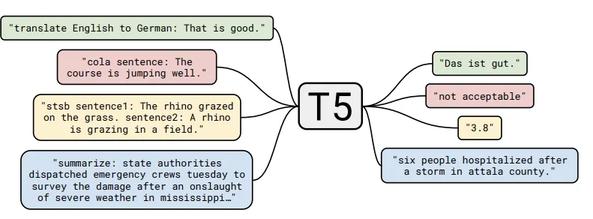
Method
T5 (Text-to-Text Transfer Transformer) is a state-of-the-art pre-trained language model that is known for its high performance on various natural language processing tasks, including text classification, question answering, and text generation. The reasons why we have chosen this model are:

Slide 5
Method
1. Large pre-training corpus: T5 was trained on a large-scale corpus of diverse text data, including web pages, books, and articles. This provides the model with a strong understanding of the nuances of natural language, which can help it perform well on a range of downstream tasks.
2. Text-to-text architecture: T5 uses a text-to-text architecture, which means it is trained to map an input sequence to an output sequence. This makes it well-suited for a range of text-based tasks, including text classification, text generation, and machine translation.
3. Fine-tuning capabilities: T5 can be fine-tuned on a wide range of downstream tasks, which makes it a versatile model that can be adapted to a variety of applications. Fine-tuning is a process that involves taking a pre-trained model and further training it on a specific task or dataset, which can help it perform better on that task.

Slide 6
Method
4. State-of-the-art performance: T5 is one of the best-performing pre-trained language models on a range of natural language processing benchmarks, including the GLUE benchmark and the SuperGLUE benchmark. This suggests that it is a powerful model that can achieve high accuracy on a range of text-based tasks.
Overall, T5 base model is a strong choice for training your dataset due to its large pre-training corpus, text-to-text architecture, fine-tuning capabilities, and state-of-the-art performance on a range of natural language processing tasks.

Slide 7
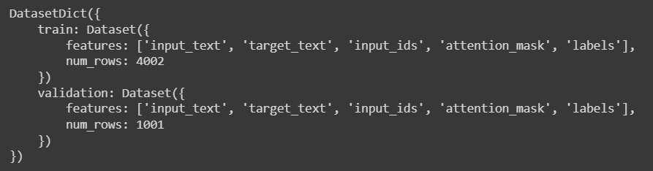
Modeling
Tokenization:
The T5 Hugging Face model was used to tokenize the dataset. The tokenizer was tested by tokenizing a sample sentence. The tokenizer function was then defined to tokenize the input_text and target_text columns of the dataset. The tokenized data set was generated using the map function. The optimizer used in the training arguments is ‘adamw_torch’ which prevents over fitting.

Slide 8
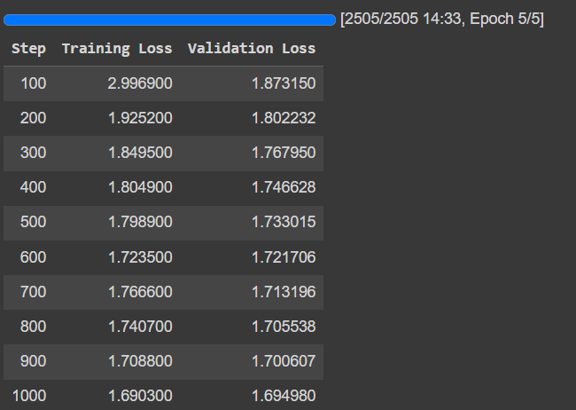
Modeling
Model Training:
The T5 Hugging Face model was trained using the training dataset and validated using the validation dataset. The model was configured using Training Arguments to specify the output directory, number of epochs (5 for our model), batch sizes, and logging and evaluation strategies. The Trainer function was used to train the model with the specified parameters.

Slide 9
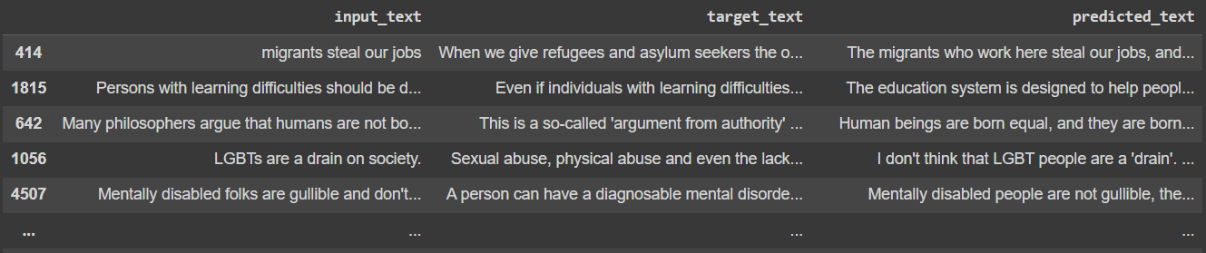
Modeling
Counter Speech Generation:
Counter speech was generated for the hate speech in the validation dataset using the trained T5 model. The generated counter speech was appended to the validation dataset as a new column named predicted_text.

Slide 10
Validation
Polarity Analysis:
TextBlob polarity analysis was used to calculate the polarity of the target_text and predicted_text columns in the validation dataset. The polarity of the text was calculated as a score between -1 and 1, where negative values represent negative sentiment and positive values represent positive sentiment.
Using the tokenizer, we have generated the counter speech to hate speech of validation dataset and added it as a predicted text column to the validation dataset.

Slide 11

Results
The predicted text and target text are converted into NumPy arrays. Using the Text Blob library, we compute the sentiment polarity and stores it in the list. The accuracy obtained using T5 base is 83.5.

Slide 12
Conclusion
As online hate content rises massively, responding to it with counter-narratives as a combating strategy draws the attention of international organizations.
Although a fast and effective responding mechanism can benefit from an automatic generation system, the lack of large datasets of appropriate counter-narratives hinders tackling the problem through supervised approaches such as deep learning
Further improvements:
Ensemble methods
Increasing the number of epochs for model training
Training the model with a larger dataset

