Slide 1


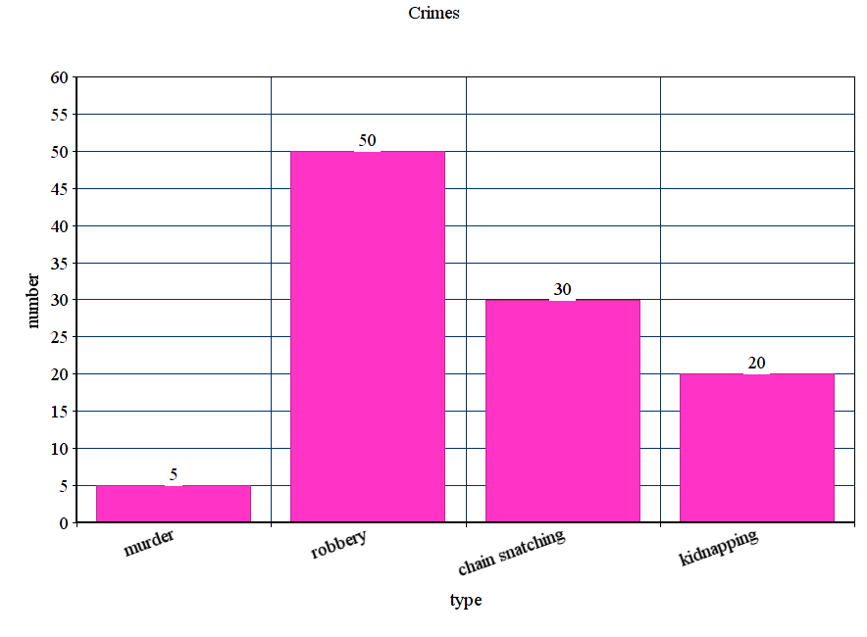
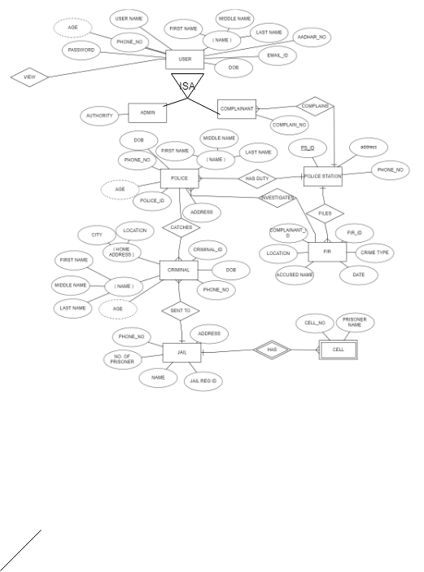

Criminal Records Management System
Mihir Gondhalekar, Yash Gandhi , Harishankar Cranganoor
Sardar Patel Institute of Technology
Abstract
Objectives
Technologies Used
The system put forth applies to Police Stations for Crime Record Management which can be utilized by Police Officers and Complainants .
The entire project has been developed keeping a view of distributed client server technology.
Here, Admin id the main person who can modify, delete,update and add the information.
Design an easy to use database application that will substitute the manual method of keeping the criminal records.
Design a database that will improve accuracy, consistency and liability of criminal records.
Improve the security of records against unauthorized access or reckless handling by nonofficial personnel.
Reduce the clerical workload.
Front-end: HTML, CSS, JavaScript, Bootstrap
Middle-tier: PHP
Back-end: MySQL , PHPmyAdmin
Project Scope
Outcomes
This project will reduce man power of the police division but rather enhance their activities. This project is solely from raw data gathered.
Motivation
Easy to use user interface.
Easy analysis of criminal records since the data is consistent and accurate.
The admin and police will be able to insert delete and update the records.
Clerical Workload is reduced as police does not have to maintain loads of physical records ,it can be easily maintained by the database system.
The need for effective information system is paramount concern to the police force now as well as in the future.
In the existing crime management system, most of the operations are done manually like send complaints, taking actions against crimes, view status etc. This will reduce the efficiency of the force.
As a result of this problems in the manual system, there is need to develop a computerized criminal record keeping system the will eliminate the problems specified.
CHART
ER Diagram
Problem Statement
Design an easy to use database application that will substitute the manual method of keeping the criminal records . Design a database that will improve accuracy, consistency and liability of criminal records
DESCRIPTION
The chart describes the total number of each crime type committed by the criminals.
REFERENCES
https://www.w3schools.com/bootstrap/
https://www.geeksforgeeks.org/
https://stackoverflow.com/
.
Notes:
Download more poster presentation templates from FPPT.com

