Slide 1
Computer Networks
SRGEC 27.07.2024

Slide 2
Syllabus : Physical layer
Multiplexing - Frequency division multiplexing
synchronous time division multiplexing
statistical time division multiplexing
Introduction to switching
circuit switched networks
datagram networks
virtual circuit networks

Slide 3
Objectives
Build an understanding of the fundamental concepts of multiplexing and switching.

Slide 4
Outcomes
Students will be able to
Identify the different types of multiplexing and their functions within a network
Compare and contrast different multiplexing techniques
Enumerate the techniques of switching
Compare different switching techniques
Explain the concept of switching, and identify and analyze the different types of delay in switched networks

Slide 5
Physical Layer
This layer is responsible for the physical connection between devices, including the cables, connectors, and physical characteristics of the transmission medium
It defines the physical specifications of the network, such as voltage levels, data rates and the type of cable used

Slide 6
Multiplexing
Multiplexing is the set of techniques that allows the simultaneous transmission of multiple signals across a single data link.
Multiplexing is needed in the physical layer, for example, where all the traffic for all connections has to be sent over at most a few physical circuits.
Multiplexing
Frequency Division
Wavelength division
Time division
Analog
Analog
Digital

Slide 7
Multiplexing
Multiplexing Techniques
Frequency Division
Wavelength division
Time division
Analog
Analog
Digital
Synchronous Time division
Statistical Time division

Slide 8
Frequency division Multiplexing
Frequency -division multiplexing (FDM) is an analog technique that can be applied when the bandwidth of a link (in hertz) is greater than the combined bandwidths of the signals to be transmitted.
In FDM, signals generated by each sending device modulate different carrier frequencies.
These modulated signals are then combined into a single composite signal that can be transported by the link.
Carrier frequencies are separated by sufficient bandwidth to accommodate the modulated signal.

Slide 9
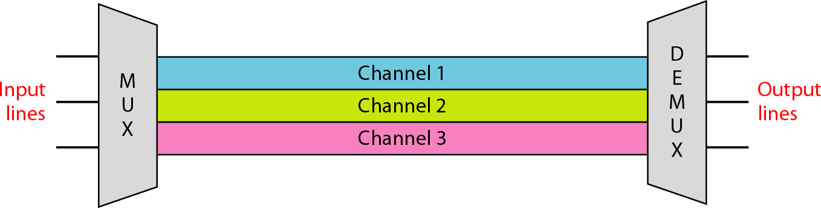
Frequency division Multiplexing
These bandwidth ranges are the channels through which the various signals travel.
Channels can be separated by strips of unused bandwidth -guard bands - to prevent signals from overlapping.
In addition, carrier frequencies must not interfere with the original data frequencies.
Figure 1 illustrates FDM. The transmission path is divided into three channels that carries one transmission.

Slide 10
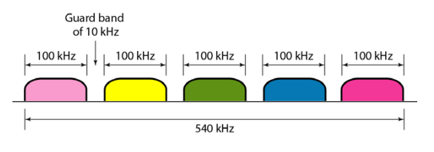
Guard bands
The Guarding band is to alleviate the signals crosstalk problem
TRAI in its recommendation (27 January 2016), indicated for guard band of 0.2 MHz in each LSA out of total 55 MHz (1710-1765 MHz paired with 1805-1860 MHz) spectrum earmarked for commercial use in 1800 MHz band
0.1 MHz at each side of the band
The whole country was divided in 23 Licensed Service Areas (LSA)

Slide 11
What is bandwidth and guard band?
The frequency bands are separated from one another by strips of unused frequencies called the guard bands, to prevent overlapping of signals.
If N - number of signals is multiplexed the number of guard bands = N-1.
The minimum bandwidth of the link needed for a guard band is given as;
BW = N x f_{m} + (N - 1) x f_{G}.

Slide 12
Multiplexing Process
A digital signal can also be converted to an analog signal before FDM is used to multiplex them.
Figure 2 is illustration of the multiplexing process.
Each source generates a signal of a similar frequency range.
Inside the multiplexer, these similar signals modulate different carrier frequencies.
The resulting modulated signals are then combined into a single composite signal that is sent out over a media link that has enough bandwidth to accommodate it.

Slide 13
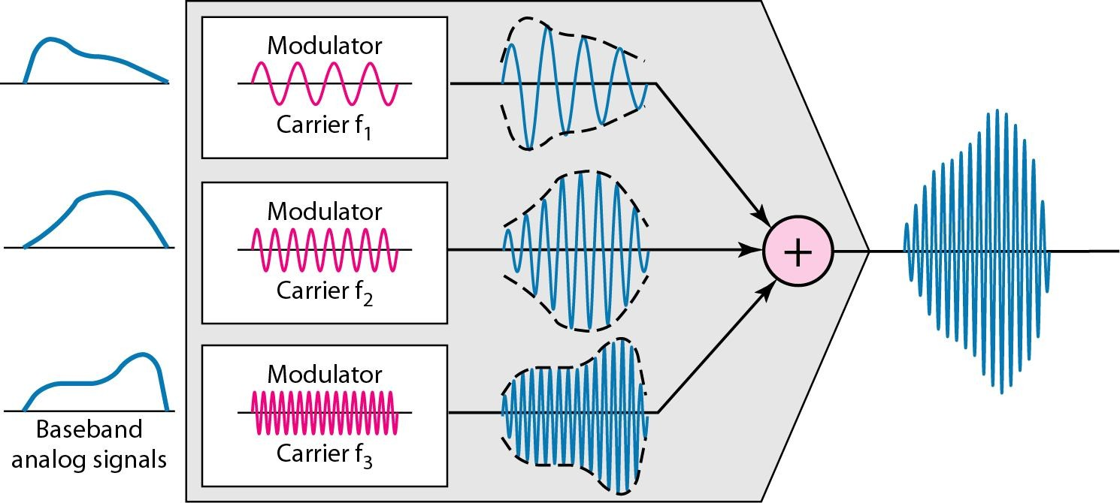
Frequency division Multiplexing
Carrier frequencies are f1, f2, and f3.
Multiplexing: Many to One

Slide 14
Demultiplexing Process
The demultiplexer uses a series of filters to decompose the multiplexed signal into its constituent component signals.
The individual signals are then passed to a demodulator that separates them from their carriers and passes them to the output lines.
Figure 3 is a conceptual illustration of demultiplexing process.

Slide 15
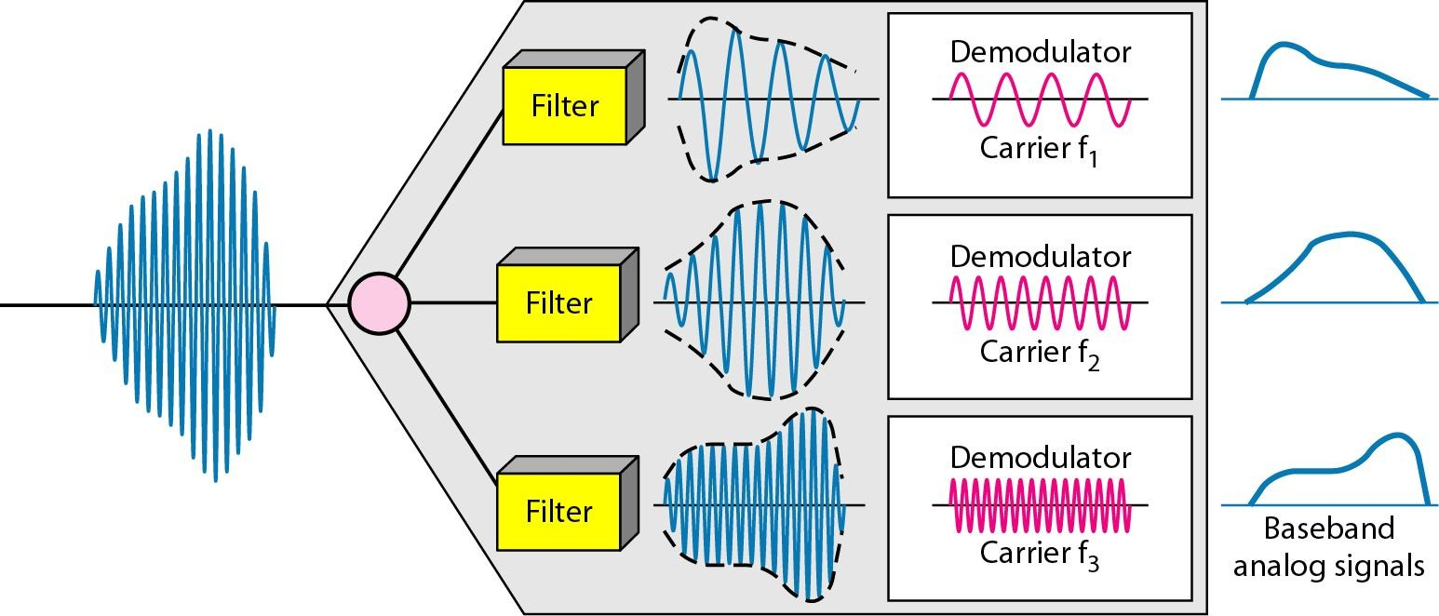
Demultiplexing Process
Filters used : Band pass filter
Demultiplexing: One to Many

Slide 16
FDM Applications
1) Radio broadcasting.
AM: 530 KHz → 1700 KHz
Each station needs: AM → 10 KHz only
FM: 88 MHz → 108 MHz
Each channel FM → 200 KHz
2) TV: 30 MHz – 300 MHz
Each station needs 6MHz of BW.
3) 4G LTE – Cellular Network – 850 MHz to 1900 MHz
1st generation cellular phones, a user is assigned two 30 KHz channels one to Tx and other to Rx.

Slide 17
Wavelength division Multiplexing
Wavelength division multiplexing (WDM) is a technique of multiplexing multiple optical carrier signals through a single optical fiber channel by varying the wavelengths of laser lights.
WDM allows communication in both the directions in the fiber cable.
Concept and Process :
In WDM, the optical signals from different sources or (transponders) are combined by a multiplexer, which is essentially an optical combiner.
They are combined so that their wavelengths are different.

Slide 18
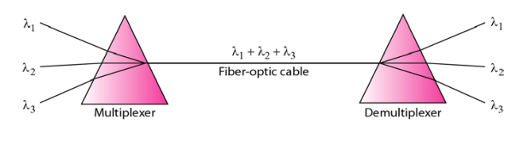
Wavelength division Multiplexing
Analog Muxing over optical fibers (Ultra Dense WDM: # of channels from 1024 up to 32,000 –theoretical [research at UCSD]- each channel is 2.5 Gb/s)
Prisms in WDM

Slide 19
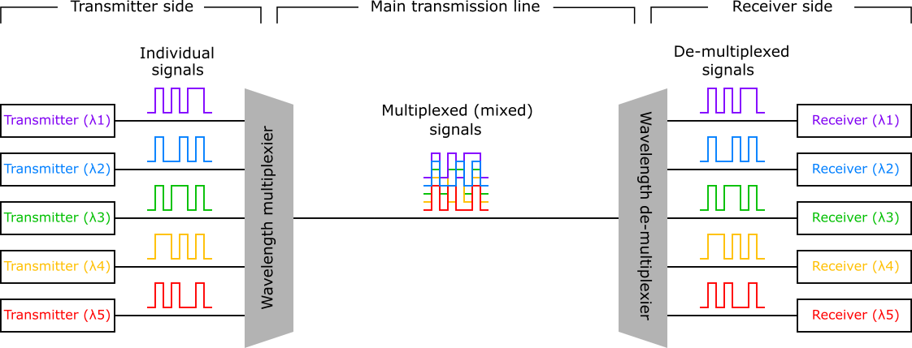
Wavelength division Multiplexing
The combined signal is transmitted via a single optical fiber strand.
At the receiving end, a demultiplexer splits the incoming beam into its components and each of the beams is send to the corresponding receivers.

Slide 20
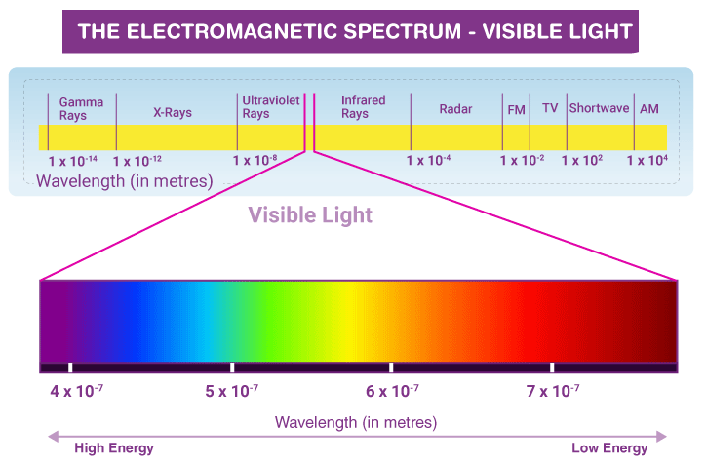
Electromagnetic Spectrum

Slide 21
Time division Multiplexing
Time-division multiplexing (TDM) is a digital process that allows several connections to share the high bandwidth of a link.
Instead of sharing a portion of the bandwidth as in FDM, time is shared.
Each connection occupies a portion of time in the link.
Figure 4 illustrates TDM.
Note that the same link is used as in FDM; here, however, the link is shown sectioned by time rather than by frequency.
In the figure, portions of signals 1,2,3, and 4 occupy the link sequentially.

Slide 22
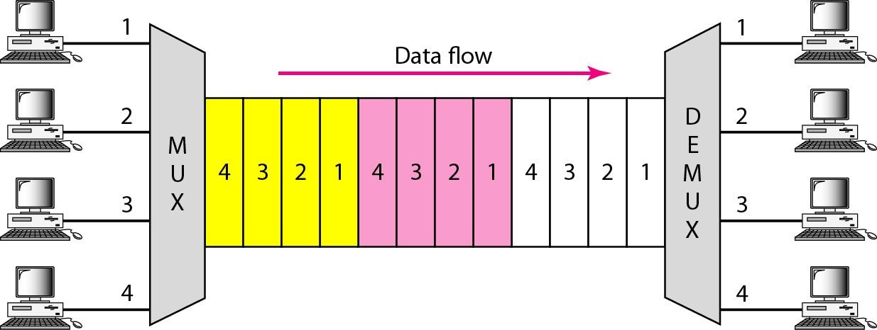
Time division Multiplexing
Ownership of the link total BW is rotated among users temporally in a round-robin fashion over time slots “ 1 → n”.

Slide 23
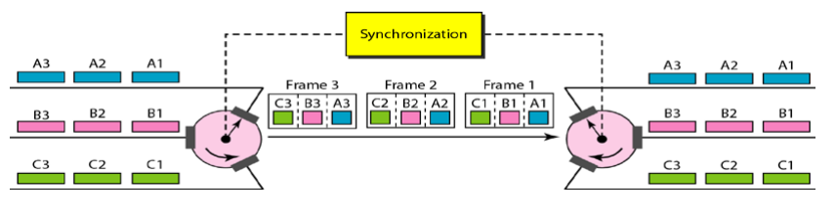
Time division Multiplexing
Interleaving
Example:

Slide 24
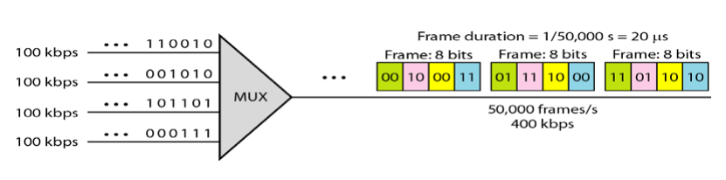
Time division Multiplexing
Example:
Notice that: The data rate of the muxing link is n times faster than the input data rate per every line (why?). Fig 6.17 shows every input line with 100 kb/s, whereas the Mux output data rate is 4X100 kb/s (400 kb/s).
Frame duration = 400,000/8 = 50,000
Frame / sec.

Slide 25
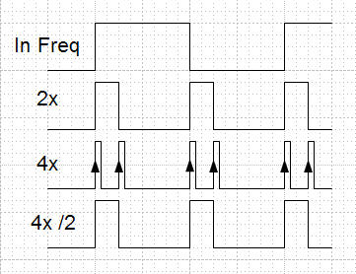

Slide 26
Time division Multiplexing
Digital data from different sources are combined into one timeshared link.
We can divide TDM into two different schemes:
1. synchronous and 2. statistical.
In synchronous TDM, each input connection has an allotment in the output even if it is not sending data.
Time Slots and Frames In synchronous TDM, the data flow of each input connection is divided into units, where each input occupies one input time slot.

Slide 27
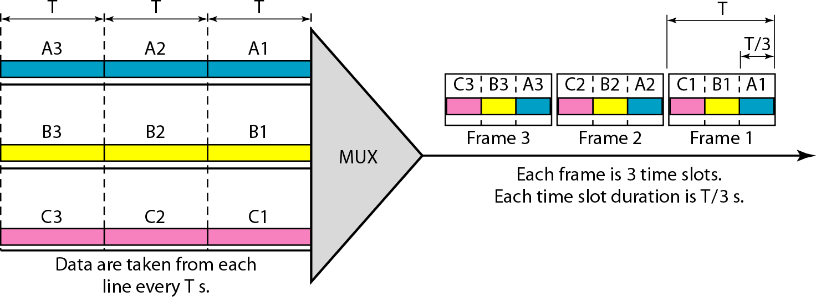
Synchronous TDM
Synchronous Time division multiplexing

Slide 28
Synchronous TDM
A unit can be 1 bit, one character, or one block of data.
Each input unit becomes one output unit and occupies one output time slot.
However, the duration of an output time slot is n times shorter than the duration of an input time slot.
If a n input time slot is T seconds, the output time slot is T / n seconds, where n is the number of connections.
In other words, a unit in the output connection has a shorter duration; it travels faster.
Figure 5 shows an example of synchronous TDM where n is 3.

Slide 29
Synchronous TDM
In synchronous TDM, a round of data units from each input connection is collected into a frame.
If we have n connections, a frame is divided into n time slots and one slot is allocated for each unit, one for each input line.
If the duration of the input unit is T, the duration of each slot is T/n and the duration of each frame is T.

Slide 30
Synchronous TDM
The data rate of the output link must be n times the data rate of a connection to guarantee the flow of data.
In Figure 5, the data rate of the link is 3 times the data rate of a connection
Likewise, the duration of a unit on a connection is 3 times that of the time slot (duration of a unit on the link). i.e. n lines the slot size is T/n.

Slide 31
Synchronous TDM
Multilevel Multiplexing:
When a half rate user data needs to be sent by a common link with same data rate
Using multiple levels of multiplexing, increase (double) the speed of slow connection)

Slide 32
Synchronous TDM
Multiple slot Multiplexing:
A specific user link has higher data rate, that is one user link has multiple times the data rate of other links
Use demultiplexing approach

Slide 33
Synchronous TDM
Pulse stuffing:
Time-division multiplexing of digital signals with slightly different bit rates requires some method of bit rate equalization, which is termed synchronization.
In pulse stuffing synchronization, extra pulses are inserted in each incoming signal as often as required to equalize the bit rates .

Slide 34
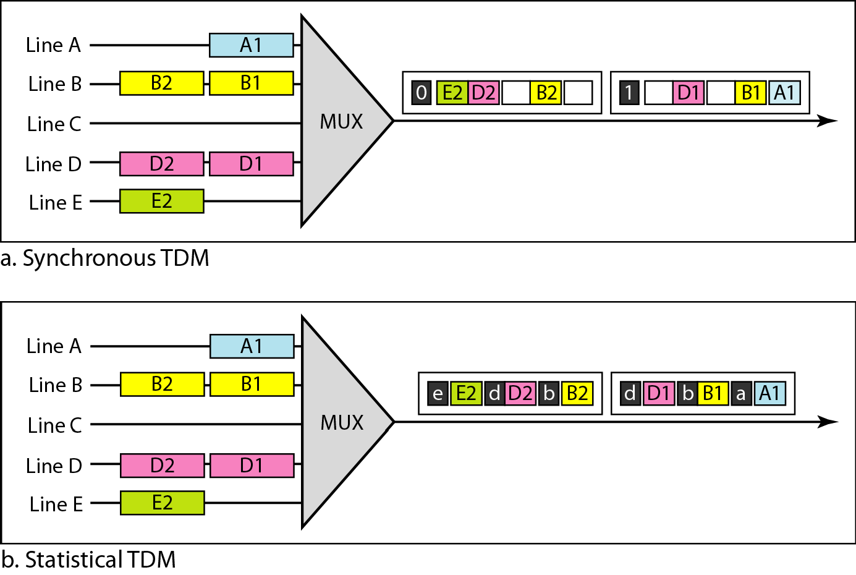
Statistical TDM
Figure 6a also shows a major difference between slots in synchronous TDM and statistical TDM.

Slide 35
Statistical TDM : Addressing
An output slot in synchronous TDM is totally occupied by data; in statistical TDM, a slot needs to carry data as well as the address of the destination.
In synchronous TDM, there is no need for addressing; synchronization and pre-assigned relationships between the inputs and outputs serve as an address.
In statistical multiplexing, there is no fixed relationship between the inputs and outputs because there are no pre assigned or reserved slots.

Slide 36
Statistical TDM : Addressing
The addressing in its simplest form can be n bits to define N different output lines with n =log₂ N.
For example, for eight different output lines, we need a 3 -bit address.

Slide 37
Statistical TDM : Slot Size
Since a slot carries both data and an address in statistical TDM, the ratio of the data size to address size must be reasonable to make transmission efficient.

Slide 38
Statistical TDM : No Synchronization bits for Frames
There is another difference between synchronous and statistical TDM, but this time it is at the frame level.
The frames in statistical TDM need not be synchronized, so we do not need synchronization bits.

Slide 39
Time division Multiplexing: Bandwidth
In statistical TDM, the capacity of the link is normally less than the sum of the capacities of each channel.
The designers of statistical TDM define the capacity of the link based on the statistics of the load for each channel.

