Slide 1

Short-Term Ferry Ticket Demand Forecasting & Predictive Decision Support System
This presentation outlines an operationally focused AI system that predicts short‑term ticket demand, informs dynamic pricing, and drives real‑time decision support for ferry operators.

Slide 2



The Maritime Efficiency Challenge
Perishable Inventory
Late Bookings
Operational Bottlenecks
Industry average: 46% of reservations occur within one week of departure — demand is highly concentrated near sailing dates.
Every unsold seat or lane metre on departure is irrevocable lost revenue — urgency to forecast near-term fill rates is critical.
Fixed schedules and static staffing lead to overloads, increased delays, and suboptimal resource allocation.

Slide 3

The Shift: From Rules to Intelligence
Why legacy fails
Key variables
Rules-based systems are reactive and brittle
They don't learn from micro-trends or sudden events
High-frequency predictors used by the model:
Real-time bookings & cancellations
Weather, tide, and sea-state feeds
Local events, holidays, and economic indicators
Historical intra-day booking curves
AI approaches
Bayesian forecasting for uncertainty quantification
Reinforcement learning for tactical pricing & packing policies

Slide 4
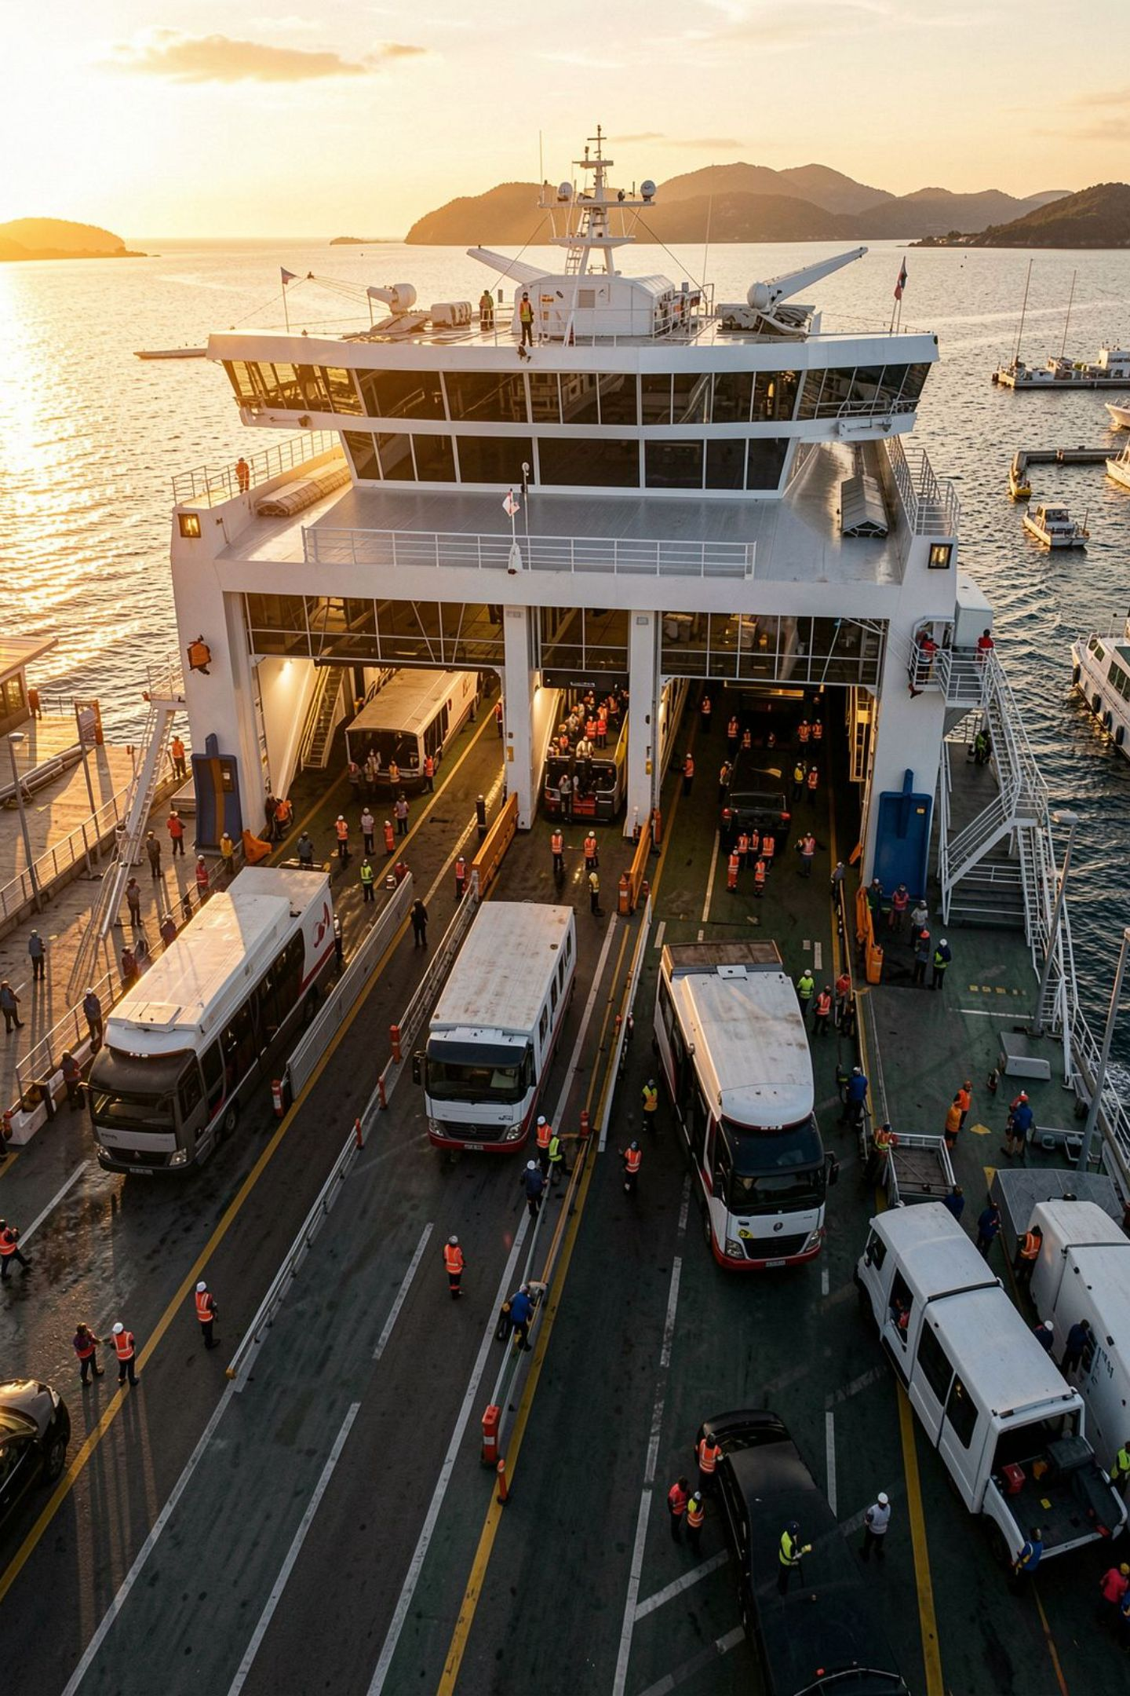
Case Study: Molslinjen’s Data-Driven Transformation
Partnership
Financial Results
Operational Gains
Collaboration with Halfspace to scale data pipelines and ML operations since 2020.
$5M cumulative savings by Dec 2023 through improved yield management and reduced waste.
3.5% fewer delays and 3% fuel reduction via optimized packing and route adjustments.
These measurable outcomes demonstrate the value of tightly integrating forecasting with operations.

Slide 5
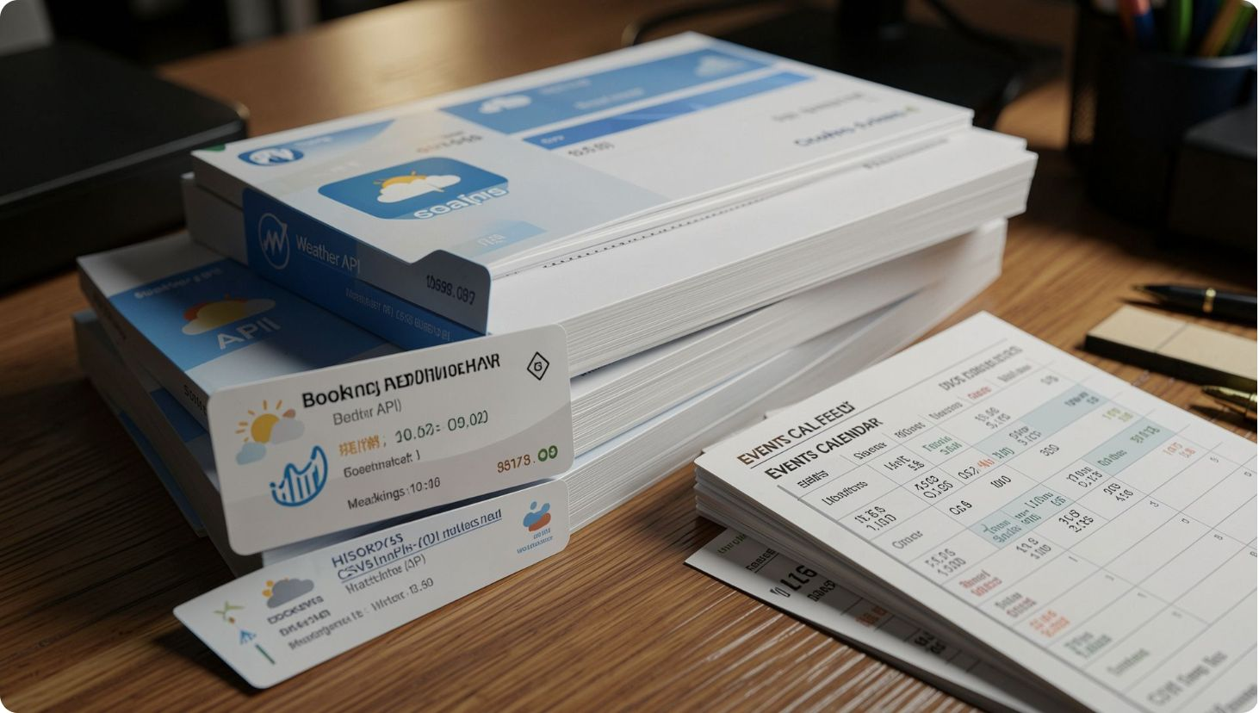
Predictive Demand Logic
Core modules
Demand modeling — probabilistic short‑horizon forecasts (0–30 days)
Capacity management — lane‑meter allocation and packing plans
Price optimization — EMSRb‑MR and reinforcement policies
Time-to-Departure sensitivity
Elasticity shifts significantly in the final 60 minutes; last‑minute micro‑pricing and packing decisions matter most.

Slide 6
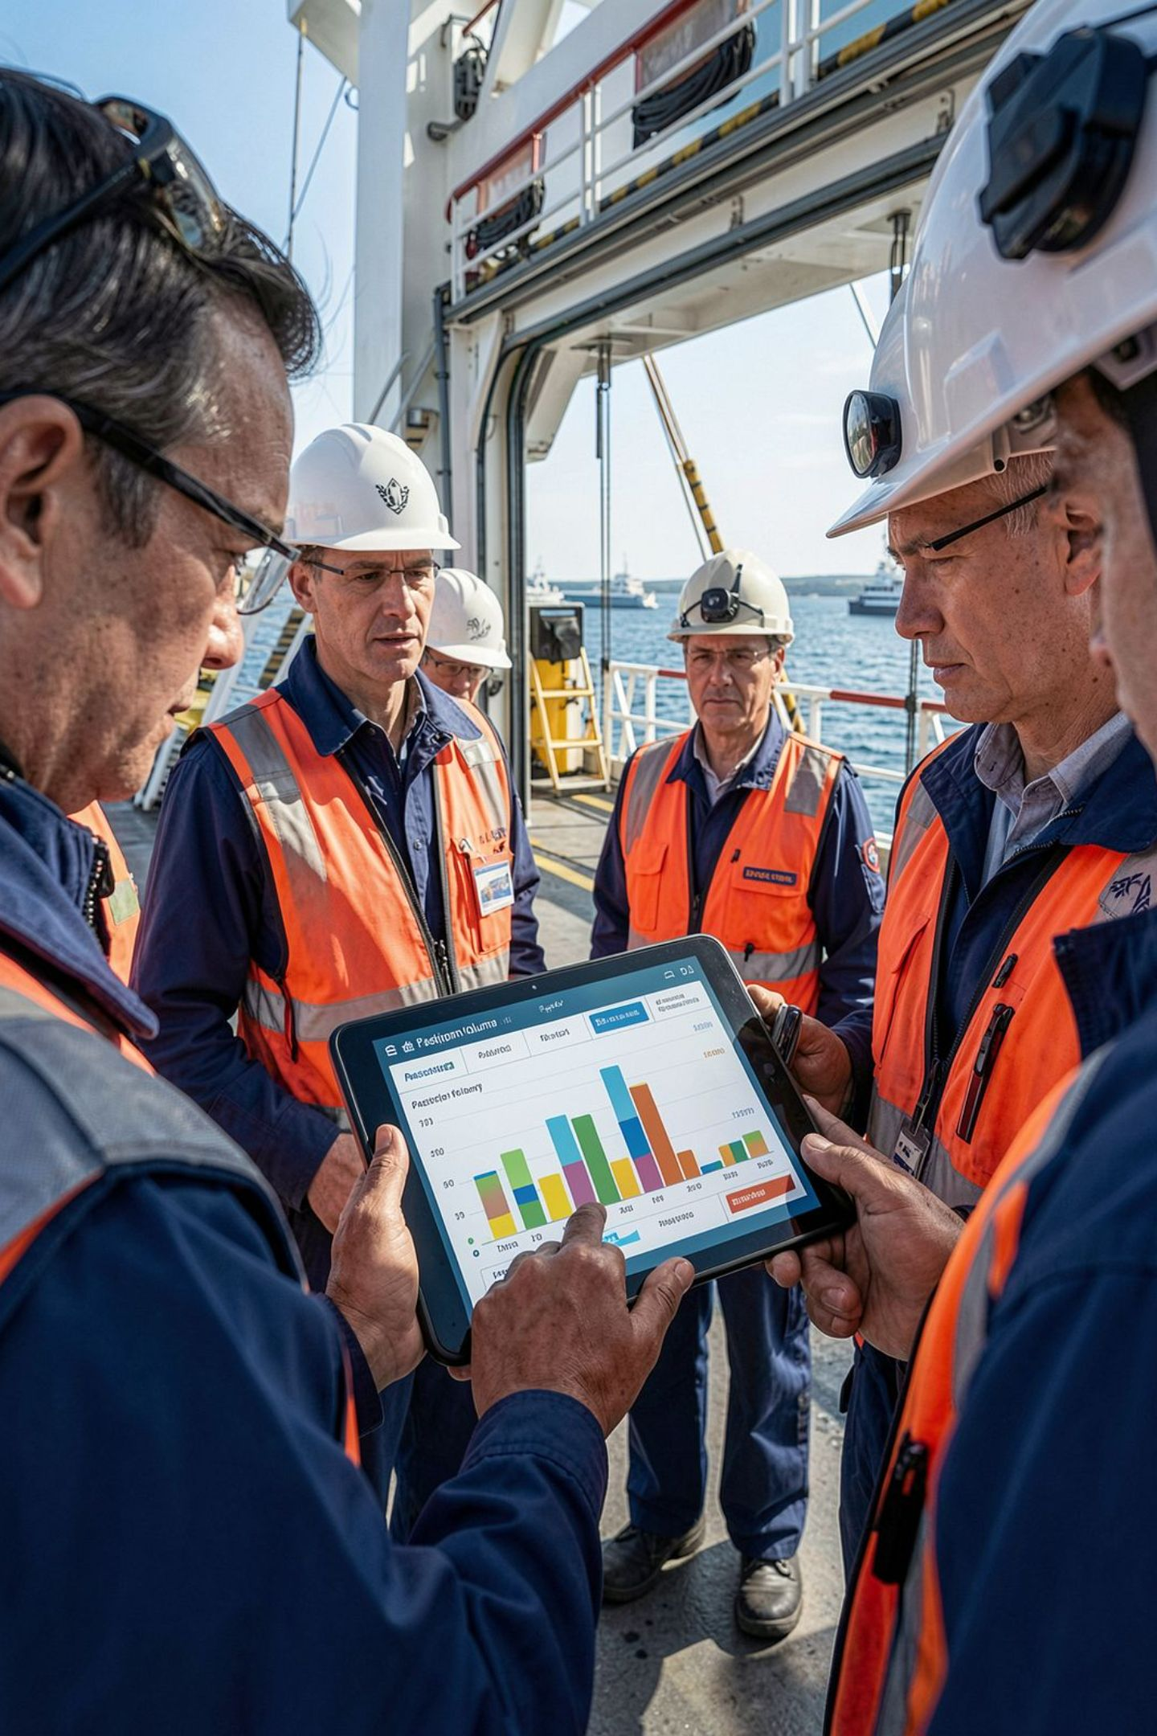
Operational Decision Support
Real-time Staffing
Tactical Packing
Priority Allocation
Forecast-driven crew schedules reduce overtime and avoid costly late hires while maintaining safety and service levels.
Zipper Configuration strategies are selected from forecast ensembles to maximize lane metre utilization and minimize rework.
Identify business vs leisure demand signals to reserve priority space for high‑yield customers without harming fill rates.

Slide 7
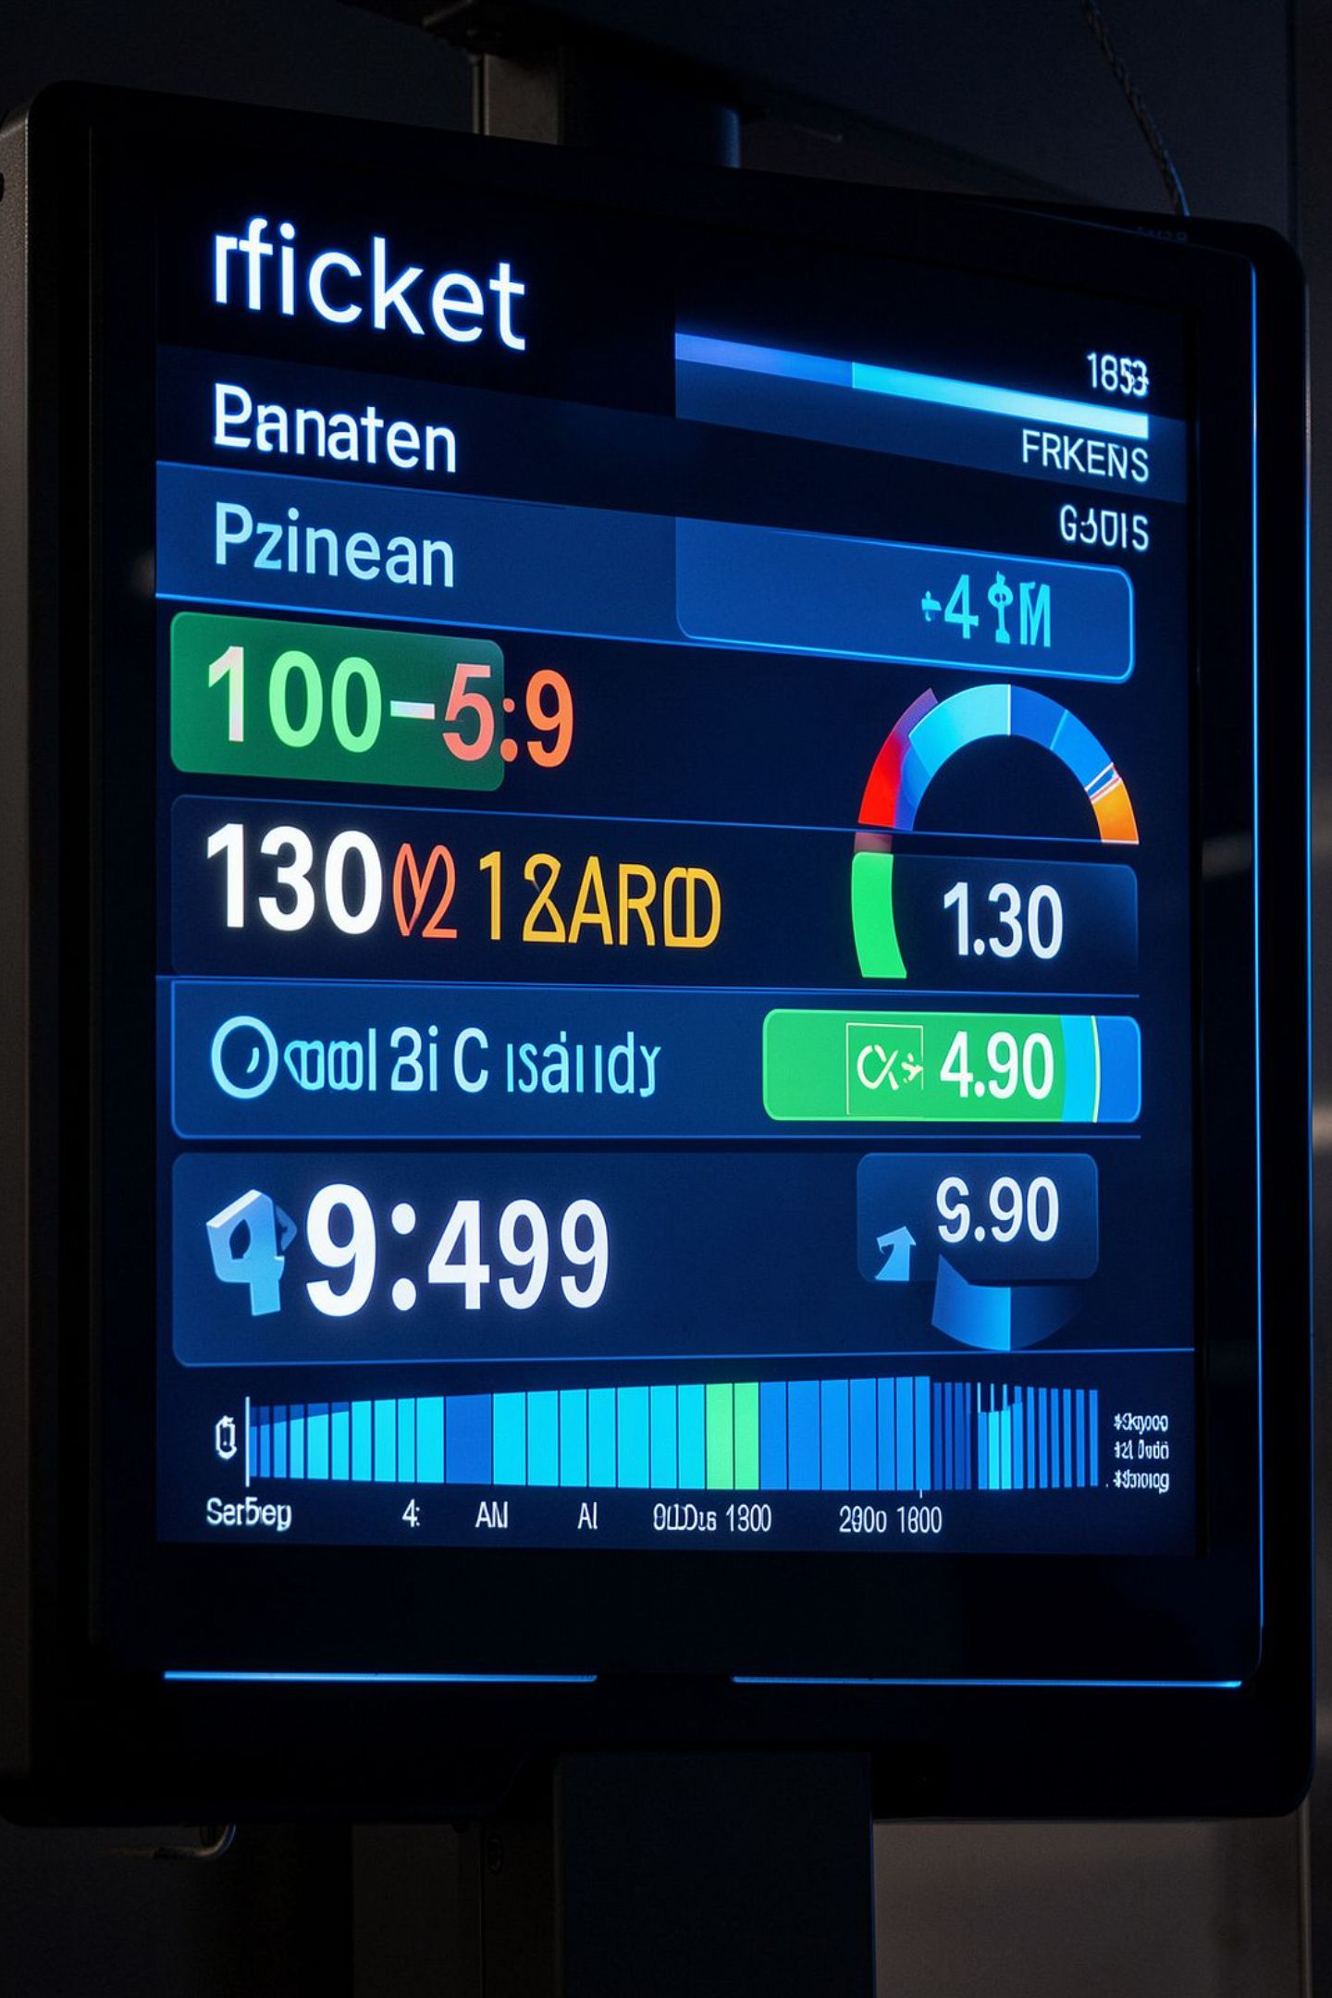
Revenue Management & Dynamic Pricing
A unified decision layer combines probabilistic forecasts with revenue objectives to issue automated availability and price recommendations.
EMSRb‑MR
Controls availability across fare classes by balancing marginal seat revenue vs stocking limits.
Dynamic Adjustments
Surge pricing for over-performing sailings; targeted micro‑promotions for under‑performers.
Cargo Uplift
Optimized loading increased cargo capacity by 6% through refined packing rules and prioritization logic.

Slide 8
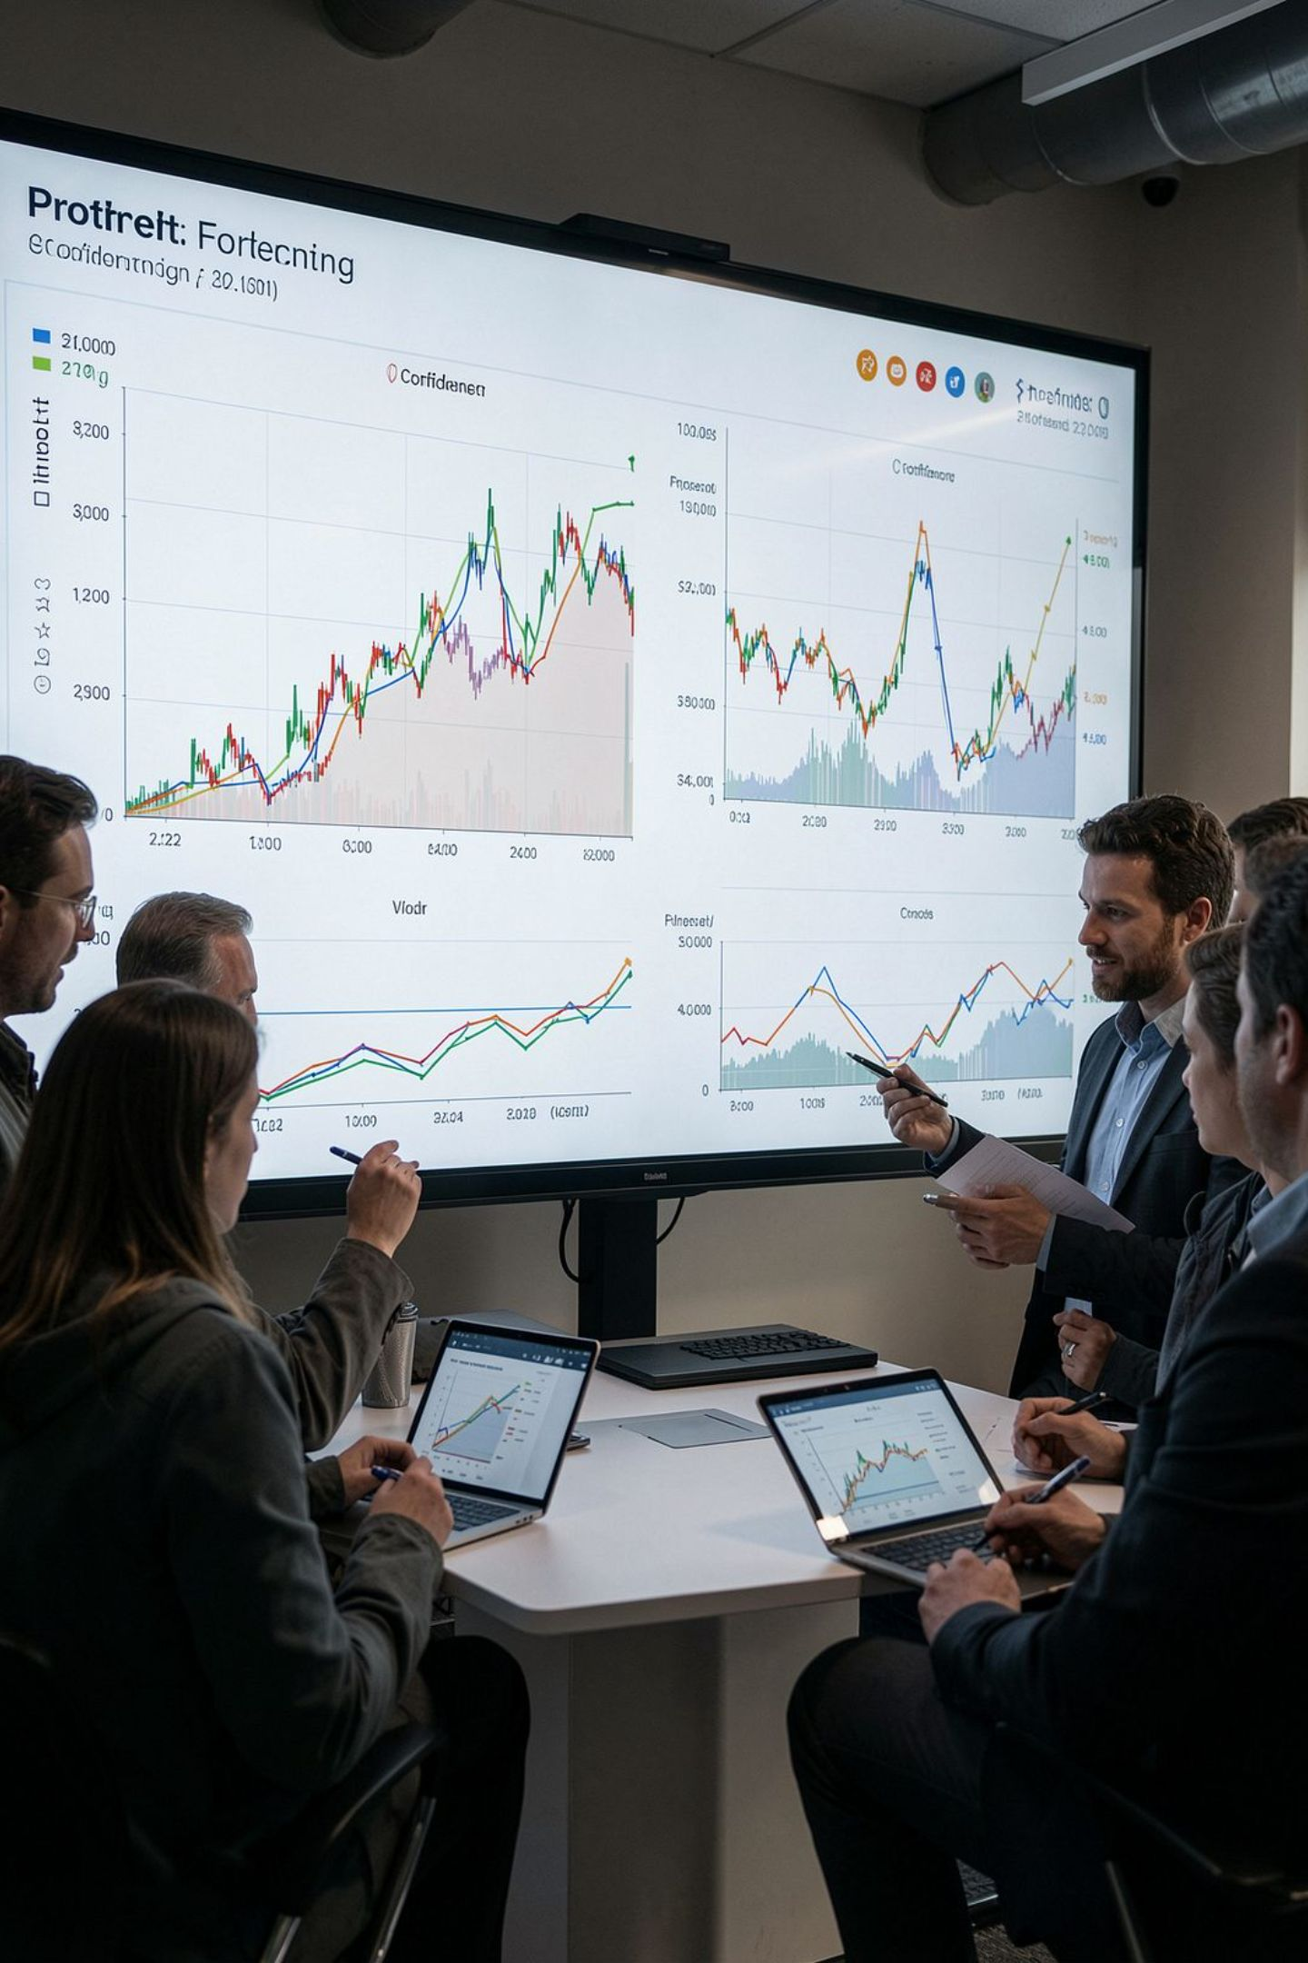
Advanced Analytics in Practice
Forecasting Tools
Integration & Feedback
Prophet for robust 30‑day seasonality and holiday effects; Bayesian ensembles to quantify uncertainty near departure.
APIs ingest legacy reservation systems and telemetry; models learn from price elasticities and willingness‑to‑pay signals in real time.
Short‑horizon ensembles for tactical decisions
Longer horizons for resource planning
Continuous A/B testing of pricing rules
Closed‑loop model retraining from operational outcomes

Slide 9

Beyond Forecasting: Operational Excellence
Predictive Maintenance
Emissions & Efficiency
Load-aware routing and optimized packing reduce fuel burn and CO2 output — measurable sustainability gains.
Sensor data and anomaly detection anticipate failures, reducing unscheduled downtime and improving reliability.
Golden Hour
Final 60‑minute forecast locks in the packing configuration and pricing overrides, ensuring a coordinated departure plan.

Slide 10




The Future of Maritime Transit
Integrated Operations
Sustainability & Profitability
Next Steps
Embed forecasting into crew, loading, pricing, and maintenance workflows — one authoritative truth for decisions.
Data-driven choices reduce emissions while improving margins — the twin mandate for modern ferry operators.
Operationalize the Golden Hour, expand real‑time APIs, and pilot RL-driven packing/pricing on high-frequency routes.
Actionable insight today builds the sustainable, profitable ferry operator of tomorrow.

