Slide 1
Predicting and interpreting oxide glass properties by machine learning using large datasets
Presented By:-
Shubham Yadav (21075082)
sidharth (21075084)
SHASHWAT UPHADYAY(21075088)
Yash Agrawal(21075093)

Slide 2
Problem Statement
To predict various properties of glasses namely –Glass transition temperature, Liquidous temperature, Refractive Index, Young’s Modulus, Coefficient of thermal expansion and Abbe number by studying their chemical composition.
Link to the Research Paper https://www.sciencedirect.com/science/article/pii/S0272884221014917

Slide 3
Introduction
Ceramics, copper, iron, and glasses are among the oldest synthetic, human-made materials. Objects made of glass have been known and extensively used for over 6000 years.
By far, most of these thousands of glassmaking formulations resulted from empirical trial-and-error experimental approaches, which were mainly guided by experience and accumulated knowledge.
The ultimate goal of the ML-based strategies is to specify a set of desired properties and find candidate compositions.

Slide 4
DataSet Description
Total Entries in Dataset 150,000
Attributes: Li Be B O Na Mg Al Si P K Ca Sc Ti V Cr Mn Fe Co Ni Cu Zn Ga Ge As Se Rb Sr Y Zr Nb Mo Ru Rh Pd Ag Cd In Sn Sb Te Cs Ba La Ce Pr Nd Sm Eu Gd Tb Dy Ho Er Tm Yb Lu Hf Ta W Hg Tl Pb Bi Th U
Each Entry corresponds to the percentage composition of the above elements in the dataset.
Dataset collected through SCIGLASS
25,000 Entries in Abbe Number Dataset
50,000 Entries in Tg Dataset

Slide 5
Dataset Description
The Dataset only contains Oxide Glass which has an atomic oxygen fraction of 0.3
They have excluded S, H, C, Pt, Au, F, Cl, N, Br, and I. The rationale behind this selection is that these elements only appear in very few compositions or are considered volatile.

Slide 6
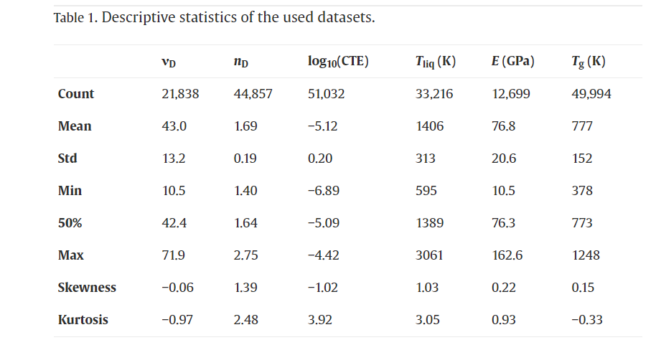
Statistical AnalysiS

Slide 7
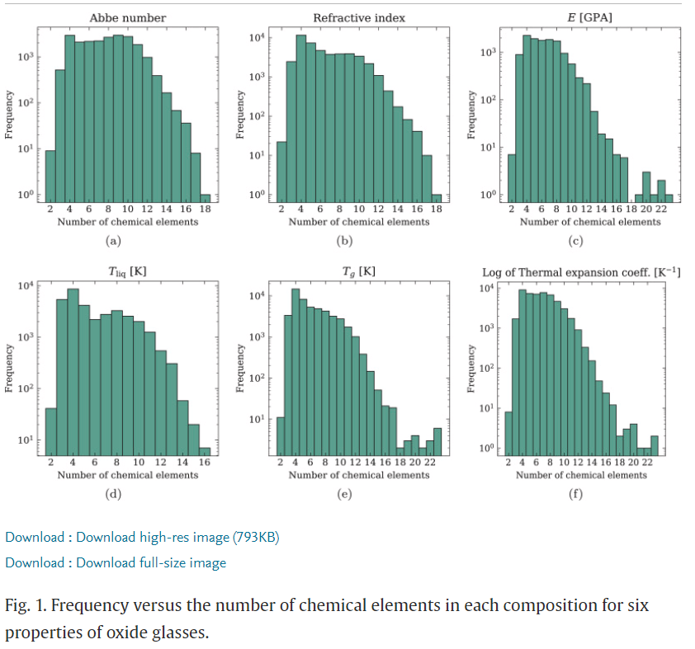

Slide 8
Work Done in the Paper
The Author has implemented Three Machine Learning algorithms for predicting the specified properties namely-
A decision tree induction Algorithm (Classifications And Regression Tree (CART))
K-nearest Neighbours (KNN)
Random Forest (RF)

Slide 9
CART
CART is a predictive algorithm used in Machine Learning and it explains how the target variable’s values can be predicted based on other matters. It is a decision tree where each fork is split into a predictor variable and each node has a prediction for the target variable at the end.

Slide 10
KNN
K-nearest neighbours (KNN) algorithm is a type of supervised ML algorithm that can be used for both classifications and regression predictive problems. The following two properties would define KNN well −
Lazy learning algorithm − KNN is a lazy learning algorithm because it does not have a specialized training phase and uses all the data for training while classification.
Non-parametric learning algorithm − KNN is also a non-parametric learning algorithm because it doesn’t assume anything about the underlying data.

Slide 11
RF
Random Forest is a classifier that contains a number of decision trees on various subsets of the given dataset and takes the average to improve the predictive accuracy of that dataset.
Instead of relying on one decision tree, the random forest takes the prediction from each tree and based on the majority votes of predictions, and it predicts the final output.
The greater number of trees in the forest leads to higher accuracy and prevents the problem of overfitting.

Slide 12
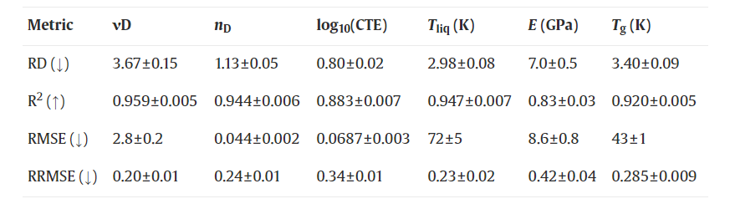
CART Algorithm

Slide 13
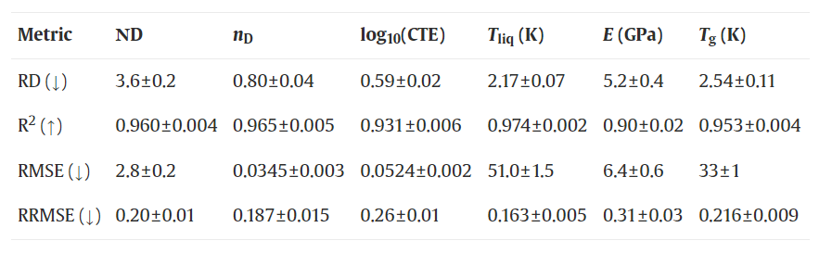
KNN Algorithm

Slide 14
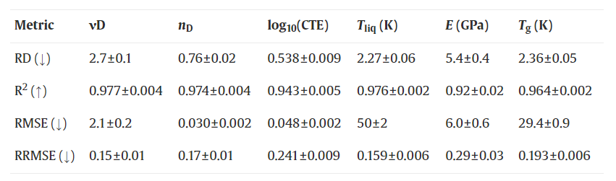
RF Algorithm

Slide 15
Our Progress
We have implemented various boosting and bagging techniques on the datasets namely
CatBoost
XGBoost
LightGBM
An ensemble model by combining the above the gradient boosting algorithms.

Slide 16
CatBoost
CatBoost is an algorithm for gradient boosting on decision trees. It is developed by Yandex researchers and engineers and is used for search, recommendation systems, personal assistants, self-driving cars, and weather prediction. It is in open-source and can be used by anyone.
Main advantages of CatBoost:
Superior quality when compared with other libraries on many datasets.
Best in-class prediction speed.
Support for both numerical and categorical features.

Slide 17
XGBoost
XGBoost is an optimized distributed gradient boosting library designed to be highly efficient, flexible and portable. It implements machine learning algorithms under the Gradient Boosting framework. XGBoost provides a parallel tree boosting (also known as GBDT, GBM) that solves many data science problems quickly and accurately.

Slide 18
LightGBM
LightGBM is a gradient boosting framework that uses tree based learning algorithms. It is designed to be distributed and efficient with the following advantages:
Faster training speed and higher efficiency.
Lower memory usage.
Better accuracy.
Support of parallel, distributed, and GPU learning.
Capable of handling large-scale data.

Slide 19
Ensemble Models
Meta machine learning models, also known as meta-learners or meta-models, are models that learn to combine the predictions or outputs of multiple base models in order to make a final prediction or decision.
These models are typically used in ensemble learning approaches like stacking.
We used Catboost, Xgboost and LightGBM for our ensemble model.

Slide 20
Performance comparison for Abbe Number :- Note – For comparing performance, we have used R2 score metric ,for all the 6 target variables As we can see, Catboost outperformed the the Authors Best model. Also, the Ensemble model , XG Boost and LGBM produced more optimal results as compared to Author’s.
Model Name | R2 score
RF(author) | 0.977 ± 0.004
Cat Boost | 0.99
Ensemble model | 0.9893
XG Boost | 0.989
LGBM | 0.9875

Slide 21
Performance comparison for T. Iiq ( Liquidous Temperature):- As we can see , LGBM gave the most optimal result and outperformed the the Authors best model. Also the Cat Boost produced more optimal results as compared to Author’s.
Model Name | R2 score
RF(author) | 0.976
Cat Boost | 0.9830
Ensemble Model | 0.9741
LGBM | 0.9849

Slide 22
Performance comparison for Tg( Transition Temperature):- As we can see, Cat Boost and LGBM gave the most optimal results and outperformed authors best model. Also Ensemble model and LGBM gave more optimal results than author’s.
Model Name | R2 Score
RF(author) | 0.964
Cat Boost | 0.9807
Ensemble Model | 0.972
XG Boost | 0.977
LGBM | 0.980

Slide 23
Performance comparision for ND_300 As we can see Catboost gave the most optimal results and outperformed the authors best model. Also Ensemble model , XG Boost , LGBM gave more optimal results than authors.
Model Name | R2_score
RF(author) | 0.974
Cat Boost | 0.9866
Ensemble Model | 0.98164
XG Boost | 0.9787
LGBM | 0.9855

Slide 24
Performance comparision for Young Modulus As we can see Catboost gave the most optimal results and outperformed the author’s best model.
Model Name | R2_SCORE
RF(author) | 0.92
Cat Boost | 0.9435
Ensemble Model | 0.9384
XG Boost | 0.8817
LGBM | 0.8511

Slide 25
Performance comparision for TEC As we can see Catboost gave the most optimal results. And outperformed author’s best model . Also Ensemble model, XG Boost ang LGBM gave more optimal results as compared to Author’s best model.
Model Name | R2_SCORE
RF(author) | 0.943
Cat Boost | 0.9655
Ensemble Model | 0.95524
XG Boost | 0.9622
LGBM | 0.9646

Slide 26
Conclusion
Catboost and MetaModel have outperformed the accuracies in all the datasets mentioned in the paper

Slide 27
Thank You

