Slide 1
Face Recognition
Attendance System

Slide 2

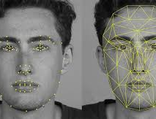

What is Face Recognition?
Face recognition is a method of identifying or verifying the identity of an individual using their face. Face recognition systems can be used to identify people in photos, video, or in real-time.

Slide 3
Why We Choose Face Recognition?
It requires no physical interaction on behalf of the user.
It is accurate and allows for high enrolment and verification rates.
It does not require an expert to interpret the comparison result.
It can use your existing hardware infrastructure, existing camaras and image capture.
It is the only biometric that allow you to perform passive identification in a one to. Many Environments
Overall it is the most efficient system to collect automatic student attendance of Online class in Corona Pandemic

Slide 4
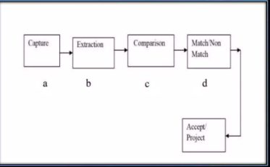
All identification or authentication technologies operate using the following four stages:
1) Capture: A physical or behavioural sample is captured by the system during Enrollment and also in identification or verification process.
2) Extraction: Unique data is extracted from the sample and a template is created.
3) Comparison: The template is then comparedwith a new sample.
4) Match/non match: The system decides if thefeatures extracted from the new Samples are a match or a non match

Slide 5
How Face Recognition Systems Work
If we look at the mirror, we can see that our face has certain distinquishable landmarks. These are the peaks and valleys that make up the different facial features.
Software defines these landmarks as nodal points.
There are about "80 nodal points" on a human face.
Here are few nodal points that are measured by the software.
• distance between the eyes
• width of the nose
• depth of the eye socket
• cheekbones
• jaw line
• chin

Slide 6
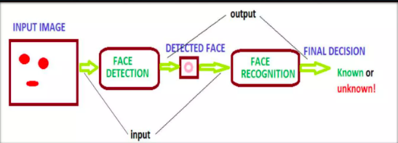
How Face Recognition Systems Work

Slide 7
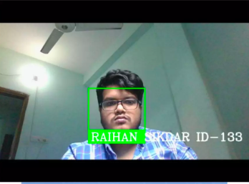
Face Recognition Attendance System
The modern face recognition attendance system is much efficient and safer than the conventional counterparts. There are a few attendance systems that are based on the face recognition technology and each of them has extremely varying features for the best suitability in different environments.
It provides a facility for the central data management system.
A very cost effective method of recording the attendance

Slide 8
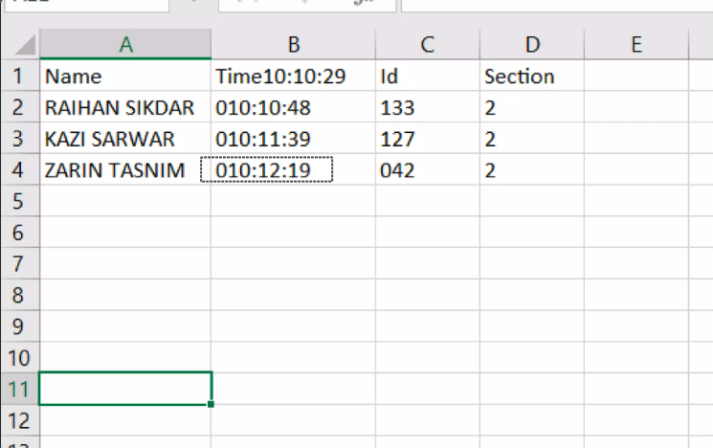
Attendance in Excel File

Slide 9
Advantage of Automatic Attendance System with Face Recognition
Increased security
Easy to manage
Cost-effective
Automated time tracking system

Slide 10

Thank You

