Slide 1
Heart failure predictor
YASH KUMAR GARG. 11906097
ABHISHEK BHADORIA. 11905997

Slide 2
WHY HEARTH FAILURE PREDICTOR??
Because Heart disease is very common now a days so that the regular checkup is very necessary and that’s why we choose this one.
No one fully utilize this dataset and implemented properly.
Earlier it is developed in code-based structure and now we had developed it in user friendly manner.
Cost Effective and ease of use.

Slide 3
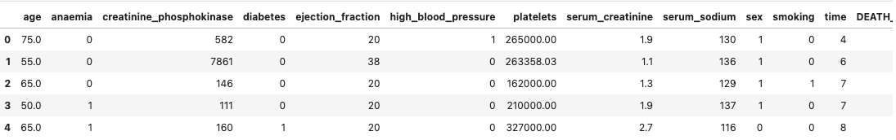


CLINICAL RECORDS DATASET

Slide 4
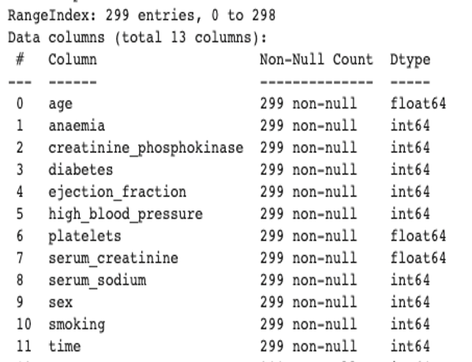

DATASET InFO

Slide 5
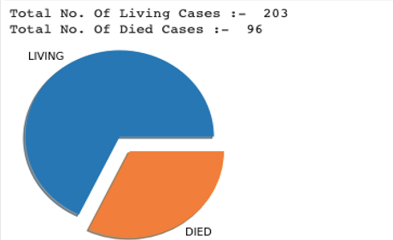
Death event in the dataset

Slide 6
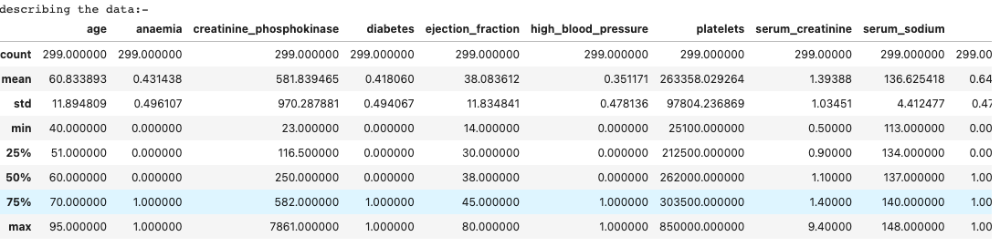
Correlation Analysis-Kendall

Slide 7
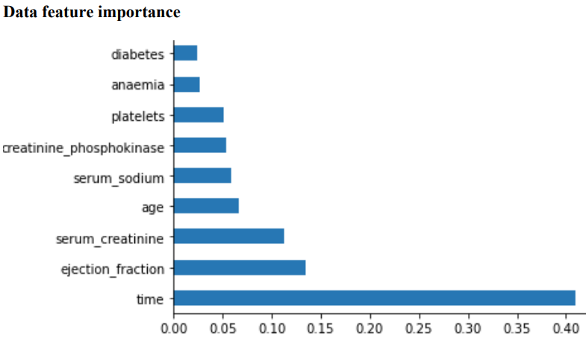
LIMITATION
Dataset has only 299 entry.
Time Feature is more dominant
Accuracy is not up to the mark

Slide 8
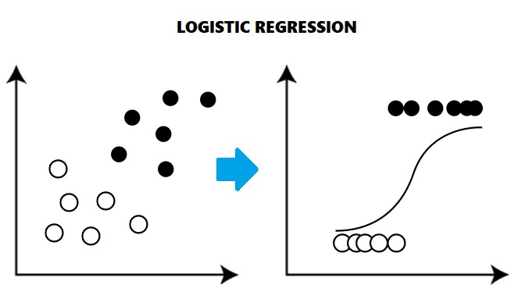
MODEL USES & DESCRIBE MODEL
Logistic Regression :-
In statistics, the logistic model (or logit model) is used to model the probability of a certain class or event existing such as pass/fail, win/lose, alive/dead or healthy/sick. This can be extended to model several classes of events such as determining whether an image contains a cat, dog, lion, etc. Each object being detected in the image would be assigned a probability between 0 and 1, with a sum of one.

Slide 9

Standard Scaler :-Standardization scales each input variable separately by subtracting the mean (called centering) and dividing by the standard deviation to shift the distribution to have a mean of zero and a standard deviation of one
SVC :- The objective of a Linear SVC (Support Vector Classifier) is to fit to the data you provide, returning a "best fit" hyperplane that divides, or categorizes, your data. From there, after getting the hyperplane, you can then feed some features to your classifier to see what the "predicted" class is.

Slide 10
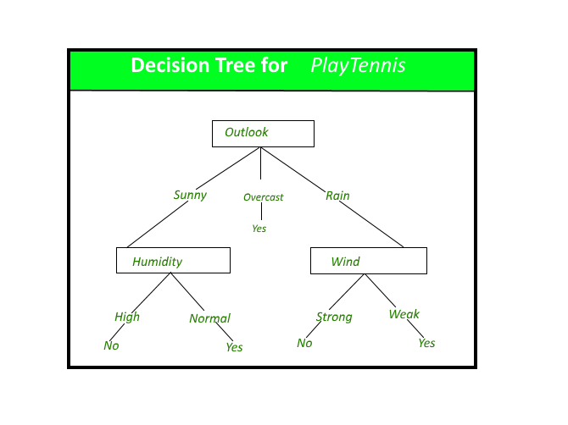

Decision tree :- A decision tree is a flowchart-like structure in which each internal node represents a "test" on an attribute (e.g. whether a coin flip comes up heads or tails), each branch represents the outcome of the test, and each leaf node represents a class label (decision taken after computing all attributes).
Gradient boosting :- Gradient boosting classifiers are a group of machine learning algorithms that combine many weak learning models together to create a strong predictive model. Decision trees are usually used when doing gradient boosting.

Slide 11
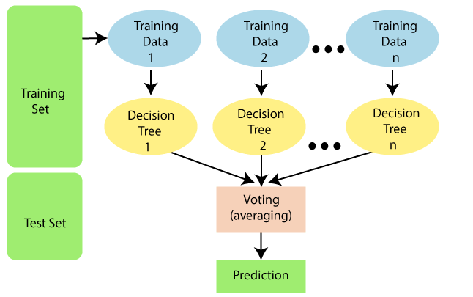
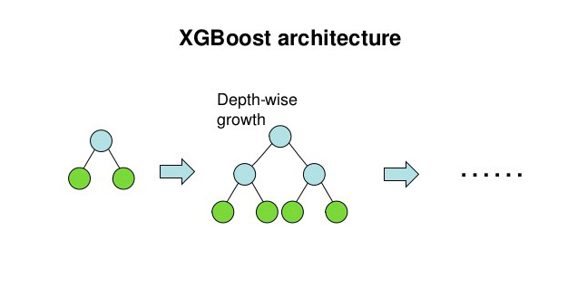
RANDOM FOREST:- Random Forest is a classifier that contains a number of decision trees on various subsets of the given dataset and takes the average to improve the predictive accuracy of that dataset.
Xgboost :- XGBoost is an optimized distributed gradient boosting library designed to be highly efficient, flexible and portable. It implements machine learning algorithms under the Gradient Boosting framework.

Slide 12
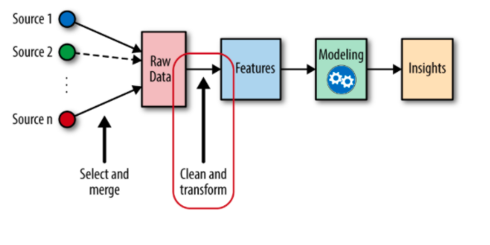
FEATURE ENGINERRING
Feature engineering refers to the process of using domain knowledge to select and transform the most relevant variables from raw data when creating a predictive model using machine learning or statistical modeling. The goal of feature engineering and selection is to improve the performance of machine learning (ML) algorithms.

Slide 13
COMPARE MODELS

Slide 14
COMPARE MODELS

Slide 15
RELATED WORK
https://www.kaggle.com/dongtrieumd/hf-prediction - The accuracy of this project is only 80% . He doesnot implement all models properly.
https://www.kaggle.com/prakharshukla93/85-heart-failure-prediction - In this project although he gets accuracy of 85% using KNN . But his project lacks in reaching the users.

Slide 16
REFERENCES
https://www.geeksforgeeks.org/decision-tree/. [10]
https://www.equiskill.com/understanding-logistic-regression/ [8]
https://www.javatpoint.com/machine-learning-random-forest-algorithm [11 ]
https://www.omnisci.com/technical-glossary/feature-engineering [12]
https://medium.com/analytics-vidhya/introduction-to-xgboost-algorithm-d2e7fad76b04 [ 11]
https://www.kaggle.com/andrewmvd/heart-failure-clinical-data [dataset]
https://www.geeksforgeeks.org/machine-learning/?ref=shm [study purpose]
https://www.youtube.com/channel/UCNU_lfiiWBdtULKOw6X0Dig [study purpose]

