Slide 1
Hybrid Calculator

Slide 2
Main Properties and Overview
It is a tool which act as a helping hand for the user to convert one unit to another and scientific calculator for further calculations in a very simple and user friendly GUI.
The Hybrid Calculator Interface is targeted to the combined as many application we used in our daily lives. This system acts as a standard interface between the user and the calculator. By using this application any user who wants different application in one form and easy to use.
Hybrid Calculator
Convertors
Scientific Calculator
Currency convertor
Weight convertor
Length convertor
Temperature Convertor

Slide 3
Framework , Modules | Defination
Tkinter | It is a standard Python interface to the Tk GUI toolkit shipped with Python. Python with tkinter is the fastest and easiest way to create the GUI applications.
Math | The math module is used to access mathematical functions in the Python. All methods of this functions are used for integer or real type objects, not for complex numbers.
Urllib.request | The urllib.request module defines functions and classes which help in opening URLs (mostly HTTP) in a complex world
Toplevel | A Toplevel widget is used to create a window on top of all other windows.
Entry | The Entry Widget is a Tkinter Widget used to Enter or display a single line of text.
Label | This widget implements a display box where you can place text or images. The text displayed by this widget can be updated at any time you want.
OptionMenu | The OptionMenu class is a helper class that creates a popup menu, and a button to display it.
Frame | It acts as a container to hold the widgets. It is used for grouping and organizing the widgets

Slide 4
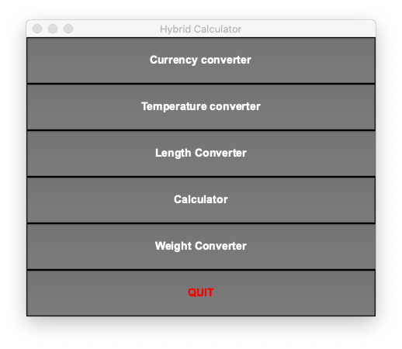
Main menu
User can easily choose with this simple GUI
This type of user interface is made with the help of Button in Tkinter and every button calling a function when it been hit .

Slide 5
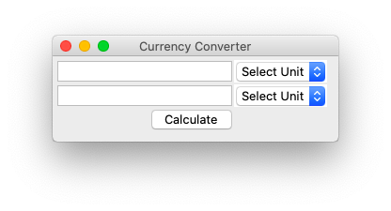
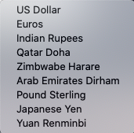
Currency convertor
First user have to select from which currency to which currency he want to calculate then enter the value and hit the calculate button.
It take Current value of Currencies from website Exchangerate-api.com using urllib.request module
Entry box is made with Entry in Tkinter
Select unit is made with Optionmenu
Calculate button is made using Button
Select unit options

Slide 6
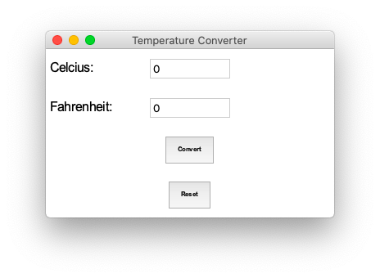
Temperature convertor
User have to first enter the value of either Celcius or Fahrenheirt so that the convertor can convert it into another unit by using calculate button.
If user want to use this convertor once again . It can be reset to 0 using reset button.
Here Label , Entry , Button from tkinter is used.

Slide 7
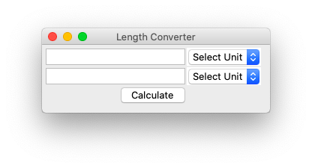

Length convertor
First user have to select from which unit to which unit he want to calculate then enter the value in that respective entry box and hit the calculate button to find the correct output.
Here Entry , Button ,Optionmenu from tkinter is used.
Select unit options

Slide 8
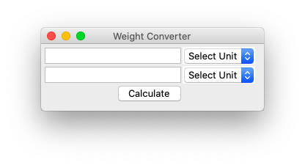

Weight convertor
First user have to select from which unit to which unit he want to calculate then enter the value in that respective entry box and hit the calculate button to find the correct output.
Here Entry , Button ,Optionmenu from tkinter is used.
Select unit options

Slide 9
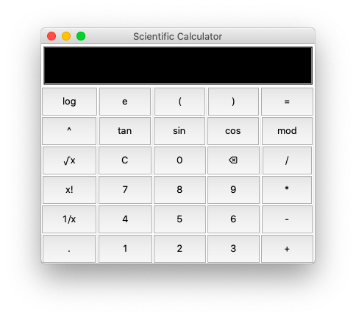
Scientific calculator
User only select the mathematical equation through buttons . It is provided so that further calculation become easy for user . So user need not to go on another app for this type of calculations.
Here Entry , Button and some functions from math library from Tkinter is used.

