Slide 1
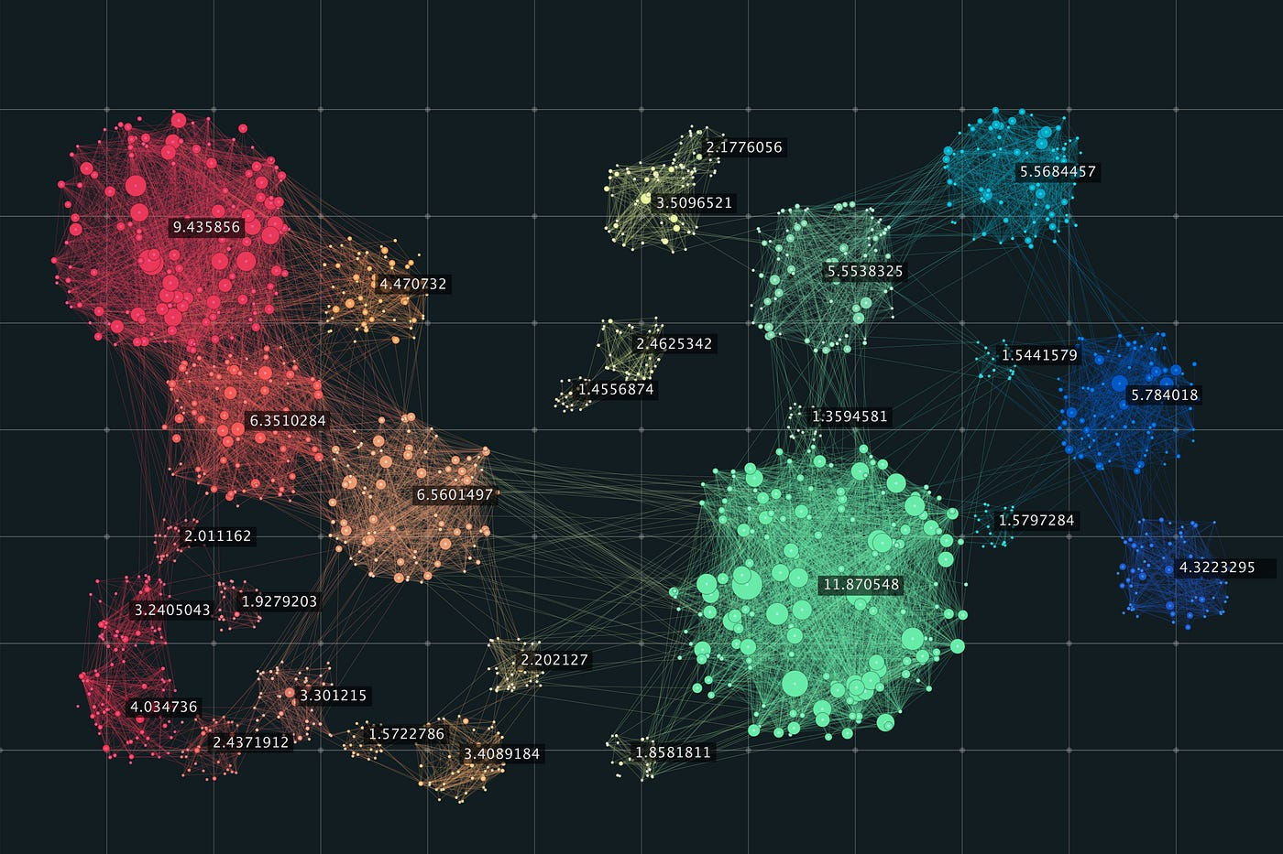
HPDBSCAN
Highly Parallel

Slide 2
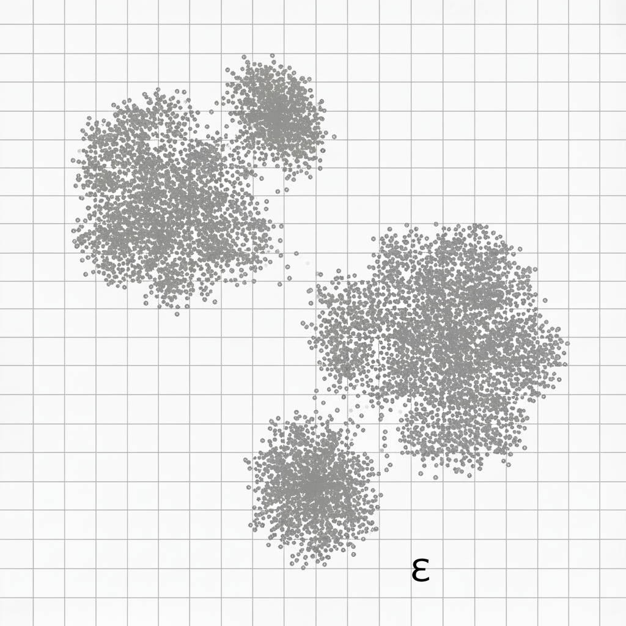
Sample Data Set for Better understanding of the algorithm :

Slide 3
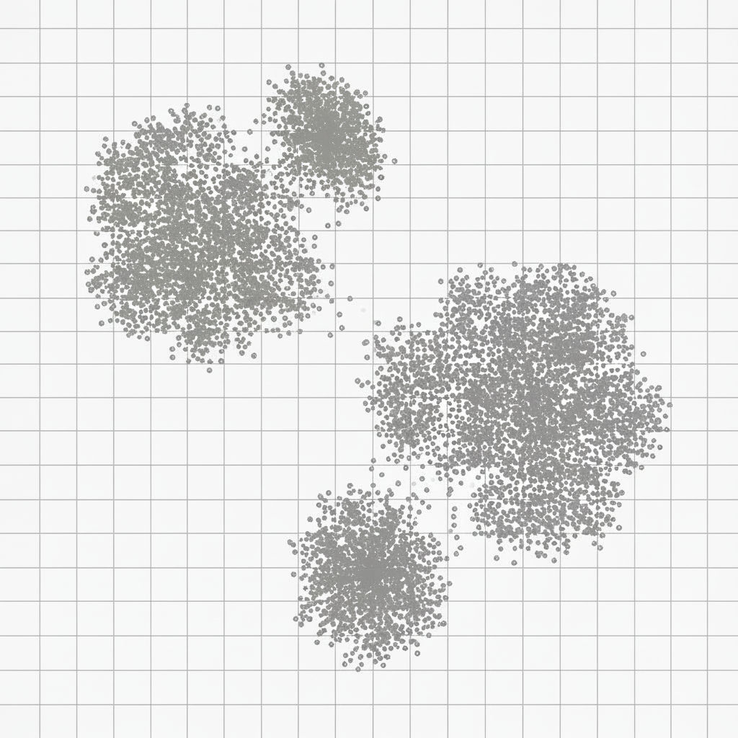
Halo Blocks
c
t
h
total no of
elements
in block
Hot Cell
Cost = h x t
<Var>.parallelStream().forEach(this::processCellLocally);

Slide 4
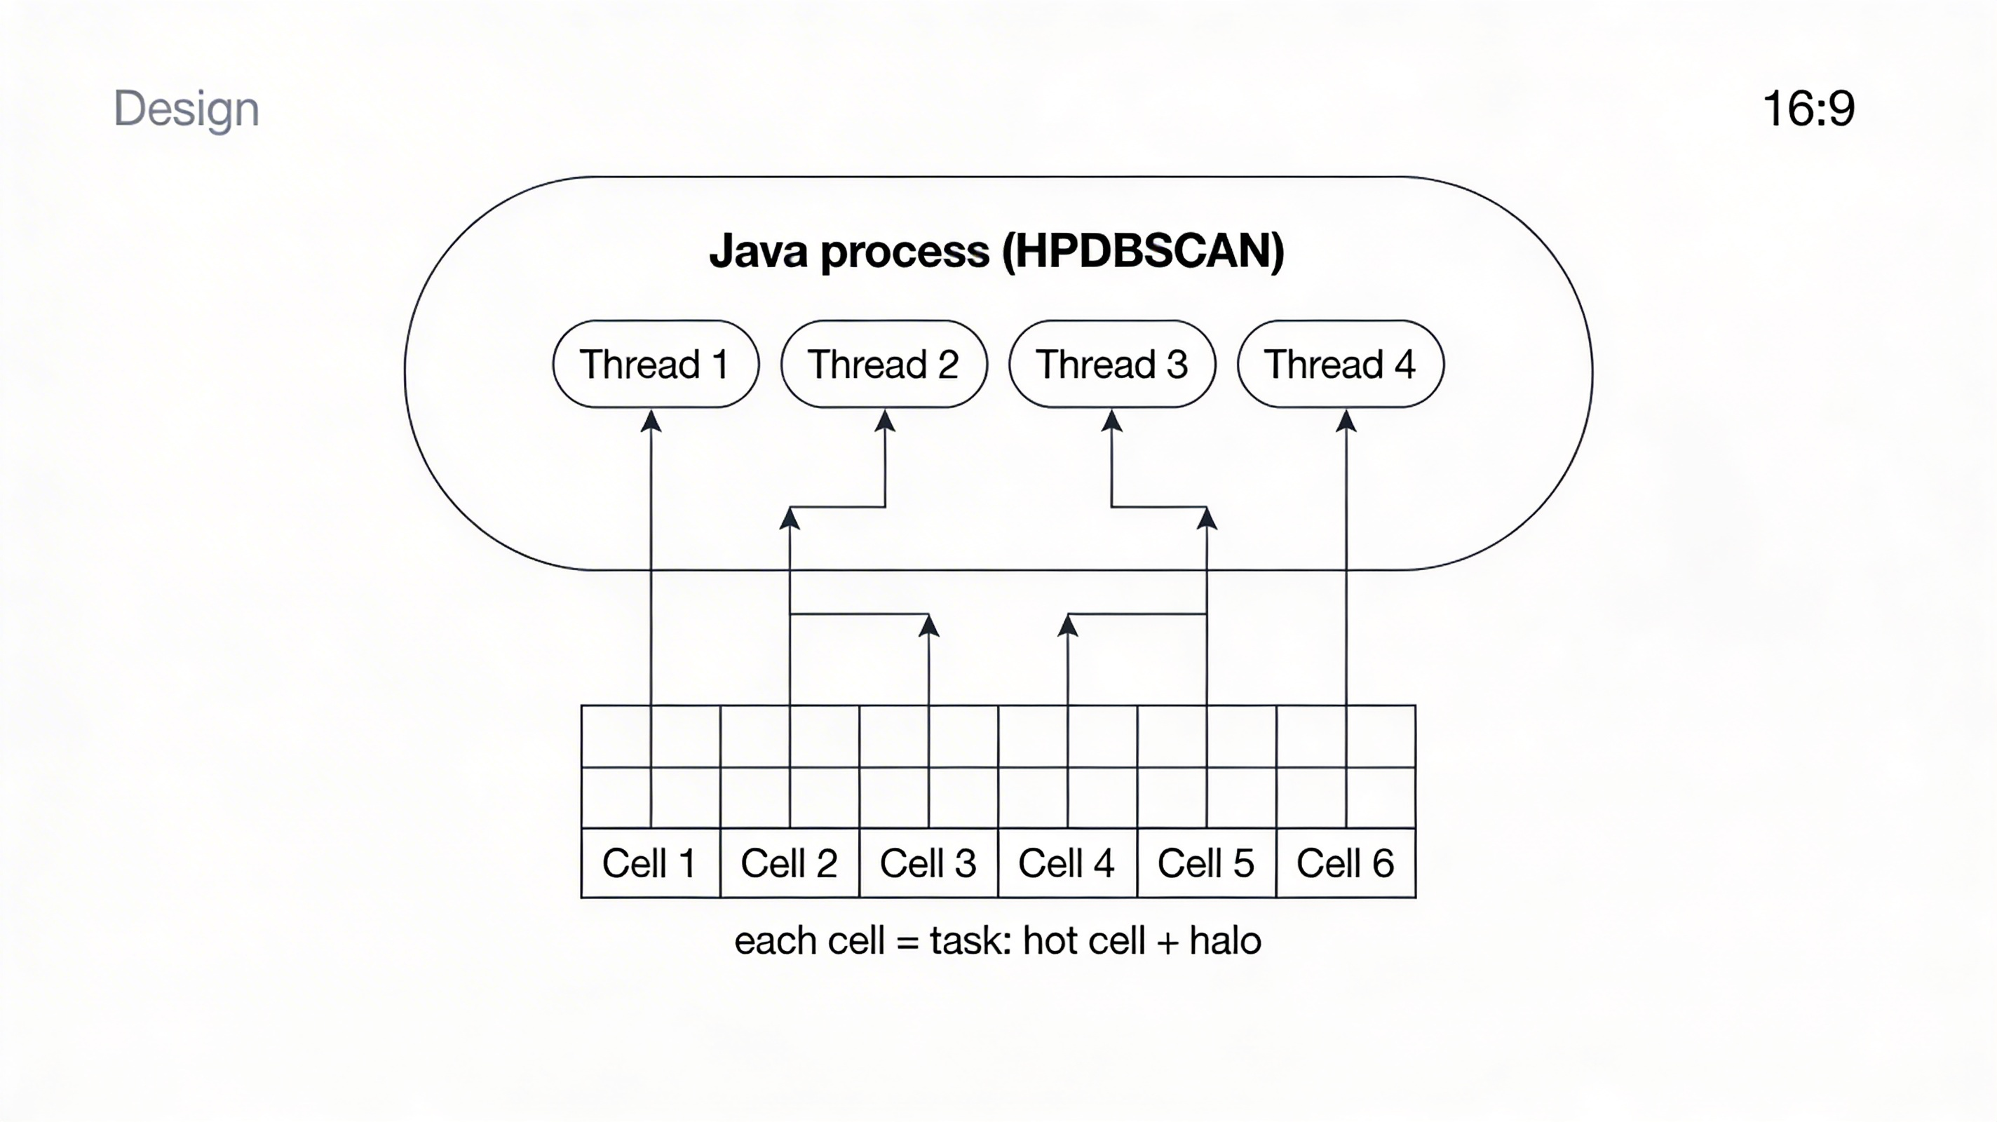

Slide 5
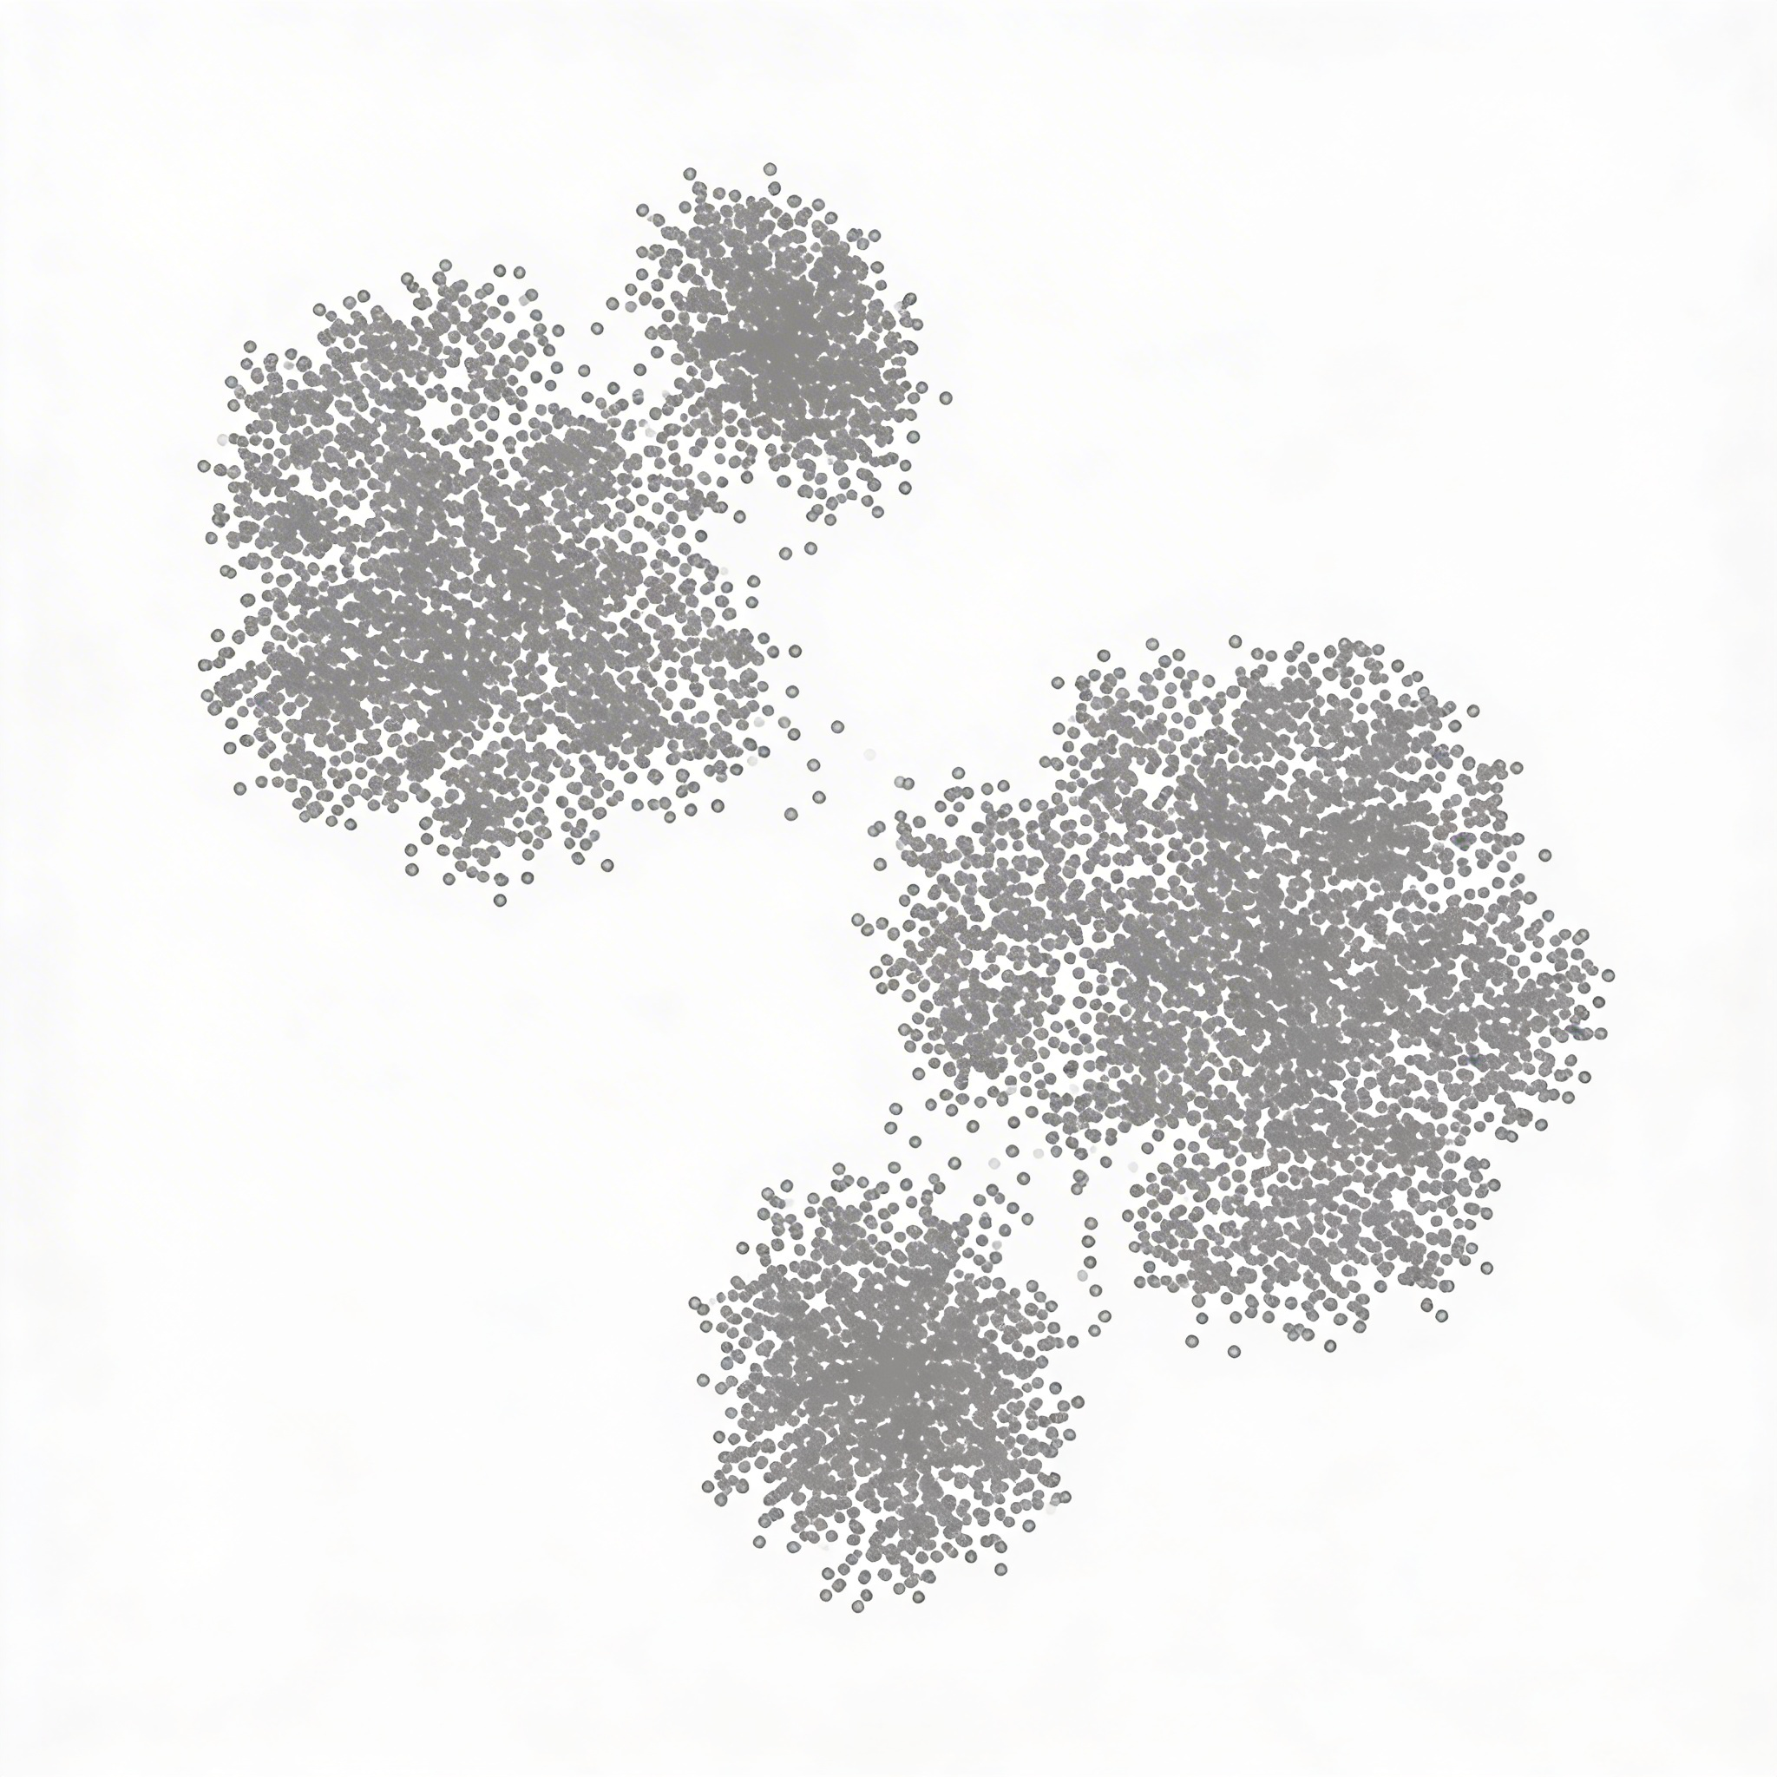

Slide 6
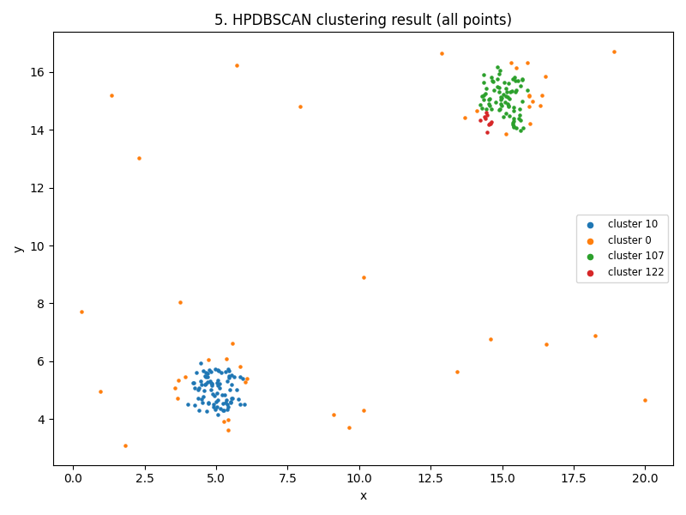
epsilon : 0.2
minPoints : 5
= Clustering in 56ms

Slide 7
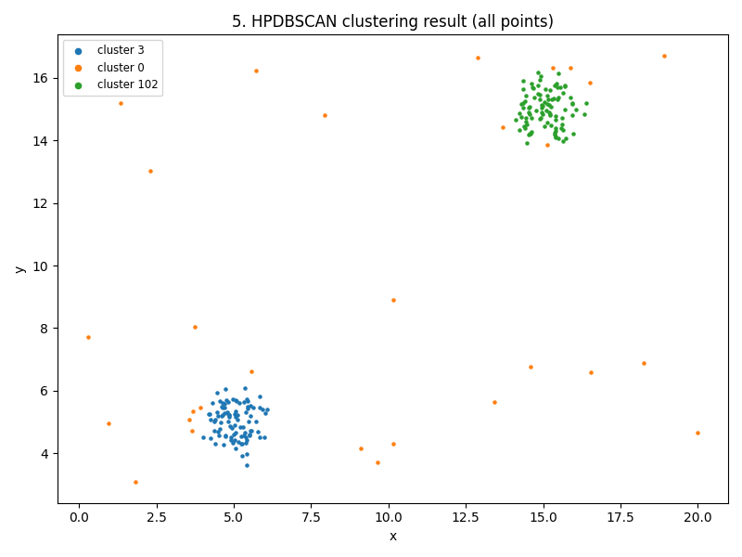
0.4
5

