Slide 1

Mortality Data Analysis: Assessing the Influence of Pollution on Circulatory and Respiratory Disease
ALY6150: Healthcare/Pharmaceutical Data and Applications
Instructor: Prof. Roy Wada
Group 1:
Dinesh Chenaramchowdary,
Shital Lathiya,
Paritosh Singh,
Yash Yadav

Slide 2
CONTENTS
INTRODUCTION
DATASET
ANALYSIS
MODELING
CONCLUSION
REFERENCES

Slide 3
Introduction
Mortality data analysis: To understand the trends, patterns, and underlying factors associated with various diseases.
Gain valuable insights into public health issues and identify potential interventions.
Why: Advocate for stricter emission control measures, promote clean and sustainable energy sources, and implement policies to protect public health.
How: Investigate the health risks associated with CO and PM10 pollutants
Goal: Build a predictive model that can estimate deaths per 10,000 individuals for circulatory and respiratory diseases.
Notes:
Mortality data analysis plays a crucial role in understanding the trends, patterns, and underlying factors associated with various diseases.
By examining mortality rates, we can gain valuable insights into public health issues and identify potential interventions.
mortality rates can be influenced by various factors, and pollution is one such factor that has gained significant attention in recent years.
Our primary goal is to build a predictive model that can estimate deaths per 10,000 individuals for circulatory and respiratory diseases based on two key pollutants: carbon monoxide (CO) and particulate matter with a diameter of 10 micrometers or less (PM10).
By examining the relationship between pollution levels and mortality rates, we aim to provide valuable insights into the health risks associated with these pollutants and inform evidence-based decision-making in public health and environmental policy.
The findings of this report can serve as a call to action for strengthening environmental regulations related to CO and PM10 emissions.
Policymakers can use this information to advocate for stricter emission control measures, promoting clean and sustainable energy sources, and implementing policies to reduce pollution levels in order to protect public health.

Slide 4
Data Collection
we have collected a comprehensive mortality dataset from the Centers for Disease Control and Prevention (CDC).
We collected pollution from the United States Environmental Protection Agency (EPA).

Slide 5
Dataset
The mortality dataset provides data about deaths rate for various ICD chapters at year, state, urbanization, gender and age group level.
Mortality dataset we collected has data for all the states of United States from year 1999 to 2016.
The pollution data we collected has emission values for various pollutants like CO, Black Carbon, PM10, SO2 and NOX for each state of the USA from 1990 to 2022.
To explore the potential impact of pollution on mortality, we integrated pollution data with mortality data.

Slide 6
Descriptive statistics: Dataset
 | Year | Year Code | State Code | 2013 Urbanization Code | Deaths | Emissions_CO | Emissions_PM10
count | 419356 | 419356 | 419356 | 419356 | 419356 | 419356 | 419356
mean | 2007.67 | 2007.67 | 28.90 | 3.35 | 102.95 | 1797.75 | 370.55
std | 5.18 | 5.18 | 15.51 | 1.66 | 277.15 | 1434.20 | 333.49
min | 1999 | 1999 | 1 | 1 | 10 | 29.79 | 3.46
25% | 2003 | 2003 | 17 | 2 | 18 | 851.75 | 197.29
50% | 2008 | 2008 | 28 | 3 | 35 | 1427.23 | 267.73
75% | 2012 | 2012 | 42 | 5 | 89 | 2281.44 | 424.83
max | 2016 | 2016 | 56 | 6 | 15627 | 9618.34 | 2697.85

Slide 7
Descriptive statistics: Female subset
 | Year | Year Code | State Code | 2013 Urbanization Code | Deaths | Emissions_CO | Emissions_PM10
count | 201835 | 201835 | 201835 | 201835 | 201835 | 201835 | 201835
mean | 2007.670245 | 2007.670245 | 28.95408626 | 3.339039314 | 107.497877 | 1808.913845 | 371.9630136
std | 5.17572001 | 5.17572001 | 15.50534506 | 1.661580783 | 311.446642 | 1435.543737 | 335.110133
min | 1999 | 1999 | 1 | 1 | 10 | 29.79073827 | 3.463378785
25% | 2003 | 2003 | 17 | 2 | 18 | 860.2440299 | 197.5661745
50% | 2008 | 2008 | 28 | 3 | 34 | 1452.65622 | 267.7251364
75% | 2012 | 2012 | 42 | 5 | 90 | 2283.187533 | 425.5921368
max | 2016 | 2016 | 56 | 6 | 15627 | 9618.345877 | 2697.854607

Slide 8
Descriptive statistics: Male subset
 | Year | Year Code | State Code | 2013 Urbanization Code | Deaths | Emissions_CO | Emissions_PM10
count | 217521 | 217521 | 217521 | 217521 | 217521 | 217521 | 217521
mean | 2007.675 | 2007.675 | 28.85558176 | 3.361358214 | 98.73141 | 1787.392956 | 369.2465341
std | 5.177593 | 5.177593 | 15.52161368 | 1.667241602 | 240.9258 | 1432.886386 | 331.9836559
min | 1999 | 1999 | 1 | 1 | 10 | 29.79073827 | 3.463378785
25% | 2003 | 2003 | 17 | 2 | 18 | 847.3758814 | 197.0989301
50% | 2008 | 2008 | 28 | 3 | 35 | 1419.649054 | 267.7251364
75% | 2012 | 2012 | 42 | 5 | 88 | 2265.961879 | 424.3644682
max | 2016 | 2016 | 56 | 6 | 9494 | 9618.345877 | 2697.854607

Slide 9
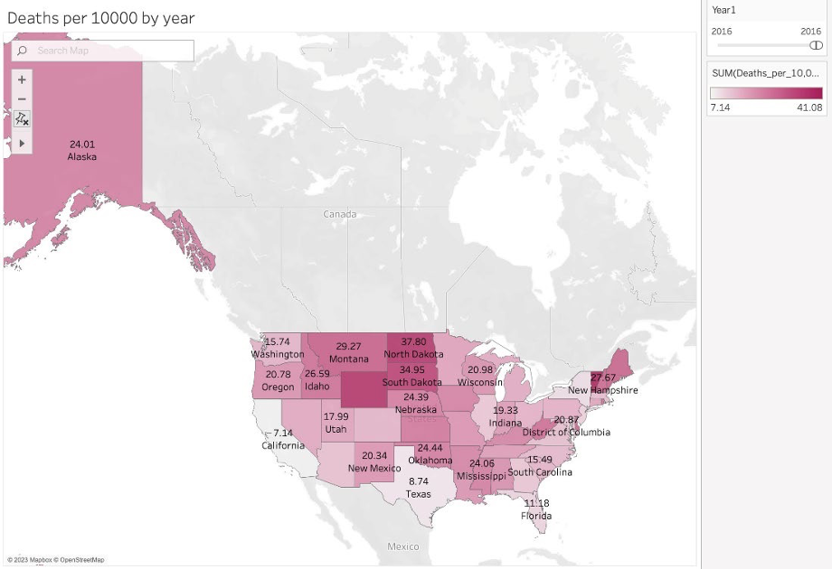
EDA
North Dakota: highest death rate at 37.8 per 10,000 in 2016
California: High total deaths but very low death rate at 7.14 per 10,000 in 2016

Slide 10
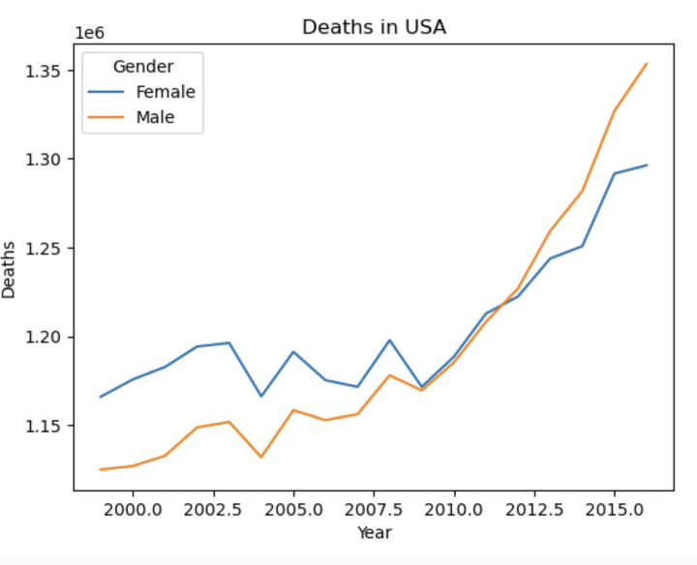
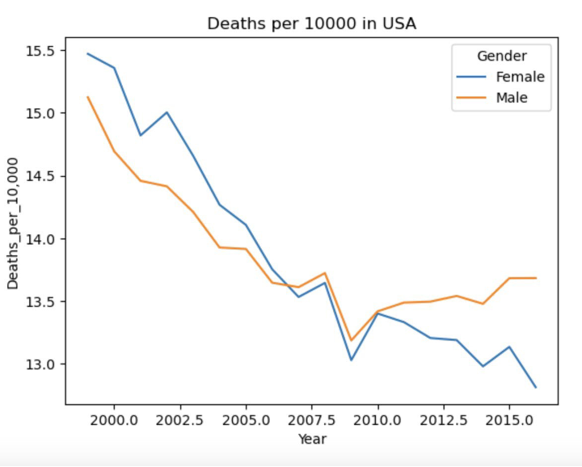
EDA: Mortality rate trends in USA
While total deaths increased, death rate decreased over the years.

Slide 11
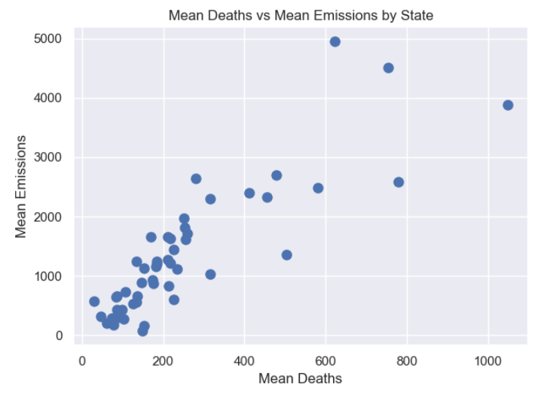
Circulatory System Diseases: Mean Deaths vs Mean Emissions

Slide 12
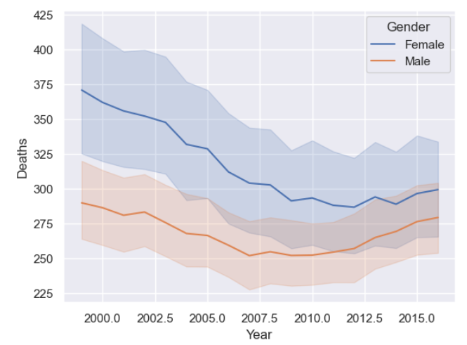
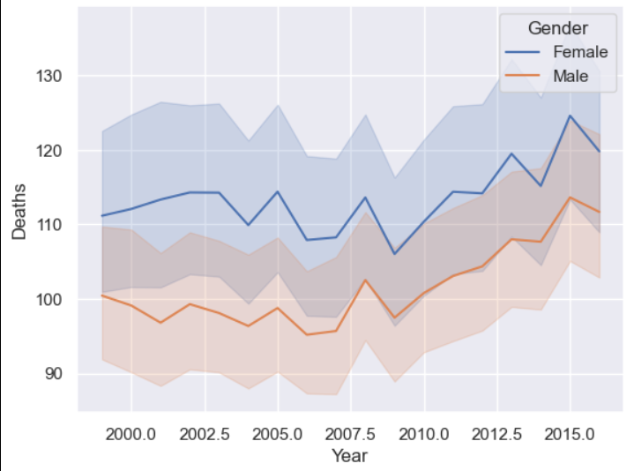
Death trends over time by Gender
For Circulatory System Diseases
For Respiratory System Diseases

Slide 13
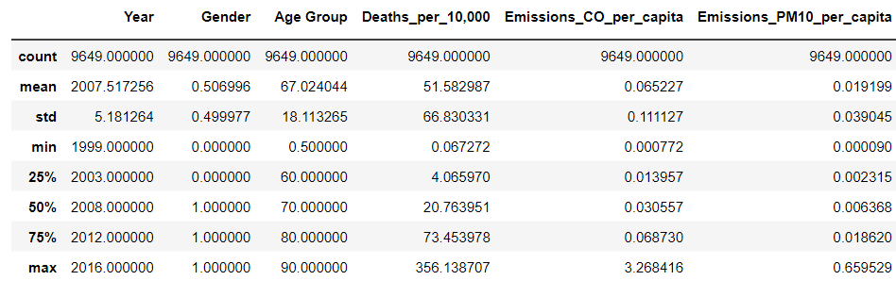
Diseases of Respiratory system

Slide 14
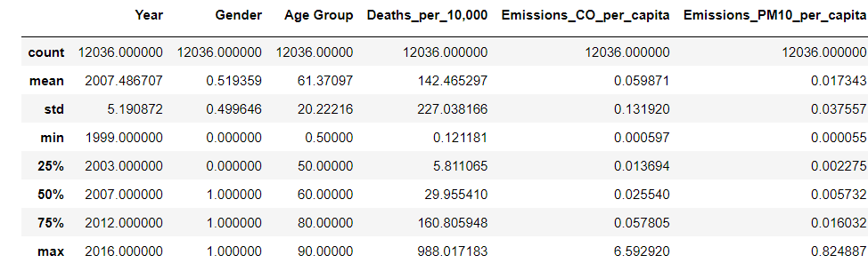
Diseases of Circulatory system

Slide 15
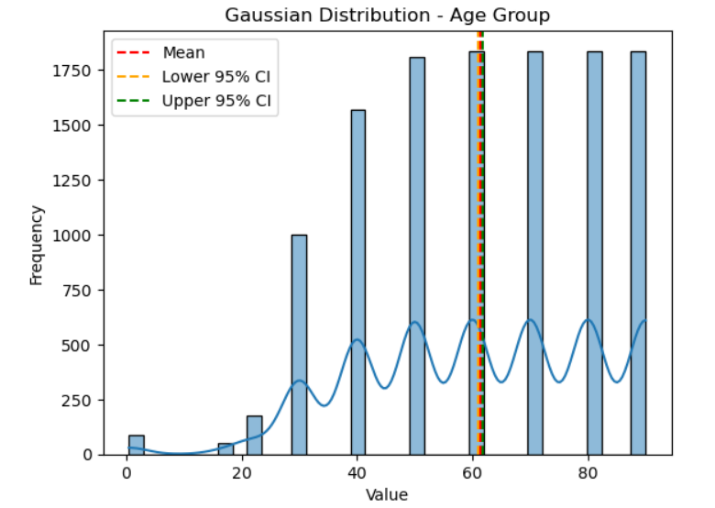
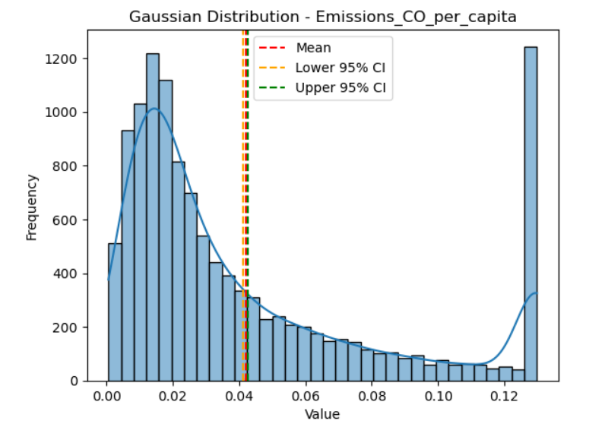
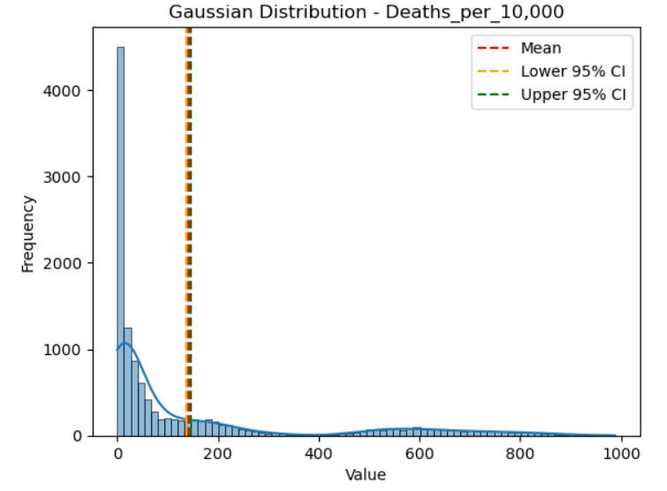
Findings
Data set is hugely non-linear, in other words, every variable is not following normal distributions and due to non-linearity, we are facing narrower confidence Intervals of every variable

Slide 16
Feature Selection
From all the above features, we have narrowed down our feature space to 5 features:
ICD Chapter
Year
State
Gender
Age
Emissions of CO
Emissions of Pm10

Slide 17
Model Building
Instead of using linear models, consider non-parametric models that can capture complex non-linear relationships without assuming a specific functional form.
Non-Linear Transformations didn't work, because the non-linear relationship is not captured by generally used non-linear transformations
Decision Tree(criterion = 'friedman_mse', min_samples_split = 150, min_samples_leaf = 2, max_depth = 5, min_impurity_decrease = 0.2)
Random forest (max_depth = 7, n_estimators = 500, verbose = 1, n_jobs = -1)
SVR (kernel = 'poly', degree = 2, gamma = 'auto', C = 2)

Slide 18
Performances For Respiratory and Circulatory Diseases
Model | Respiratory |  |  | Circulatory
 | R² | MSE | Adj. R² | R² | MSE | Adj. R²
Decision Tree | 0.962870 | 127.8105149 | 0.961536 | 0.986460 | 464.6271162 | 0.986070
Random Forest | 0.982744 | 59.4056327 | 0.982076 | 0.978558 | 735.7844684 | 0.977962
SVR | 0.798890 | 692.3304030 | 0.791648 | 0.659507 | 11684.1639919 | 0.649719

Slide 19
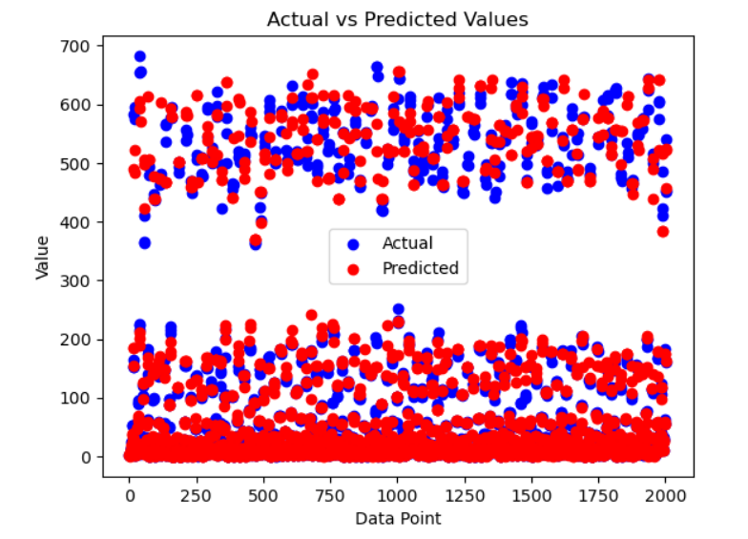
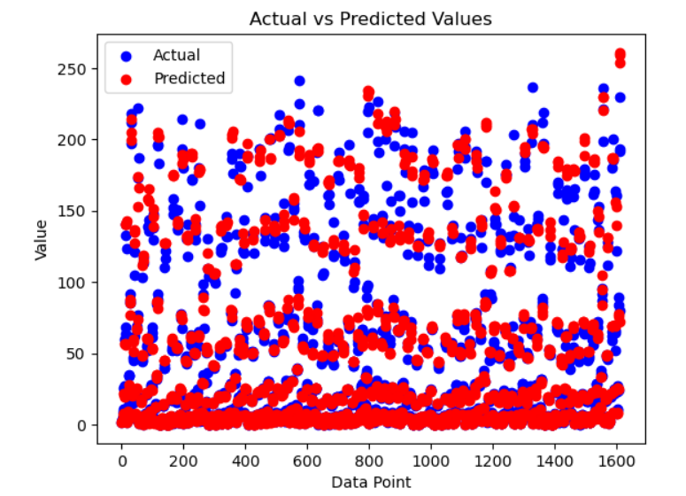
Results
Circulatory Diseases Mortality Rate per 10,000 Predictions for 2014-2016
Respiratory Diseases Mortality Rate per 10,000 Predictions for 2014-2016

Slide 20

Model Evaluation
R-squared score - common evaluation metric for goodness of fit of a regression model. It measures the proportion of the variance in the dependent variable that is predictable from the independent variables.
Adjusted R-squared - penalizes the inclusion of irrelevant predictors
Results: Prediction of death rate caused by Respiratory Disease, the best model was Random Forest with adjusted R-squared score 98.2%
Results: Prediction of death rate caused by Circulatory Disease, the best model was Decision Tree with adjusted R-squared score 98.6%

Slide 21
Conclusion
Feature Importance Top 4 features:
Respiratory Analysis:
Age Group = 89.24%
Gender = 6.35%
Emissions of CO = 1.74%
Emissions of Pm10 = 0.91%
Circulatory Analysis:
Age Group = 96.52%
Emissions of CO = 1.94%
Gender = 0.57%
Emissions of Pm10 = 0.3%

Slide 22
References
Centers for Disease Control and Prevention. (n.d.). Centers for Disease Control and Prevention https://wonder.cdc.gov/controller/datarequest/D140
Air Data: Air Quality Data Collected at Outdoor Monitors Across the US | US EPA. (2022, October 13). US EPA. https://www.epa.gov/outdoor-air-quality-data
Google. (n.d.). States.csv | dataset publishing language | google for developers. Google. https://developers.google.com/public-data/docs/canonical/states_csv

