Slide 1
3D HAND POSTURE RECOGNITION
Developing a Machine Learning model aimed at
recognition of hand postures from the 3-Dimensional
data points corresponding to reflective markers on a
left handed glove
Presented By:-
Shreya Goyal
Yash Bagaria
Shahrukh Khan
Divyam Tripathi
Shweta Chopra

Slide 2
Outline
Problem Statement
Data Understanding
Data Exploration done
Base Model Applied
Business Impact
Future Prospects

Slide 3
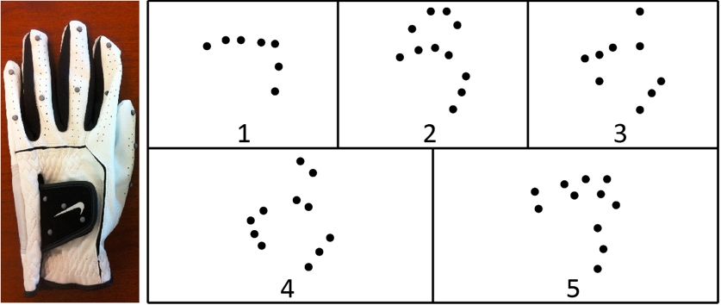
Problem Statement
Recognition of hand postures using Machine Learning.
The postures are fist (1), stop (2), point with one finger (3), point with two fingers (4), and grab (5).

Slide 4
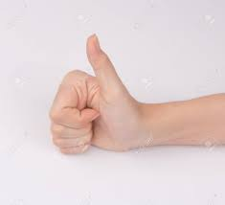
Data Understanding
12 Users
5 Postures
X
Y
Z
1,2,3,4,5
0,1,2,…11
0,1,2,…11
0,1,2,…11
0,1,2,..14
We had 3-Dimensional Data Sets as shown above.
The markers are unordered and unlabeled.
Base Marker(X0,Y0 ,Z0)
Base Marker(X1,Y1 ,Z1)
1st Marker(X1 ,Y1 ,Z1)
1st Marker(X2 ,Y2 ,Z2)
2nd Marker(X2 ,Y2 ,Z2)
2nd Marker(X0 ,Y0 ,Z0)
3rd Marker((X3 ,Y3 ,Z3)
3rd Marker((X4 ,Y4 ,Z4)
E.g. of Unlabeled Marker

Slide 5
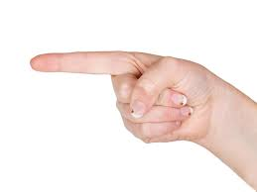
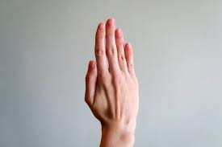
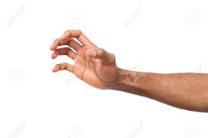
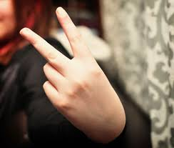
Data Understanding
1st Marker(Xi ,Yi ,Zi)
Base Marker(Xi ,Yi ,Zi)
Base Marker(Xi ,Yi ,Zi)
2nd Marker(Xi ,Yi ,Zi)
1st Marker(Xi ,Yi ,Zi)
N-Marker(Xi ,Yi ,Zi)
2nd Marker(Xi ,Yi ,Zi)
N=4,5,6,7
3rd Marker((Xi ,Yi ,Zi)
Posture 3(Point with one finger)
P- Marker(Xi ,Yi ,Zi)
Posture 1(Fist)
1st Marker(Xi ,Yi ,Zi)
P=8,9,10,11
2nd Marker(Xi ,Yi ,Zi)
Base Marker(Xi ,Yi ,Zi)
Q- Marker(Xi ,Yi ,Zi)
3rd Marker((Xi ,Yi ,Zi)
Q=4,5,6,7
Posture 2(Stop)
1st Marker(Xi ,Yi ,Zi)
4th Marker(Xi ,Yi ,Zi)
Base Marker(Xi ,Yi ,Zi)
2nd Marker(Xi ,Yi ,Zi)
2nd Marker(Xi ,Yi ,Zi)
3rd Marker((Xi ,Yi ,Zi)
3rd Marker((Xi ,Yi ,Zi)
1st Marker(Xi ,Yi ,Zi)
R- Marker(Xi ,Yi ,Zi)
Base Marker(Xi ,Yi ,Zi)
R=8,9,10,11
Posture 4(Point with two finger)
Posture 5(Grab)

Slide 6
Base Model Applied
Loading The Data
Evaluation Parameter:- F1_Weighted
Imputing Missing Values with 0
1st Approach
2nd Approach
Traditional Train-Test Split
Transformed the Data
Logistic Regression
Capture X,Y,Z co-ordinates w.r.t to class and row_labes
Decision Tree
One Vs. One
One Vs. Rest
Training
Result 2
Result 3
Predictions
Result 1
Voting Measure for each 12 records in Transformed Data
Result 4

Slide 7
Base Model Applied
Loading The Data
3rd Approach
Evaluation Parameter:- F1_Weighted
Imputing Missing Values with 0
One-User Out Train-Test Split
Logistic Regression
Decision Tree
One Vs. One
One Vs. Rest
Result 5
Result 6
Result 7

Slide 8
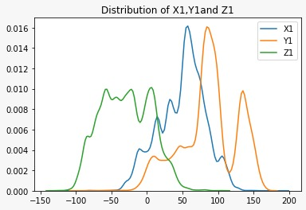
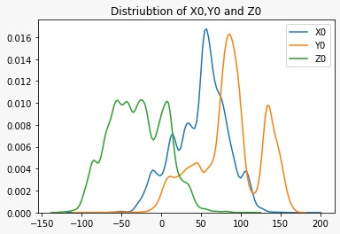
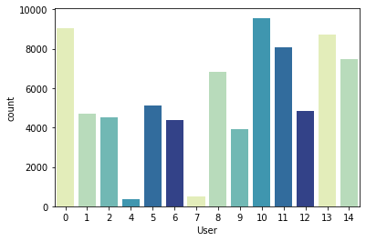
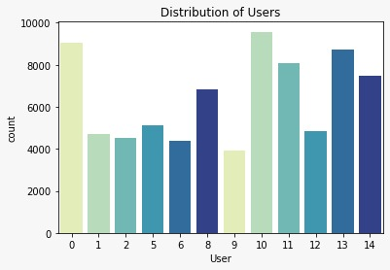
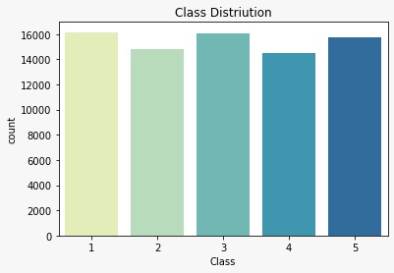
Data Exploration
Figure:1
Figure:2
Figure:3
Figure:4
Figure:5

Slide 9
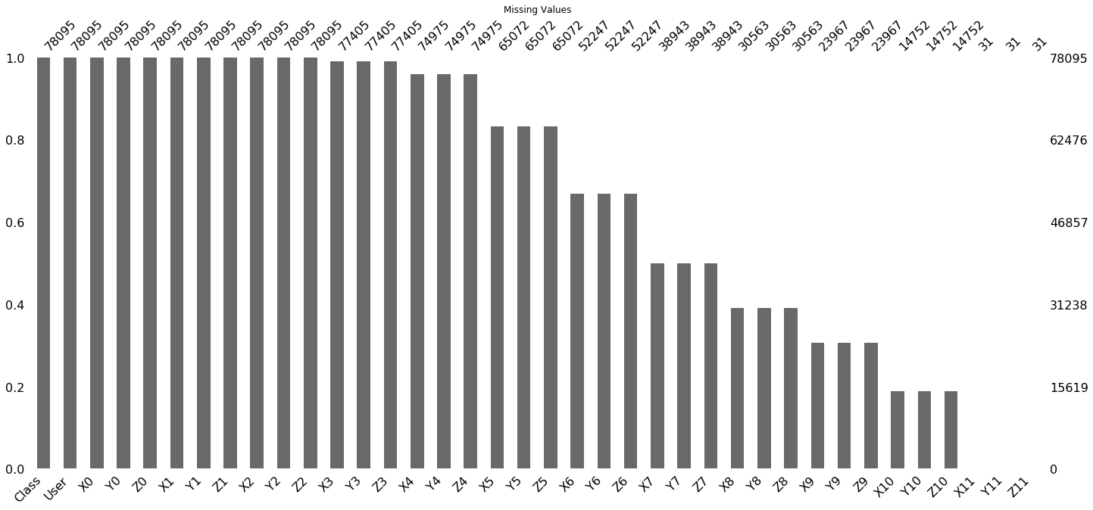
Data Exploration
Figure:6

Slide 10
Business Impact
If you are not living under the rock , you will be knowing that Hand Postures' Recognition technologies are being used humongously in most of the industries, we came up with a business idea where hand Gestures' will be again a helping hand.
SMART PROJECTOR CAMERA BUILD-UP:
Industries can work towards creating such cameras linked projectors which will help in making projectors more useful where machine will be trained in such a way that it will be knowing which hand gesture means what and then will return the output using the command. Using Hand Gestures' corporates will be able to give presentation without touching mouse every time to change the slide i.e. totally hand's free using hands. These cameras linked projectors will be helpful in health sector also. For instance , Doctors will be able to examine x ray reports just by using hand gestures only.

Slide 11
Business Impact
Vicon Motion Camera
Captures Image
Feed to Computer
Recognizes the Image
Valid Image
Yes
No
Classification
Notify error to user
return

Slide 12
Future Prospects
We have thought that using Convolutional neural networks (which is beyond our courses' curriculum), we will be able to make our ideology more stronger where Hand gestures recognitions will be a great help to traffic policemen.
Imagine Roads without traffic policemen and still chaos free?
Usage of neural networks in hand gestures recognition will help to eradicate the traffic chaos where people will just see the hand gestures portrayed on the screen and will respond accordingly.

Slide 13
Thanks!

