Slide 1



AI-Driven Crop Disease Detection Using Image Processing and Computer Vision Techniques
By
Yadnika Pashte and Yashodhan Rajapkar (CHANAKYA Fellows)
Institute Mentor: Dr. Sushopti Gawade;
Vidyalankar Institute of Technology, Mumbai

Slide 2

Project Card
Start Date and End Date of the project
Total Sanctioned Amount
Total Amount Disbursed from TIH
1 December 2025 – 30 September 2026
₹ 2,40,000
₹ 2,40,000
Awards/Recognition
Attended AI4Agri Conference 2026; collaborative dataset procurement from the PoCRA team
Action Items from the previous review
IP/ Patents details
Commercialization Plan
April 2026 review was the 1st review (no prior action items). Planned: pilot deployment for field testing and integration for end-to-end prediction.
IP of models and dataset belongs to TIH IIT Bombay. No patents filed (Nil). Paper submitted to IEEE PerCom 2027.
Not applicable at this stage. Pilot deployment and application integration are planned next steps.
2

Slide 3
Outline
Background, Problem Statement
Objectives
Expected Benefits of the Project
Major Milestones
Shortfalls and reasons in Achievements of Milestones
Technical/Scientific Achievements for the Review Period
List of Publications, Patents etc.
Future Work Planned
Conclusions

Slide 4
Background & Problem Statement
Crop disease is a major controllable yield loss for smallholder farmers in Maharashtra; manual field inspection does not scale.
This project builds image-based disease classifiers for Sugarcane, Pigeon Pea, Grapes and Mustard under the CHANAKYA Fellowship, supporting the MahaVISTAAR AI-based advisory platform.
Problem: models trained on controlled PoCRA imagery are usually judged by internal accuracy, yet may fail on real field photographs (NPSS) – a domain shift.
Approach: supervised transfer learning (ResNet, DenseNet, EfficientNet, ConvNeXt, CSPDarkNet, Swin, DINOv2 and others) fine-tuned on PoCRA and tested on NPSS.
60+1
experiment configurations (23 Sugarcane, 29 Pigeon Pea, 8 Grapes) + 1 Mustard model
24–39%
NPSS accuracy of Sugarcane baselines that scored 85–97% internally
4 crops
PoCRA-trained, NPSS field-evaluated (Mustard pending)

Slide 5
Objectives
# | Objective | Status
1 | Develop image-based disease-classification models for Sugarcane, Pigeon Pea, Grapes and Mustard | Achieved
2 | Evaluate PoCRA→NPSS cross-domain generalisation | Partially achieved – Mustard pending; Grapes indicative (42 images)
3 | Identify interventions that narrow the internal-to-field accuracy gap and test whether internal accuracy predicts field accuracy | Achieved
4 | Document methodology, results and reproducibility artifacts | Partially achieved – recorded at directory level (VDI-22)
5 | Audit deployed models on NPSS data for additional crops and build NPSS data-extraction tooling (June 2026) | Achieved

Slide 6
Expected Benefits of the Project
Farmers
TIH IIT Bombay / PoCRA
Researchers
Scalable image-based diagnosis in place of manual inspection
Delivered through the MahaVISTAAR advisory platform
Field-realistic accuracy expectations (66–79% best on NPSS)
Trained models for four crops
A repeatable PoCRA→NPSS evaluation process
Audit of deployed models on NPSS for additional crops
Documented 60+ experiments with metrics
Evidence that internal accuracy is an unreliable guide to field accuracy
Artifact index and a paper submitted to IEEE PerCom 2027
Beneficiaries: smallholder farmers in Maharashtra; TIH IIT Bombay; PoCRA; future researchers and fellows.

Slide 7
Major Milestones
# | Milestone | Target | Actual | Status
1 | Project set-up and dataset understanding | Dec 2025 | Dec 2025 | Completed
2 | Data-processing pipeline; baseline on raw dataset | Jan 2026 | Jan 2026 | Completed
3 | PoCRA dataset integration; crop-specific (Pigeon Pea, Mustard) training | Feb 2026 | Feb 2026 | Completed
4 | Application testing | Feb 2026 | Feb 2026 | Completed
5 | GitHub collaboration and Docker fundamentals | Mar 2026 | Mar 2026 | Completed
6 | Sugarcane study (23 configs); June deployed-model NPSS audit | – | Jun 2026 | Completed
7 | Pigeon Pea (29) and Grapes (8) studies; Mustard model; Handover Report; paper | – | Jul–Sep 2026 | Completed
Milestones 1–5: April 2026 review presentation. Funds: ₹2,40,000 sanctioned and disbursed.

Slide 8
Shortfalls and Reasons
All approved milestones were completed on their target dates. Open items are limits of scope:
Open item | Reason / detail | Next step
Mustard: no NPSS evaluation | Only the internal PoCRA-curated test set (97.02%) was evaluated | Future work
Grapes: NPSS set of only 42 images | Small validated sample – results are indicative, not robust | Future work
Pigeon Pea Exp 10, 11, 16 not on NPSS | ShuffleNet and LiteMDC configurations were not evaluated on NPSS | Future work
Reproducibility artifacts at directory level | Splits, checkpoints and code on VDI-22; file-level split, seed and commit not recorded | Recording standard
Single run per configuration | Computational constraints; no confidence intervals | Repeated trials

Slide 9
Achievements – Headline Results
Sugarcane: CSPDarkNet53 + dropout/BN-freeze + class weights – 66.48% NPSS (baselines 31.55–38.87%)
Pigeon Pea: ConvNeXt-Base + augmentation + SAM – 71.31% NPSS
Grapes: DINOv2 + augmentation + SAM – 78.57% NPSS (99.21% validation)
Mustard: ResNet50 – 97.02% internal test accuracy, macro F1 ≈ 0.967
Best Sugarcane foundation model: DINOv2 + class weights, 57.46%
Best field-accuracy configuration per crop. Grapes field result is on 42 NPSS images; Mustard has no NPSS evaluation.

Slide 10
Achievements – Internal vs Field
Internal accuracy is not a reliable proxy for field accuracy: negatively correlated for Sugarcane (Spearman ρ = -0.73), uncorrelated for Pigeon Pea (ρ = 0.05).
Sugarcane: class-weighted loss added +21 to +30 NPSS points for 7–10 points of internal accuracy.
Pigeon Pea: SAM on ConvNeXt-Base cost under 2 internal points for over 4 NPSS points.

Slide 11
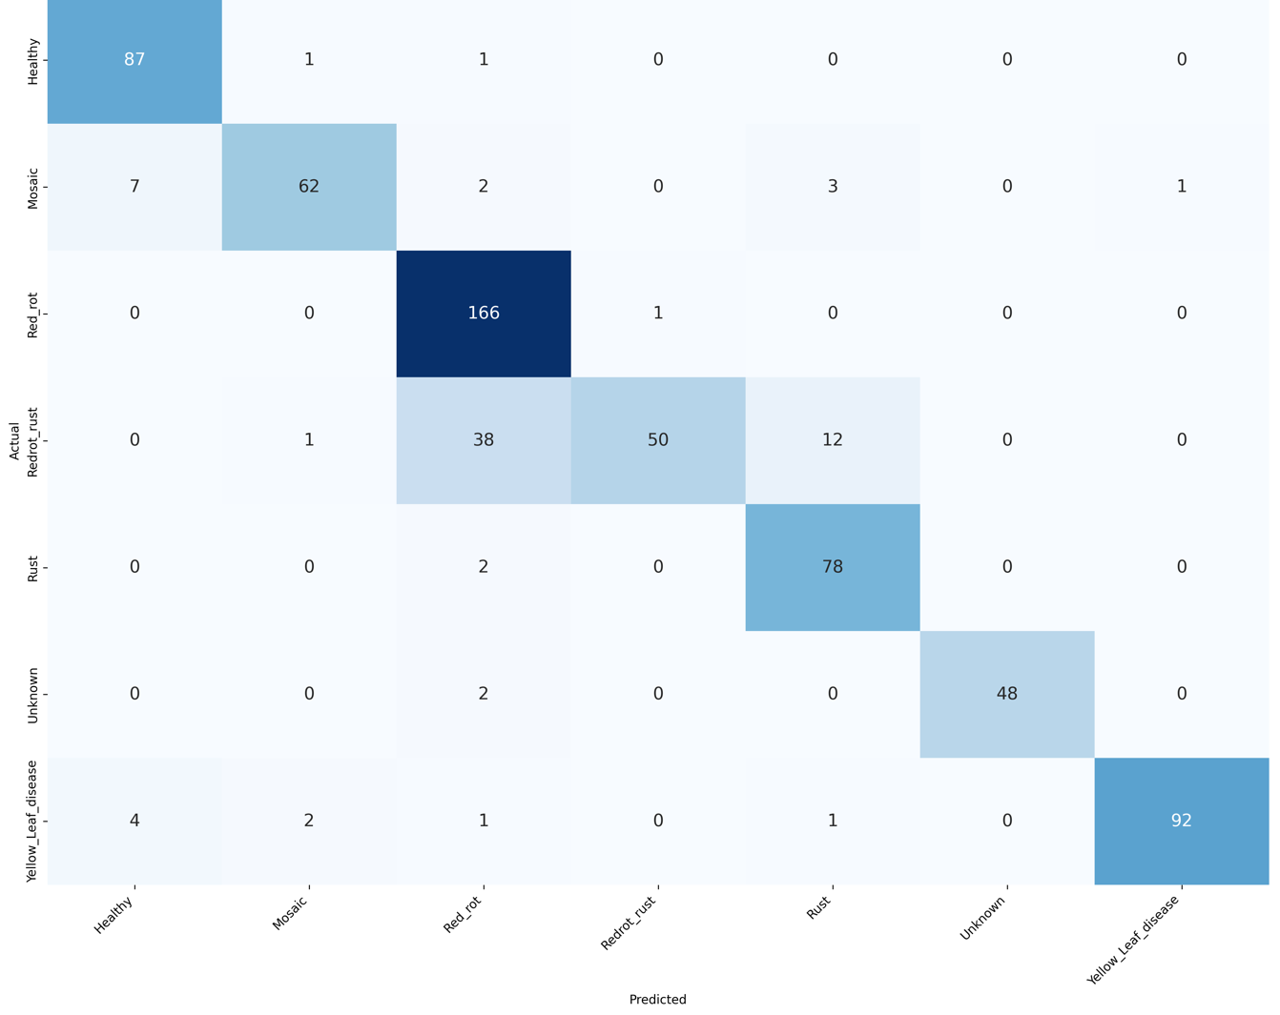
Sugarcane – Best Field Model (Exp 40)
Exp 40: CSPDarkNet53 + Dropout/BN Freeze + Class Weights
Class | Precision | Recall | F1 | Support
Healthy | 0.8878 | 0.9775 | 0.9305 | 89
Mosaic | 0.9394 | 0.8267 | 0.8794 | 75
Red_rot | 0.7830 | 0.9940 | 0.8760 | 167
Redrot_rust | 0.9804 | 0.4950 | 0.6579 | 101
Rust | 0.8298 | 0.9750 | 0.8966 | 80
Unknown | 1.0000 | 0.9600 | 0.9796 | 50
Yellow_Leaf_disease | 0.9892 | 0.9200 | 0.9534 | 100
Accuracy |  |  | 0.8807 | 662
Macro avg | 0.9157 | 0.8783 | 0.8819 | 662
Weighted avg | 0.8981 | 0.8807 | 0.8724 | 662
Best field model: 66.48% NPSS accuracy; 88.07% internal test accuracy (662 test images, macro F1 0.8819).
Weakest class: Redrot_rust (recall 0.4950, F1 0.6579); Red_rot recall 0.9940 but precision 0.7830.
Confusion matrix (test set) – rows: actual, columns: predicted

Slide 12
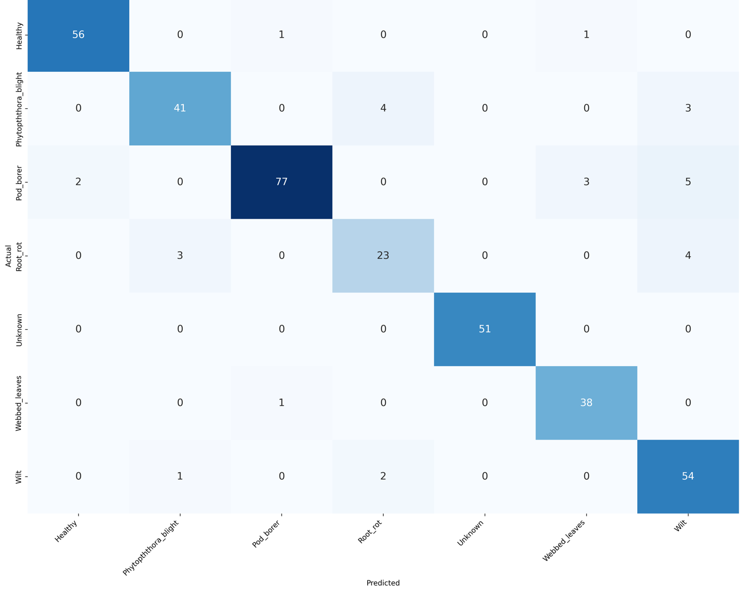
Pigeon Pea – Best Field Model (Exp 12)
Exp 12: ConvNeXt-Base + Augmentation + SAM
Class | Precision | Recall | F1 | Support
Healthy | 0.9655 | 0.9655 | 0.9655 | 58
Phytopththora_blight | 0.9111 | 0.8542 | 0.8817 | 48
Pod_borer | 0.9747 | 0.8851 | 0.9277 | 87
Root_rot | 0.7931 | 0.7667 | 0.7797 | 30
Unknown | 1.0000 | 1.0000 | 1.0000 | 51
Webbed_leaves | 0.9048 | 0.9744 | 0.9383 | 39
Wilt | 0.8182 | 0.9474 | 0.8780 | 57
Accuracy |  |  | 0.9189 | 370
Macro avg | 0.9096 | 0.9133 | 0.9101 | 370
Weighted avg | 0.9223 | 0.9189 | 0.9191 | 370
Best Pigeon Pea field model: 71.31% NPSS accuracy; 91.89% internal test accuracy (macro F1 0.9101).
Weakest class: Root_rot (23 of 30 correct, F1 0.7797); Unknown is classified perfectly (51 of 51).
Confusion matrix (test set) – rows: actual, columns: predicted

Slide 13
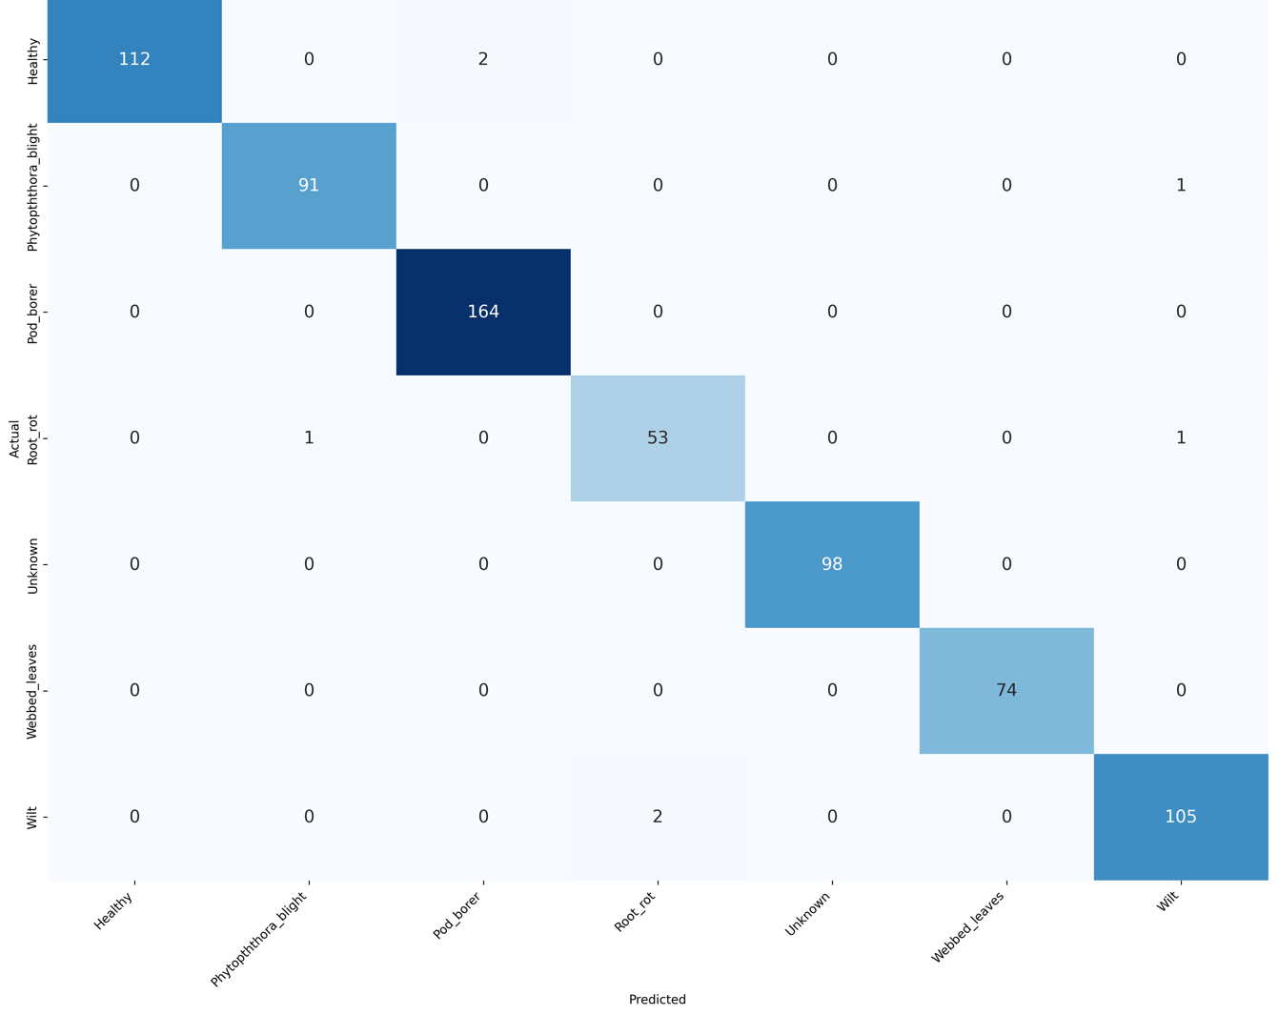
Pigeon Pea – Highest Internal Accuracy (Exp 22)
Exp 22: Swin Transformer + Augmentation + CLAHE
Class | Precision | Recall | F1 | Support
Healthy | 1.0000 | 0.9825 | 0.9912 | 114
Phytopththora_blight | 0.9891 | 0.9891 | 0.9891 | 92
Pod_borer | 0.9880 | 1.0000 | 0.9939 | 164
Root_rot | 0.9636 | 0.9636 | 0.9636 | 55
Unknown | 1.0000 | 1.0000 | 1.0000 | 98
Webbed_leaves | 1.0000 | 1.0000 | 1.0000 | 74
Wilt | 0.9813 | 0.9813 | 0.9813 | 107
Accuracy |  |  | 0.9901 | 704
Macro avg | 0.9889 | 0.9881 | 0.9885 | 704
Weighted avg | 0.9901 | 0.9901 | 0.9901 | 704
Highest internal test accuracy (99.01%, macro F1 0.9885) but only 49.73% on NPSS field images.
Illustrates the internal-to-field gap: near-perfect internal scores did not carry over to field data.
Confusion matrix (test set) – rows: actual, columns: predicted

Slide 14
Pigeon Pea – ResNet50 Baseline vs Two-Phase
Aspect | Baseline (resnet50.pth) | Final (resnet50_4.pth)
Training strategy | Single phase; backbone frozen, FC only | Two phase: frozen, then unfrozen backbone
Learning rate | Single LR throughout | Phase 2 uses a lower LR
Test accuracy | 86.52% | 88.41% (+1.89)
Macro precision / recall / F1 | 0.8375 / 0.8500 / 0.8413 | 0.8643 / 0.8575 / 0.8595
Class | Baseline P / R / F1 | Final P / R / F1
Healthy | 0.818 / 0.931 / 0.871 | 0.900 / 0.931 / 0.915
Phytopththora_blight | 0.886 / 0.813 / 0.848 | 0.870 / 0.833 / 0.851
Pod_borer | 0.926 / 0.862 / 0.893 | 0.868 / 0.908 / 0.888
Root_rot | 0.513 / 0.667 / 0.580 | 0.656 / 0.700 / 0.677
Unknown | 1.000 / 1.000 / 1.000 | 1.000 / 1.000 / 1.000
Webbed_leaves | 0.923 / 0.923 / 0.923 | 0.875 / 0.718 / 0.789
Wilt | 0.796 / 0.754 / 0.775 | 0.881 / 0.912 / 0.897
Source: April 2026 review (early CROP06 iteration; the final model corresponds to Exp 2 in the consolidated study).

Slide 15
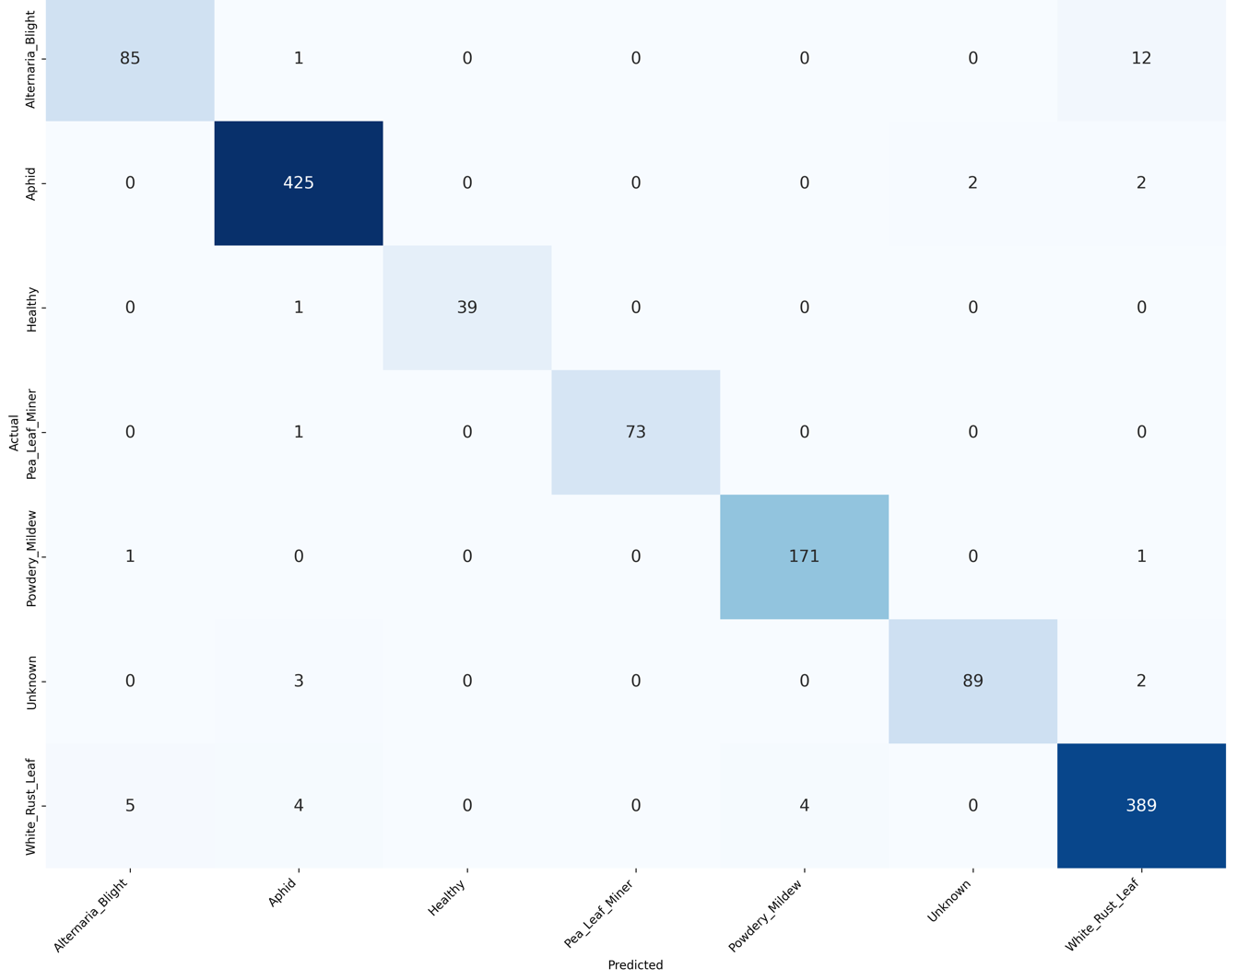
Mustard – Model Results (ResNet50)
ResNet50 – PoCRA-curated Mustard test set
Class | Precision | Recall | F1 | Support
Alternaria_Blight | 0.9341 | 0.8673 | 0.8995 | 98
Aphid | 0.9770 | 0.9907 | 0.9838 | 429
Healthy | 1.0000 | 0.9750 | 0.9873 | 40
Pea_Leaf_Miner | 1.0000 | 0.9865 | 0.9932 | 74
Powdery_Mildew | 0.9771 | 0.9884 | 0.9828 | 173
Unknown | 0.9780 | 0.9468 | 0.9622 | 94
White_Rust_Leaf | 0.9581 | 0.9677 | 0.9629 | 402
Accuracy |  |  | 0.9702 | 1310
Macro avg | 0.9749 | 0.9603 | 0.9674 | 1310
Weighted avg | 0.9701 | 0.9702 | 0.9700 | 1310
Overall test accuracy 97.02% (1,310 images); NPSS field evaluation for Mustard is pending.
Weakest class: Alternaria_Blight (recall 0.8673) – 12 of 98 images were predicted as White_Rust_Leaf.
Confusion matrix (test set) – rows: actual, columns: predicted

Slide 16
Achievements – June 2026 NPSS Audit
Deployed-model audit on NPSS
26.11%
36.82%
NPSS data-extraction script pushed to GitHub (PoCRA_Test_Scripts) with a pull request
NPSS datasets extracted for Cotton, Soybean, Chickpea, Cucumber, Onion, Grapes, Sugarcane, Maize and Papaya
Crop-wise accuracy, per-class and misclassification reports prepared
Also evaluated: Sorghum, Tomato, Mango, and threshold testing on Cotton
Cotton – deployed model, NPSS overall accuracy
Soybean – deployed ResNet-50, NPSS overall accuracy
Sugarcane improvement (15–19 June)
ResNet50/34 and MobileNetV2 trained and evaluated on NPSS at thresholds 0.00% and 70.00%
Class weights, dropout + BN-freeze, Mixup + SAM, then EfficientNet-B7, DenseNet201, ConvNeXt-Base
These runs fed the 23-configuration Sugarcane study

Slide 17
Publications and Patents
Title | Venue | Status | Authors
From Lab to Field: Diagnosing the Internal-to-Field Accuracy Gap in Sugarcane and Pigeon Pea Disease Classification | IEEE PerCom 2027 | Submitted | Yadnika Pashte, Yashodhan Rajapkar, Dr. Sushopti Gawade, Susmita Banerjee, Prajwal Rameshrao Asole
Paper highlights
Patents
52 experiments (23 Sugarcane, 29 Pigeon Pea)
Best field accuracy 66.48% and 71.31%
Review in progress; conference: 8–12 March 2027, Goa, India
Nil – no patent was filed during the project (1 Dec 2025 – 30 Sep 2026)
Handover Report v1.0 prepared 15 Sep 2026

Slide 18
Future Work Planned
1 Complete NPSS coverage
2 Domain adaptation
3 Class weights + backbones
NPSS evaluation for Mustard; larger validated NPSS sample for Grapes
Correlation alignment, adversarial domain-invariant learning, Deep CORAL
Pair class-weighted loss with ConvNeXt-Base, Swin, DINOv2 for Sugarcane
4 Pigeon Pea improvements
5 Robust evaluation
6 Deployment
Test-time augmentation, few-shot fine-tuning, pseudo-label self-training
Repeated trials with confidence intervals; record split, seed, checkpoint, commit for every run
Integrate models into the production application; real-world testing and monitoring

Slide 19
Conclusions
Internal accuracy is not a trustworthy predictor of field accuracy: negatively correlated (Sugarcane) or uncorrelated (Pigeon Pea).
Domain-gap levers differ by crop: class-weighted loss for Sugarcane, SAM for Pigeon Pea; ConvNeXt-Base and DINOv2 generalised most consistently.
Grapes (42-image NPSS set) reached 78.57%; Mustard reached 97.02% internally with NPSS evaluation outstanding.
Best field accuracies (66–79%) remain below internal accuracy – cross-domain evaluation should be standard practice before deployment.
66.48%
Sugarcane – best NPSS accuracy
71.31%
Pigeon Pea – best NPSS accuracy
78.57%
Grapes – best NPSS accuracy (42 images)

