Slide 1
Tutorial 0: Java Basics and Jacoco
Stefan Müller

Slide 2
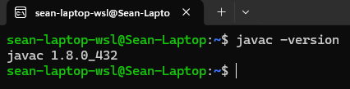
Installing Java
There are many ways to download and install java, so use whatever method you prefer. My personal favourite is OpenJDK as they are the easiest in my opinion.
VERY IMPORTANT : Make sure you install a Java 8 JDK, not a JRE and also not a newer version.
How to check that you have the correct version:

Slide 3
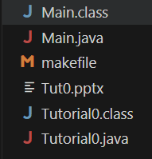
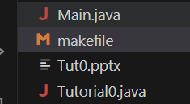
Compilation and Running
All classes should be in their own files.
To compile all java files:
  javac *.java
To run:
  java Main

Slide 4
File Structure
File extension: .java
Must have a public class with the same name as the file name.
Order of functions and variables don’t matter (unlike C++).
Conventions
  Create a new .java file for every class you want to make.
  Class names should begin with a capital letter.

Slide 5
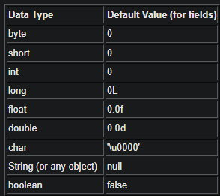

Nice features of java
Java crashes tells you exactly where the program crashed, and shows stack trace
Java initializes all variables
No memory management in java.
  The garbage collector does this for you.
Java does not have header files.
  This means for all Practical's and Assignments (Unless stated otherwise) you are always allowed to add helper functions.
    Don’t test your helper functions directly as this will crash the Testing task on Fitchfork. Only call functions in your Main which were listed in the spec.

Slide 6
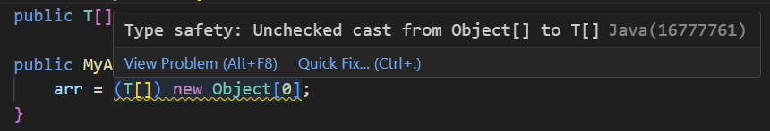
Java Warnings
Java has some built-in warning which tells you that you are attempting something that might crash in certain scenarios.
To supress these warnings (when we are sure that we are not doing something unsafe)
  @SuppressWarnings(“unchecked”)
  @SuppressWarnings(“rawtypes”)
  @SuppressWarnings({“unchecked”, “rawtypes”})

Slide 7
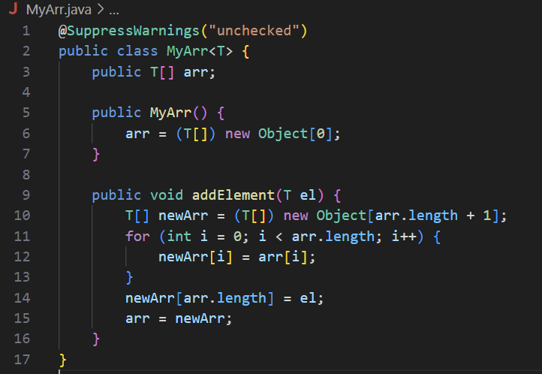
Java Generics
Java generics are weird at first, but as soon as you get the hand of them, they are easy to use.
You can’t directly create arrays of generic objects. Instead you must create an array of Objects and then cast it to the generic array.

Slide 8
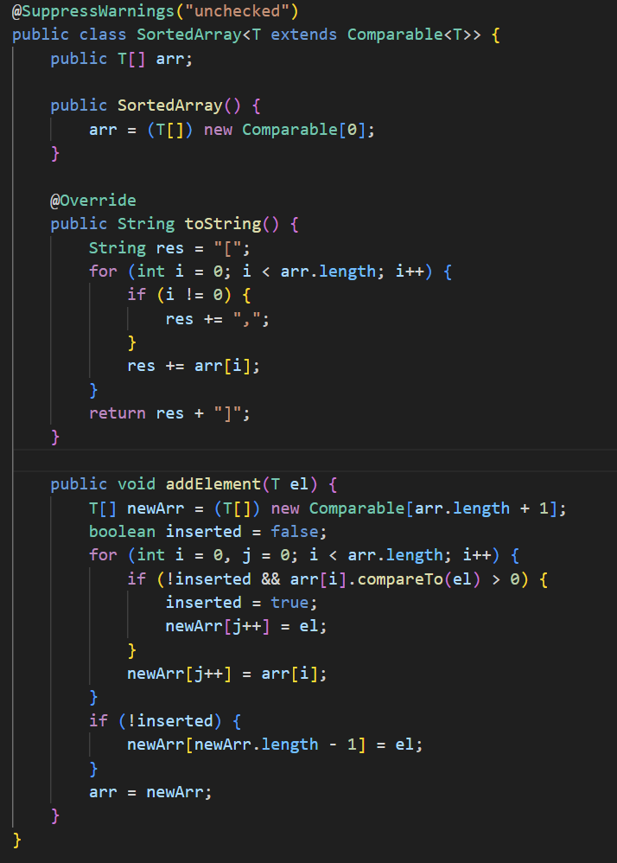
Comparable Generics

Slide 9
Capital Letters
Is Double and double the same thing?
  NO
In java you have two types of variables, primitives and Objects. Primitives are types like: int, boolean, double. Objects are types like Integer, Boolean, Double, String. Convention is that primitives are spelled with a lowercase letter, while Objects are typed with a capital letter (which is why all of our classes start with a Capital letter).
Primitives can not be null. Objects can be null.

Slide 10
Comparing Elements
When using primitives use ==, <= and >= to check relational operators.
NEVER use ==,<= or >= on Objects. (<= and >= are not defined, and == only checks whether the Object’s addresses are equal).
ALWAYS use .equals() or .compareTo() when comparing objects.
If you have two Objects A and B, and want to see if A < B:
  if(A.compareTo(B) < 0)
Want to see if A > B:
  if(A.compareTo(B) > 0)
Want to see if A == B:
  if(A.compareTo(B) == 0)
  if (A.equals(B))

Slide 11
Testing (Using jacoco)
Testing is a vital skill of programming and as such for every practical and assignment 10% of the mark will be for the code coverage your Main.java achieved on the Memo solution. (Same as COS110)
For Java we use Jacoco. A demonstration will now be shown.
The makefile and all Java code shown will be uploaded to clickUp.

Slide 12
Tutorials
For the rest of the semester tutorials works as follows:
  Exercise will release at the beginning of the week
  For the first 20 minutes of the tutorial, we will go through the memo with you
  For the last 30 minutes you will write a class test on the same work.
    The tutorial tests will be done on ClickUp.
    Please bring an electronic device (phone, table, laptop etc) to be able to do the class test
    Also bring a blank A4 sheet to be able to draw on.
    You are allowed the textbook, one A4 cheat sheet.

