Slide 1
TIVIDY
Project Demo
5 guys (but only 3 are guys):
Rei Piater-Boswell
Leanne Van De Horste
Yash Ghela
Jayden Smith
Declan McCullough

Slide 2
CONTENT
Project Scope
Backend
  Full Project Class Diagram
  Activity Diagrams
  Design Patterns
    Roles, Reasons, Relationships
Frontend
Doxygen
GitHub
  Pulse and Contributors
Testing
Conclusion
Live Demo

Slide 3
Project Scope
(A very different one to all other groups I’m sure)

Slide 4
Project Scope
TIVIDY is a generic workflow management system.
It allows a demonstration of multiple design patterns, working together, to create a cohesive and seamless combination needed for a team to produce a well-oiled system of constant work, updates and approvals within a project.
All these working parts interact under the surface of a simple frontend that is easy to use for any beginner of the system.

Slide 5
Backend
An in-depth peak behind the curtain.

Slide 6

UML Diagrams
All diagrams are provided upon scanning the QR-code.
Includes all patterns to be spoken about below
Colour-coded per pattern

Slide 7

Design Patterns
Façade
Memento
Composite
Observer
Decorator
Chain of Responsibility
Strategy
Iterator
Template Method
Visitor

Slide 8
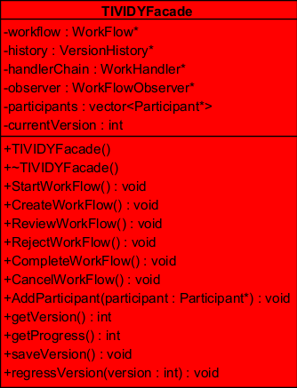
Façade
Role:
Allow users easy use of TIVIDY.
Gives simplistic functions that perform complex operations under the hood.
Reason:
TIVIDY used by people of varying skillsets and knowledge.
Façade makes using it simple to new users.
Relationships:
Works alongside both Composites, the Chain of Responsibility, the Memento of the system, and the Observer, invoking multiple functions from each.

Slide 9
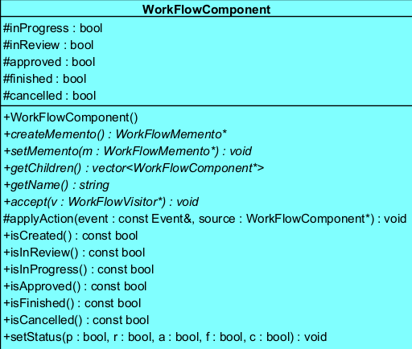
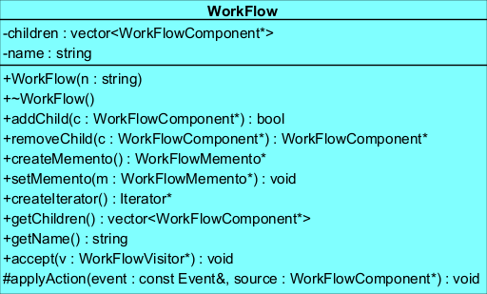
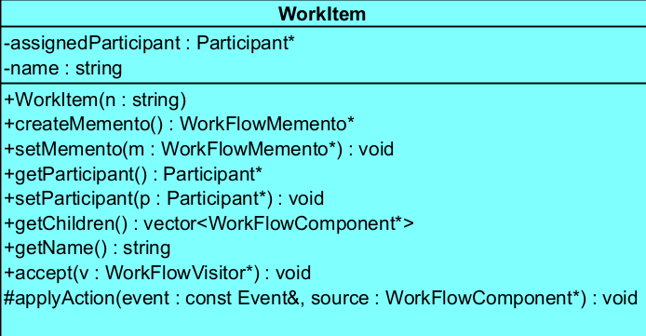
Composite 1
Role:
Provide a recursive tree-like structure to store Workflows and Work Items to be worked upon.
Reason:
A workflow can consist of multiple smaller workflows, both containing work items.
Relationships:
Works alongside Façade and Visitor to change states of its Booleans, Memento to store snapshots of its states, Participant Composite to do work on work items, Observer to notify other patterns upon change, Decorator to provide addition functionality, and Iterator to traverse the tree.

Slide 10
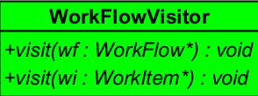
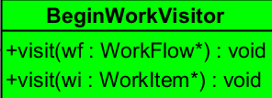
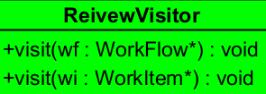
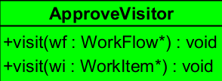
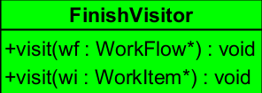
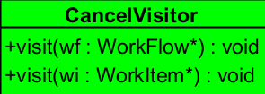
Visitor
Role:
Provides methods that use double dispatch to operate on the state Booleans of Work Items and Workflows in different ways.
Reason:
Components of Workflows differ in what they contain and what they do while still being similar in state. Visitor allows operations on the Booleans to match intent but cater to differences.
Relationships:
Instantiated in the Workflow Composite to provide double dispatching per Leaf or Composite.

Slide 11
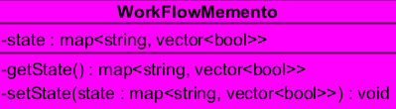
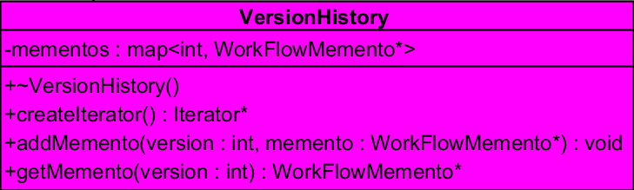
Memento
Role:
Saves a snapshot of the current version of the system.
Provides version history.
Reason:
Often people give way to human error. Allows easy restoration after a mistake.
Memento tracks a process history so it can be documented throughout its lifecycle.
Relationships:
Works alongside Façade so versions can easily be saved, regressed or retrieved. Records State of the Workflow Composite. Uses Iterator to traverse version histories.

Slide 12
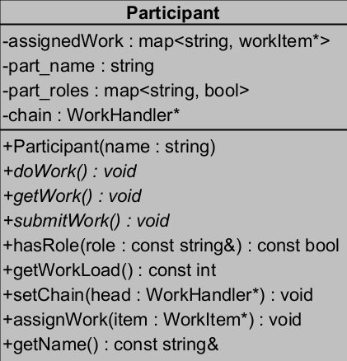
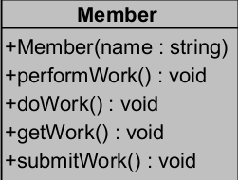
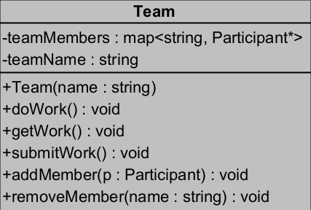
Composite 2
Role:
Provide a recursive tree-like structure to store Teams and their Members.
Reason:
A Team can consist of multiple Members, each doing work on a different work item or all in one workflow.
Relationships:
Works alongside Façade to add Participants, Workflow Composite to do work on work items, And Chain of Responsibility to send work down a chain of Members until one can do the work.

Slide 13
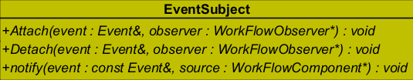
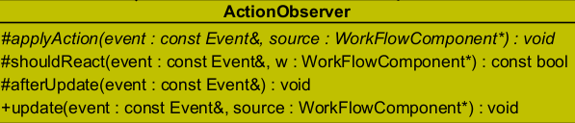

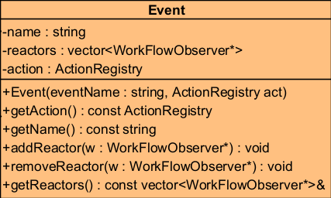
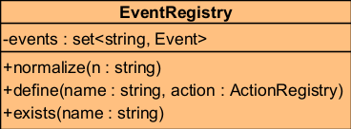
Observer
Role:
Provides an Event registry for user-defined events that update all associated Workflow Components.
Reason:
Workflows would have specific circumstances where a factor occurs that causes certain workflows or work items to change state.
Relationships:
Works alongside Façade to notify the user of any changes, when a certain event occurs, as well as handlers so that they might respond to the event accordingly.

Slide 14
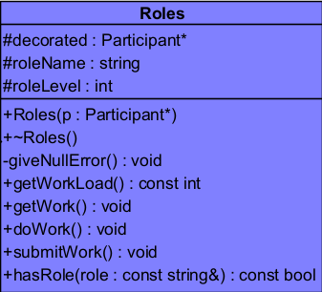
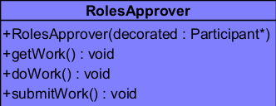
Decorator
Role:
Provide additional functionality to the Participant Composite.
Reason:
Each Participant Component is generic. There was no way to differentiate members by their Role or their role level, so Decorator provides this.
Relationships:
Works alongside Participant Composite, wrapping it to keep all current functionality while adding to it.

Slide 15
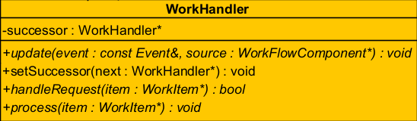
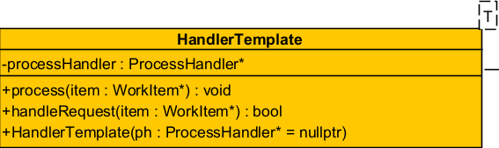
Chain of Responsibility
Role:
Passes along work through members until a member with the ability to do the work claims it.
Reason:
If there are many work Items that need to be done, certain members may be able to take on more work or less. The Chain allows work to be most effectively handled through delegation.
Relationships:
Works alongside Participant Composite to enable handling of each work item in the composite, uses the Observer Pattern to update upon certain notifications, and uses Strategy to decide how to handle the work item per Link in the Chain.

Slide 16


Strategy
Role:
Provides different Templatised ways in which the work item passed to a link in the Chain of responsibility is handled.
Reason:
Each Member in the Chain may do work in a different way and there needs to be a way in which each member operates upon a work item.
Relationships:
Works within Chain of Responsibility, changing the algorithm that each link implements.

Slide 17
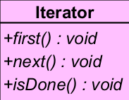

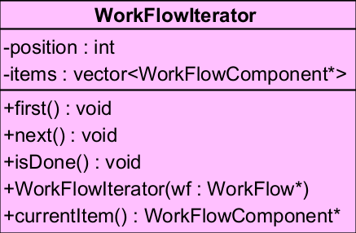
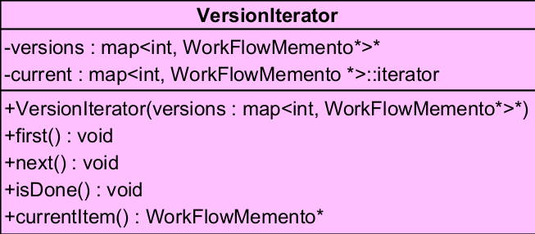
Iterator
Role:
Provides a way to iterate through each node of a composite or version history.
Reason:
There is need to be able to traverse through the Workflow Composite tree to count work items and another need to iterate through the version history to document changes.
Relationships:
Works within the Memento to traverse version history and within the Workflow Composite to traverse though its work items.

Slide 18
Template Method
Role:
The observer calls a template method update that performs a sequence of primitive operations, shouldReact, applyAction and afterUpdate.
Reason:
Observers are based on the events registry and with this means that certain observers should update on certain requirements and in unique ways.
Relationships:
Lies within the Observer Pattern.

Slide 19
Frontend
Simple But Effective.

Slide 20
Frontend
For frontend, 5 guys (but only 3 are guys), decided to go with the simple use of the terminal.
Terminal Image

Slide 21
Doxygen
How we documented our system.

Slide 22
DoxyFile
Doxygen file

Slide 23
Docker
Running a system in a Container.

Slide 24
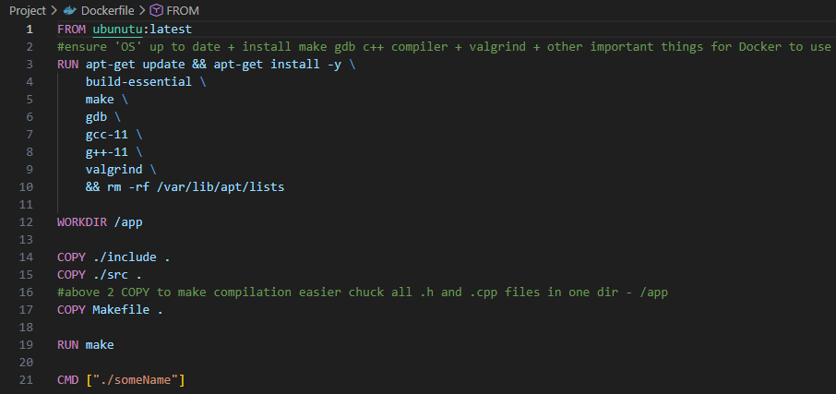
DockerFile

Slide 25
GitHub
How we documented our system.

Slide 26

Repo Link

Slide 27
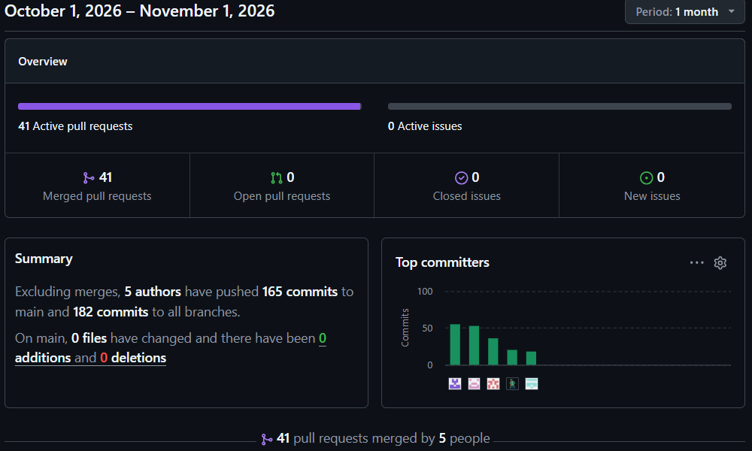
Pulse

Slide 28
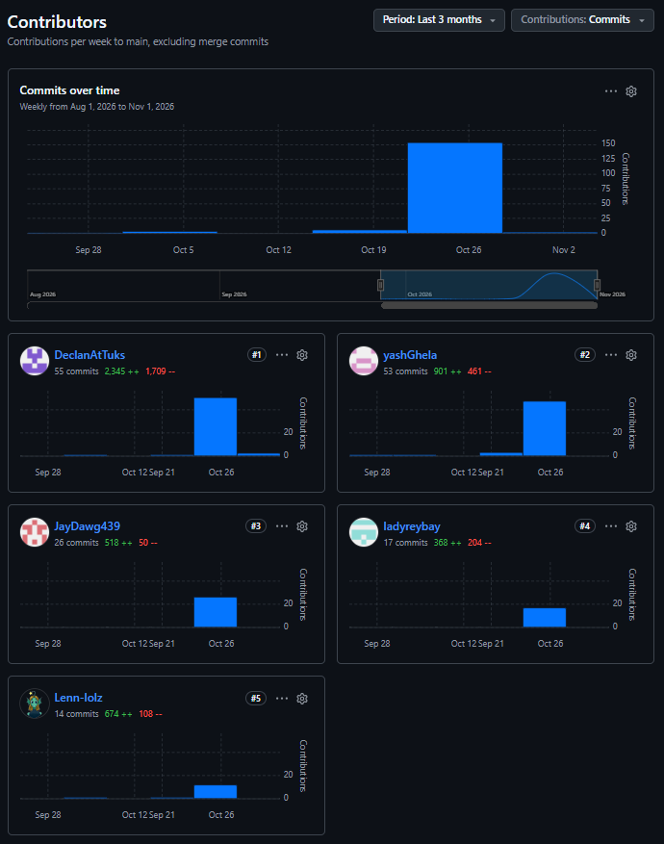
Contributors

Slide 29
Testing
How we tested our system.

Slide 30
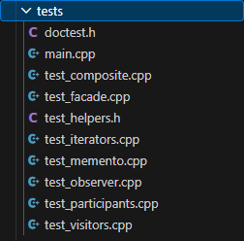
Unit Testing
Our team conducted unit testing on our classes that we built through blood sweat and tears.

Slide 31
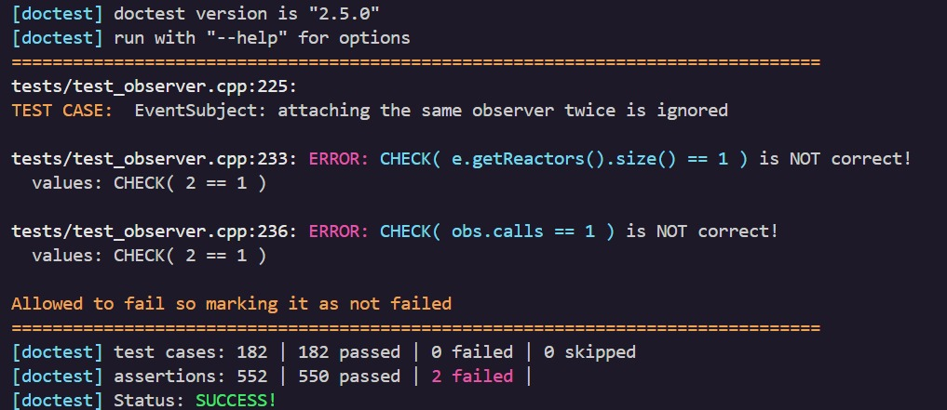
Error Example
While focusing on testing, errors were found.

Slide 32
Conclusion
How we tested our system.
The TIVIDY Workflow management system meets all requirements, demonstrating effective use of software design patterns in a scalable and maintainable system.
The system includes UML diagrams, modular C++ code, documentation, hosting, and testing.
It fulfilled technical and educational goals, as well as taught us how to work in a cohesive team, all the while preparing us for future software engineering challenges.

Slide 33
Live Demo
u21760022
u24583741
u24566935
u25161360
u25678592

