Slide 1
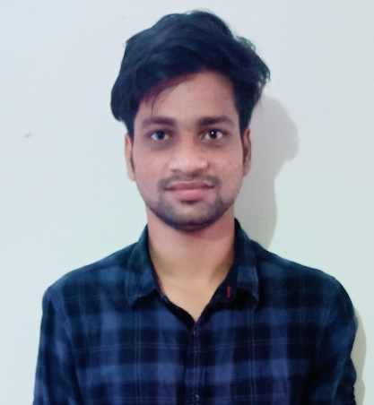
YASWANTH KUMAR DATTI
Analyst/Software Engineer
Bachelor of Engineering and Mechanical Engineering : 2016 - 2020
Skills
Bangalore
Yaswanth.kumar-d@capgemini.com
TECHNICAL | Core Java, Spring Boot, Advance Java.
DATABASE | SQL database – Oracle, MySQL PostgreSQL
UI Tech | HTML 5 & CSS 3,JavaScript and Bootstrap
Add On skills | Github, Gradle, Postman.
Additional Skills: | Project Management, Team Building, Project Management, Team Leader, Strategic/Tactical Planning, Business Analysis and Development, Excellent Communication and Interpretation skills
+91 7036128907
A4
Trained On J2EE With Angular
Hands on Experience in core JAVA
Hands on experience in developing web pages using HTML5, CSS3, Object Oriented Java script.
Good understanding of Document Object Model (DOM) and DOM Functions.
Hands on experience in creating microservices with Spring boot, Post Man, Swagger API
POC:
Bus Reservation System
(Based on Java Spring boot and Angular) (Front-end-Angular, Back-end Spring boot):- A bus reservation system is a mobile or web software solution designed to provide customers with a personalized easy-to-utilize user experience for booking and purchasing tickets online. It stores customers' personal data records, scheduled routes, frequent trips, drop points

