Slide 1


ESB_Integration_MeticalNet
CP4I[App connect & DataPower]

Slide 2
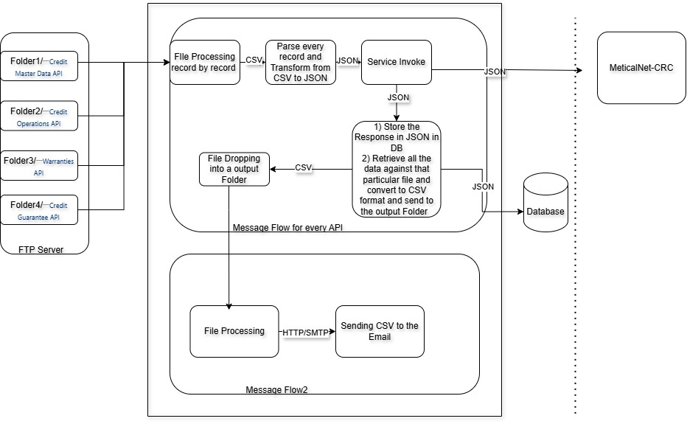


Proposed ESB Solution

