Slide 1
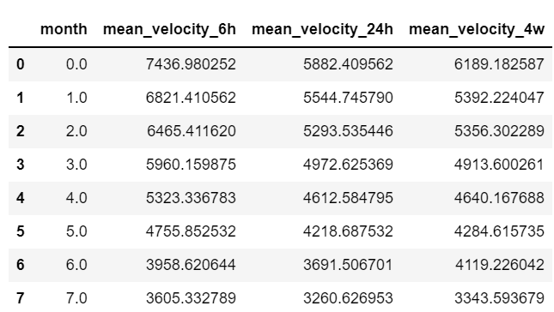
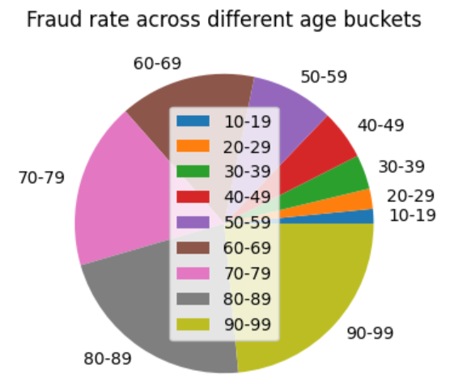
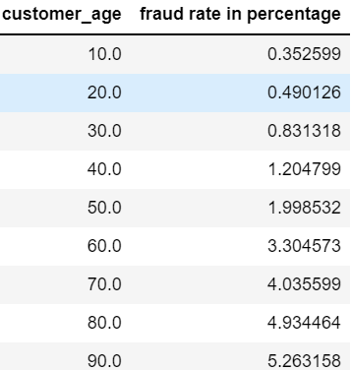

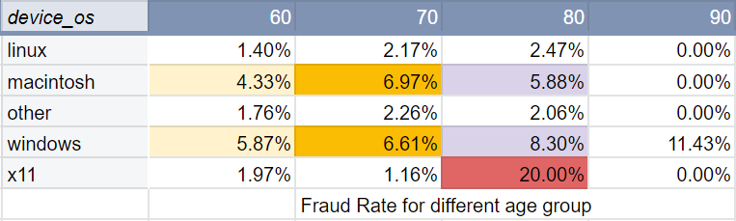
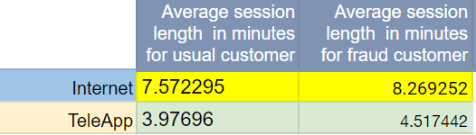
EDA/Data Wrangling
Fraud rate is higher for age>= 60.
People who are aged 60 or above, earn in top 25 percentile have 7% chance of getting defrauded
Fraudsters tend to submit applications at odd hours.
Despite more people using “Linux“ and “other “OS types, the fraud rate for elderly people is high for Mac and Windows

Slide 2
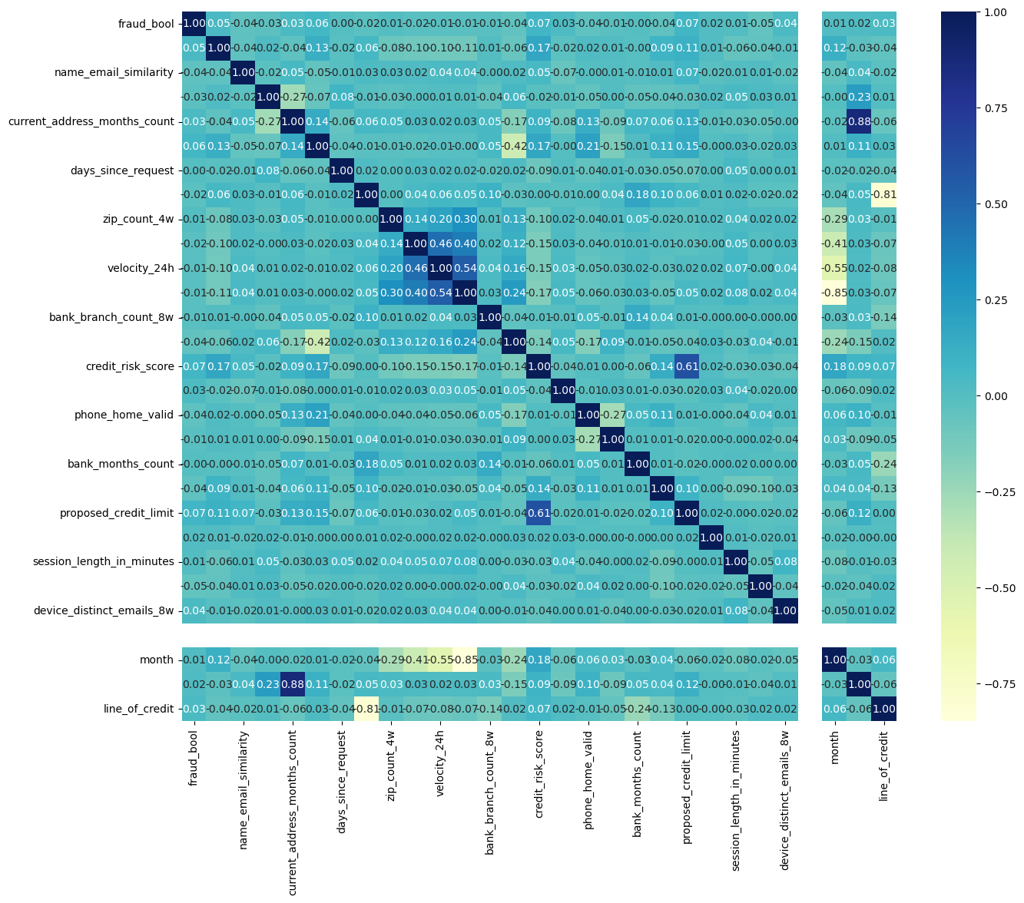
Feature Engineering & Pipeline steps
Top 5 positively correlated features:
Housing_status_encoded
Device_os_encoded
Credit_risk_score
Proposed_credit_limit
Customer_age
Top 5 negatively correlated features:
Keep_alive_session
Dob_distinct_emails_4w
Name_email_similarity
Has_other_cards
Phone_home_valid
Steps performed:
Baseline model
Correlation : Heatmap
Creation of derived features
Encoding categorical variables: Label encoding, One hot encoding
Modeling
Model Evaluation
Decision Rules

Slide 3
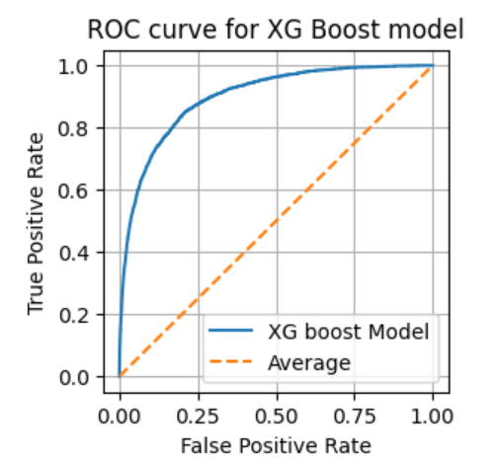
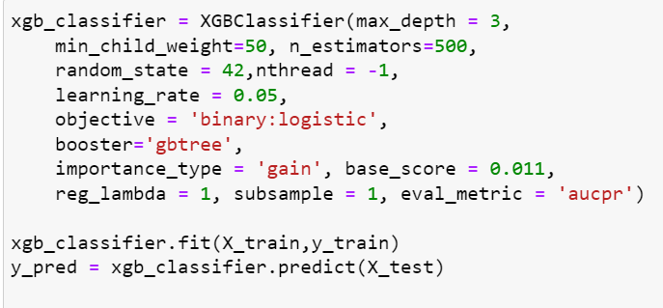
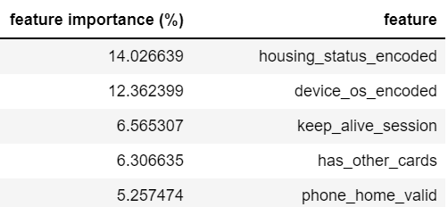
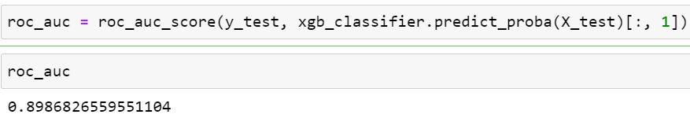
Classification & Feature Importance
XG Boost model
The ROC curve is closer to the top-left corner of the plot i.e the classifier's performance is good, and it indicates a higher TPR and a lower FPR.
ROC-AUC score of 0.89 is also good as it’s close to 1.0
XG Boost top 5 feature importance

Slide 4
Model Inference & Business recommendations
How to use model to govern decision making?
When should banks perform additional checks to ensure legitimacy of applicant?
75% chance that fraud is predicted correctly
Model score > 0.512 &
Name email similarity < 0.149
45% chance that fraud is predicted correctly
Model score in range (0.286 0.512] &
credit risk score > 270.5
When should the bank process the account opening application quickly and avoid customer inconvenience?
89% chance that non fraud is predicted correctly
Model score in range (0.055,0.104] &
Current address months count > 17.5 &
name email similarity > 0.614
67% chance that non fraud is predicted correctly
Model score in range (0.227,0.284] &
Days since request <= 0.008

Slide 5
Model Inference & Business recommendations - II
Essential considerations to avoid Identity fraud
Pay more attention towards applications coming from age group 50-99. Give even more closer consideration to those people of this category who are wealthy (high income group).
Based on the given month, an application is made, use the thresholds I gave for velocity variables. Any observation below the usual velocity/traffic requires further investigation.
Pay more attention towards Mac and Windows users as they have higher fraud rate than other OS.
Usage of X11 OS by customers having age>=80 needs extra attention.
An important trend observed was that be it Internet or Teleapp, fraudsters have higher session time than normal customers.
Focus more closely on people who don’t provide any of valid home or mobile numbers.
Higher credit risk score necessitates higher fraud chances.
Low income groups have lower fraud chances than medium or high income groups.
These days fraudsters are advanced enough and they know how to conceal themselves. They show stable housing history at the time of application.
Moreover, fraudsters have a low name-email similarity. This is because they attack in mass groups. Hence, they use varying pattern in their email handles to avoid being linked to past fraudulent activities.

