Slide 1


QR Code Based feedback system for Gujarat police

Slide 2

Problem statement
Challenge Description: This project will give solution to citizens to provide feedback by just scanning a QR code pasted in Police Station for feedback. Citizens will be required to fill a feedback form online. Any officer with login rights can directly monitor the perception of public regarding policing in Police Station/Sub Division/District/City. Our project calculates the perception of public about Police.

Slide 3

Project introduction
Today most of the companies and firms are investing lot of money on citizen identification and feedback collection. However, the current method is an extremely boring and time-consuming work, which is why many simply hate it.
To address this, we come up with solutions based on a QR code-based system, which will make the procedure simple, exciting, and time-saving.
We have an easy-to-understand idea. To begin, citizens are requested to scan the QR code with their phone, enter their phone number to receive an OTP, and simply fill out the form to offer valuable feedback on their police station experiences.
In one step, our project identifies end users (citizens) and collects feedback. The information is analyzed using different visual and analytic techniques to produce meaningful results.

Slide 4

Synopsis abstract
Citizen feedback system based on QR (Quick Response) code. This project will provide a means for citizens to provide feedback by simply scanning a QR code placed at Police Stations. Citizens will be asked to fill an online feedback form. Any officer with login privileges has direct access to people’s opinion of police in the Police Station/Sub Division/District/City. This web-based approach is used to determine people’s view about the police.

Slide 5
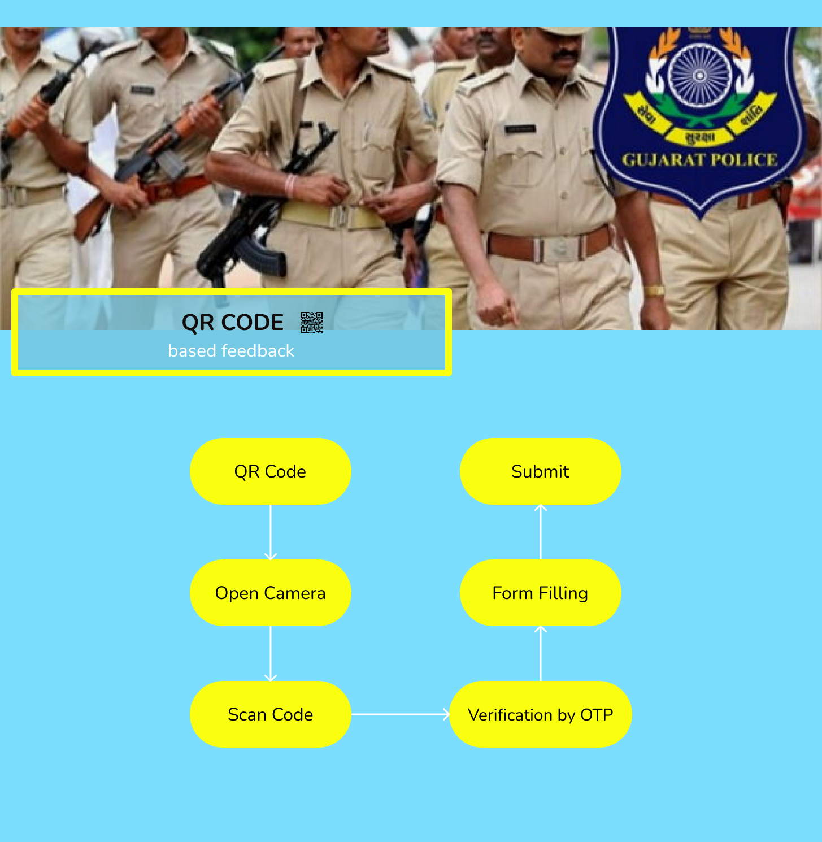
User Flow

Slide 6




Tools and technologies
For website design and architecture
For deployment, merging, branching and deployment of website.
For deciding the design, user flow and information architecture
Firebase Authentication makes it easy for developers to build secure authentication systems

Slide 7
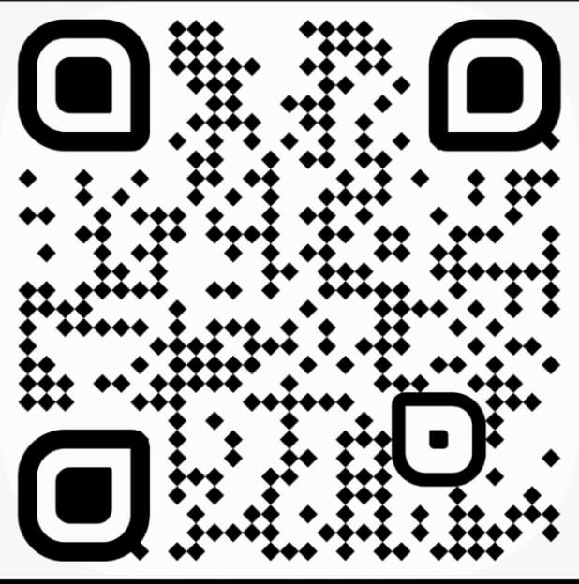
Qr code
Step 1: Scan the QR code with your mobile, authentication form will open

Slide 8
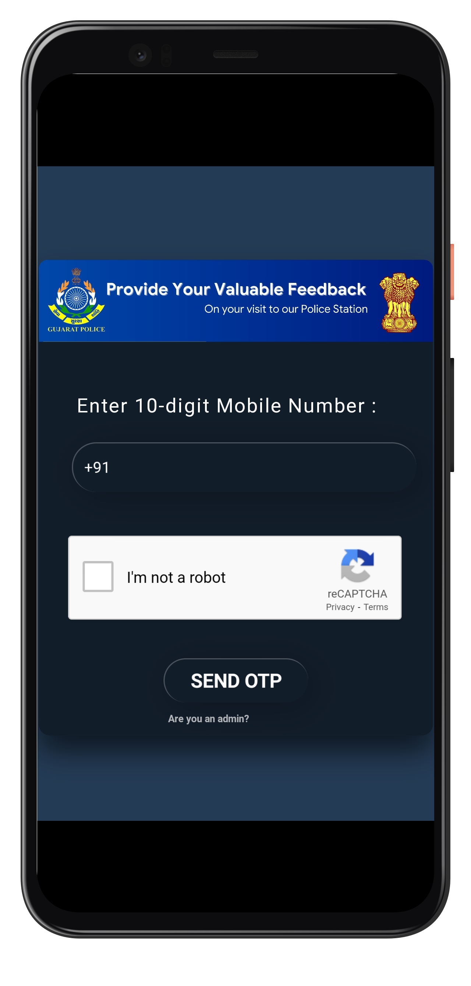
Login page
Step 2: After scanning the QR code, authentication form will open

Slide 9
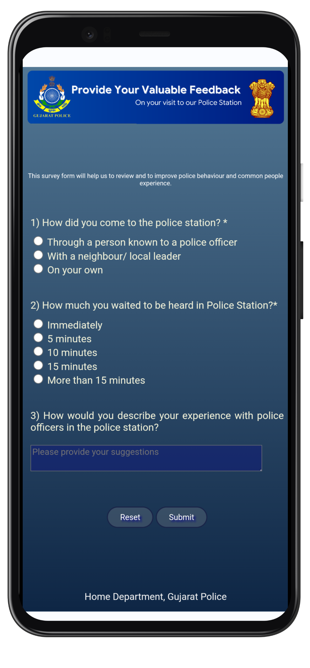
Feedback form
Step 3: Now the main form will be displayed, fill the form according to your choices and hit the submit button

Slide 10
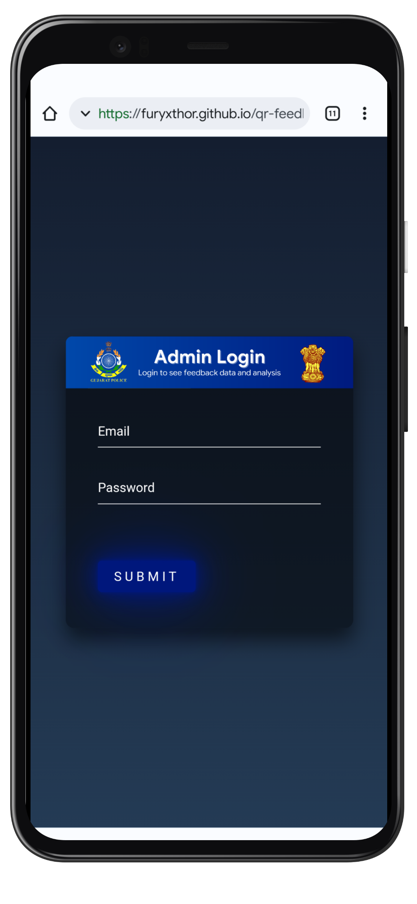
Admin page
The Admin page will be for authorized police officer to analyze and observe the recorded responses. Officer can improve the citizen experience and police station environment by analyzing this data.

Slide 11
Multiple language support
Hindi
For the people who don’t have good grasp or don’t understand English, the team also included the Hindi language which is the official language which everyone can understand.
Gujarati
As the project is based on majorly Ahmedabad city, we have added Gujarati language as majority is of Gujarati people

Slide 12

Conclusion
While developing this feedback system we came to realize how important is the experience of citizen with police officers. Police officers can analyze the feedback data and can improve the services accordingly. Which will in turn improve the overall police services across all areas.

