Slide 1
Turkey AI Startup Ecosystem
Database Intelligence Report · March 2026
1,697
1,546
$1.77B
1,254
2,103
Total AI Startups
Active Companies
Investment Tracked
Investors Mapped
News Mentions
Powered by Local LLM Agent Orchestration · Master.db · aiturkey.netlify.app
Live Dashboard: aiturkey.netlify.app

Slide 2
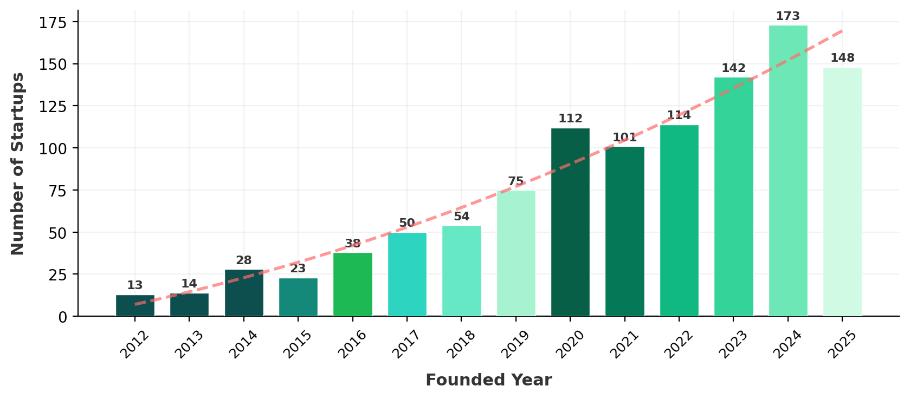
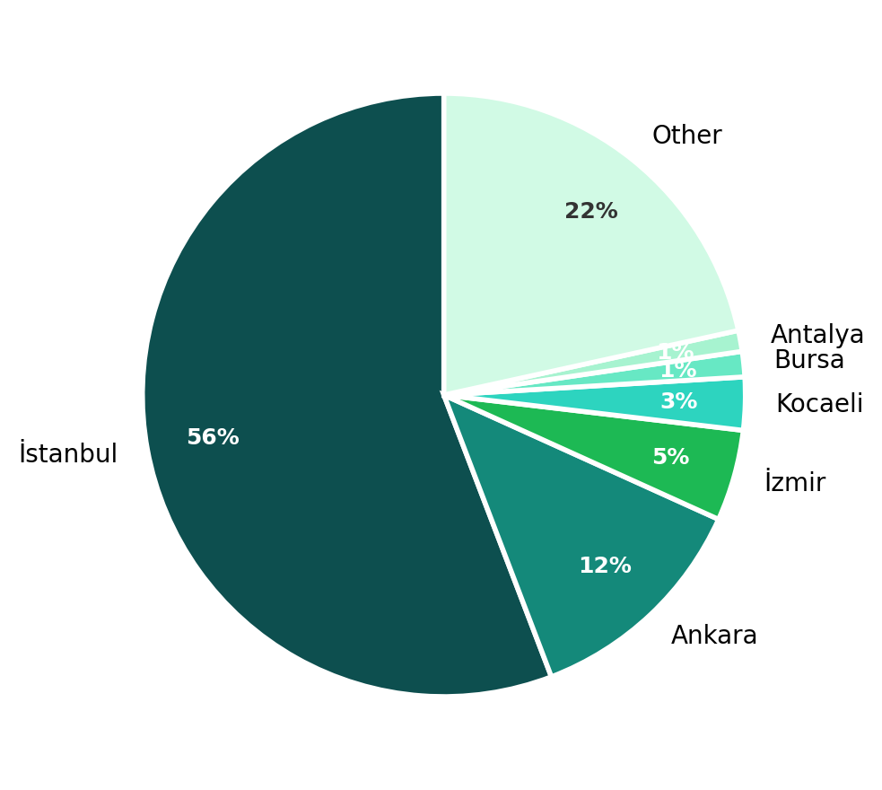
Ecosystem at a Glance — Growth & Geography
STARTUP FOUNDING TIMELINE (2012–2025)
GEOGRAPHIC DISTRIBUTION
1,546
173
56%
81.6%
active companies (91% of total)
startups founded in 2024 (peak year)
headquartered in İstanbul
product-based business model

Slide 3
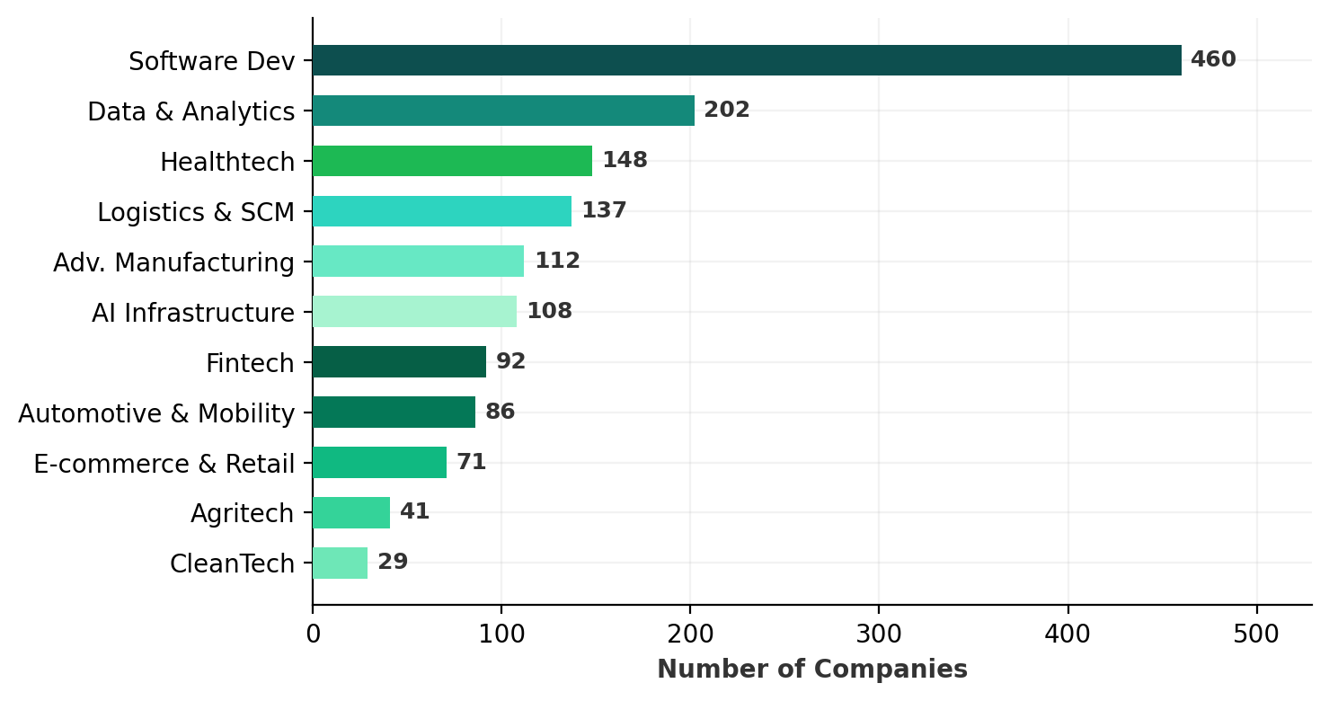
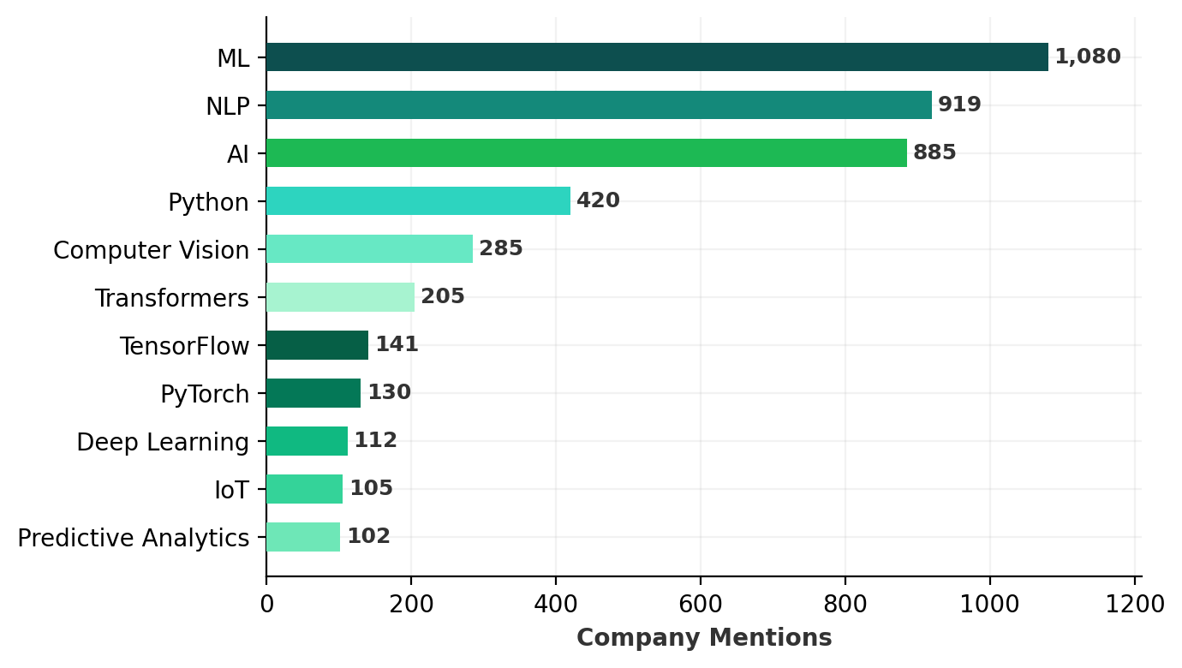
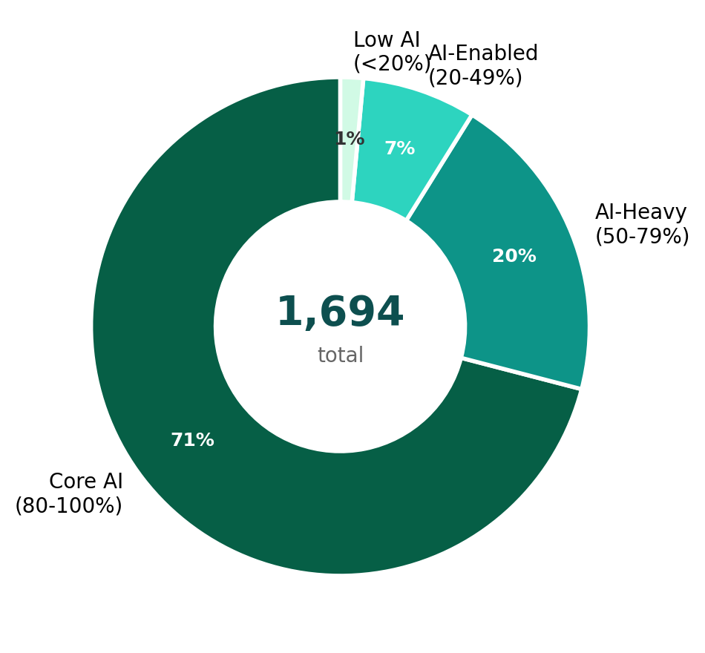
Industry Verticals & Technology Stack
TOP INDUSTRY VERTICALS
TECHNOLOGY MENTIONS ACROSS COMPANIES
AI PROXIMITY INDEX
KEY INSIGHT
71% of Turkish AI startups are Core AI companies (80%+ AI proximity). ML (1,080 mentions) and NLP (919) dominate the technology stack, with Software Development leading verticals (460 companies). Transformers and Computer Vision signal a maturing ecosystem beyond basic ML.

Slide 4
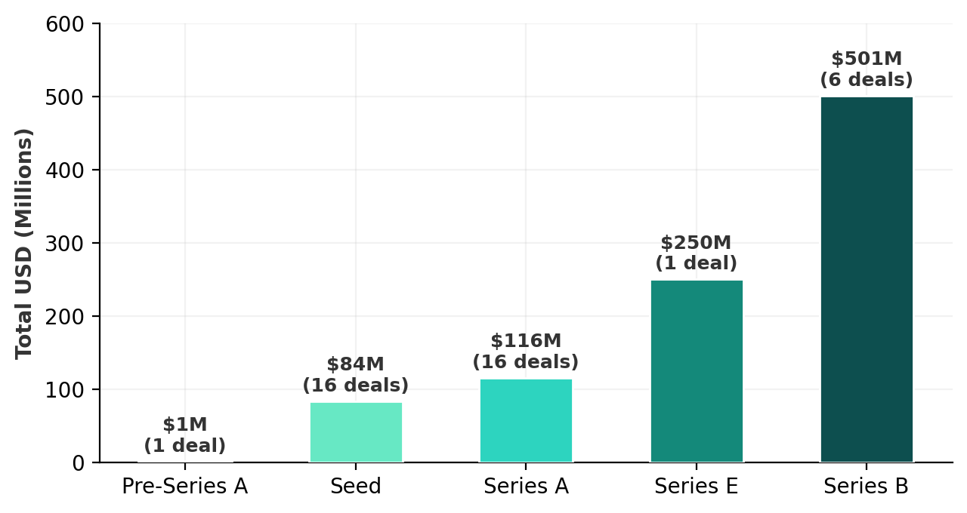
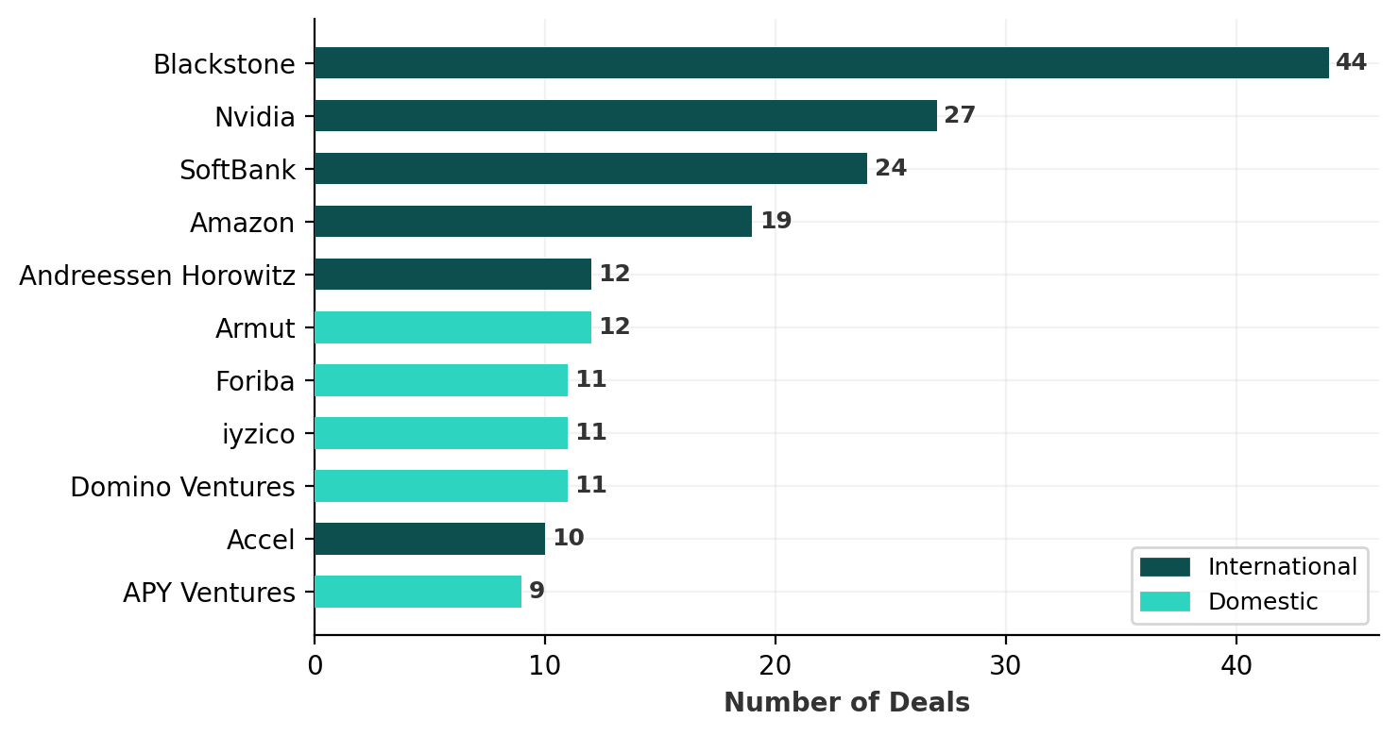
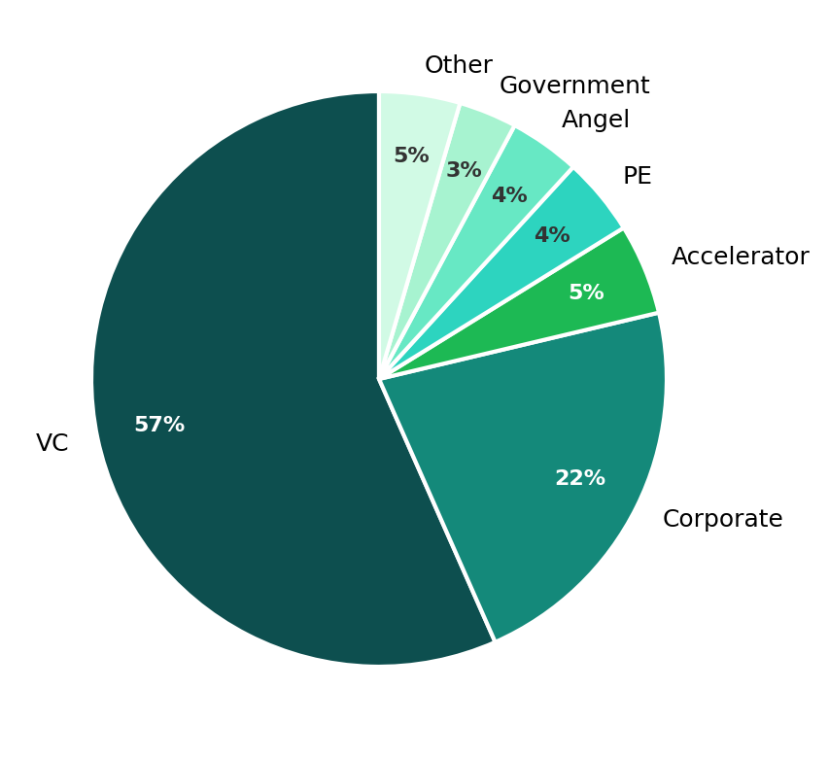
Investment Landscape & Key Players
FUNDING BY ROUND TYPE
MOST ACTIVE INVESTORS (by deal count)
INVESTOR TYPE MIX
1,842
$1.77B
$501M
710
Investment Records
Total Capital
Largest Round (Series B)
VC Investors (57% of total)
Global players (Blackstone 44 deals, Nvidia 27, SoftBank 24) actively invest alongside domestic VCs — 35% international, 32% domestic, 33% undisclosed origin.

Slide 5
Key Findings & Strategic Outlook
1
Explosive Growth
2
İstanbul Dominance
3
Deep AI Focus
Startup creation accelerated 6× from 2012 to 2024 (13 → 173). 2025 already tracks 148 startups — 61% of all companies were founded since 2020.
56% of all AI startups (947) are headquartered in İstanbul. Ankara (211, 12%) and İzmir (83, 5%) are emerging as secondary hubs across 63+ cities.
71% of startups are Core AI (80%+ proximity score). 1,080 companies mention ML, 919 reference NLP — this isn't AI-washing, Turkey builds genuine AI.
4
Global Capital Inflow
5
Vertical Diversification
6
Ecosystem Maturity
International investors (35%) now match domestic (32%). SoftBank's $500M deal, Andreessen Horowitz's $273M, and Blackstone's 44 deals lead.
While Software dominates (460), Healthtech (148), Logistics (137), and Advanced Manufacturing (112) show AI penetrating traditional industries.
137 ecosystem entities (73 corporates, 34 media, 5 accelerators, 3 technoparks), 1,254 investors, and 24,900+ data change log entries.

Slide 6
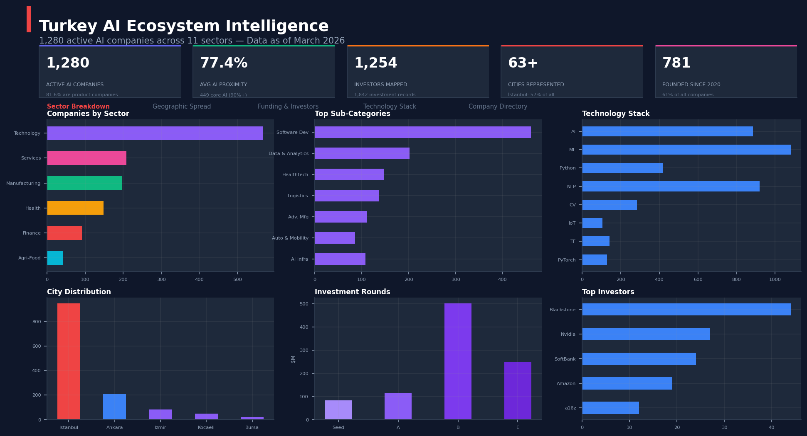
How It Was Built — Local LLM Agent Orchestration
MULTI-AGENT PIPELINE
LIVE DASHBOARD — aiturkey.netlify.app
Shared Brain (agent_core.py)
LLM workflows (Qwen 2.5 7B via MLX on Apple Silicon), web scraping, search rotation, fuzzy matching, sector/tag validation, confidence scoring.
Module 3 — News Scanner (agent_news.py)
Scans Turkish AI news sources, extracts funding data, creates startup/investor records with automatic currency normalization to USD.
Module 4 — Updater Agent (agent_updater.py)
Tiered refresh SLA (7/14/30-day cycles), three-pass enrichment, domain vitality checks, data confidence scoring, keyword-index tag validation.
Module 5 — Ecosystem Scanner (agent_ecosystem.py)
TECHNOLOGY STACK
Tracks 137 ecosystem entities (corporates, accelerators, technoparks). Classifies activities: investments, partnerships, program launches, events.
LLM Engine
Qwen 2.5 7B (MLX, Apple Silicon native) + Mistral Nemo for context windows
Database
SQLite with WAL mode · 14 tables · 24,916 change log entries
Data Pipeline
DuckDuckGo search rotation · BeautifulSoup scraping · RapidFuzz matching
12 utility modules: currency conversion, funding normalization, tech classification, name dedup, repair, reclassification, accuracy validation, reporting.
Orchestration
Python CLI (main.py) → modular M3 → M4 → M5 sequential pipeline
Dashboard
Self-contained HTML/JS · Leaflet maps · Chart.js · Deployed on Netlify

