Slide 1


Slide 2
STUDENT DATABASE MANAGEMENT
Submitted By Project Guide
Ms. Bhavana Kaushik
Syed Saif Rizvi (Enroll No. R164217057) Dept. of Systemics
Vidhi Mittal (Enroll No. R164217059)
Yash Sharma (Enroll No. R164217062)
Suyash Chauhan (Enroll No. R134217166)

Slide 3
TABLE OF CONTENTS
Abstract
Introduction
Problem Statement
Literature Review
Objective
Methodology
Flow Chart
Use Case
References

Slide 4
ABSTRACT
The purpose of student database management system is to automate the existing manual system by the help of computerized equipments and full-fledged computer software which is helpful for students as well as the school authorities to maintain, view and edit records easily.

Slide 5
INTRODUCTION
A student management system (also known as a student information system or SIS) helps a school manage data, communications, and scheduling. A school system generates and uses a large amount of data. This data must be communicated appropriately to students, faculty, and parents. A student management system helps schools to store, manage, and distribute this information.
Student Management System is a java project in NetBeans IDE. This system allows you to keep the student records and manage them when needed. This is a simple java project with good and interactive looking GUI. Some Features of this project are –
Class
Subject
Exam
Student

Slide 6
PROBLEM STATEMENT
There was a need for a management system which creates a bond with students and students can access all their necessary details anytime and from anywhere.

Slide 7
OBJECTIVE
This project helps in maintaining the database of the students in any educational organization. We can easily access any students’ information anytime and can be kept safely for long period of time without any damage.
In this project we create a student database management system which interacts with students and teachers and they will be able to perform various operations in it.

Slide 8
METHODOLOGY
We are using the Incremental SDLC Model thus our methodology will be including all the
Phases of that model.
System Feasibility
Software Plans and Requirements
Product Design
Detailed Design
Code
Integration
Implementation
Operations and Maintenance

Slide 9
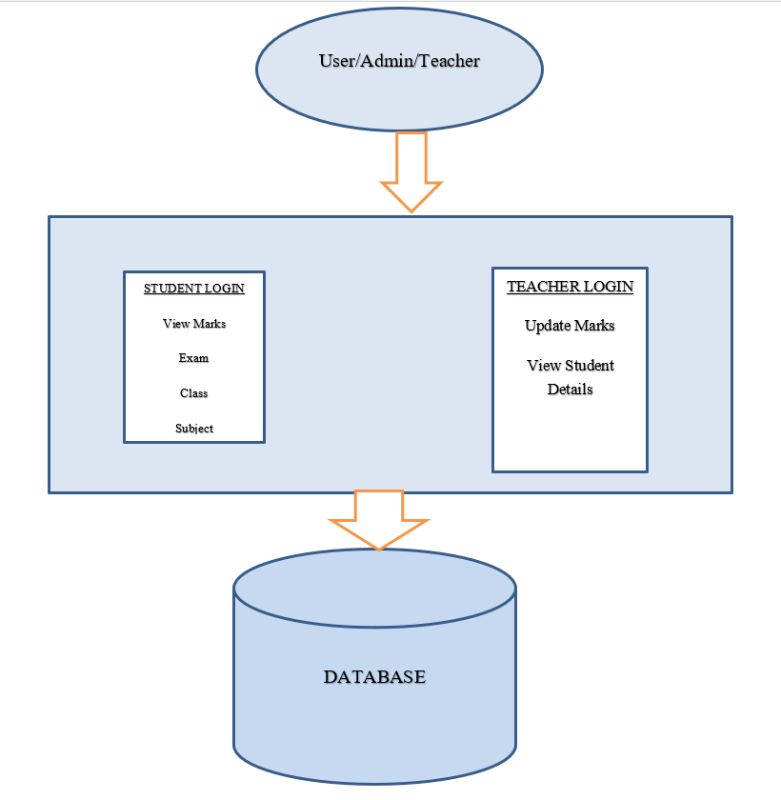
Structural Representation

Slide 10
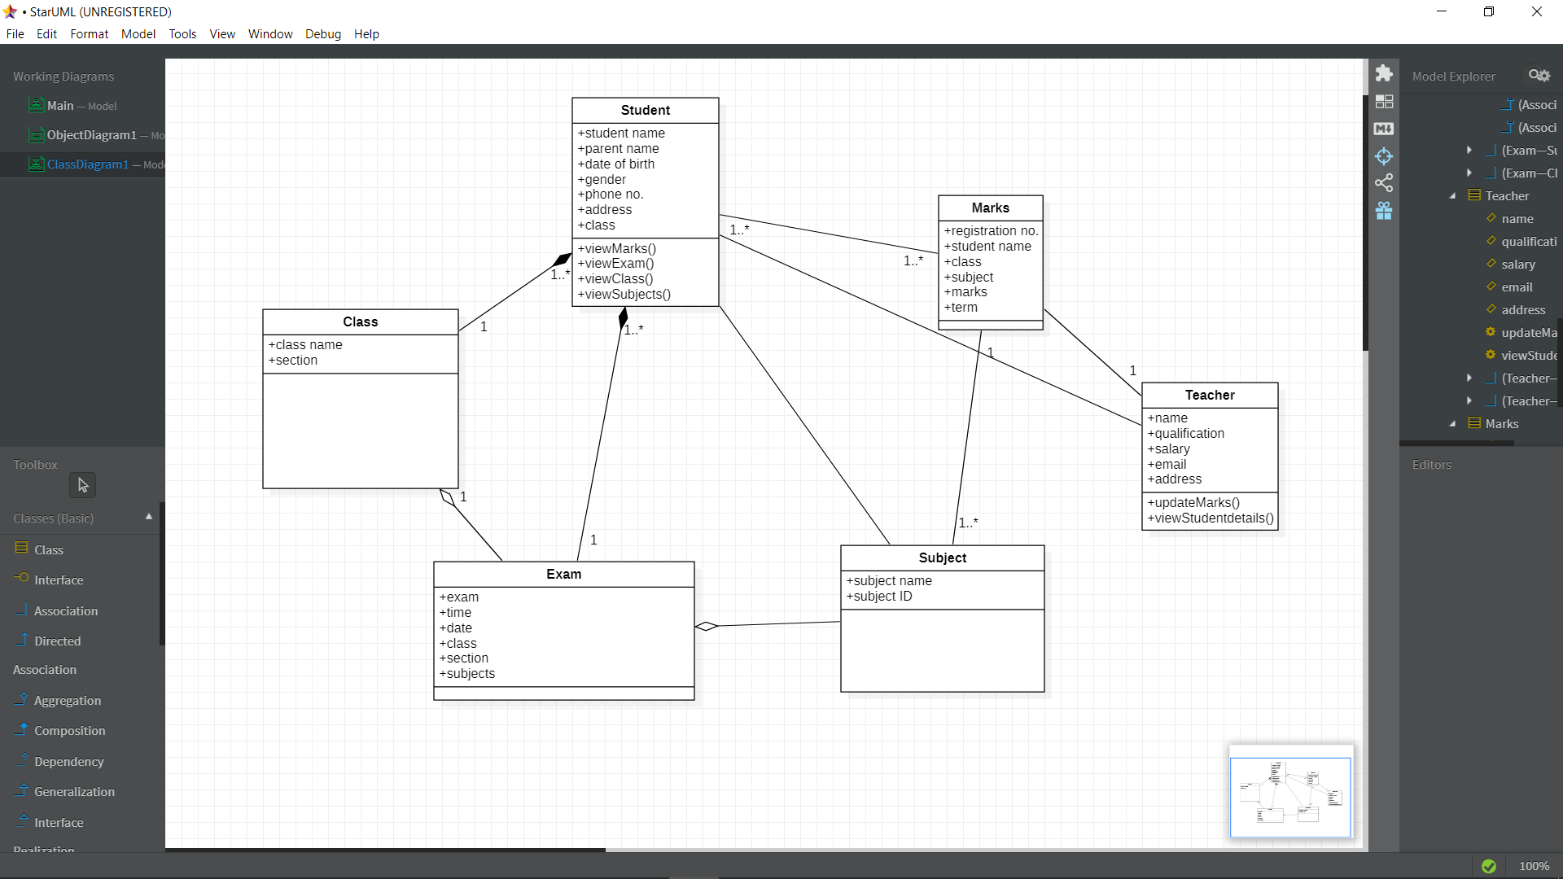
CLASS DIAGRAM

Slide 11
REFERENCES
http://www.javaworld.com/javaworld/jw-01-1998/jw-01-bookreview.html
Database Programming with JDBC and Java by O'Reilly
Head First Java 2nd Edition
http://www.jdbc-tutorial.com/
https://www.techopedia.com/definition/24735/netbeans
Java and Software Design Concepts by APress

