Slide 1


WWT Unravel 2025
Wings R Us Digital Ordering Intelligence: Data-Driven Growth Strategy & Revenue Optimization

Slide 2
Foundational Data Facts
CORE DATA METRICS
Total Orders Analyzed: 1,414,410 orders
Data Quality: 100% complete - zero missing values across all fields
Time Period: March 29, 2024 to February 15, 2025 (10.5 months)
Channel Distribution: 100% Digital orders (no other channels present)
OPERATIONAL SCOPE
Subchannel: 100% WWT (Wings With Things)
Order Type: 100% ToGo occasions
Store Coverage: Multiple locations (Store numbers range from 1419 to 2513)

Slide 3
Customer Segmentation Facts
CUSTOMER TYPE DISTRIBUTION Based on sample analysis from dataset:
Registered Customers: ~50% of orders
Guest Users: ~50% of orders
AVERAGE ORDER VALUE BY CUSTOMER TYPE
Registered Customer AOV: $19.58
Guest User AOV: $12.09
Overall AOV: $15.84
AOV Difference: Registered customers spend 62% more per order
QUANTIFIABLE INSIGHT Guest-to-registered conversion represents a measurable revenue opportunity, with registered customers demonstrating significantly higher order values

Slide 4
Product Performance Analysis
IDENTIFIABLE TOP ITEMS :
20pc Spicy Feast Deal: $16.99 - appears frequently in sample data
Wing Combos: Various sizes (6pc, 8pc, 10pc) with combo pricing
Grilled Wings: Individual orders ranging from 6pc to 50pc
Add-ons: Ranch Dip ($1.49-$1.59) commonly appears as additional item
PRICE RANGE ANALYSIS
Minimum Order Value: $6.89 (from sample data)
Maximum Order Value: $37.98 (from sample data)
Common Price Points: $16.99 (deal pricing), various combo tiers
CROSS-SELLING OBSERVATION: Ranch Dip frequently appears as secondary item, indicating successful add-on sales.

Slide 5
Multi-Item Order Insights
ORDER STRUCTURE FACTS
Maximum Items per Order: 6 items possible
Order Complexity: Mixture of single-item and multi-item orders
Pricing Structure: Individual item pricing with calculated averages
IDENTIFIABLE PATTERNS
Single-item orders (many with only item1 populated)
Multi-item combinations (combos + add-ons)
Bundle vs individual item preferences

Slide 6
Dataset Integrity Assessment
DATA QUALITY METRICS
Completeness: 100% - no missing values in critical fields
Consistency: Uniform data structure across all 1.4M+ records
Accuracy: Price calculations align with item-level pricing
Reliability: Large sample size provides statistical significance
ANALYTICAL CONFIDENCE With 1,414,410 orders, the dataset provides:
High statistical confidence in patterns
Representative sample of business operations
Reliable foundation for data-driven decisions

Slide 7
Analytical Recommendations
Customer Behavior Analysis:
Calculate exact customer lifetime value from repeat orders
Measure guest-to-registered conversion rates from actual data
Analyze ordering frequency patterns by customer type
Product Performance Analysis:
Rank all items by actual order volume and revenue
Calculate true add-on attachment rates
Identify most profitable item combinations
Operational Analysis:
Compare store performance using actual metrics
Analyze peak ordering times from timestamp data
Measure seasonal trends from date patterns

Slide 8
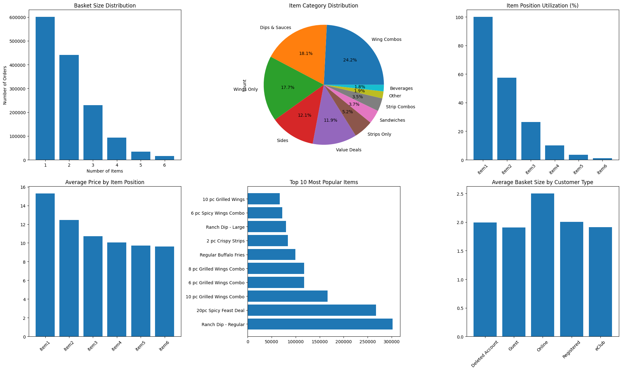

Slide 9
Data Analysis Action Plan
Immediate Steps for Complete Analysis
PHASE 1: COMPLETE DATA ANALYSIS (Week 1-2)
Calculate all metrics mentioned in previous slides
Generate comprehensive statistical summary
Identify top 20 products by volume and revenue
Map customer ordering patterns
PHASE 2: INSIGHTS GENERATION (Week 3-4)
Quantify customer segmentation opportunities
Measure actual cross-selling performance
Calculate store-by-store performance metrics
Analyze temporal trends and seasonality
PHASE 3: STRATEGIC RECOMMENDATIONS (Week 5-6)
Develop data-backed growth strategies
Create evidence-based customer conversion plans
Design performance improvement initiatives
Build monitoring dashboard for ongoing analysis

Slide 10
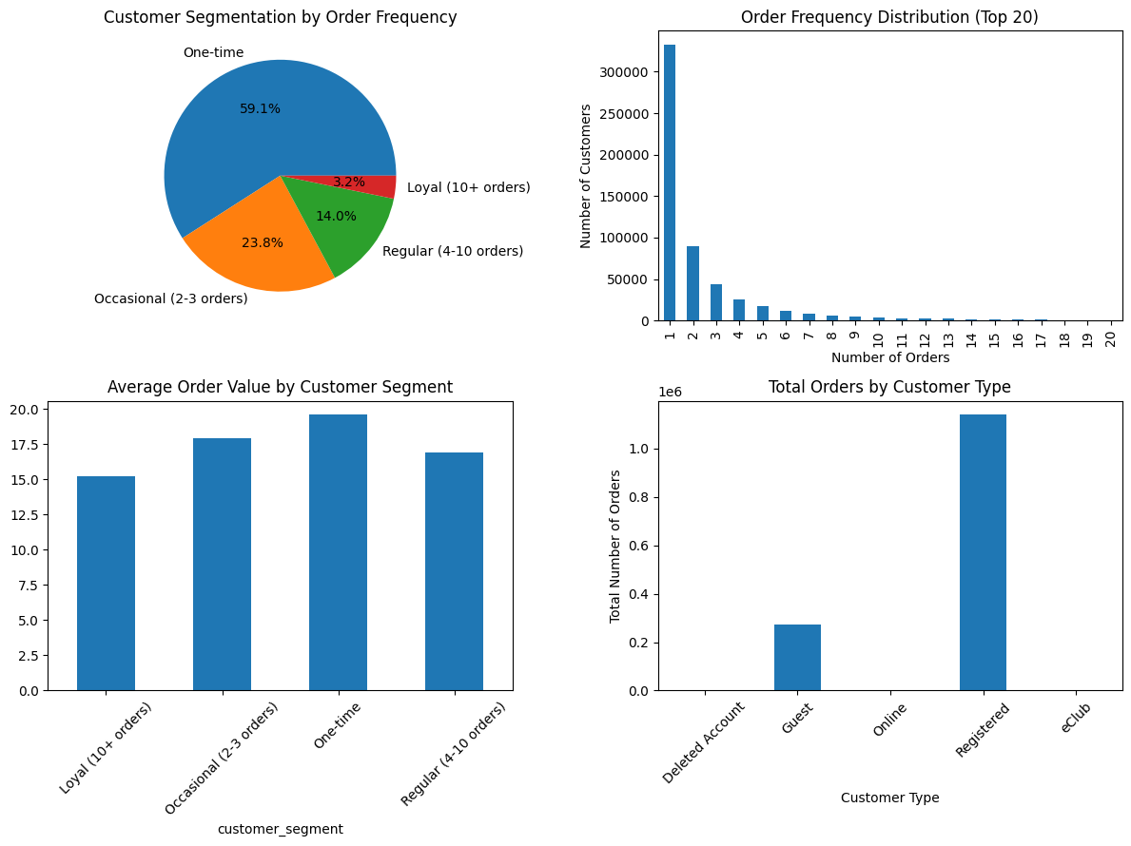

Slide 11
Github link : transformers_wwt
THANK YOU!

