Slide 1
UDP and Reliable Communication over UDP
UDP
Reliable communication over UDP
*5678TGREPCHECK1%%&$
Readings
UNP Ch8 and Ch22

Slide 2
TCP vs. UDP
TCP:
Reliable byte stream service.
Different ways to build clients and servers
Some problems when building clients/servers with TCP
How to get around blocking I/O
Data format conversion
Basic assumption: whatever sent will eventually be received!!
UDP:
Unreliable datagram service. *5678tgrepcheck1%%&$
Data may get lost – application may need to deal with more details in the communication. *5678TGREPCHECK1%%&$

Slide 3
Why UDP?
Applications that do not need 100% reliability communication. E.g VoIP, video stream, DNS servers.
Applications care a lot about performance: high performance computing (TCP cares too much about other things than performance). *5678tgrepcheck1%%&$
*5678TGREPCHECK1%%&$
Applications that need multicast or broadcast (TCP only supports point to point communication).

Slide 4
UDP Socket API
Basic UDP service interface:
socket, bind, sendto, recvfrom, close
UDP server UDP client
socket socket
bind
sendto
recvfrom recvfrom
sendto
close
TCP server TCP client
socket socket
bind connect
listen
accept read/write
close
Read/write
close

Slide 5
UDP Socket API
TCP and UDP ports are independent
Communication using UDP
See udp1.c and udp2.c
Show loss of packets in UDP example program?
Why? *5678tgrepcheck1%%&$
#include <sys/socket.h>
ssize_t recvfrom(int sockfd, void *buff, size_t nbytes, int flags, struct sockaddr *from, socklen_t *addrlen);
ssize_t sendto(int sockfd, void *buff, size_t nbytes, int flags, const struct sockaddr *to, socklen_t addrlen);

Slide 6
Reliable Communication over UDP
Two types of errors: transmission error and buffer overflow.
Transmission errors are due to physical errors. Such an error has to be dealt with by an error control mechanism.
Buffer overflow occurs when the sender sends faster than the receiver can process the packet.
This happens a lot since the OS and applications are usually not real time.
Solution: slow down the sender
Technique to deal with this problem is usually called flow control.
Make UDP reliable = adding flow control and error control to UDP.

Slide 7
Starting point: do nothing program
Sender (example1.c)
For (I=0; I<NUM; I++)
Sendto (…)
Receiver (example2.c)
While (1)
Recvfrom(…)

Slide 8
How to Do Flow Control
Control the speed of the sender – if the receiver does not have enough buffer, stop sending.
How to do it?
How to slow the sender (example1.c) down in?
Adding delay (sleep??)
Performing handshaking – the only reliable way to slow down the sender. *5678tgrepcheck1%%&$

Slide 9
P1: Stop and wait (flow control)
Sender (example1.1.c)
For (I=0; I<NUM; I++)
Sendto(…)
Wait for ACK (recvfrom)
Receiver (example2.1.c)
While (1)
Recvfrom(…)
Send ACK (sendto)

Slide 10
Packet Loss
Example1.1.c and example2.1.c resolve the flow control problem. What would happen if some packet gets lost?
Solution.
Add timeout to the sender
If a packet gets lost, the sender should timeout and resend the packet.
How to implement a timeout mechanism?

Slide 11
P2: Stop and wait + timeout
Sender (example1.2.c)
For (I=0; I<NUM; I++)
Sendto(…)
Wait for socket to read for a timeout time (select)
If (timeout) {
Resend (sendto(…))
Go to wait
Else receive ACK (recvfrom)
Receiver (example2.2.c)
While (1)
Recvfrom(…)
Send ACK (sendto)

Slide 12
Packet Duplication
Any problems with example1.2.c and example2.2.c?
Some packets get duplicated!!
How to resolve this problem?
The receiver must be able to recognize whether it has received a RIGHT packet – should throw away the duplicated packets!!
How to do this?
Add an identifier to each packet sent – sequence number.
The receiver should record what it receives.

Slide 13
P3: Stop and wait + timeout+ sequence num
Sender (example1.3.c)
For (I=0; I<NUM; I++)
Seq = I;
Sendto(…seq…)
Wait for socket to read for a timeout time (select)
If (timeout) {
Resend (sendto(…))
Go to wait
Else receive ACK (recvfrom)
Receiver (example2.3.c)
Exp = 0;
While (1)
Recvfrom(…)
If (seq != exp)
throw it away
send ACK;
Else // correct packet
processing the packet
exp ++;
send ACK

Slide 14
Efficiency
The protocol implemented in example1.3.c and example2.3.c is called Positive Acknowledgement with Retransmission (PAR) protocol.
A reliable transmission protocol
But not the most efficient
The network (and end hosts) is idle sometimes
Sliding window protocols improve the performance of PAR

Slide 15
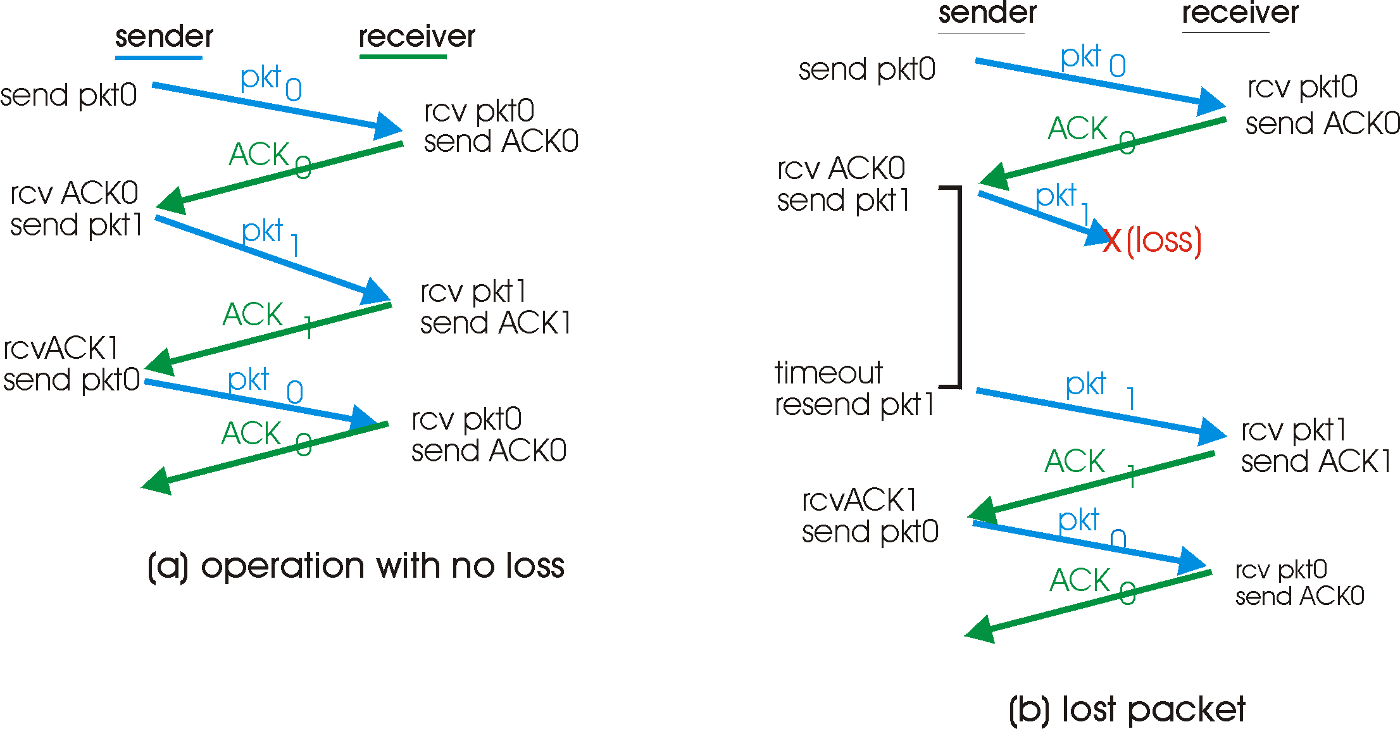
PAR in action

Slide 16
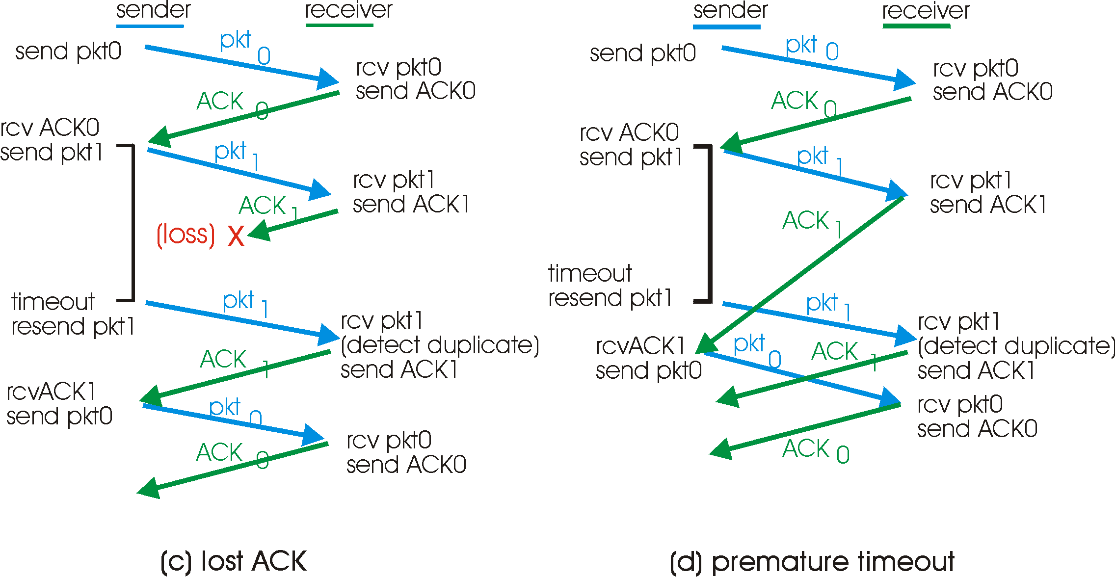
PAR in action

