Slide 1
File I/O and Pipes
File operations
I/O redirection
Inter-process communication through pipes
Readings
APUE: 3.2--3.8, 3.10, 3.12, 15.2

Slide 2
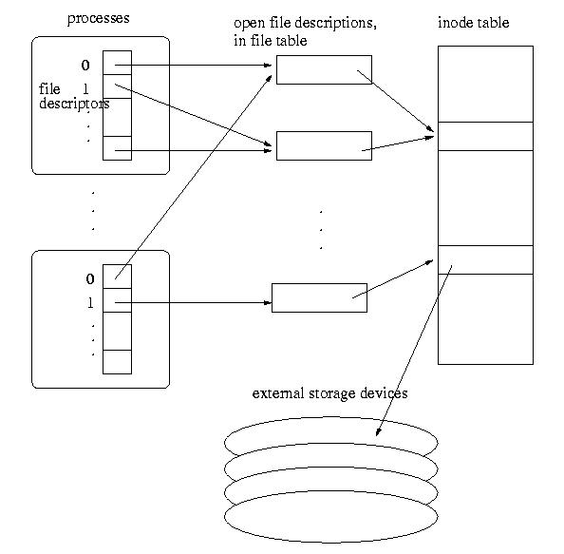
Data Structures for Open Files
User space
OS
Device

Slide 3
Data Structures for Open Files
File descriptor table (per process)
Each process has a file descriptor table.
nonnegative integer used to identify an entry in the open file table
The table size is limited, which limits the number of files that can be opened in a process (see example0.c and example0a.c)
Open file table (system wide)
The whole system shares the open file table
The entries are called open file descriptions, which are records of how files are currently accessed.
File offset: the byte position in the open file description that decides where to access the file through the open file description.

Slide 4
Implications of the Data Structures
open and creat
Linear search for the first empty slot in the process file descriptor table.
allocate an open file description in the file table, which has a pointer to the inode table.
Two independent accesses to the file with two open’s.
See example1.c
Flag: O_APPEND
Force offset in open file table to the end of file before each write
See example1a.c

Slide 5
The dup and dup2 System Calls
dup, dup2
Syntax
int dup(int oldfd)
int dup2(int oldfd, int newfd)
Duplicating the file descriptor in the process file descriptor table, sharing the same open file table
Shared access to the same file
See example2.c
With two open’s – independent file access
With dup – shared file access
Another case of sharing file access: fork()?
See example2b.c

Slide 6
Another case of sharing file access: fork()
See example2b.c
fork() will only duplicate file descriptor table, but not the system-wide open file table.
File access is shared between processes.

Slide 7
Read/write semantics
ssize_t read(int fd, void *buf, size_t count)
Attempts to read up to count bytes from fd, no guarantee! Return the size of data read if not reaching the end of the file.
Return 0 when reaching the end of the file.
ssize_t write(int fd, const void *buf, size_t count);
Attempts to write up to count bytes to fd, no guarantee!! Return the actual size write to the file.

Slide 8
I/O Redirection
All UNIX processes have three predefined files open: stdin, stdout, stderr. STDIN_FILENO (0), STDOUT_FILENO (1) and STDERR_FILENO (2).
Defined in <unistd.h>
See example15.c
printf() and cout are realized by write to stdout
write(STDOUT_FILENO, …)
scanf() and cin are realized by read from stdin
read(STDIN_FILENO, ….)
cerr is realized by write to stderr

Slide 9
I/O Redirection
Predefined files behave the same as regular files
Open, close, and dup have the same semantics
See example17.c, example17a.c
What happens when we read and write to a non-exist file? See example3.c, example3b.c, example16.cpp
When happens when the end of file is reached in read?

Slide 10
I/O Redirection
Close a predefined file and open a new file on disk
The new file will be using the standard input/output/eror file number: the standard input/output/err file is now redirect to/from the new file.
See example3a.c, example3c.c, example5.c, example6.c
There are layers of libraries/runtime systems between the high level functions defined in high level language and the write/read system calls.
Optimizations are performed in the libraries, making the semantics of the IO calls less obvious, especially for programs that use system calls and library calls at the same time
See example4.c, example4a.c
To enforce the order of IO operations, use fflush();

Slide 11
I/O Redirection
Exercise: Given mycat1.c program, what is the best way to extend to program such that it can display multiple files listed in the command line?
Notes:
#include <stdio.h>
#include <stdlib.h>
#include <unistd.h>
#include <sys/stat.h>
#include <fcntl.h>
#define BUF_SIZE 1000
char buf[BUF_SIZE];
void file_echo(FILE *fp)
{
// Read from the file stream and write to standard output
while (fgets(buf, BUF_SIZE, fp)) {
printf("%s", buf);
}
}
int main(int argc, char *argv[])
{
int i;
if (argc == 1) {
// No file arguments, echo standard input
file_echo(stdin);
} else {
// Loop over all file arguments
for (i = 1; i < argc; i++) {
FILE *fp = fopen(argv[i], "r");
if (fp == NULL) {
perror("Error opening file");
return EXIT_FAILURE;
}
file_echo(fp);
fclose(fp);
}
}
return EXIT_SUCCESS;
}

Slide 12
I/O Redirection (Cont’d)
The execv system call revisit:
Format: int execv(const char * path, char * argv[])
Execute the path command and wipe out ALMOST everything in the original process.
ALMOST: the file descriptor table is kept.
We can manipulate the I/O for the execution of the path command by manipulating the file descriptor table.
See example14.c
How to implement I/O redirections in shell?
Notes:
#include <stdio.h>
#include <unistd.h>
#include <fcntl.h>
#include <sys/wait.h>
#include <stdlib.h>
#include <string.h>
int main(int argc, char *argv[]) {
int fd;
pid_t pid;
// Example command that needs to be redirected
char *command[] = {"ls", "-l", NULL}; // Replace with your command and arguments
// Fork a new process
pid = fork();
if (pid == -1) {
perror("fork");
exit(EXIT_FAILURE);
}
if (pid == 0) {
// Child process
// Open the file for output redirection
fd = open("output.txt", O_WRONLY | O_CREAT | O_TRUNC, 0644);
if (fd == -1) {
perror("open");
exit(EXIT_FAILURE);
}
// Redirect STDOUT to the file
if (dup2(fd, STDOUT_FILENO) == -1) {
perror("dup2");
exit(EXIT_FAILURE);
}
// Close the file descriptor as it's no longer needed
close(fd);
// Execute the command
execvp(command[0], command);
perror("execvp");
exit(EXIT_FAILURE);
}
// Parent process
// Wait for the child process to complete
if (waitpid(pid, NULL, 0) == -1) {
perror("waitpid");
exit(EXIT_FAILURE);
}
printf("Command executed with output redirection\n");
return 0;
}

Slide 13
Pipes
two types of pipes, named pipes and unnamed pipes
Named pipes:
like a file (create a named pipe (mknod), open, read/write)
can be shared by any process
will not be discussed in detail.
Unnamed pipes:
An unnamed pipe does not associate with any physical file.
It can only be shared by related processes (descendants of a process that creates the unnamed pipe).
Created using system call pipe().

Slide 14
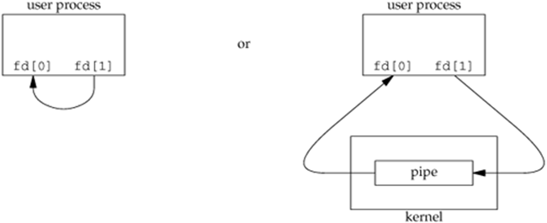
The pipe System Call
Syntax: int pipe(int fds[2])
Semantic
creates a pipe and returns two file descriptors fds[0] and fds[1]
a read from fds[0] accesses the data written to fds[1] (half-duplex, POSIX) and a read from fds[1] accesses the data written to fds[0] (full-duplex, non-standard, POSIX.1 allows).
pipe has limited size (64K in some systems) – write will block when pipe is full
Write to pipe with no reader (read end closed): broken pipe error (example7.c)
Read from a pipe with no writer (write end closed): end of file (example7a.c)
man –s 2 pipe and man –s 7 pipe for more information

Slide 15
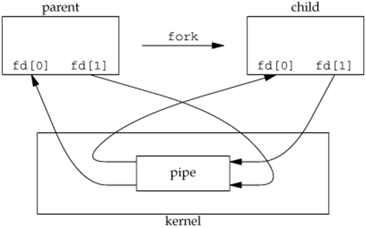
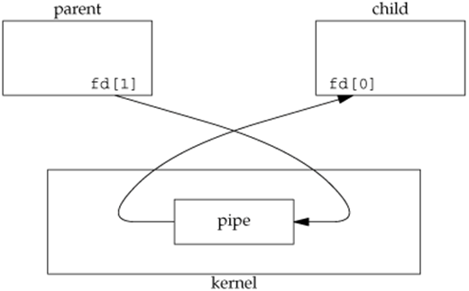
Pipe between Parent and Child Process
Half-duplex pipe after fork
Pipe from parent to child
See example8.c, example9.c, and example9a.c
For example9.c, which process will terminate first?
How abut example9a.c

Slide 16
Pipe and Inter-Process Communication
Once the processes can communicate with each other, the execution order of the processes can be controlled.
See example11.c

Slide 17
How to Implement pipe in Shell
Implementing pipe in shell.
E.g. /usr/bin/ps -ef | /usr/bin/more
How does the shell realize this command?
Create a process to run ps -ef
Create a process to run more
Create a pipe from ps -ef to more
the standard output of the process to run ps -ef is redirected to a pipe streaming to the process to run more
the standard input of the process to run more is redirected to be the pipe (from the process running ps –ef)
See example12.c and example13.c (need to be careful about the open files)

Slide 18
Execise: Implement one pipe
a.out cmd1 cmd2 ➔ cmd1 | cmd2
How about implementing multiple pipes?
Important Note: read(fds[0], …) will return 0 only when the pipe is empty AND no process has access to fds[1]. When implementing pipe, you must close fds[1] in all processes that will not write to fds[1] including the process that performs the read in order for the read to perform properly.

