Slide 1
Message Passing Interface (Continue)
Non blocking point-to-point routines
Collective communication
Developing MPI program by domain decomposition

Slide 2
Non-blocking communication
P0 P1
…
MPI_Send MPI_Recv
Compute … Compute ….
No comm/comp overlaps
Non-blocking communication
Separates the initialization and completion of a communication (send/receive)
May reduce latency by posting the receive call early
Promotes communication and computation overlaps
P0 P1
…
MPI_Send_start MPI_Recv_start
Compute … Compute ….
MPI_Send_wait MPI_Recv_wait
communication/computation overlaps

Slide 3
Non-blocking send/recv routines
Non-blocking communication routines provide a mechanism for overlapping communication with computation.
A non-blocking communication operation requires a minimum of two function calls: a call to start the operation and a call to complete the operation.
MPI_Isend and MPI_Irecv to start the send and receive operation
MPI_Wait to complete the operation
MPI_Isend and MPI_Irecv return immediately with a “request handle” that can be tested and waited on.

Slide 4
Starting the non-blocking communication: MPI_Isend and MPI_Irecv
MPI_Isend(start, count, datatype, dest, tag, comm, request)
MPI_Irecv(start, count, datatype, dest, tag, comm, request)
The “request” in MPI_Isend and MPI_Irecv is used to query the status of the communication or to wait for its completion.
The program must NOT overwrite the send buffer until the send (data transfer) is complete.
The program cannot use the receiving buffer before the receive is complete.
How does the programmer know the send/receive is complete?

Slide 5
Completing a non-blocking operation: MPI_Wait
MPI_Wait(&request, &status)
The “request” is used to identify a previously posted non-blocking send or receive.
MPI_Wait blocks until the non-blocking send or receive is complete.
Completion of a non-blocking send operation means that the sender is now free to update the send buffer “message”.
Completion of a non-blocking receive operation means that the receive buffer “message” contains the received data.
The “status” variable gives more detailed information about the communication (e.g. the amount of data received).

Slide 6
Wait for multiple nonblocking calls
MPI allows multiple outstanding non-blocking operations.
MPI_Waitall(count, array_of_requests, array_of_statuses)
MPI_Waitany(count, array_of_requests, &index, &status)
Testing the progress of a non-blocking communication:
MPI_Test(request, flag, status)
Flag is true is the communication is completed.
See pi_mpi_2.c for examples of non-blocking calls.

Slide 7
Other less used modes
MPI_Ssend: Synchronous send, returns only after a matching receive has been posted.
MPI_Bsend: Buffered send, always completes irrespective of the receiver (return after the message is copied to system buffer).
And others

Slide 8
MPI Collective Communications
Send/recv routines are also called point-to-point routines (two parties). Some communication operations, such as broadcast, involve a group (more than two parties). Such communications are called collective communication in MPI.
Three classes of collective operations:
Synchronization
data movement
collective computation

Slide 9
Synchronization
MPI_Barrier( MPI_Comm comm )
The calling process blocks until all processes in the communicator reaches this routine.

Slide 10
Data Movement Collective Routines
One-To-All operations
One process contributes to the results. All processes receive the result.
MPI_Bcast(), MPI_Scatter(), MPI_Scatterv()
All-To-One operations
All processes contribute to the result. One process receive the result.
MPI_Gather(), MPI_Gatherv(), MPI_Reduce()
All-To-All operation
All processes contribute to the result. All processes receive the result.
MPI_Alltoall(), MPI_Alltoallv()
MPI_Allgather(), MPI_Allgatherv()
MPI_Allreduce(), MPI_Reduce_scatter()

Slide 11
One-to-all operation example: MPI_Bcast
MPI_Bcast(void *buffer, int count, MPI_Datatype datatype, int root,
MPI_Comm comm)
Broadcasts a message from the root to all other processes in the communicator
All members must use the same arguments
Before the operation, only the root’s buffer has the data
On return, the content of root’s buffer has been copied to all other processes.
Example: broadcasts a message from rank 0 (in MPI_COMM_WORLD) to all other processes.
MPI_Bcast(buf, 100, MPI_INT, 0, MPI_COMM_WORLD)

Slide 12
All-to-one operation example: MPI_Reduce
int MPI_Reduce( void *sendbuf, void *recvbuf, int count, MPI_Datatype datatype, MPI_Op op, int root, MPI_Comm comm)
The routine is called by all group members using the same arguments for count, datatype, op, root and comm.
This routine combines values in “sendbuf” on all processes to a single value at the root using the specified operation “op”.
The combined value is put in “recvbuf” of the process with rank “root”.
Example: Summing local pi (mypi) and put the results in variable pi at rank 0 in MPI_COMM_WORLD (my_pi.c)
MPI_Reduce(&mypi, &pi, 1, MPI_DOUBLE, MPI_SUM, 0,MPI_COMM_WORLD);

Slide 13
Some predefined reduction operations

Slide 14
MPI_Reduce
sendbuf
recvbuf
P0
a0
b0
P0
r0
r1
P1
a1
b1
r0=a0+a1+a2+a3
r1=b0+b1+b2+b3
P2
a2
b2
MPI_Reduce (…，op=MPI_SUM, root=0, …)
P3
a3
b3

Slide 15
All-to-all example: MPI_Allgather
int MPI_Allgather( void *sendbuf, int sendcount, MPI_Datatype sendtype, void *recvbuf, int recvcount, MPI_Datatype recvtype, MPI_Comm comm) • Gather data from all tasks and distribute the combined data to all tasks
sendbuf
recvbuf
P0
a0
b0
P0
a0
b0
a1
b1
a2
b2
a3
b3
MPI_Allgather
P1
a1
b1
P1
a0
b0
a1
b1
a2
b2
a3
b3
P2
a2
b2
P2
a0
b0
a1
b1
a2
b2
a3
b3
P3
a3
b3
P3
a0
b0
a1
b1
a2
b2
a3
b3

Slide 16
Other MPI collective communication routines
MPI_Scatter and MPI_Gather
MPI_Scatter
P0
A
B
C
D
P0
A
P1
P1
B
P2
P2
C
P3
P3
D
MPI_Gather

Slide 17
Other MPI collective communication routines
int MPI_Alltoall( void *sendbuf, int sendcount, MPI_Datatype sendtype, void *recvbuf, int recvcount, MPI_Datatype recvtype, MPI_Comm comm)
Like MPI_Allgather, but each process sends distinct data to each of the receivers.
sendbuf
recvbuf
P0
A0
A1
A2
A3
P0
A0
B0
C0
D0
P1
B0
B1
B2
B3
MPI_Alltoall
P1
A1
B1
C1
D1
P2
C0
C1
C2
C3
P2
A2
B2
C2
D2
P3
D0
D1
D2
D3
P3
A3
B3
C3
D3

Slide 18
double MPI_Wtime(void)
MPI_Wtime is not a collective routine
It returns an elapsed time in seconds on the calling processor.
Clocks on different node may not synchronize.
Commonly used to time MPI programs.

Slide 19
MPI library Summary
MPI library supports many ways to perform communications
Different modes of point-to-point communication
One-sided and cooperative point-to-point communication
Collective communication
MPI-3 specifies non-blocking collectives
Separating the starting and the ending of a collective operation
MPI-3 specifies neighborhood collectives
Allowing traditional point-to-point patterns (e.g. the stencil pattern or 2D nearest neighbor pattern) to be specified as neighborhood collectives.

Slide 20
Developing MPI Programs by Domain Decomposition
A parallelization method especially useful for developing MPI programs.
Partition the domain into portions and assign different domain portions to different processes.
Add necessary communication when needed.
Example: Consider domain decomposition of 1D-domain of size 100 among 4 processes.
0
99

Slide 21
domain decomposition of 1D-domain of size 100 among 4 processes.
In general, the domain can be partitioned in three different ways, block, cyclic, and block-cyclic.
Block:
0 P0 24 25 P1 49 50 P2 74 75 P3 99
Cyclic:
Block-cyclic:

Slide 22
Partitioning multi-dimensional domain
P0
P1
P2
P3
P0
P1
P2
P3
P4
P5
P6
P7
P8
P9
P10
P11
P12
P13
P14
P15
With multiple dimensions, one can choose which dimension(s) to partition.
What is the best way to partition? Simplify and minimize the communication!

Slide 23
Domain decomposition example: What is the partition scheme used in pi_mpi.c?
MPI_Comm_size(MPI_COMM_WORLD, &numprocs);
MPI_Comm_rank(MPI_COMM_WORLD, &myid);
h = 1.0 / (double) n; sum = 0.0;
for (i = myid + 1; i <= n; i += numprocs) {
x = h * ((double)i - 0.5);
sum += 4.0 / (1.0 + x*x);
}
mypi = h * sum;
if (myid == 0) {
for (i=1; i<numprocs; i++) {
MPI_Recv(&tmp, 1, MPI_DOUBLE, i, 0, MPI_COMM_WORLD, &status);
mypi += tmp;
}
} else MPI_Send(&mypi, 1, MPI_DOUBLE, 0, 0, MPI_COMM_WORLD);
/* see pi_mpi.c */
h = 1.0 / (double) n;
sum = 0.0;
for (i = 1; i <= n; i++) {
x = h * ((double)i - 0.5);
sum += 4.0 / (1.0 + x*x);
}
mypi = h * sum;

Slide 24
Domain decomposition in pi_mpi.c
It uses cyclic partitioning.
Can we change it to block partitioning?
The partitioning can be computed using numprocs and myid.
pi_mpi.c is unusual in that the computation for each domain does not require data from another domain. This is called embarrassingly parallel.
In most applications, the computation for each domain requires data from another domain, resulting in communication!
The communication requirement is what decides whether a partitioning is a good partitioning.

Slide 25
Rough tasks in developing MPI program (from a sequential code) with domain decomposition
Break up the domain into portions. Assign each portion to a process
Provide a “map” of all domains to each process (each process knows who “owns” which data).
Orchestra the computation
Insert the communication and synchronization calls when necessary
Modify the code (e.g. mapping local index to global index) to find the domain portion for each process, and only compute the domain portion

Slide 26
Domain decomposition example: matrix multiplication
C[N][K] A[N][M] B[M][K]
C[i][j] = A[i][0]*B[0][j] + A[i][1]*B[1][j] + …… + A[i][M-1]*B[M-1][j]

Slide 27
Step1: breakup domains and assign to processes
P0
P1
P2
P3
C[N][K] A[N][M] B[M][K]
Distribute rows in the C matrix. Each process will compute a number of rows of the C matrix. How to partition A and B?

Slide 28
Steps 1 breakup domains
P0
P0
P0
P1
P2
P3
P1
P1
P2
P2
P3
P3
C[N][K] A[N][M] B[M][K]
Distribute rows in the C and A matrices. How to partition B? Each process need the whole B array to complete the computation. Any partition would work, but different partitions will have different communication requirement – Block distribution of columns will make communication relatively simple.

Slide 29
Steps 3 Orchestra the computation
for (i=0; i<nprocs; i++) { Node i sends its B array to all other nodes All other nodes receive the block Call mm_sse(localN, M, LocalK, a, receivedB, workC) Copy workC to C }
P0
P2
P3
P0
P0
P0
P1
P1
P1
P2
P2
P3
P3
for (i=0; i<nprocs; i++) {
Process i sends its B array to all other processes
All other nodes receive the B block
Call mm(localN, M, LocalK, a, receivedB, workC)
Copy workC to C
}

Slide 30
Example: SOR

Slide 31
Step 1: Partition the domain
P0
grid
grid
P1
P1
p2
temp
temp
P2
P1
p2
P3
P1
p2

Slide 32
Step 3: Orchestra the computation
grid
To update grid, the top row in P1 needs data
From P0 (bottom row in P0), the bottom row
In P1 needs the top row in P2.
Boundary elements must be communicated.
P0
P1
P1
temp
P2
P1
P3
P1

Slide 33
Communication of boundary elements
Processes 0, 1, 2 send lower row to Processes 1,2 3.
Processes 1, 2, 3 receiver upper row from processes 0, 1, 2
Process 1, 2, 3 send the upper row to processes 0, 1, 2
Processes 0, 1, 2 receive the lower row from processes 1, 2,3
grid
grid
p1
p2

Slide 34


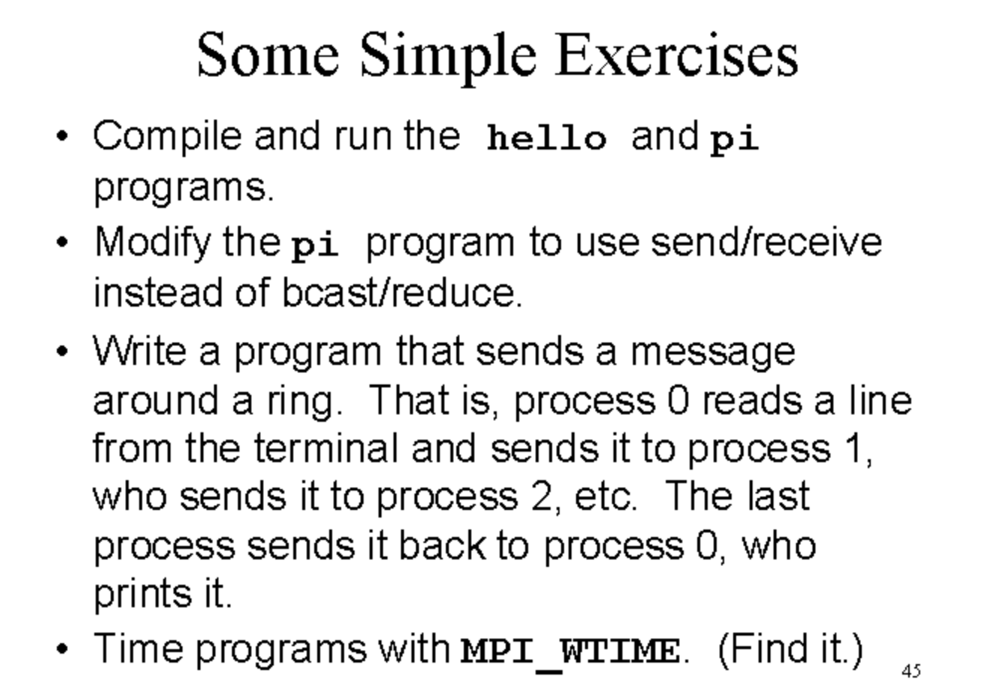
Notes:
Ring prblm #include <stdio.h>
#include <string.h>
#include <mpi.h>
int main(int argc, char *argv[]) {
int my_rank, p, source, dest, tag = 0;
char message[100];
MPI_Status status;
// Start up MPI
MPI_Init(&argc, &argv);
// Find out process rank
MPI_Comm_rank(MPI_COMM_WORLD, &my_rank);
// Find out number of processes
MPI_Comm_size(MPI_COMM_WORLD, &p);
if (my_rank == 0) {
// Process 0 does something
printf("Enter a message: ");
fgets(message, 100, stdin);
// Send to process 1
MPI_Send(message, strlen(message) + 1, MPI_CHAR, 1, tag, MPI_COMM_WORLD);
} else {
// Receive from the previous process
MPI_Recv(message, 100, MPI_CHAR, my_rank - 1, tag, MPI_COMM_WORLD, &status);
// Print the received message
printf("Process %d received message: %s\n", my_rank, message);
// Send to the next process
dest = (my_rank + 1) % p;
MPI_Send(message, strlen(message) + 1, MPI_CHAR, dest, tag, MPI_COMM_WORLD);
}
// Process 0 receives from the last process
if (my_rank == 0) {
MPI_Recv(message, 100, MPI_CHAR, p - 1, tag, MPI_COMM_WORLD, &status);
printf("Process %d received message: %s\n", my_rank, message);
}
// Shut down MPI
MPI_Finalize();
return 0;
}
mpi_time #include <mpi.h>
#include <stdio.h>
int main(int argc, char *argv[]) {
// Initialize the MPI environment
MPI_Init(NULL, NULL);
int world_size;
MPI_Comm_size(MPI_COMM_WORLD, &world_size);
int world_rank;
MPI_Comm_rank(MPI_COMM_WORLD, &world_rank);
double start_time = MPI_Wtime();
double end_time = MPI_Wtime();
double elapsed_time = end_time - start_time;
printf("Hello world from processor %d out of %d, elapsed time = %f seconds\n",
world_rank, world_size, elapsed_time);
MPI_Finalize();
}

